Slide 1

SOC DESIGN AND VERIFICATION
By : MD SHAKIL ANSARI

Slide 2
CONTENTS
INTRODUCTION
SoC & Microcontroller
Components of an SoC
SoC Verification
Conclusion

Slide 3
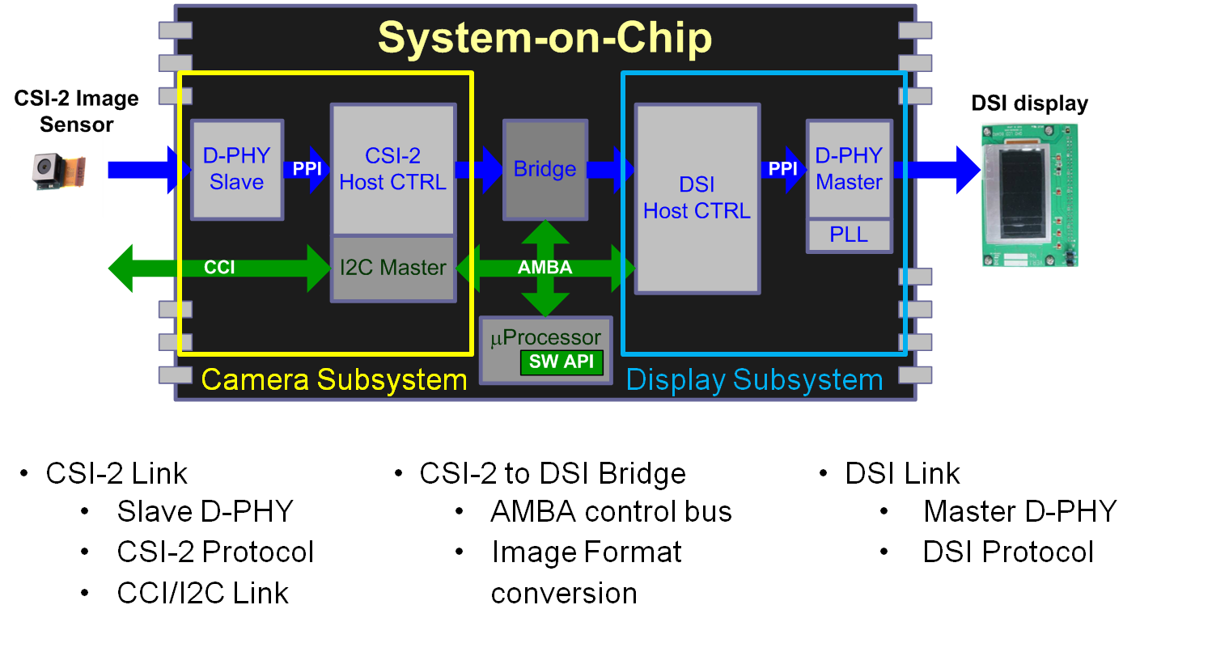
INTRODUCTION
A system on chip (SoC) is basically an IC that integrates all components of a computer or other electronic systems.
It consists of CPU ,memory ,I/O ports and secondary storage al on a single substrate of microchip.
Normally the size of SoCs are similar to a coin.
They consume less power than multi chip design with equivalent functionality.

Slide 4
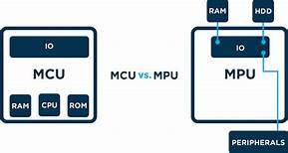
SoCs and Microcontrollers
An SoC can be seen as integrating a microcontroller with even more advanced peripherals .
Microcontrollers typically have under 100kb of RAM and are often of single chip system ,Whereas SoCs are packed with comparatively larger storage and more powerful processors to handle some software like Windows and linux.

Slide 5
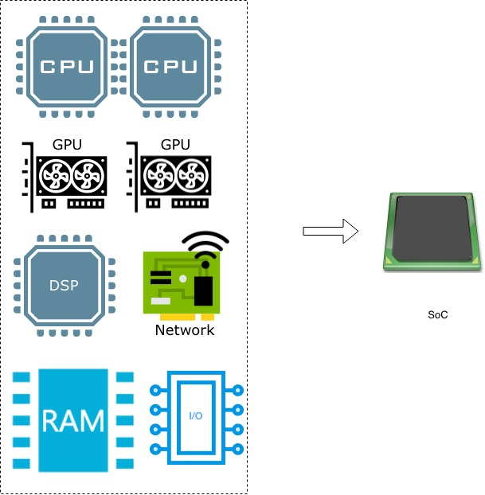
COMPONENTS of an SoC

Slide 6
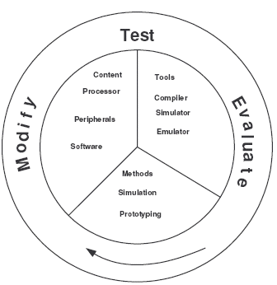
SoC Verification
A typical SoC verification flow consists of three major tasks; modify, test and evaluate.
Designers follow this iterative loop of modification, testing and evaluation until the verification objectives are met.
The verification team aims at reducing the number of iterations or size of the loop.
In the test phase, verification methodology and
tools have major impact on reduction of the
Iterative Loop circumference.
systemC ,systemVerilog languages are most
Commolny used for verification purposes.

Slide 7
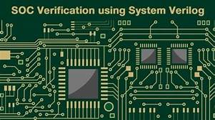
CONCLUSION
SoCs are in many way far better and reliable than multi-chip systems
It consumes less power ,has better performance and require less space comparable to size of a coin .
Nowadays , most of the system on chip are an inbuilt part of devices like smartphones and tablets.

