Slide 1
IGNITION MCP SERVER
How Claude, MCP, and the
Ignition Gateway work together
Components, protocol, and a step-by-step trace of a live request — from a plain-English ask in VS Code to a value read off the plant floor.
VS Code
Claude
MCP Client
MCP Server
Ignition Gateway

Slide 2
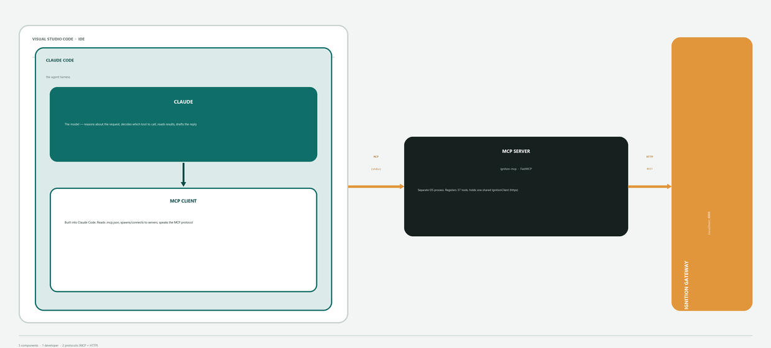
OVERVIEW
Five components, one request
Components
2

Slide 3
CONCEPT 01
What is an agent?
An agent is a model given a reasoning loop and a set of tools, rather than a single question-and-answer pass.
AGENT = CLAUDE + TOOL LOOP
In this session, "Claude" is
that reasoning loop.
It never talks to the
Ignition Gateway directly —
every fact it states came
back through a tool call.
Example: to answer
"what's Ramp0 worth?",
it called read_tags,
not a database query it
wrote itself.
— Reads the request. Understands the ask in the context of the whole conversation, not just the last message.
— Chooses a tool. Decides which of the 37 registered ignition-mcp tools (if any) the request needs, and with what arguments.
— Reads the result. Interprets the tool's structured JSON reply — including errors — before deciding what to do next.
— Loops when needed. A single request can trigger many tool calls in sequence: read logs, diagnose, fix, re-verify.
— Formulates the answer. Only once it has real data does it write the natural-language reply back to you.
Concepts — Agents
3

Slide 4
CONCEPT 02
What is an MCP tool?
A tool is a typed function the server exposes, with a name, a description, and a JSON Schema for its arguments — that's what the agent actually reads.
TOOL DEFINITION · what the agent sees
{
"name": "read_tags",
"description": "Read runtime values
of one or more Ignition tags.
Returns {path, value, quality,
timestamp} for each tag.",
"inputSchema": {
"tag_paths": {
"type": "array",
"items": {"type": "string"},
"maxItems": 100
}
}
}
— Name. read_tags — one of 37 tools this server registers.
— Description. Plain-English explanation the agent uses to decide *when* to call it.
— Schema. tag_paths: array of strings, max 100 — the agent must match this exactly.
— Implementation. Python function in tools/tags.py that talks to the gateway and returns JSON.
Concepts — Tools
4

Slide 5
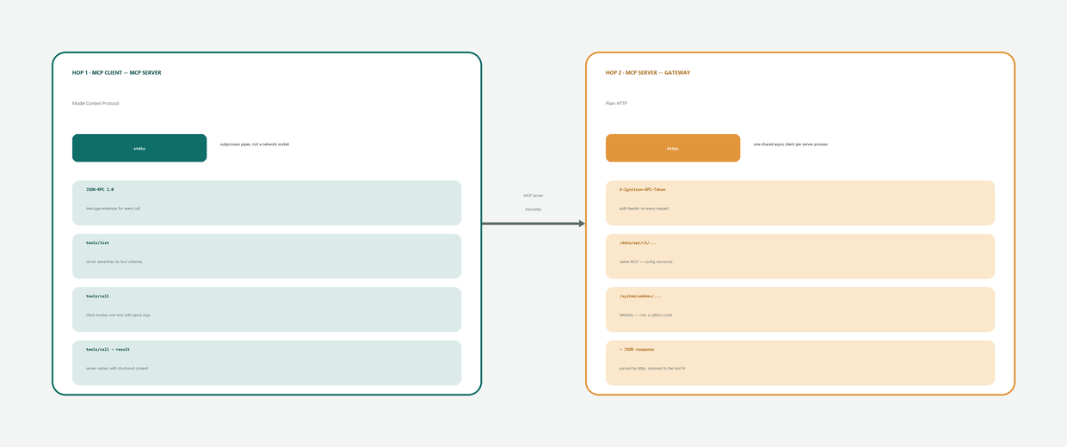
CONCEPT 03
The protocol connecting them: MCP
Model Context Protocol — a JSON-RPC 2.0 contract for how a client and a tool server talk. Two different transports carry it across the two hops in this system.
Concepts — Protocol
5

Slide 6
COMPONENT
Claude Code — agent host + MCP client, in VS Code
— Runs inside VS Code. The IDE this whole session happened in — you saw file-open notifications for config.py, main.py, docs, the log file — that's VS Code telling Claude Code what you have open.
— Hosts the agent loop. Sends your messages and the conversation history to Claude, gets back either a reply or a tool call to make.
— Is also the MCP client. Reads .mcp.json, which says: run "uv run --no-sync python mcp_server.py --transport stdio" and talk to it as an MCP server.
— Owns the connection lifecycle. Spawned the ignition-mcp subprocess once at session start — which is exactly why a Designer-side or repo-side code fix needed a manual /mcp reconnect to actually take effect.
HOW CLAUDE CODE FINDS THE SERVER
.mcp.json
{
"mcpServers": {
"ignition-mcp": {
"command": "uv",
"args": ["run", "--no-sync",
"python", "mcp_server.py",
"--transport", "stdio"]
}
}
}
Components — Claude Code
6

Slide 7
COMPONENT
MCP Server — ignition-mcp
— A real OS process. mcp_server.py, built on the FastMCP framework — separate from VS Code and Claude Code entirely.
— Registers 37 tools. tools/__init__.py:register_all() wires up gateway.py, projects.py, tags.py, alarms.py, historian.py, and more, each contributing tools.
— Owns one shared client. A single IgnitionClient (one httpx.AsyncClient) is created once, in the FastMCP lifespan, and reused by every tool call for the process's lifetime.
— Chooses auth. Prefers the X-Ignition-API-Token header if an API key is configured, else falls back to HTTP Basic auth.
— Never crashes on a gateway error. Every tool wraps its call in try/except and returns {"error": ...} as a normal result instead.
WHERE THE 37 TOOLS LIVE
src/ignition_mcp/
ignition_client.py
config.py
tools/
gateway.py
projects.py
tags.py
tag_providers.py
alarms.py
historian.py
execution.py
Components — MCP Server
7

Slide 8
COMPONENT
Ignition Gateway — two subsystems, one process
NATIVE REST
WEBDEV
/data/api/v1/...
/system/webdev/...
— Built into the gateway — nothing to deploy
— Backed by a generic resources/{list,find} framework
— Config-level data: projects, tag providers, connections, logs
— Fast, reliable — most bugs here were just wrong URLs
— Hand-deployed Jython scripts, written in the Designer
— Runs inside the gateway JVM (Jython 2.7), calls system.tag.*, system.alarm.*
— Runtime data: tag values, tag CRUD, alarms, history
— Nearly every bug this session lived here
Components — Ignition Gateway
8

Slide 9
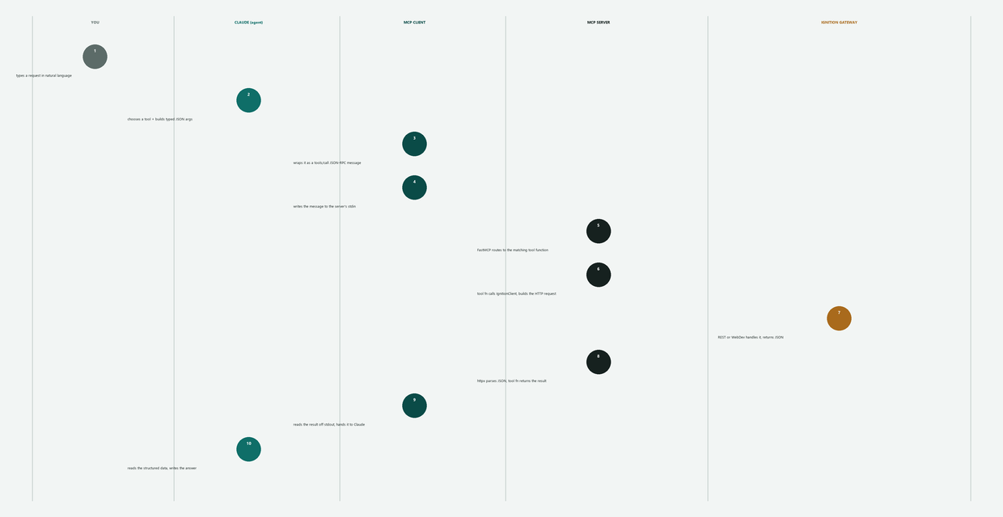
TRACING A REQUEST
Ten steps, every single call
Tracing a request
9

Slide 10
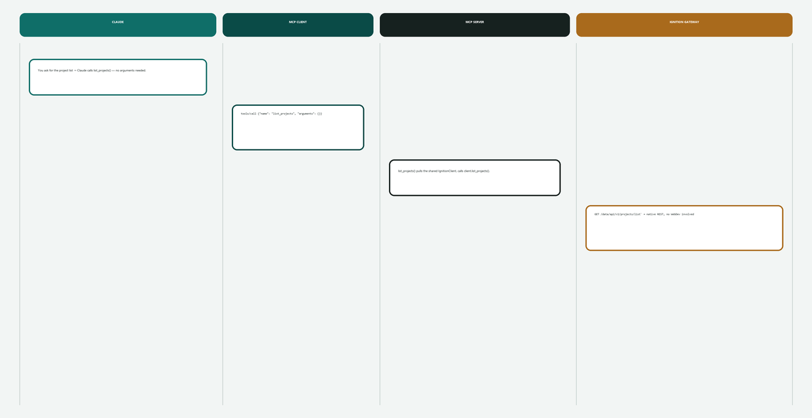
WORKED EXAMPLE · 01
“List the projects on the gateway”
Worked example — native REST
10

Slide 11
WORKED EXAMPLE · 01 · THE RESPONSE
What actually came back
RAW GATEWAY RESPONSE · application/json
— httpx parses the JSON (content-type is application/json).
— FastMCP wraps that Python dict as the tool's structured result.
— The MCP client reads it off the server's stdout as a JSON-RPC response.
— Claude turns 3 JSON objects into a one-line table: Global, Test Project, iggy — each enabled.
GET /data/api/v1/projects/list
{
"items": [
{"name": "Global", "enabled": true},
{"name": "Test Project", "enabled": true},
{"name": "iggy", "enabled": true}
],
"metadata": {"total": 3}
}
Worked example — native REST
11

Slide 12
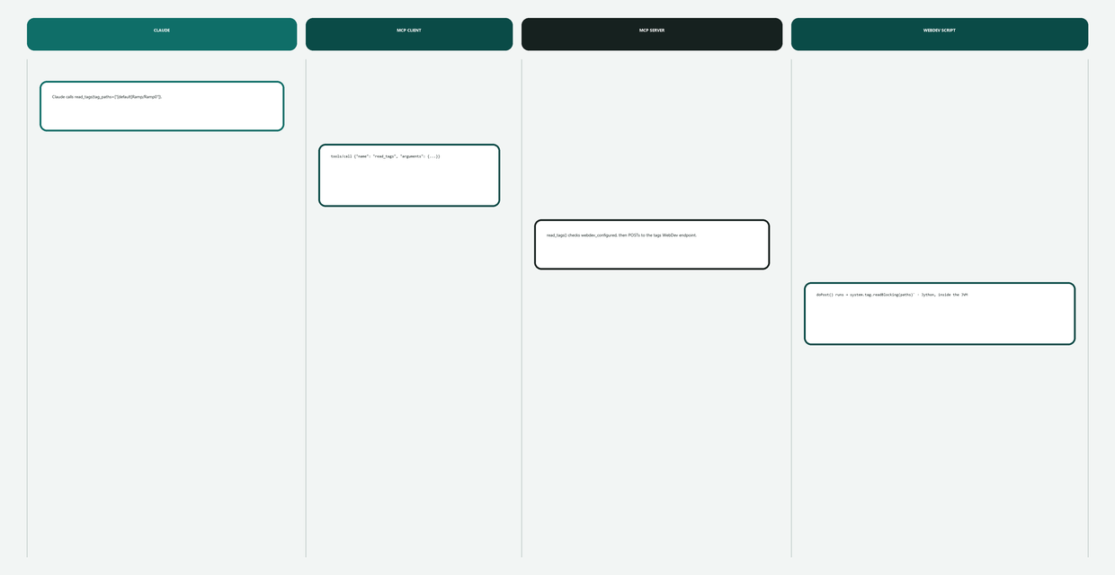
WORKED EXAMPLE · 02
“What's the value of [default]Ramp/Ramp0?”
Worked example — WebDev
12

Slide 13
WORKED EXAMPLE · 02 · THE RESPONSE
The extra hop: a script runs inside Ignition
THE WebDev SCRIPT'S OWN LOGIC
— Same shape, one more hop. The result is still plain JSON by the time it leaves the gateway — the extra step is that Jython code, not another network call.
— This is why WebDev bugs were harder. A native-REST 404 is a wrong URL. A WebDev 500 is a live traceback from code running inside Ignition's JVM.
— Claude's answer: “[default]Ramp/Ramp0 currently reads 0.2443, quality Good.” — one number, four hops of translation behind it.
POST /system/webdev/Global/GatewayAPI/tags
{"paths": ["[default]Ramp/Ramp0"]}
# inside the gateway JVM:
qv = system.tag.readBlocking(paths)[0]
return {'json': [{
'path': '[default]Ramp/Ramp0',
'value': 0.2443,
'quality': 'Good',
'timestamp': '2026-08-10 19:09:52'
}]}
Worked example — WebDev
13

Slide 14
RESPONSE FORMULATION
What kind of answer, at each layer
Ignition Gateway
Raw JSON body (or, on the WebDev path, whatever the Jython doPost() returns as {'json': ...})
HTTP response
MCP Server
A Python dict/list — parsed JSON, or {"error": "..."} if the gateway call failed
Tool result
MCP Client
The tool result wrapped back into the MCP protocol envelope, sent over stdout
JSON-RPC response
Claude (agent)
A written answer — numbers, tables, or a fix — grounded only in the structured data above
Natural language
Response formulation
14

Slide 15
TAKEAWAYS
Five components, two protocols, one honest answer
— Claude never touches the gateway directly. Every fact in an answer traced back through a real tool call and a real HTTP response.
— MCP is the contract, not the connection. stdio + JSON-RPC between client and server; plain HTTP between server and gateway — two different transports, one protocol shape.
— The gateway has two faces. Native REST for config, hand-written WebDev/Jython for runtime data — and the second one is where deployed code can silently drift from what's documented.
— A stdio MCP server needs a reconnect to see new code. It's a subprocess spawned once at session start, not a live-reloading service.
— Every example in this deck ran for real. list_projects and read_tags("[default]Ramp/Ramp0") are both taken directly from this session's actual queries.
Takeaways
15

