Slide 1


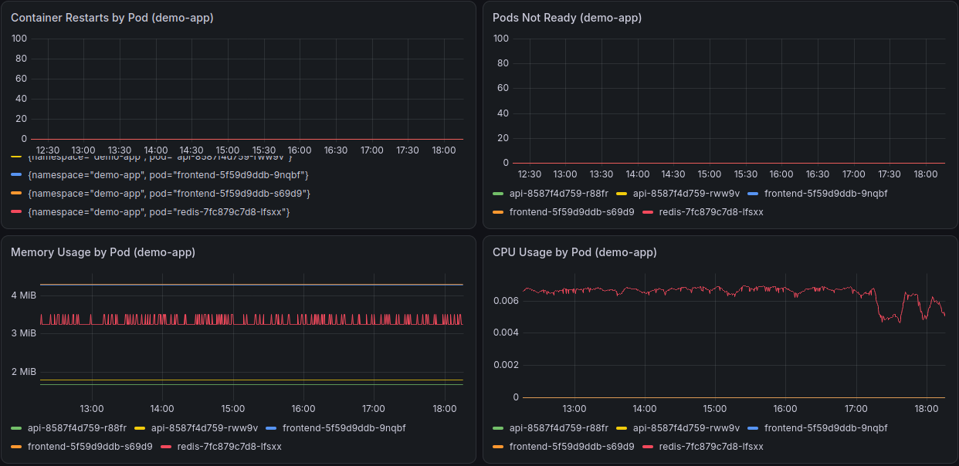

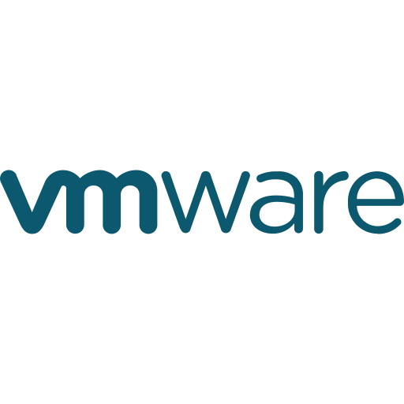
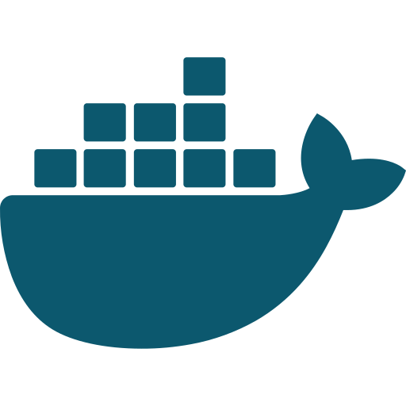
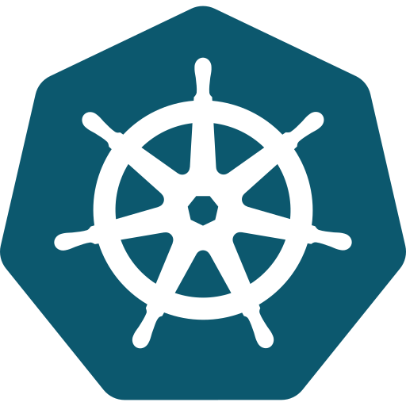





Kubernetes Observability Lab
Monitoring, alerting and hands-on labs for DSYS601 students
Kabir Thukral | Bachelor of Information & Communication Technologies
Scan to open the lab on GitHub
Ara Institute of Canterbury | Semester 2, 2026 | kat0870@arastudent.ac.nz
Project partner: Ara DSYS601 teaching team
1
Introduction
4
Outcomes
5
Learnings
DSYS601 students learn to run apps on Kubernetes. Seeing what is happening inside a cluster, and being told when something breaks, is a core DevOps skill, but there was no ready-made lab to teach it.
Figure 1. Lab architecture: one VM runs the whole cluster
Kubernetes in depth: pods, probes, resource limits and node pressure
PromQL and alert design: tuning wait times to stop false alarms
Reproducibility: pinned versions, image digests and rebuild tests
Writing for others and acting on supervisor feedback
Ubuntu VM · Docker · Kind cluster "dsys601-lab"
control-plane
worker
worker2
2
Aim
namespace: demo-app
namespace: monitoring
Frontend nginx
scrape
Prometheus + alert rules
A reproducible Kubernetes lab with monitoring, dashboards and alerts that tutors can rebuild each cohort.
API go-httpbin
Grafana dashboard
Datastore Redis
Alertmanager
6
Conclusion
3
Method
Figure 2. Grafana "DSYS601 Workload Health" dashboard
Tutors can rebuild a working, monitored cluster from one repo each cohort, and students learn by breaking things safely and watching the alerts fire.
15 brief tasks, one at a time, each with an evidence report reviewed by my industry supervisor.
References
1 Build cluster
2 Deploy app
Grafana Labs. (n.d.). Grafana documentation. https://grafana.com/docs/
Kubernetes. (n.d.). Kubernetes documentation. https://kubernetes.io/docs/
Kubernetes SIGs. (n.d.). kind. https://kind.sigs.k8s.io/
Prometheus. (n.d.). Prometheus documentation. https://prometheus.io/docs/
Prometheus Community. (n.d.). kube-prometheus-stack [Helm chart]. https://github.com/prometheus-community/helm-charts
Simple Icons. (n.d.). Tool logos [Graphics]. https://simpleicons.org/
3 Add monitoring
4 Write alerts
5 Inject failures
6 Hand over
3
cluster nodes
4
custom alerts
6
student labs
15
brief tasks
Figure 3. Failure injection testing: every test fired its alert
Acknowledgements
Failure injected | DSYS601 alert | Result
Container keeps crashing | PodCrashLooping | Fired ✓
Memory held near its limit | ContainerMemoryNearLimit | Fired ✓
Broken readiness probe | PodNotReady | Fired ✓
Node under memory pressure | NodeUnderPressure | Fired ✓
Course Convenor: Dr David Weir
david.weir@ara.ac.nz
Academic Supervisor: Dr Bernard Otinpong
bernard.otinpong@ara.ac.nz
Industry Supervisor: Abdul Rehman
abdul.rehman@ara.ac.nz
Tools used
Ubuntu
VMware
Docker
K8s
Helm
Prometheus
Grafana
Git
GitHub

