Slide 1

Kata Revanth(00742695) Alluri Sri Ram (00720436) Lavanya Chadalawada(00747884)
Spring ‘22

Slide 2
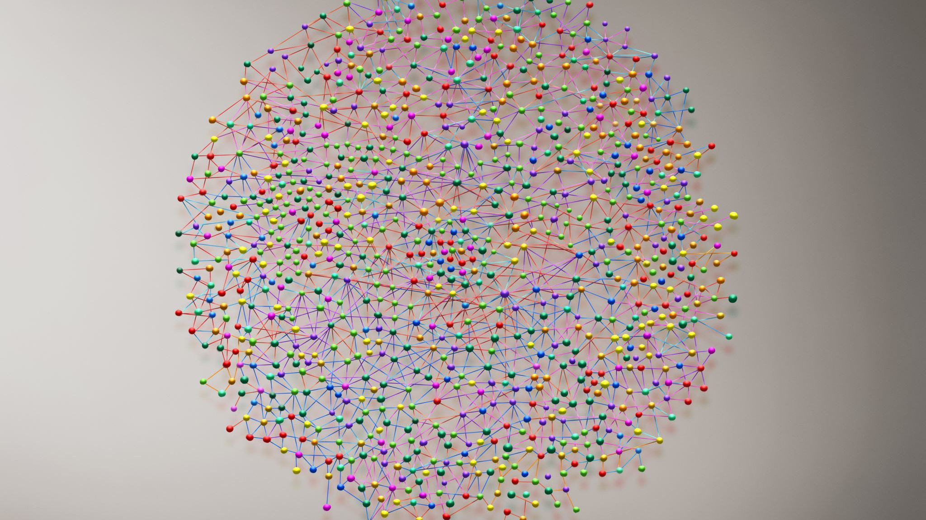
Path Way Radar
Using Q-Learning Algorithm

Slide 3

Project Statement
The main objective of the project is to train the agent in reaching the Goal state from any point in the grid with optimal transitions.
Model can be extended to:
>To find the shortest path between two destinations in real world scenario.

Slide 4

Project Approach
Design the grid(environment) for the agent
Apply the Q-Learning model to train the agent in-order to find the optimal path to reach the Goal state.
Provide different scenarios to test the agent’s learning.

Slide 5
Deliverables
A python code of a fully trained agent which can find optimal path in grid based environment.
GitHub repository link for project code.
Code walkthrough video on YouTube

Slide 6
Evaluation Methodology
Q table with rewards for all the states in the grid.
Graphs to show agent’s learning curve from first episode to end of the training program.

