Slide 1
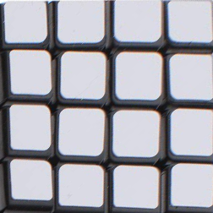
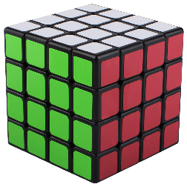
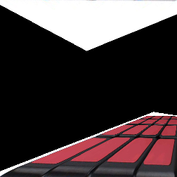
Perspective Transformation
0:[0,0]
3:[w,0]
From pers.py (example in BOX)
Input
Right
3:[493,20]
0:[27,142]
2:[967,147]
1:[0,h]
2:[w,h]
1:[514,309]
0:[0,0]
3:[w,0]
Wrong
2:[0,h]
1:[w,h]

Slide 2
PS4
Target
Mouse Pick
Left side is not included
Perspective Transformation
Refer Right side and generate transformation matrix
Apply transformation
Interpolation default: bi-linear
You can chose CUBIC/LANCZOS4
Learning part
Alpha blending to equalize the brightness
Utilizing JSON
Avoid picking every time for quick development
1
1
2
1/2
3
1/3
0
1/0
-> 1.0
Number of overlap
Weight
1.0 / np.max(1.0, mask)
Avoid 0 division

Slide 3
JSON file
JSON
Similar to “dictionary” of python
Data type: Number and String
Program asks “use saved points?”
Y: load JSON file
Data should be stored in “result.json”
N: pick 4points from each picture
4x2 for right-center
4x2 for left-center
Why?
Save picking every time
Tired or boring after a few try.
Focus on the programming side

