Slide 1

KLH UNIVERSITY
Hyderabad – Bachupally Campus
Department of Electronics and Communication Engineering
Conservative Offline Deep Reinforcement Learning
for Safe Spectrum Access in Dense IoT Networks
PROJECT PROGRESS PRESENTATION
PROJECT GUIDE
Dr. Vinnakota Venu Balaji
PROJECT TEAM
Mithilesh Gullapalli
Roll No.: 2520040056
Tejashwer Reddy S
Roll No.: 2520040059
K Dashwath
Roll No.: 2520040122
Paidi Sai Chaitanya
Roll No.: 2520049125
Electronics and Communication Engineering • KLH University

Slide 2
Problem Statement & Objectives
THE CHALLENGE
• Dense IoT devices compete for limited spectrum resources.
• Interference, congestion and collisions can degrade latency, packet delivery and energy cost.
• Live trial-and-error reinforcement learning may explore undesirable channel choices.
• Historical transmission data can support policy learning without online exploration.
DECISION
Select a frequency channel from the observed network state.
OBJECTIVE
Improve a reward balancing delivery and data rate against transmission costs.
SAFETY
Screen historically high-risk actions using interference, loss, collisions and latency.
KLH University • Electronics & Communication Engineering

Slide 3
Dataset & Wireless State Representation
10,000
42
5
transmission records
raw dataset columns
frequency channels
10 STATE FEATURES
DISCRETE ACTION SPACE
• Channel occupancy; interference power and density
• Packet collision rate; packet loss rate; latency
• RSSI; SNR; node density; network congestion
• 433 MHz
• 470 MHz
• 868 MHz
• 915 MHz
• 923 MHz
Data are observational; metric units follow the dataset definitions. No live radio experiment is claimed.
KLH University • Electronics & Communication Engineering

Slide 4
Proposed Method: Conservative Offline Q-Learning
1 State
2 Action
3 Reward
10 standardized wireless/network features
Choose among five recorded frequency channels
Data rate + delivery success + SNR; penalties for interference, loss, latency and energy
4 Q-network
5 Conservative objective
6 Safety filter
10 → 128 → 64 → 32 → 5 outputs
Bellman loss + α[logsumexp(Q) − Q(observed action)]
Reject actions above the historical risk threshold
Prototype settings: γ = 0.95 • α = 0.10 • batch size = 128 • 25 epochs • 80/20 train–test split
KLH University • Electronics & Communication Engineering

Slide 5
Implementation Workflow
Historical CSV
Preprocess
Build transitions
Train offline
Apply safety
Evaluate
→
→
→
→
→
Transmission records
Select features; standardize
State, observed action, reward, next-state approximation
Conservative Q-network
Historical risk screening
Reward and wireless metrics
Implementation notes
• Training uses historical data only; the evaluation is offline and empirical.
• The next-state construction is a prototype approximation, not a causal model of network evolution.
KLH University • Electronics & Communication Engineering

Slide 6
Project Workflow / Implementation — Block Diagram
Transmission\nDataset
Preprocess &\nNormalize
State–Action–\nReward
Conservative\nQ Network
Safety\nFilter
Evaluation &\nWireless Metrics
Implementation notes
• Environment states are represented by recorded transmission conditions, not live RF experimentation.\n• Offline training uses historical samples; evaluation remains an offline estimate.\n• Outputs include channel decisions, estimated reward, risk screening, and wireless performance plots.
KLH University • Electronics and Communication Engineering

Slide 7
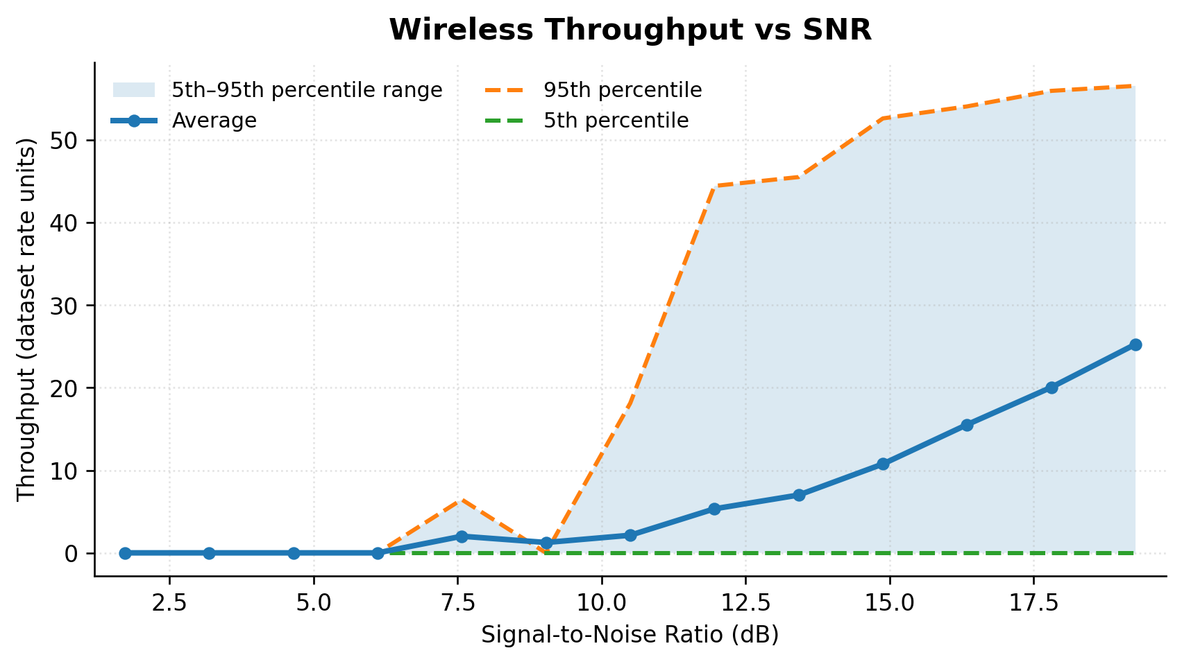
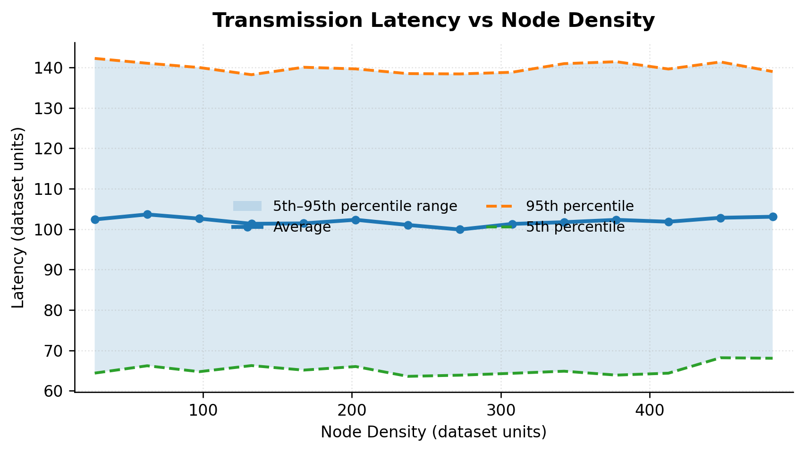
Wireless Link Performance
Percentile curves show the average trend and 5th–95th percentile spread across recorded observations.
KLH University • Electronics & Communication Engineering

Slide 8
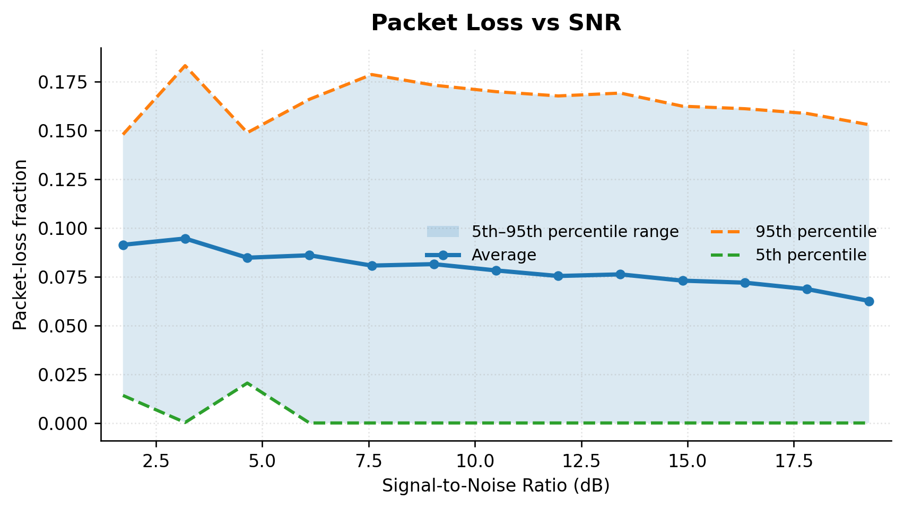
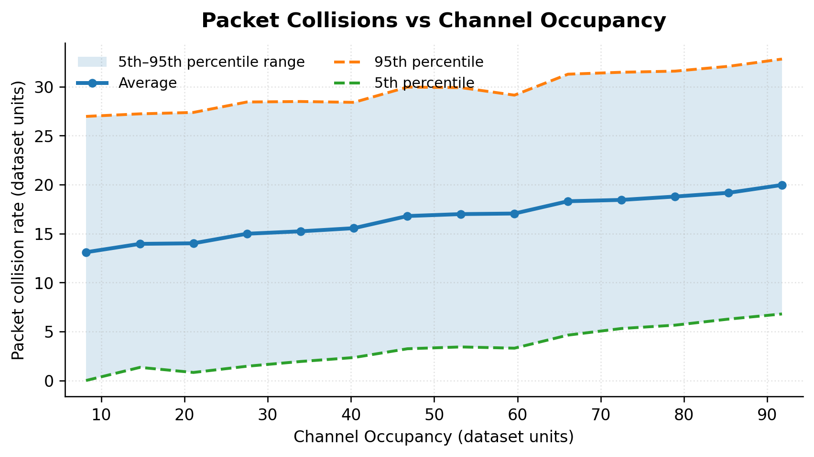
Transmission Reliability & Interference
Packet-loss fraction is based on Packet_Loss_Rate; it is not a directly measured bit-error rate (BER).
KLH University • Electronics & Communication Engineering

Slide 9
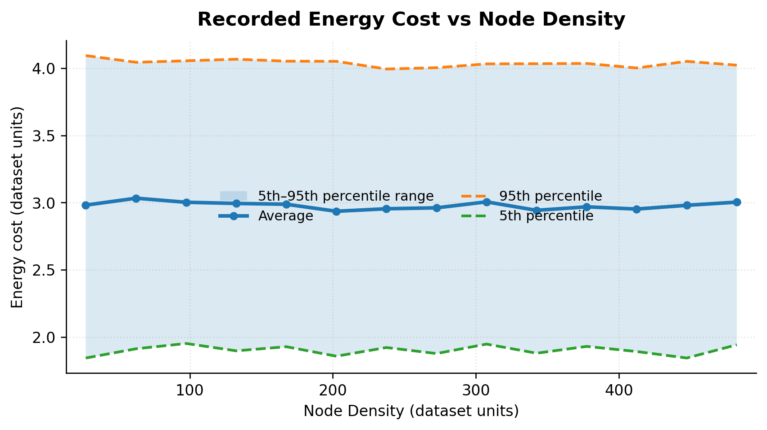
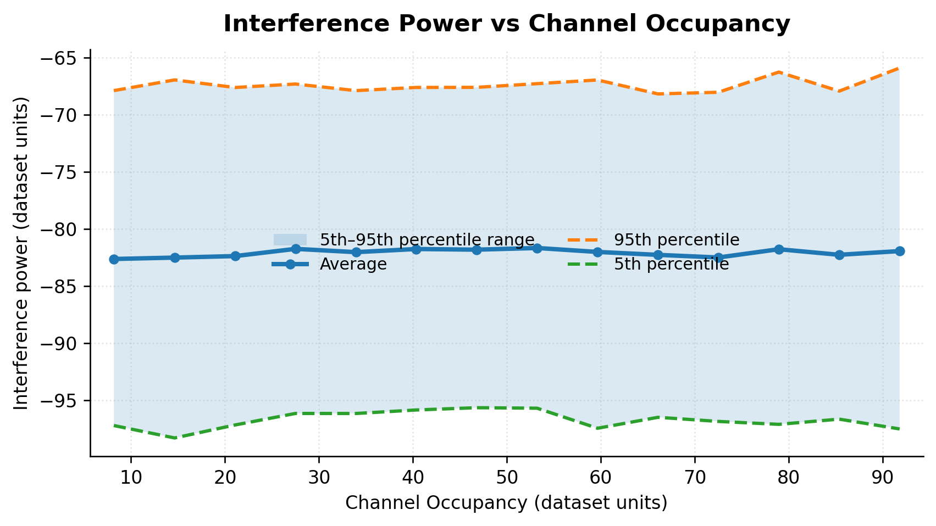
Energy, Interference & Channel Comparison
Successful-throughput proxy = Data_Rate × delivery-success indicator. It is not a time-measured throughput result; plots show associations, not causation.
KLH University • Electronics & Communication Engineering

Slide 10
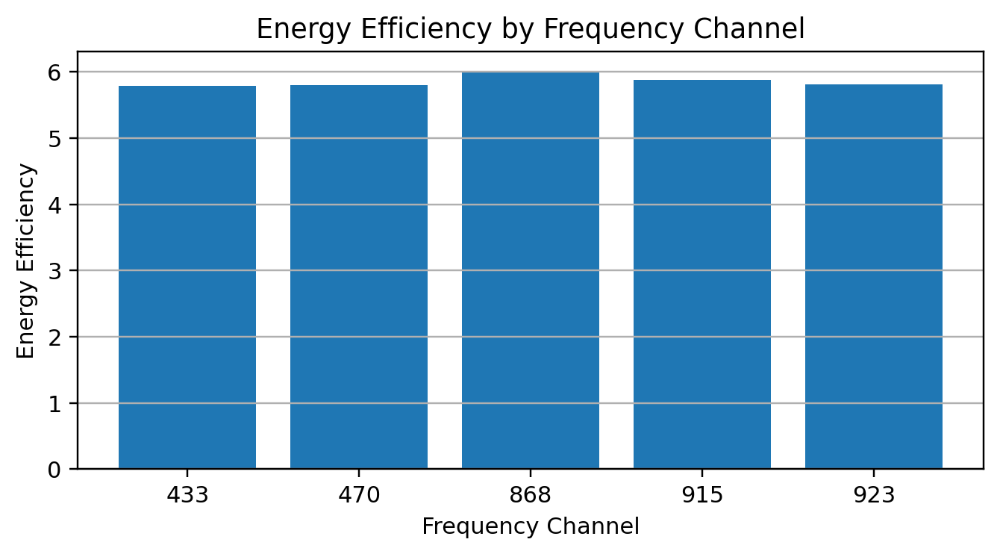
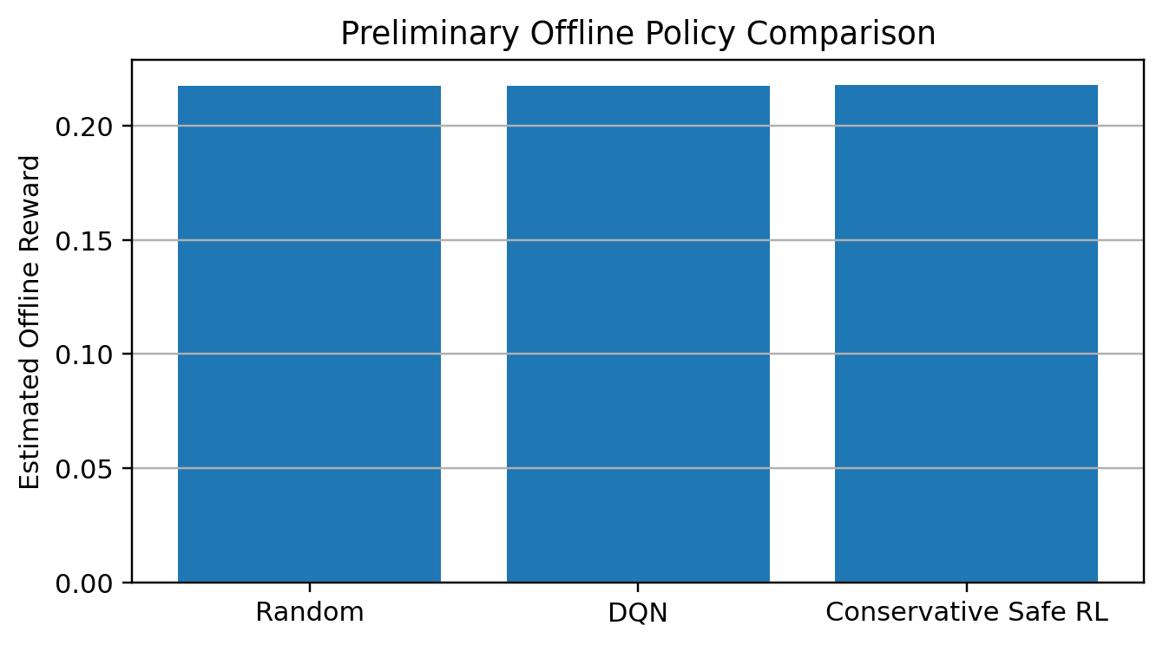
Safety Screening & Preliminary Policy Results
HISTORICAL RISK SCREEN
OFFLINE ESTIMATED REWARD
Project-defined score combines interference density, packet loss, collision rate and latency. 915 MHz ranked highest in the recorded comparison; 470 MHz ranked lowest.
Random: 0.2176
DQN: 0.2175
Conservative Safe RL: 0.2181
Safety threshold is a project screening rule, not a certified RF safety standard. Results are preliminary offline estimates.
KLH University • Electronics & Communication Engineering

