Slide 1

Gesture Enabled Commands for Laptops/PCs
Presented By:
G. Bhargav(201801330007)
K. Sandeep(201801330025)
K. Nihanth(201801330008)
K. Vineeth(201801330019)
T. Hemanth(201801330024)
Sd. Rehan (20181260007)

Slide 2
Problem statement
For any user, authenticated by face recognition, few gestures could be defined for frequently used tasks- save, exit, print, screen-lock, screen unlock, system shut down, system restart. Save, print and exit operations are context sensitive meaning that it is applicable for current application. For example if the word document is open and the gesture for save is done then the document will be saved, if the print gesture is done then printer dialog will open etc. Similarly a gesture could be defined for close/exit which will close the current application. If no application is opened then it will work as the system shuts down. It is similar to Alt+F4 key press functionality on Windows PCs

Slide 3
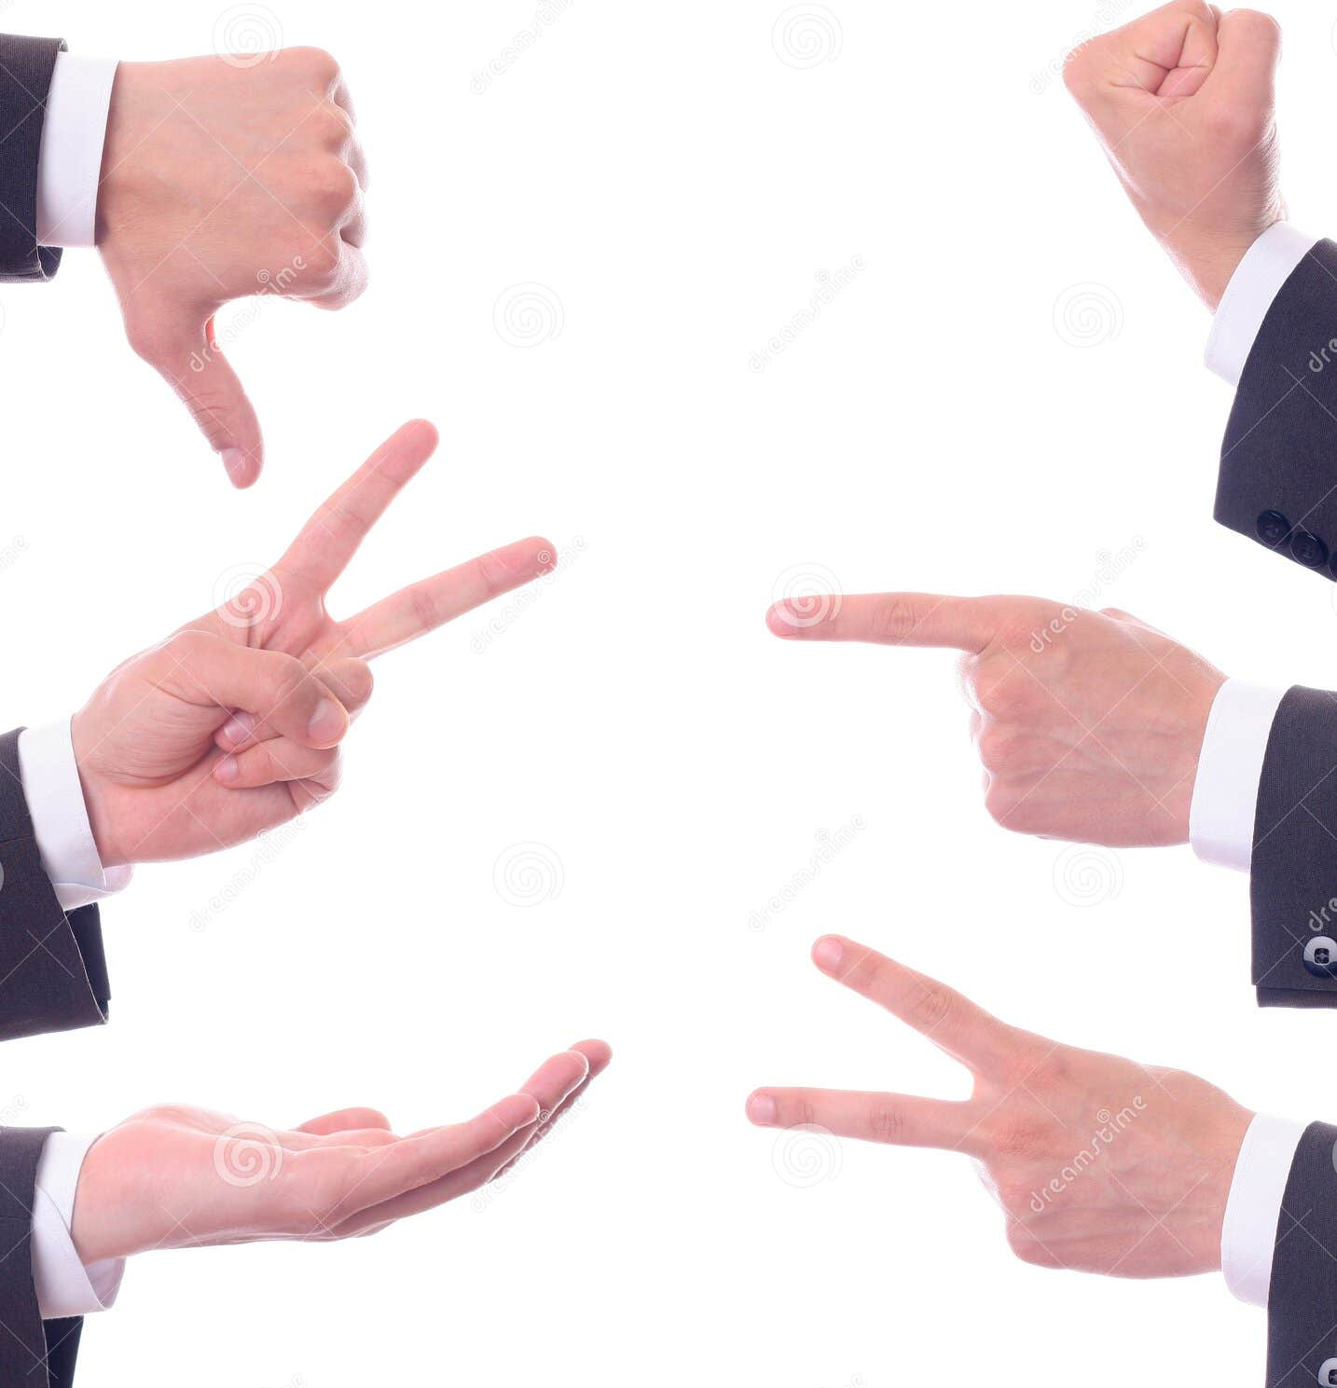
Abstract
In the era of evolving human-computer interaction, the demand for intuitive and efficient control methods for laptops and PCs has grown significantly. The primary objective of this project is to develop a robust system that enables users to control their laptops and PCs through hand gestures, reducing the dependency on physical peripherals like keyboards and mice. By employing advanced computer vision and machine learning techniques, our system interprets a user's gestures and translates them into meaningful commands for the computer.

Slide 4
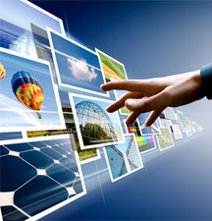
Introduction
In a world where laptops and PCs are ubiquitous, traditional input methods such as keyboards and mice have long been the standard This project seeks to explore, design, and implement a system that allows users to control laptops and PCs using hand gestures. Leveraging advances in computer vision, machine learning, and gesture recognition technology. It enables users to execute tasks, open applications, navigate files, and perform actions simply by moving their hands in predefined, meaningful ways. The potential applications for gesture-enabled commands are vast, ranging from everyday computing tasks to specialized uses in fields such as gaming, healthcare, and accessibility technology.
This Photo by Unknown author is licensed under CC BY-SA.

Slide 5
Existing System
Traditional input methods such as keyboard and mouse have been the primary means of interacting with computers for many years. However, these methods can be limiting and sometimes uncomfortable for users.

Slide 6
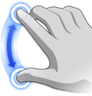
Proposed System
Gesture-enabled commands Including Voice assistant offer a remarkably intuitive and natural means of interacting with laptops and PCs. In a world where technology increasingly permeates our daily lives, this innovative approach leverages the familiarity of human gestures to bridge the gap between humans and machines. With gesture-enabled commands, you can swipe your hand through the air to flip through a presentation, pinch your fingers to zoom in on a document, or wave to switch between applications. These interactions closely mimic our natural, real-world actions, making the user experience more accessible and engaging.
This Photo by Unknown author is licensed under CC BY-SA-NC.

Slide 7
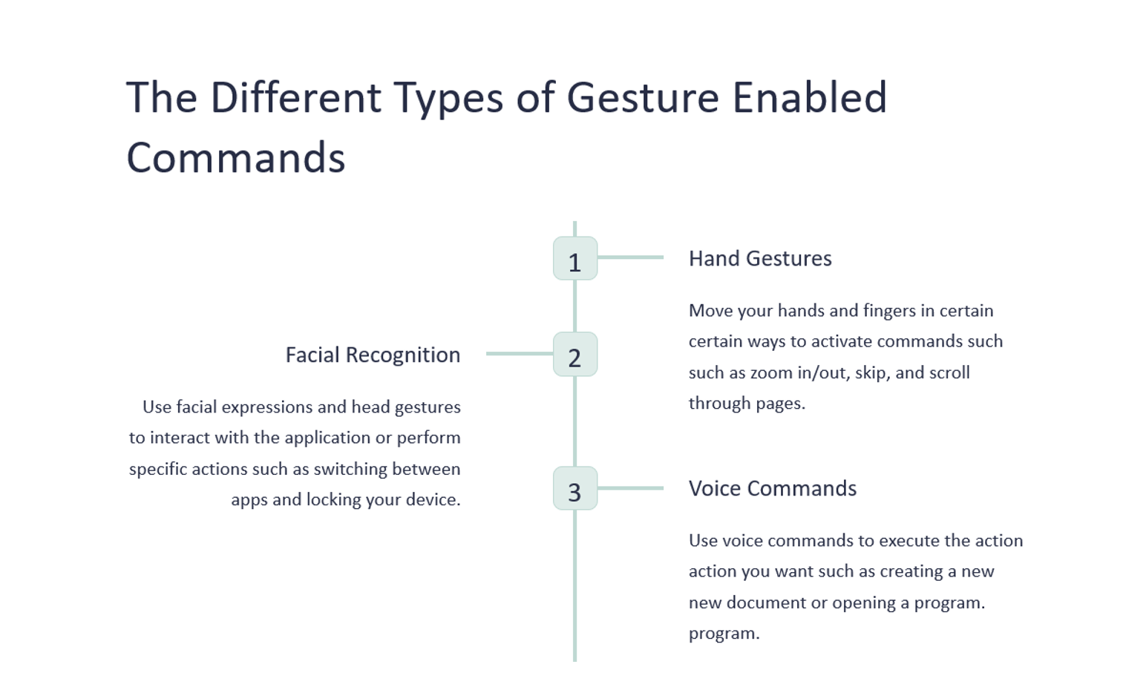

Slide 8
Libraries
pyttsx3==2.71
Speech Recognition==3.8.1
pynput==1.7.3
pyautogui==0.9.53
opencv-python==4.5.3.56
mediapipe==0.8.6.2
eel==0.14.0

Slide 9
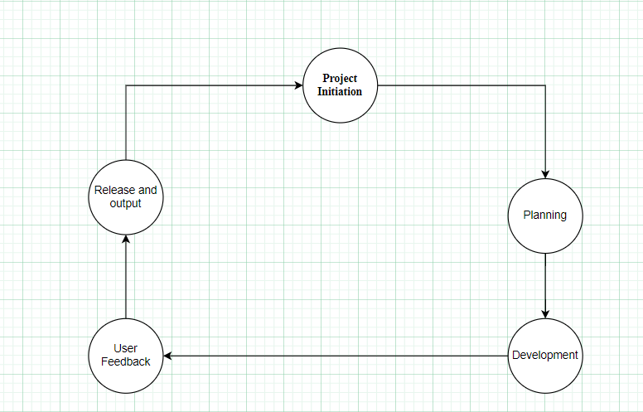
System Design

Slide 10
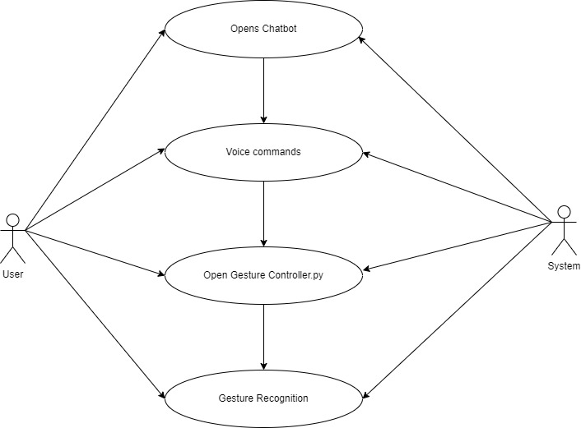
Use-case diagram

Slide 11
Hardware and Software Requirements
Hardware:
Camera - Built-in Camera or External USB
Processor - Multi Processor or Quad Processor
RAM - Minimum of 8Gb
Grpahics - Dedicated Graphics Required for Laptop
Operating System - Windows MAC Os, Linux
Software:
Modules : OpenCV, Pyautogui ,mediapipe
Development Environment: Jupyter IDE and Visual studio
Other Requirements:
Internet Connectivity.
Power Supply Required.
Environmental Conditions.

Slide 12
Commands & Gestures implemented
Gestures
Move cursor
Left Right and Double Click
Scrolling
Drag and drop
Multiple item selection
Volume Control
Brightness Control
Voice commands
Launch/stop Gesture recognition
Google search
Find a location in google maps
Current date and time
Copy and paste
Sleep and wake up chatbot

Slide 13
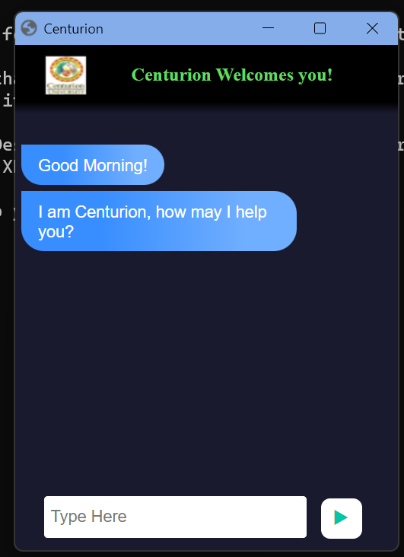
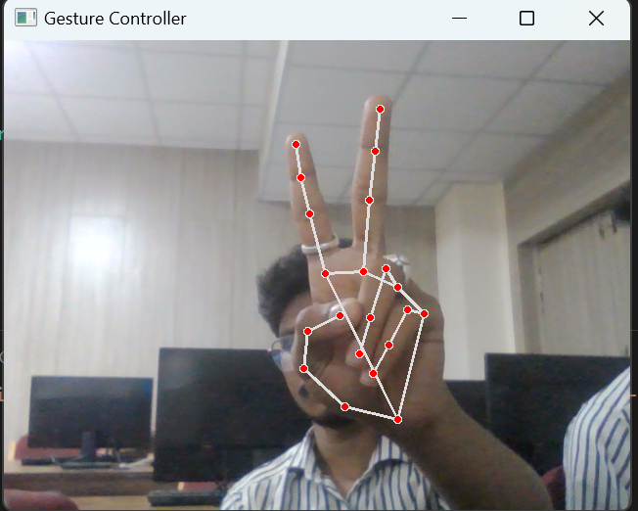
Output

Slide 14
Conclusion
In this presentation we have discussed an alternative to the conventional physical mouse that provides mouse functions with the help of computer vision that houses a web camera that recognizes fingers and hand gestures and processes the captured frames and uses a machine learning algorithm to execute the defined mouse functions like moving the cursor, right-click, left click and scrolling function After testing authors have concluded that the proposed virtual mouse system has worked exceedingly well and with great accuracy and the current system has overcome the drawbacks of the other systems. Through the Voice Assistant, authors have automated various services using a single-line command. It eases most of the tasks of the user like searching the web, file navigation, finding a location on google maps, opening any application, etc.

