Slide 1
The Institute of Quantitative Social Science
Gary King

Slide 2
The Social Science Data Revolution
The Last 50 Years:
Survey research
Aggregate government statistics
In depth studies of individual places, people, or events
The Next 50 Years: Spectacular changes due to. . .
Much more of the above
Shrinking computers & the growing Internet
Analogue-to-digital transformation of government records
The replication movement: academic data sharing (e.g., Dataverse)
Advances in methods
The march of quantiﬁcation: through academia, professions, government, & commerce (MoneyBall, SuperCrunchers, The Numerati)
The end of the quantitative-qualitative divide:
Diverse perspectives remain but, with text, video, field notes etc. as data,
We now all benefit from the same technologies
Advantages of collaboration are growing

Slide 3
IQSS
Social scientists need vastly improved infrastructure.
Harvard’s response: IQSS -- a hybrid organization
A traditional research center: facilitating research
Part of the Harvard administration: building infrastructure
(Synergies: turn administrative issues into quasi-research projects)

Slide 4
Need Bigger, Faster Computers than you can afford?
IQSS Research Computing Environment (RCE):
> 1300 shared computing cores
450 active users
A persistent environment, sign on from anywhere
Growing via collaborative research project (with Harvard CTO Jim Waldo and SEAS) to extend our platform to the Amazon cloud

Slide 5
Consulting and Training
Short courses: R, Stata, SAS, Numeric Data Resources, Atlas.ti, GIS, & many IQSS technologies
Research consulting: one-on-one help with data management and analysis
Survey Consulting: help with question wording, sampling, analysis, nonstandard data collection
Recently (re)grown with help from FAS

Slide 6
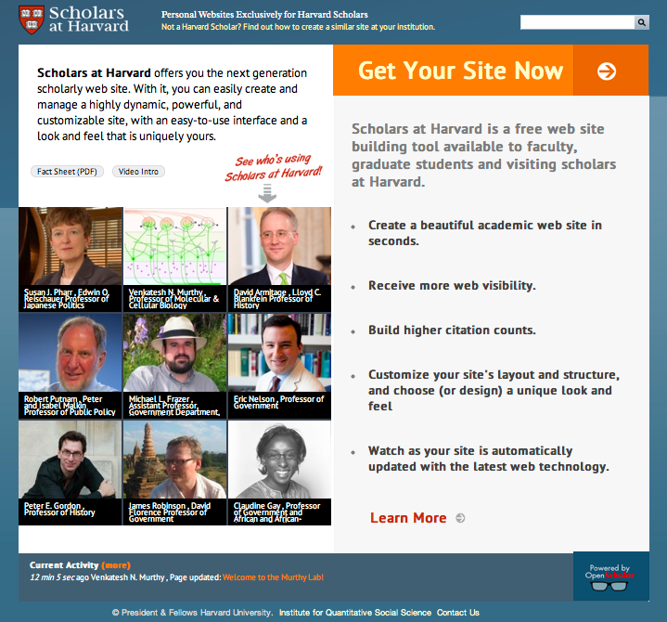
OpenScholar: Faculty & Student Web sites
> 800 scholar sites, including 300 by faculty
> 120 project sites
Free at scholar.harvard.edu
($5-20K saved per site)
Installation at > 50 other Universities
Growing via collaboration (with HUIT and HPAC) to extend OpenScholar to department sites

Slide 7
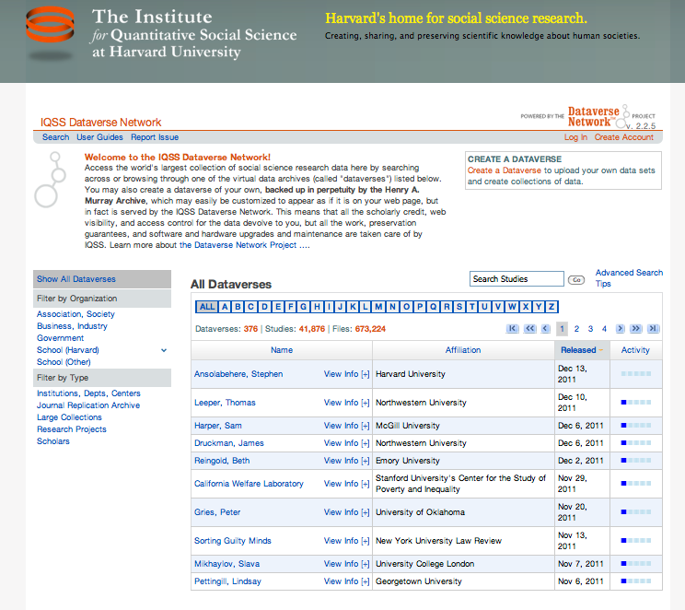
Dataverse Network
Your own easy-to-use virtual archive
Our installation: ~ 1000 dataverses, 41,000 studies, 671,000 files
> 15 installations in other Universities
Growing via collaboration (with the Harvard Library) to expand infrastructure for diverse projects across humanities, social sciences, & sciences

Slide 8
Zelig: Everyone’s Statistical Software
Easy, standardized solution to R’s power and diversity
≈100 statistical methods in common format
> 100,000 users worldwide
(Optional GUI through Dataverse, no R knowledge required)
Large network effects: students learning from each other
Growing via (open source) contributions

Slide 9
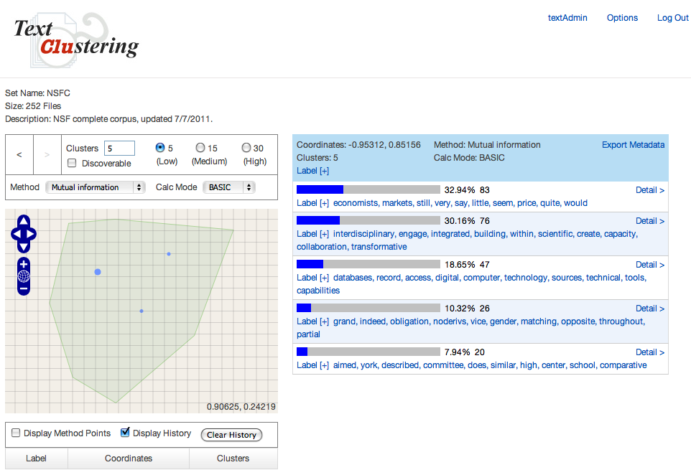
Program on Automated Text Analysis
“Computer-assisted reading”, a new way to organize and make sense of huge amounts of unstructured text.
Advising with existing approaches available now
New approaches under development, for public use in 2012

Slide 10
Grants Administration
37 active grants
30 – 40 proposals submitted annually
Pre- and post-award support
Working closely with department staff
Social scientists from FAS and other schools come for help & stay to interact on research & teachng

Slide 11
IQSS Activities Build a Community of Scholars
Administrative Services
Support for PIs, Programs and Centers
Sponsored Research Administration
Technology Services
Research and Technology Consultants
Technical Training
Research Computing Environment (RCE)
Repository for Social Science Data (Dataverse)
Faculty Web Sites (OpenScholar)
Research/Affiliated Programs
Center for Geographic Analysis
Program on Survey Research
Program on Text Research
RWJS in Health Policy Research
Positive Political Economy
Data Privacy Lab
Workshops and Conferences
Program on Methods
Community &
Collaboration
Technology Development
OpenScholar
Dataverse Network
Zelig
Text Clustering Tool
Research Computing

