Slide 1
A Few IQSS Quasi-Research Projects
Gary King
Institute for Quantitative Social Science
Harvard University
(talk at the Harvard Academic Computing Committee, 2/11/13)
Gary King (Harvard) Quantitative Social Science 1 / 7

Slide 2
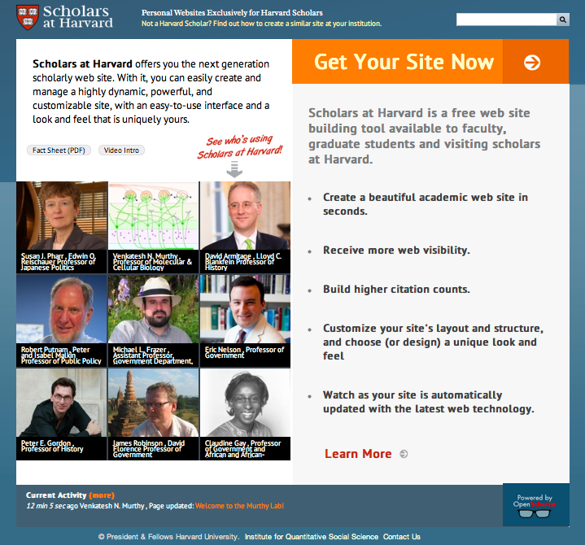
OpenScholar: Faculty & Student Web sites
> 1,540 scholar sites (growing fast)
> 381 project sites (including depts)
Free at openscholar.harvard.edu
($5-25K saved per site)
Installation at > 100 other Universities
Growing via collaboration (with HUIT and HPAC) to extend to department and administrative sites

Slide 3
Automating Support Staff Professionalization
Customized Ticketing System
Tuned: modern IT married with modern behavioral science
E.g., a closed ticket says:
HOW DID WE DO? 1. If you are completely satisfied with the resolution of this issue, and how HMDC staff handled it, read no further & take no action. 2. If issues remain that we can help with, please respond to this message with details and we will continue to work on it. 3. If this issue has been resolved, and you would like to comment on the resolution or your interaction with our staff, HMDC management would appreciate you clicking the link below to answer a few questions.
In the last 18 months: about 7,000 tickets filed
Number “dissatisfied”? Zero.

Slide 4
Need Bigger, Faster Computers than you can afford?
IQSS Research Computing Environment (RCE):
> 1500 shared computing cores
Tuned for Social Science Research
Numerous active users
A persistent environment, sign on from anywhere
Growing via collaborative research project to extend platform to the Amazon cloud
Making into open source software

Slide 5
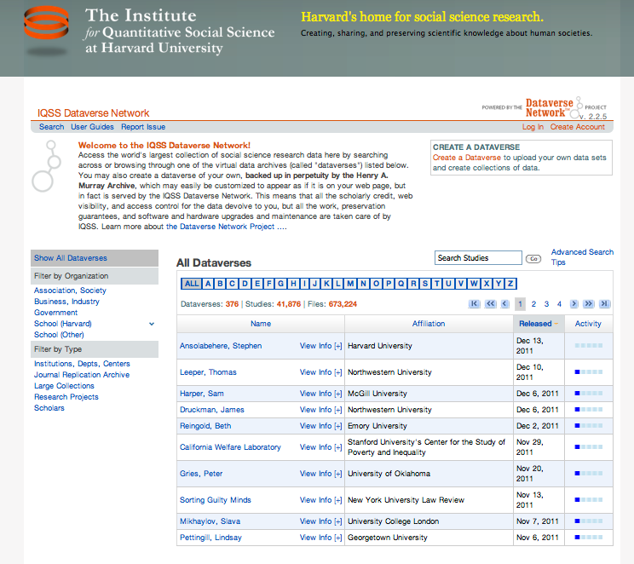
Dataverse Network
Your own easy-to-use virtual archive
Largest collection of social science data in the world
Our installation: ~ 1000 dataverses, 51,000 studies, 715,000 files
> 20 installations in other Universities
With HUL & HUIT, expanding to humanities & sciences
Free, open source

Slide 6
Zelig: Everyone’s Statistical Software
Easy, standardized solution to R’s power and diversity
>100 statistical methods in common format
Hundreds of thousands of users
(Optional GUI through Dataverse, no R knowledge required)
Huge local and international network effects: students learning from each other
Growing via open source contributions

Slide 7
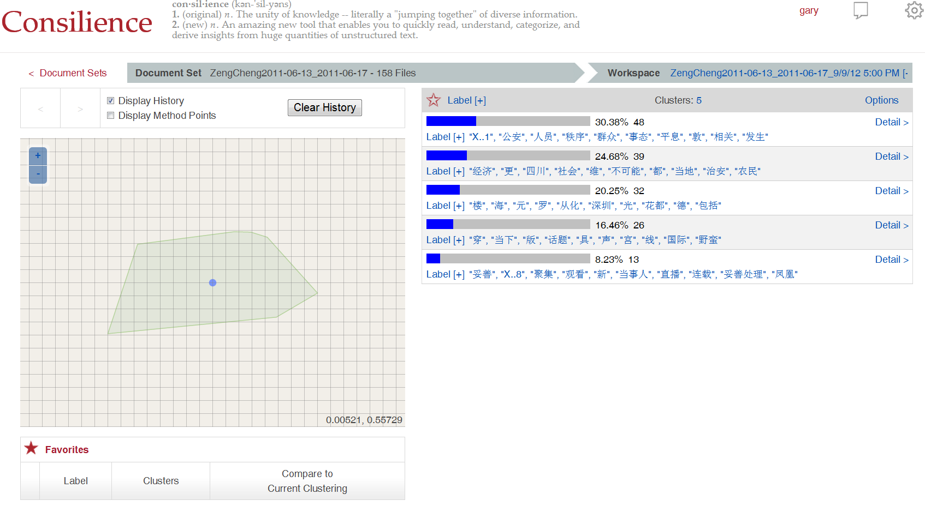
Program on Automated Text Analysis
“Computer-assisted reading”, a new way to organize and make sense of huge amounts of unstructured text.
Some services available now
New (self-serve) approaches under development, available soon

Slide 8
IQSS Activities Build a Community of Scholars
Administrative Services
Support for PIs, Programs and Centers
Sponsored Research Administration
Technology Services
Research and Technology Consultants
Technical Training
Research Computing Environment (RCE)
Repository for Social Science Data (Dataverse)
Faculty Web Sites (OpenScholar)
Research/Affiliated Programs
Center for Geographic Analysis
Program on Survey Research
Program on Text Research
RWJS in Health Policy Research
Positive Political Economy
Data Privacy Lab
Workshops and Conferences
Program on Methods
Community &
Collaboration
Technology Development
OpenScholar
Dataverse Network
Zelig
Consilience
Research Computing

Slide 9
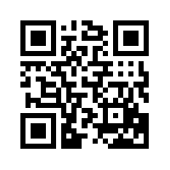
For more information…..
For more information
iq.harvard.edu

