Slide 1
Remaking the Social Sciences
Gary King
Institute for Quantitative Social Science
Harvard University
(talk at University of Virginia, 9/14/12)
Gary King (Harvard) Quantitative Social Science 1 / 7

Slide 2
The Spectacular Success of Quantitative Social Science
What university research has had the biggest impact on you?
The genetics revolution?
The Higgs-like particle?
Exoplanets? The Mars rovers?
Doubling the human life span in the last century?
•
•
•Gary
Quantitative social science
(aka “big data,” “data analytics,” “data science”):
established new industries;
transformed most Fortune 500 firms;
altered friendship networks (facebook);
increased human expressive capacity (social media);
changed political campaigns;
transformed public health;
changed legal analysis;
impacted crime and policing;
transformed sports (seen MoneyBall?);
reinvented economics;
set standards for evaluating public policy;
etc.;
etc.,
etc.

Slide 3
Cause of the Success: The Changing Evidence Base
The Last 50 Years:
Survey research
Aggregate government statistics
In depth studies of individual places, people, or events
The Next 50 Years: Spectacular increases in new data sources, due to. . .
More of the above — improved, expanded, and applied
Shrinking computers & the growing Internet
The march of quantification: through academia, the professions, government, & commerce
The replication movement: academic data sharing (e.g., Dataverse)
Governments encouraging data collection & experimentation
Biological sciences becoming social sciences
Breathtaking advances in statistical methods, informatics, & software
End of the Quantitative-Qualitative divide: Diverse perspectives but, with text, video, field notes etc. as data, we now all benefit from the same technologies
→ Change from studying problems to understanding and solving them
Gary King

Slide 4
Examples of what’s now possible with QSS
Opinions of activists: 2000 interviews → billions of opinions in social media posts (1B every 2.5Days)
Exercise: “How many times did you exercise last week?” → 500K people with cell phones accelerometers
Social contacts: “Please tell me your 5 best friends” → all phone calls, emails, text messages, Bluetooth, social media connections, electronic address books
Economic development in developing countries: Dubious or nonexistent governmental statistics → satellite images of human-generated light at night, or networks of roads and other infrastructure
Expert-vs-Statistician contests: Whenever enough information is quantified (& a right answer exists), quantitative social science wins
Many, many, more. . .

Slide 5
Building Big Social Science: The Economics
Need to move the social sciences:
Humanities (on your own) → sciences (lab-style)
Large scale, interdisciplinary, collaborative work
The science model:
Hires get: >$2M in start up costs, 10 employees, 3500sf of lab space.
A new model for the social sciences:
Greatly enhanced, shared, common infrastructure
Gary
(Not an option! but not needed either)

Slide 6
Building Big Social Science: The Politics
Common aspect of all great centers: community
Appeal to rational self-interest; when paths cross, community forms
Emphasize the whole range from academic to plumbing
Be university-wide (many social scientists outside FAS)
Cooperate with other university units, even if initially costly
Preach and practice: influence is more important than control
Give offense if you want, but never take offense (it’s not about you)
Focus on infrastructure that scales
Become an integral part of university administration (turn administrative units into quasi-research social science projects, automate them, and harvest the extra revenue)
Acquire existing units; don’t expect the administration to pay for it all from scratch

Slide 7
Need Bigger, Faster Computers than you can afford?
IQSS Research Computing Environment (RCE):
> 1500 shared computing cores
Numerous active users
A persistent environment, sign on from anywhere
Growing via collaborative research project to extend platform to the Amazon cloud
Making into open source software

Slide 8
Consulting and Training
Short courses: R, Zelig, Stata, SAS, Numeric Data Resources, Atlas.ti, GIS, & many IQSS technologies
Research consulting: one-on-one help with data management and analysis
Survey Consulting: help with question wording, sampling, analysis, nonstandard data collection

Slide 9
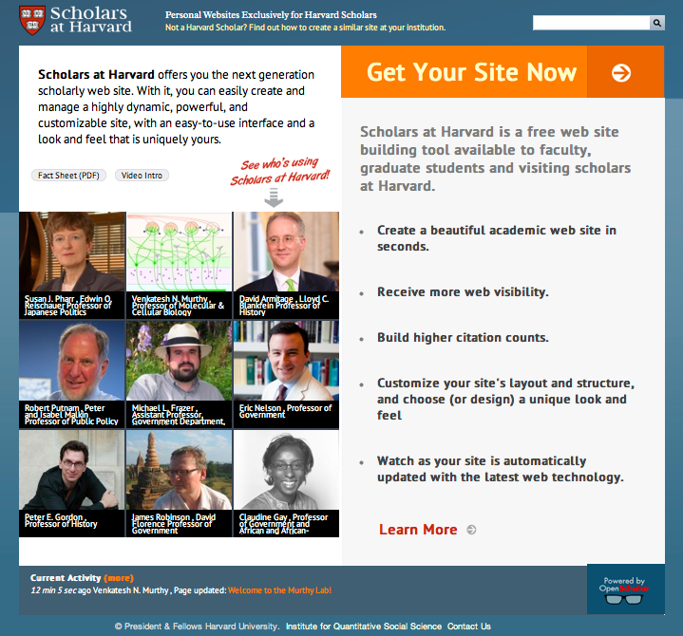
OpenScholar: Faculty & Student Web sites
> 1,259 scholar sites (growing fast)
> 295 project sites
Free at openscholar.harvard.edu
($5-20K saved per site)
Installation at > 100 other Universities
Growing via collaboration (with HUIT and HPAC) to extend to department sites

Slide 10
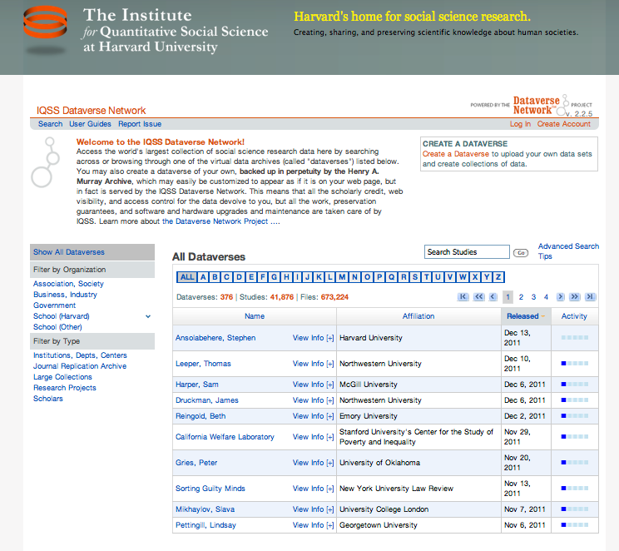
Dataverse Network
Your own easy-to-use virtual archive
Largest collection of social science data in the world
Our installation: ~ 1000 dataverses, 51,000 studies, 715,000 files
> 20 installations in other Universities
Expand across humanities, social sciences, & sciences
Free, open source

Slide 11
Zelig: Everyone’s Statistical Software
Easy, standardized solution to R’s power and diversity
>100 statistical methods in common format
Hundreds of thousands of users
(Optional GUI through Dataverse, no R knowledge required)
Huge local and international network effects: students learning from each other
Growing via open source contributions

Slide 12
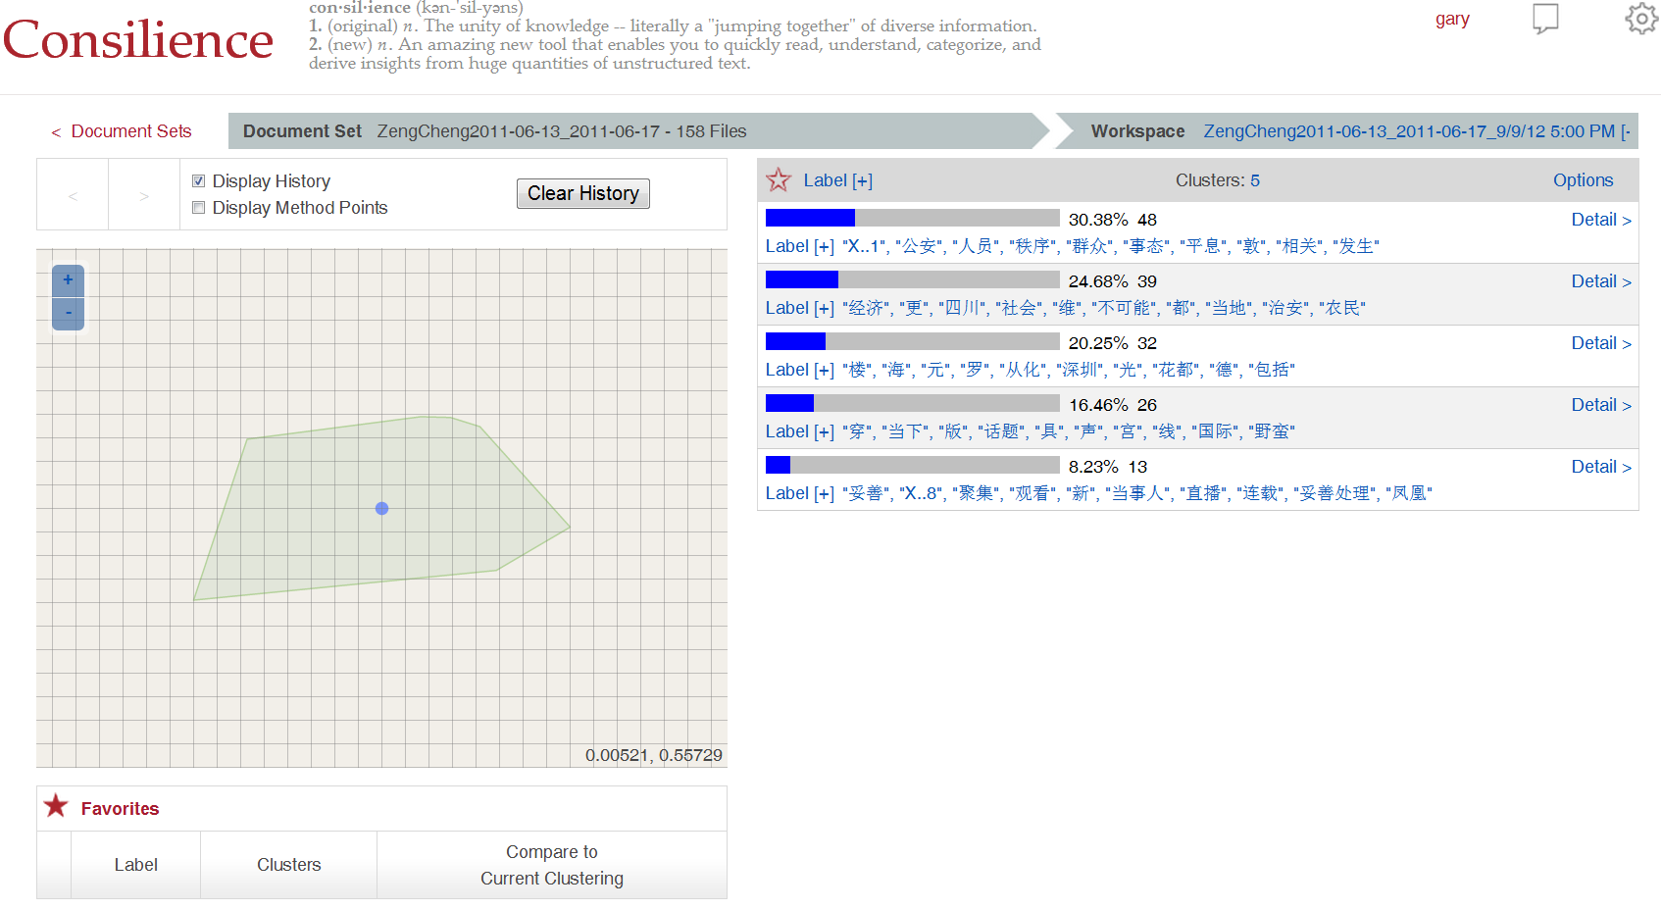
Program on Automated Text Analysis
“Computer-assisted reading”, a new way to organize and make sense of huge amounts of unstructured text.
Some services available now
New (self-serve) approaches under development, available soon

Slide 13
Grants Administration (Don’t forget Plumbing!)
Many active grants
Increasing number of proposals submitted annually
Pre- and post-award support
Working closely with department staff
Social scientists come for help & stay to interact on research & teachng

Slide 14
IQSS Activities Build a Community of Scholars
Administrative Services
Support for PIs, Programs and Centers
Sponsored Research Administration
Technology Services
Research and Technology Consultants
Technical Training
Research Computing Environment (RCE)
Repository for Social Science Data (Dataverse)
Faculty Web Sites (OpenScholar)
Research/Affiliated Programs
Center for Geographic Analysis
Program on Survey Research
Program on Text Research
RWJS in Health Policy Research
Positive Political Economy
Data Privacy Lab
Workshops and Conferences
Program on Methods
Community &
Collaboration
Technology Development
OpenScholar
Dataverse Network
Zelig
Text Clustering Tool
Research Computing

Slide 15
For more information…..
For more information
http://GKing.Harvard.edu

