Slide 1
Дима
Simon & Garfunkel The Sound of Silence

Slide 2
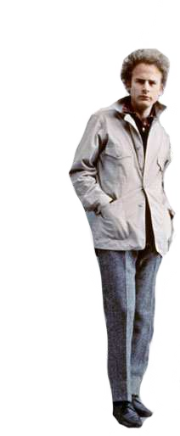
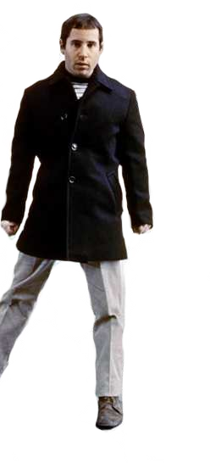
In restless dreams, I walked alone Narrow streets of cobblestone 'Neath the halo of a streetlamp
I turned my collar to the cold and damp When my eyes were stabbed by the flash of a neon light
That split the night
And touched the sound of silence And in the naked light, I saw
Ten thousand people, maybe more People talking without speaking People hearing without listening
People writing songs that voices never shared No one dared
Disturb the sound of silence "Fools", said I, "You do not know Silence like a cancer grows
Hear my words that I might teach you Take my arms that I might reach you" But my words like silent raindrops fell And echoed in the wells of silence

