Slide 1



Katari
Globant 2008 (update to 2010)

Slide 2
Katari
Katari is a framework to use as a starting point to develop new web applications.
Incorporates architecture, design and technological decisions that comes from the gained experience of previous projects at Globant.
Shows developers best practices for design, coding and testing.

Slide 3
Main Goals
Quick startup time for new projects.
Quick startup time for new developers.
List Globant approved technologies and tools, and provide examples of their appropriate use.
Good design and coding practices promotion.
Focus on reuse.

Slide 4
Reducing the ramp-up time
Built in functionality: login, user management, reporting, crud, plugable L&F.
Security features are already integrated. New projects only have to declare their permissions.
Globant open source tools already integrated.
Unit testing strategy in place.
Easy development and deployment configuration.
Developers focus on business needs instead of technological issues.

Slide 5
Reducing the ramp-up time
Built-in functionality serve as example when you're developing your application.
The open source frameworks configuration is already done.
Provides preliminary directory and package structures, as well as the needed libraries to develop a Java language-based Web application.
Reduces the cost of resource-rotation.

Slide 6
Eclipse: File -> new -> Project
Create a new project on your IDE.
Explicitly generate dependencies.
Configure open source frameworks together.
Add classes for your domain objects, facades, controlles, views ...
Add security features.
Configure the application server and database.
Define and implement a unit test strategy.
Result: every project is a world on its own.

Slide 7
Developing a Katari-based new project
For a new project (obsolete – use archetypes):
Create a project: katari create <myproject>.
Run the application: katari run.
Start coding new modules.
Result:
Developers are productive in less time: you go from the check-out to the login page in 15' or less.
Consistency across projects make it easier to rotate team members.

Slide 8
Modularity
Fully modular: each feature or built-in functionality is developed as a separate module.
Easy to add/import new functionality, encourages reuse.
Serve as a repository of generic and reusable functionality, including it’s design.
Focus is on integrating existing technologies instead of writing everything from scratch.

Slide 9
Configuration Management
Katari-based applications are prepared to be included from the beginning in Globant maven dashboard to monitor:
  Test Coverage.
  Code Quality.
  Conventions compliance.
  Unit testing execution results.

Slide 10
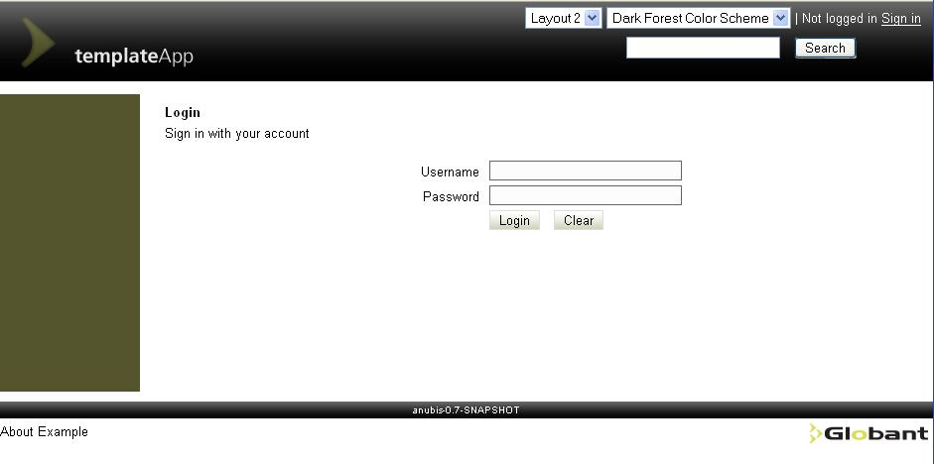
Feature: User administration
Authentication and authorization.
Single sign-on.
User and role management.

Slide 11
Feature: Reports
Final users can create reports:
Users create reports off-line, using iReports.
Users upload the report and decide which roles are needed to view the report.
Users with the appropriate roles can view the reports.

Slide 12
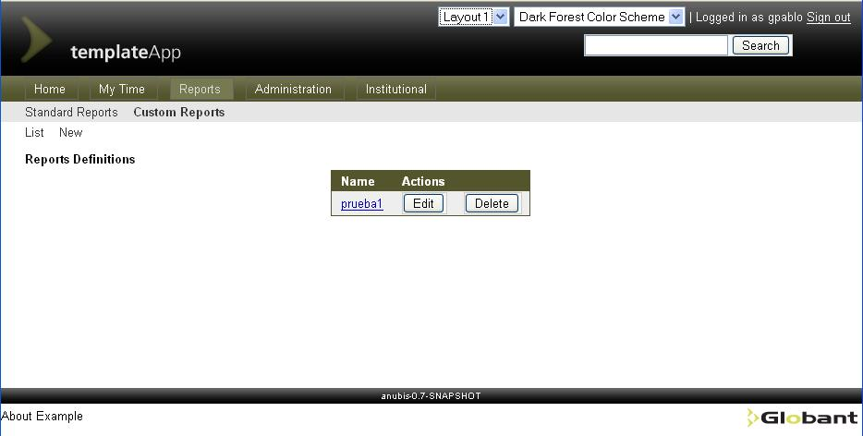
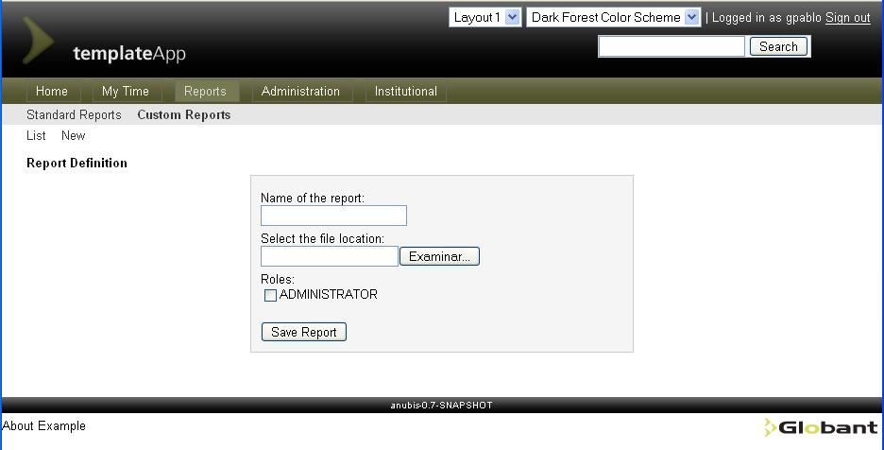
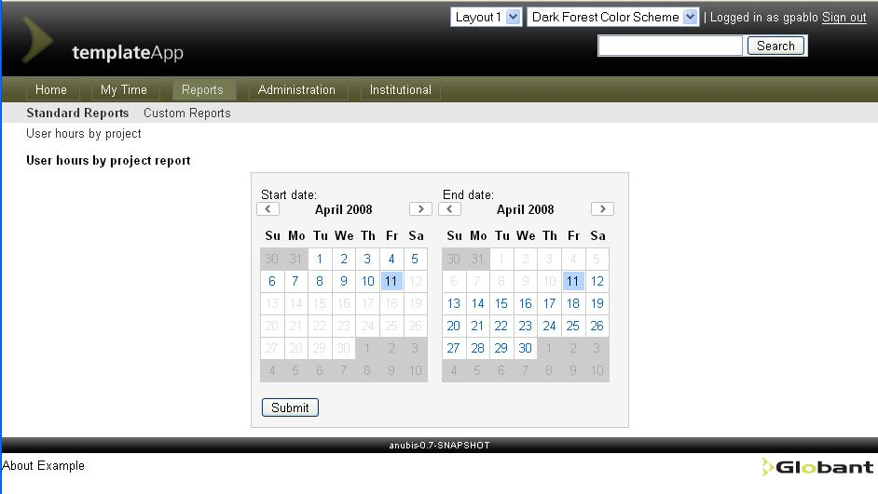
Feature: Reports

Slide 13
Feature: ABM’s in a whisper
Rapid CRUD application development for POJOs.
Introspection is used to gather information about bean properties and create the html fields to edit the entities.
A new CRUD for an entity can be done in just a couple of minutes.

Slide 14
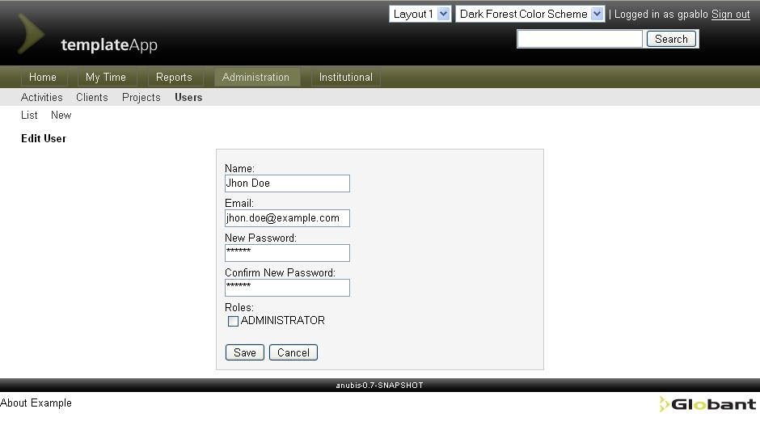
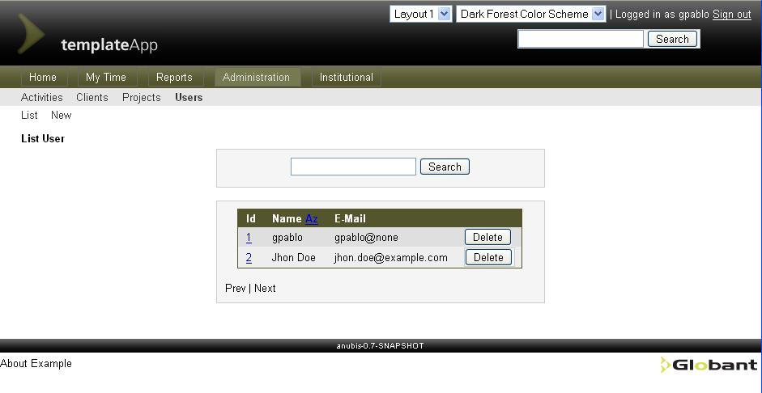
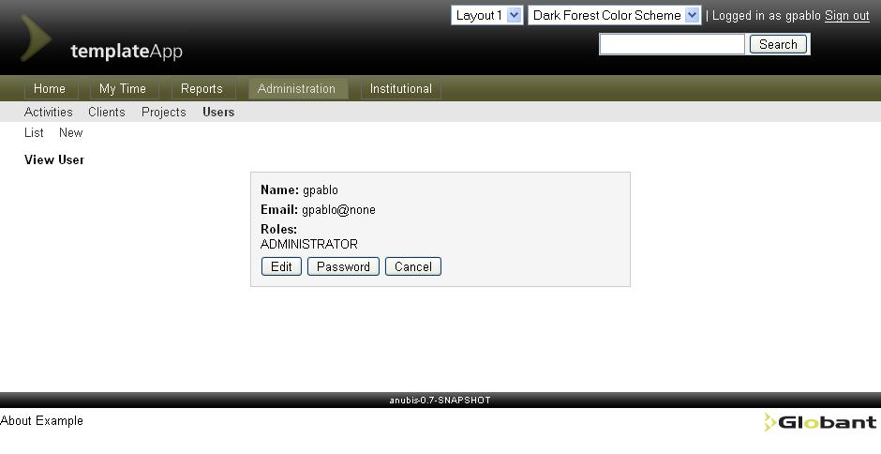
Feature: ABM’s in a whisper

Slide 15
Feature: Look & Feel
Skinability.
Page decoration.
Templated layout.
You can incorporate L&F from other projecs.

Slide 16
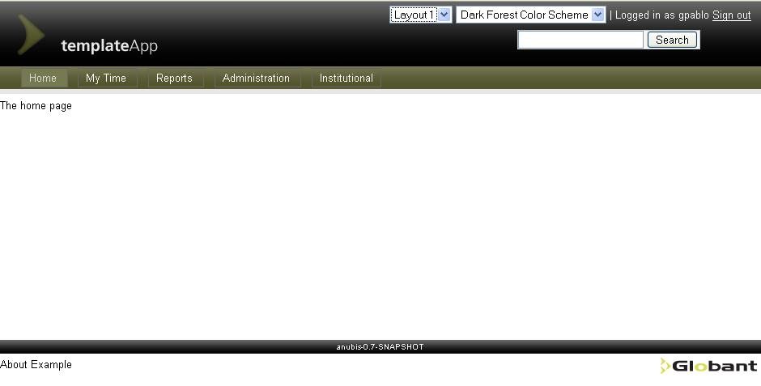
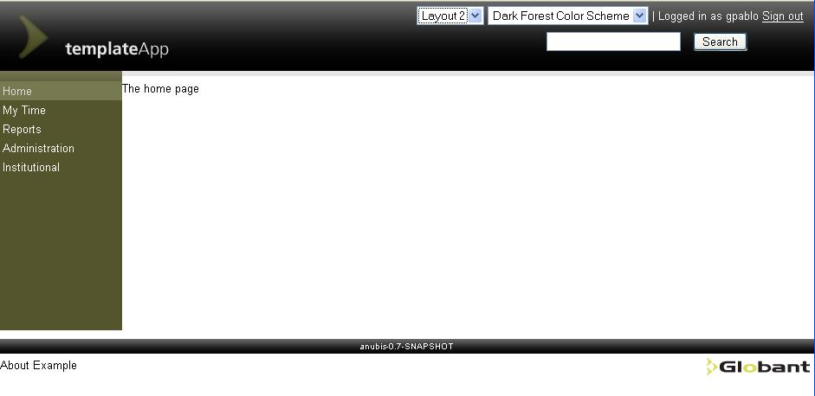
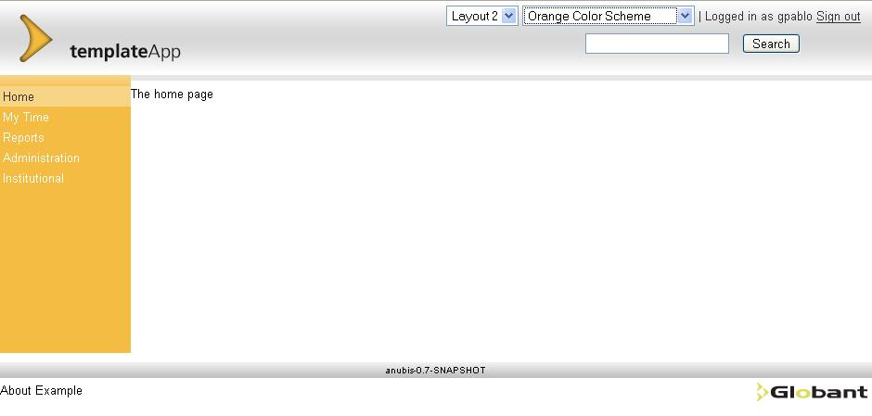
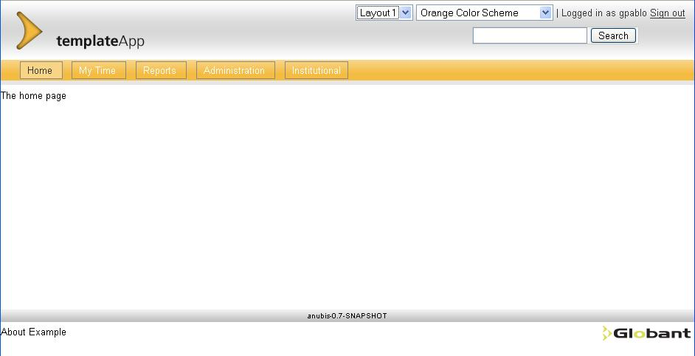
Feature: Look & Feel

Slide 17
Do not reinvent the wheel
Katari is based on powerful, flexible and tested technologies:
    Spring MVC – Spring IoC.
    Acegi & CAS.
    Hibernate.
    Jasperreports.
    Trails.
    Maven.
    Sitemesh, Freemarker, Ajax, Quartz, ...

Slide 18
Coming soon
Self-registration (in progress).
Legacy connectivity using the Mule messaging platform over ESB architecture (in progress).
e-commerce support trough Pay Pal and Google Checkout (in progress).
Declarative audit module.
Alfresco integration.
Client-side widget container.

Slide 19

Questions

Slide 20

Katari in action

