Slide 1
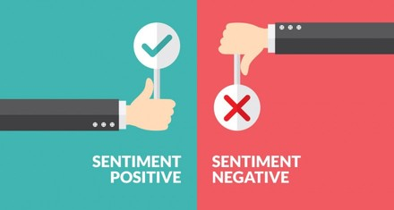
Sentimental Analysis on Movie review data using Machine Learning Approach
- Team Indium

Slide 2
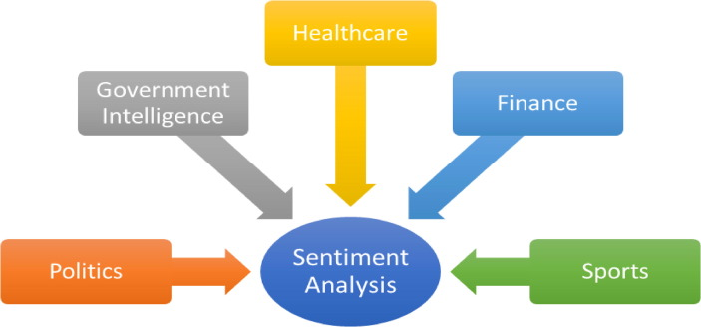
Introduction
Suppose we release a new product in the market and we want know what are the people’s reaction and how are they responding to that products so that in future releases, we can understand the sentiment of the people and implement the changes required. This situation arises in a lot of different markets and companies. Analysing the sentiments of people towards a particular product is not an easy task and requires a lot of work to be done under the hood to understand how people are reacting to that product.

Slide 3
Sentimental Analysis
Sentiment analysis examines how a text expresses emotion. It is a Natural Language Processing(NLP) method to understand the emotional tone behind the a body of text. It is used to determine whether the data is positive, negative or neutral. Customer feedback, survey replies, and product evaluations are all common uses for it. Sentiment analysis may be useful in a variety of situations, like social media monitoring, reputation management, and customer service. The paper assigned to us focuses on categorising movie reviews into negative and positive sentiments using sentiment analysis.

Slide 4
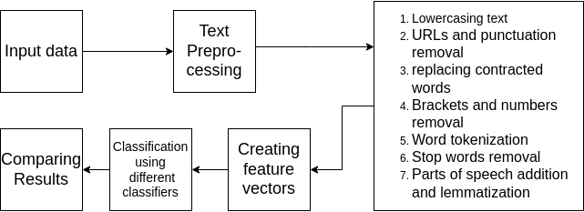
Analysis Procedure

Slide 5
Preprocessing dataset
The dataset contains 2000 movie reviews which are taken from the IMDb website. Out of the 2000 reviews, 1000 reviews are positive and the remaining are negative reviews (The dataset can be accessed through this Link). The raw review data is of very little use until preprocessed with different preprocessing techniques. The review text contains a lot of noise, words which are occurring commonly in all reviews, punctuations, URLs, etc. All these text reviews have to be cleaned so that we get accurate results after training on the preprocessed data.

Slide 6
Preprocessing dataset
There are various different preprocessing techniques available. We have used the following preprocessing techniques to reduce the noise in our dataset.
Lowercasing the text : we have converted all the texts to lowercase so that our model does not show any difference between “Good” and “good”
URLs and punctuation removal : All the punctuations and URLs are removed because they have no contribution to the sentiment of the review.
Brackets and numbers removal : Brackets and numbers play no major role in sentiment of the review and hence they have been removed from the text.
Replacing contracted words : Words like “I’ll” and “You’ve” have been replaced with “I will” and “You have” respectively to gain more clarity about the text.

Slide 7
Preprocessing dataset
Word tokenization : After cleaning all the unnecessary noise, we divide the sentences into tokens. Tokens are basically smaller units of text documents such as individual words or terms.
Stop words removal : A stop word is a commonly used word (such as “the”) which is present in almost all the documents and hence does not have much significance in deciding the final outputs.
Lemmatization : Lemmatization refers to the process of returning the base or dictionary form of the word with the use of vocabulary and structured analysis of the words. We implemented lemmatization after tagging all the words with their Parts of Speech. Parts of speech play an important role in deciding the base form of the word.

Slide 8
Creating Feature vectors
Feature vector is an n-dimensional vector of numerical features that describe some object in pattern recognition in machine learning. Machine do not understand words and sentences and they have to be provided with some kind of input that is understandable to them, i.e, numbers. All the text data in our dataset have to be preprocessed using the preprocessing steps mentioned above and then have to be converted into vector of numbers (that is the feature vectors), that can be given as an input to the machine and the machine provides us some output based on that input. There are different type of algorithms for creating feature vectors like TF-IDF, Countvectorizer, Word2Vec, One hot encoding, etc but we will briefly discuss about TF-IDF and Countvectorizer.

Slide 9
TF-IDF
TF-IDF stands for Term Frequency - Inverse Document Frequency. It is a numerical statistic that is intended to reflect how important a word is to a document in a collection or corpus. The TF-IDF of a word w in a document d is given as follows
TF-IDF(w) = TF(w)*IDF(w)
TF(w, d) = (number of time w appears in d)/(count of words in d)
IDF(w) = log(N/Number of documents in which d occurs)
*Where N is the total number of documents.

Slide 10
Countvectorizer
Countvectorizer is used to transform given text into vector on the basis of frequency of each word that occurs in the entire text. Countvectorizer works on the bag-of-words model. In bag-of-words model, a set of all different words in our corpus is created and each text document is assigned with a vector of the size of the set. Each vector has zero values for the words not occurring in that document and non-zero values, i.e, frequencies of the words occurring in that document.
Embedding(w) = 0 if w does not belong to d
= frequency(w) otherwise

Slide 11
Different types of Classifiers
Classifiers are different types of algorithms that categorizes data into different classes. We implemented different types of classifiers:
Support vector machines(SVM)
Multinomial Naive Bayes
Bernoulli Naive Bayes
Decision tree
Maximum Entropy
Neural Network classifier
LSTM’s

Slide 12
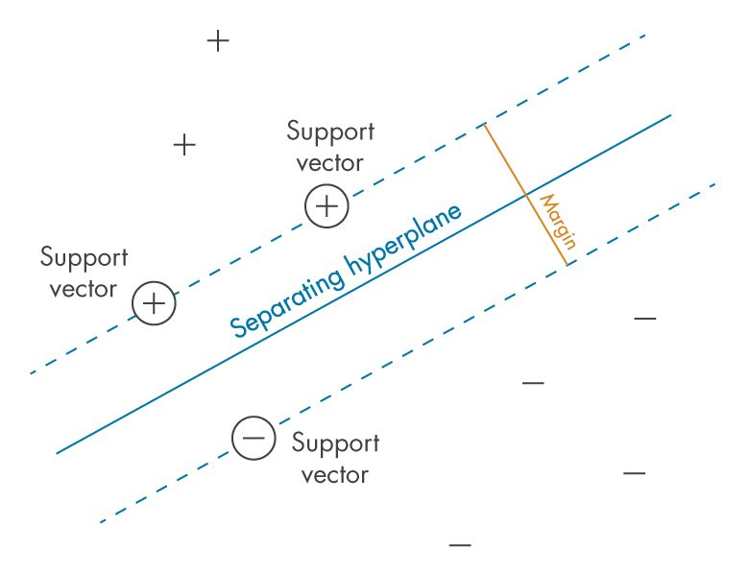
Support Vector Machines (SVM)
Support vector machines (SVM) are supervised machine learning algorithm used for both classification and regression. The main goal of SVM is to find a k-1 dimensional hyperplane that distinctly classifies k dimensional data points. SVM work with both linear data and non-linear data. Many hyperplanes are possible that classify data into different classes but the hyperplane, whose margin is the largest is considered to be the best classifier as if gives more room for test error.

Slide 13
Naive bayes classifiers
Naive bayes classifier are a collection of classification algorithms based on Bayes’ theorem. It is not a single algorithm but a family of algorithms where all of them share a “Naive” principle, i.e., every pair of features being classified is independent of each other.
Bayes Theorem : P(B/A) = P(A/B)*P(B)/P(A)
P(y/X) = P(X/y)*P(y)/P(X)
Suppose X = (x1, x2, …, xn), (X is input data and y is class to be detected)
P(y/X) ~ P(x1)*P(x2)...*P(xn)*P(y)
(As x1,x2..,xn are independent)
Multinomial Naive Bayes assumes that each P(xn|y) follows a multinomial distribution. Bernoulli Naive Bayes is similar to Multinomial Naive Bayes, except that the predictors(y values) are boolean (True/False)

Slide 14
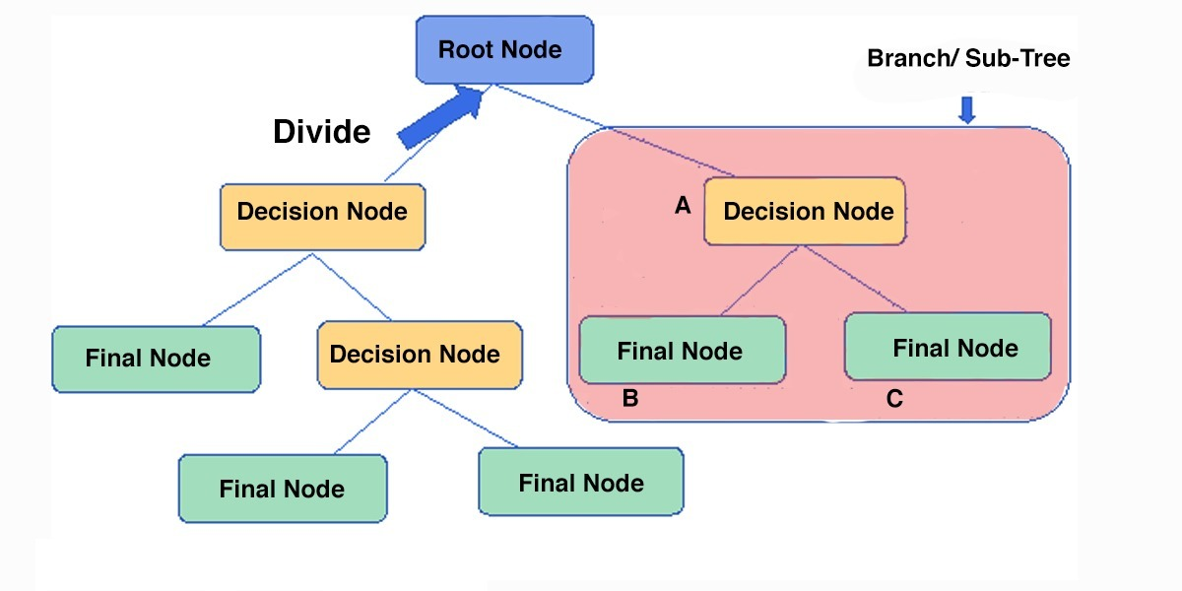
Decision trees
Decision Tree is a Supervised learning technique that can be used for both classification and Regression problems. A decision tree classifier creates a classification model by building a decision tree. Each node in the tree specifies a test on an attribute, each branch descending from that node corresponds to one of the possible values for that attribute.

Slide 15
Maximum entropy
The Max Entropy classifier is a discriminative probabilistic classifier. Unlike the Naive Bayes classifier, the Max Entropy does not assume that the features are conditionally independent of each other. The MaxEnt is based on the Principle of Maximum Entropy according to which, the distribution with maximum entropy is the best choice.

Slide 16
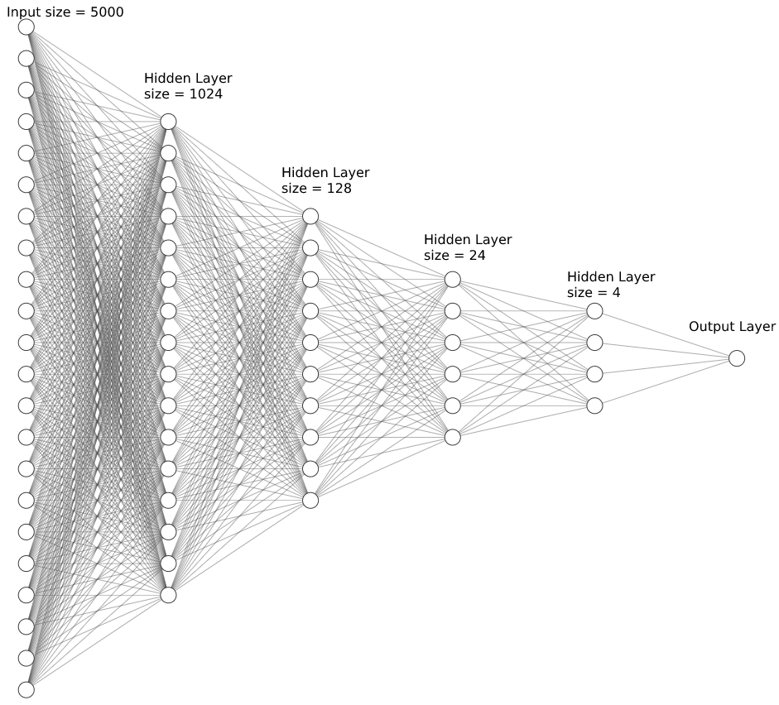
Neural networks
Neural networks are basically series of interconnected nodes passing information from input node to the output node. They work much like the neurons in the human brain. They can easily fit to non-linear data and can recognize hidden patterns in raw data. The neural network architecture we used in this project is given beside. We have also used LSTM’s as one of our classification model to compare results with other models.

Slide 17
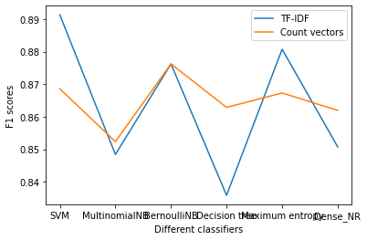
Results
This graph shows the comparison of various classification models using F1 scores. Higher the F1 score, lower will be the false positives and false negatives. Every classifier is sensitive to parameter optimization. Small changes in their parameters can bring out large differences in the outputs we see. From this graph, we can generalize that SVM and Maximum entropy do better with TF-IDF embeddings, while Multinomial naive bayes and decision tree perform better with Countvectorizer.

Slide 18
Results
As Countvectorizer gives us a frequency of the words present in the document, most of the words will have less than 2 frequency or even 0. This shows that most part of the vector is sparse with non-zero numbers having large values compared to tf-idf values, and hence it is not ideal for SVM and maximum entropy to use countvectorizer. While decision trees and multinomial naive bayes deal with probabilities, countvectorizer comes in handy as it has the actual count of the words in a document which will be helpful for calculating the probabilities.

Slide 19
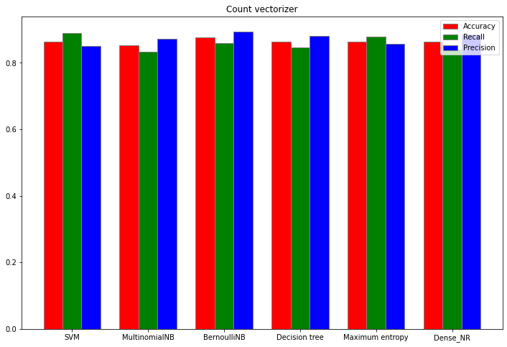
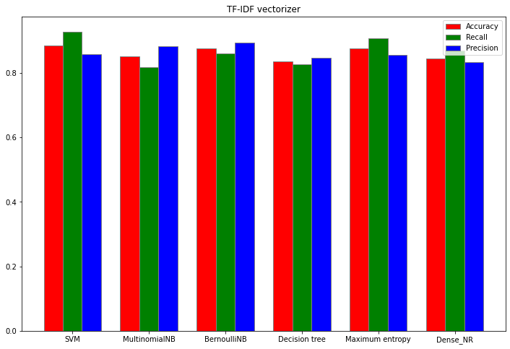
Results
The graphs beside show how different models perform for different embeddings.

Slide 20
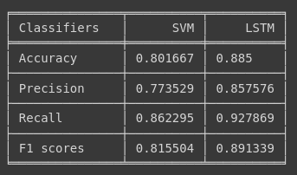
Results
LSTM show a significant improvement in the performance of the classification model. Due to their ability to remember the context of the data in efficient manner, They are better at generalization of the sentiments and hence get a good result.

Slide 21
Conclusion
From the results we got, we see that LSTMs perform the best but they are very complex and are computationally heavy. SVM performs better that the other machine learning algorithms. But, as we know we can always fine-tune the hyperparameters of different algorithms and improve their performance. Hence, A focused work of improving the classifiers and generalizing the results could be taken up and worked on.

Slide 22
Team Indium
Rajat Kataria
Meghasyam
Nitin Chandak

