Slide 1
Feel yourself free anywhere
| STREETER |
by
Irén - Katarina - Norbi
Notes:
introduction:
Name of the APP: Streeter
Name of the group: Free Spirits
Members: Irén, Katarina, Norbi

Slide 2

Sightseeing APP
for Everyone
Interactive / Solo
Anywhere
easy Search
with any Budget
All in one App
Notes:
sightseeing app
Logo: freedom, bag, travelling

Slide 3
Registration Form
Add Destination
Add your Preferences
App will offer you possibilities during your walk
You can join others or stay with yourself
with this APP it is easy to search, it can guide you, and it can offer you many other options….

Slide 4
Have you ever tried to find ……… ?

Slide 5
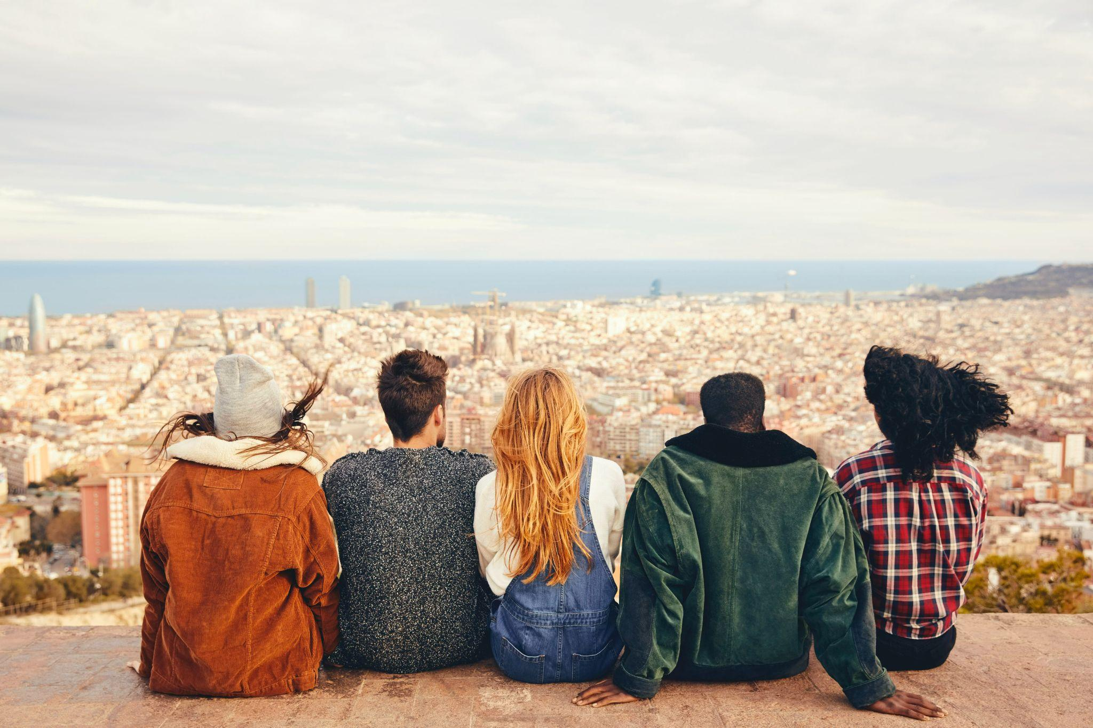
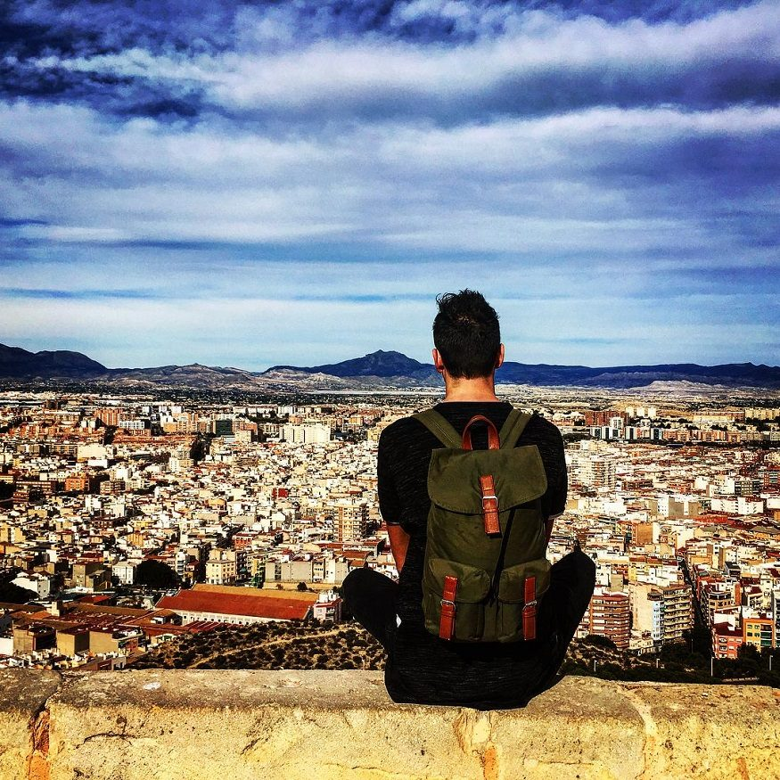
Travelling with friends or Solo
Notes:
your preferences
Pet friendly
family friendly
food preferences
disability

Slide 6
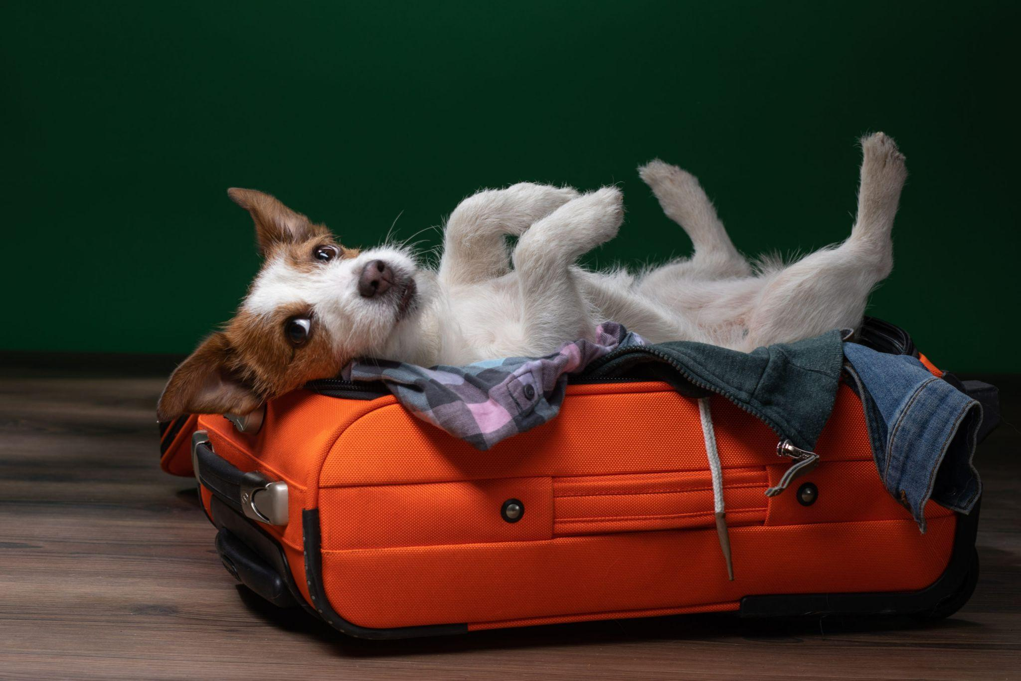
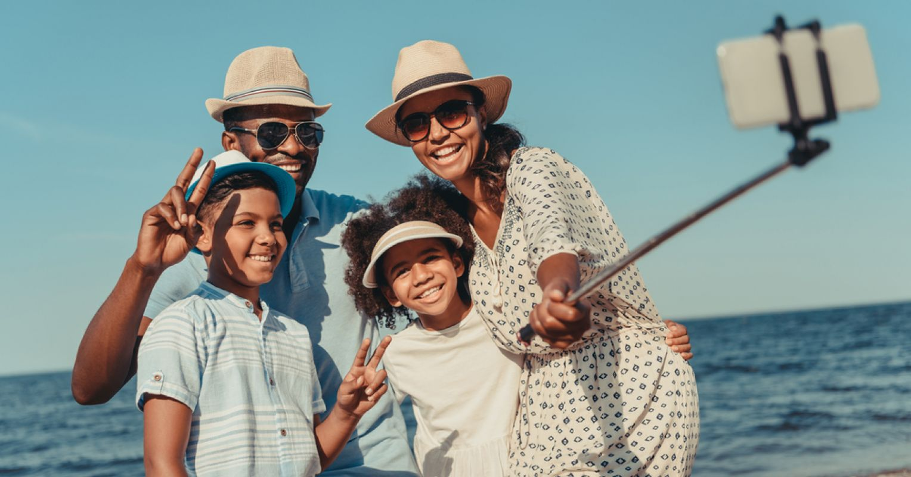
Travelling with pet or family

Slide 7
Any questions ?

Slide 8
THANK You for your Attention!
| STREETER |
by
Irén - Katarina - Norbi
Notes:
introduction:
Name of the APP: Streeter
Name of the group: Free Spirits
Members: Irén, Katarina, Norbi

