Slide 1
Learning Path 1: Configure your Microsoft 365 tenant

Slide 2
Learning Path agenda
Configure your Microsoft 365 experience
Add a custom domain in Microsoft 365
Lab 1-Exercise 1 – Initialize your Microsoft 365 tenant
Lab 1-Exercise 3 – Add a custom domain
Manage users, licenses, and mail contacts in Microsoft 365
Configure client connectivity to Microsoft 365
Manage groups in Microsoft 365
Learning Path Review
Lab 1-Exercise 2 – Manage users and groups
Notes:
Mention how this Learning Path maps to the first certification exam study area, which is Microsoft 365 tenant administration.

Slide 3
Module 1: Configure your Microsoft 365 experience

Slide 4
Introduction
This module examines the following items that an organization should consider when configuring its Microsoft 365 tenant:
Set up your organizational profile
Manage your Microsoft 365 subscription and tenant
Manage your services and add-ins
Finalize your tenant

Slide 5
Configure your organizational profile in Microsoft 365
A Microsoft 365 subscription is a paid plan that provides access to various Microsoft cloud services When an organization signs up for a Microsoft 365 subscription, Microsoft automatically creates a tenant for the company The tenant URL that Microsoft creates is based on the domain name provided during sign-up. It typically looks something like this: https://<company name>.onmicrosoft.com
An organization's Microsoft 365 tenant also includes an Azure Active Directory (Azure AD) tenant
Only Microsoft 365 Global Administrators can edit the Organization profile in the Microsoft 365 admin center
You can’t change the country/region for your subscription
The country/region where your organization is headquartered determines:
Which services are available to you
The taxes and billing currency
The location of the Microsoft data center
To change your organization's country/region, you must sign up for a new account, choose the desired country/region, and purchase a new subscription!

Slide 6
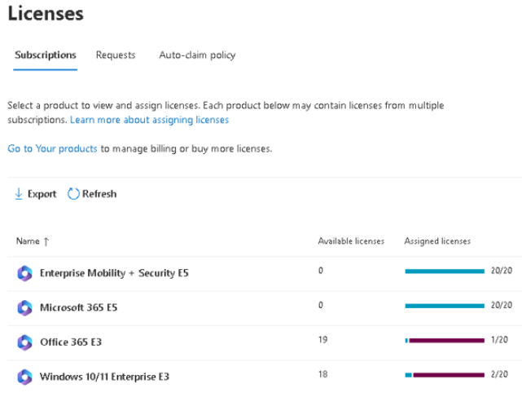
Manage your tenant subscriptions in Microsoft 365
Maintaining minimum subscription requirements for your company is essential to remaining functional
You can review all active and deprovisioned licenses from the Licenses page located under the Billing group in the admin enter
Purchasing additional licenses changes the monthly billing date
Additional actions that can be performed from the Licenses page include:
- Add a partner of record
- Add a subscription
- Convert a subscription
WARNING: Purchasing an insufficient number of licenses can result in implementation delays

Slide 7
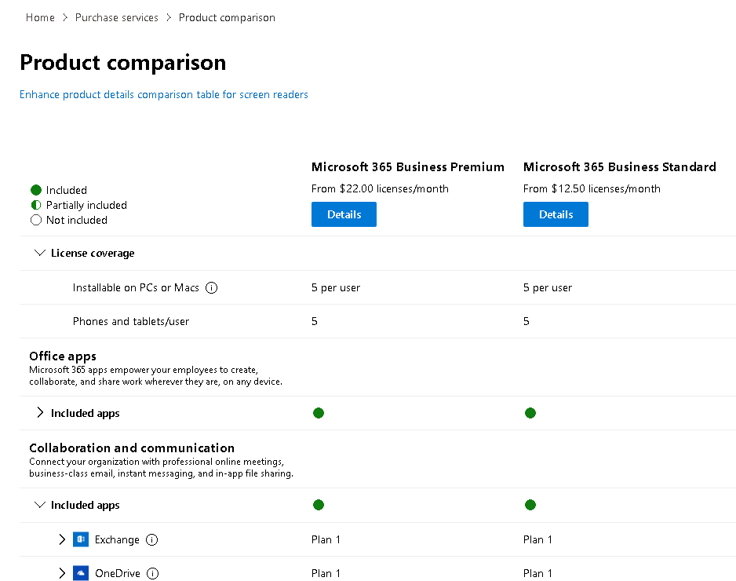
Integrate Microsoft 365 with customer engagement apps
You may need to assign additional licenses, such as Project Online, Visio, Scheduler, or Microsoft Stream
These add-on services can be found in the Purchase Services page, which is located under the Billing group in the Microsoft 365 admin center navigation pane
Some of the subscriptions provide a standard 30-days trial before the service add-on expires and must be paid for to re-enable
The Product comparison page shows a detailed comparison of the features and capabilities of products you select

Slide 8
Complete your tenant configuration in Microsoft 365
Consider the following questions before adding custom domains to your Microsoft 365 tenant:
Have all the users been moved over to Microsoft 365?
Has your company established proper governance policies for mobile devices?
Do the users have a functional mailbox and has their data been migrated to their account?
Have the DNS records been updated and published globally?
Have all the resources been created?
If Azure AD Connect is in place, is the connector properly configured?
Have all permissions been established?
If Multi-Factor Authentication is employed, has it been properly configured?
Has the vanity domain(s) been moved successfully?
Are the mailing policies in place to protect inbound and outbound mail flow?
Have all Windows 10 and 11 devices been enrolled to Intune?
Is the Organizational profile set up with the correct information?
Organizations can use tools such as the Microsoft Remote Connectivity Analyzer (RCA) and the Microsoft Support and Recovery Assistant (SARA) to confirm their deployment’s configuration and readiness These tools check DNS records and mail flow to test whether mailing policies are working properly They also test local connectivity from Outlook and other Office apps

Slide 9

Knowledge Check
Test your knowledge by answering the Knowledge Check questions at the end of this Learn module

Slide 10
Summary
This module examined the following items that must be considered when configuring your Microsoft 365 experience:
Setting up your organizational profile
Managing your Microsoft 365 subscription and tenant
Managing your services and add-ins
Completing your tenant configuration

Slide 11
Lab 1 – Configure your Microsoft 365 Tenant

Slide 12
Lab exercises
Lab introduction:
IMPORTANT: Read through the introduction at the start of the lab instructions before you begin
Exercise 1: Initialize your lab environment
Task 1
Obtain your Microsoft 365 credentials
Task 2
Set up the Adatum’s organization profile
Task 3
Create a custom theme for Adatum’s pilot project team
Task 4
Enable Information Rights Management for SharePoint Online
Task 5
Turn on Audit Logging to enable Alert policies
Task 6
Install Microsoft Graph PowerShell
Task 7
Run a PowerShell script to create and publish a sensitivity label

Slide 13
Module 2: Manage users, licenses, and mail contacts in Microsoft 365

Slide 14
Introduction
As your organization’s Microsoft 365 administrator, you’ll be responsible for creating and managing user accounts for all your users
This module examines the following items related to configuring user accounts:
Understanding user identities
Creating and managing user accounts
Managing user licenses
Recovering deleted user accounts
Create and manage guest users
Create and manage mail contacts

Slide 15
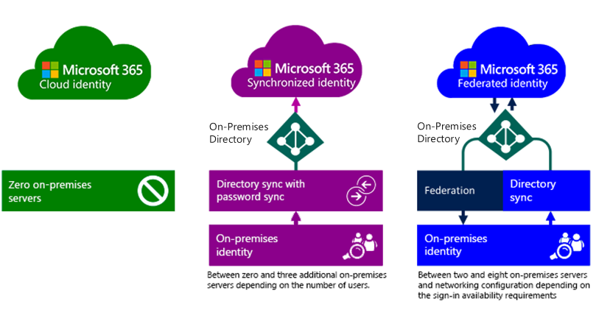
Determine the user identity model for your organization
To plan user identities, you must first understand the different user identities in the Microsoft 365 Identity Model:
Cloud identities
Synchronized identities
Federated identities
Microsoft 365 Identity Model

Slide 16
Create user accounts in Microsoft 365
Depending on your needs, you can use the following methods to provision user accounts:
Microsoft 365 admin center
Import multiple users
Windows PowerShell
Directory synchronization

Slide 17
Manage user account settings in Microsoft 365
Managing user accounts involves managing several account settings, such as:
Assigning administrator roles
Setting users’ sign-in status
Specifying user location settings
Assigning licenses
You can use the Microsoft 365 admin center to edit single or multiple users

Slide 18
Manage user licenses in Microsoft 365
One of the most basic tasks for Microsoft 365 Administrators is to manage users and their licenses
Your organization’s users need licenses to use Microsoft 365 services such as Outlook, SharePoint Online, and Skype for Business Online
When you assign a license to a user, the service is automatically set up for that user
Only members of the Microsoft 365 Global administrator and User Management administrator roles can assign or remove licenses
To assign a license, you can use the Microsoft 365 admin center or Windows PowerShell

Slide 19
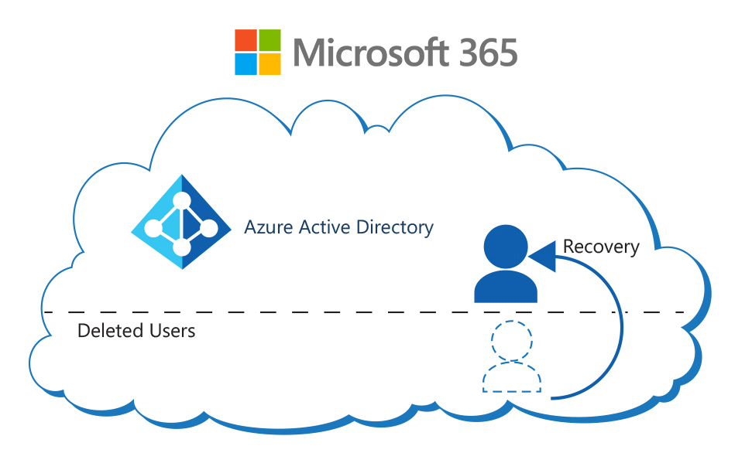
Recover deleted user accounts in Microsoft 365
When a user leaves an organization, they usually don’t need their user account in the company’s Microsoft 365 tenant
When you delete a user account:
The assigned Microsoft 365 license for that user becomes available, which you can assign to another user
The account becomes inactive, so the user can’t sign-in to access Microsoft 365 services
Microsoft 365 retains the account as a “soft deleted” inactive account for 30 days after deletion; this enables you to restore the account, if necessary
You can restore deleted user accounts using the Microsoft 365 admin center or Windows PowerShell
Deleted users are still part of their managed tenant. A recovery operation simply re-activates the Azure AD user.

Slide 20
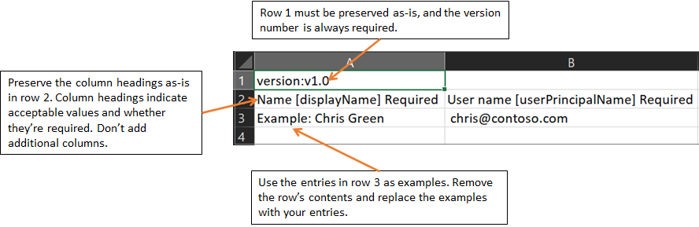
Perform bulk user maintenance in Azure Active Directory
Azure AD enables organizations to perform bulk user maintenance transactions to:
- Create new user accounts
- Delete existing user accounts
- Restore deleted user accounts
Bulk user operations require that you submit a CSV file that contains the required information for each user account being created, deleted, or restored
Microsoft 365 provides a CSV file template for each type of bulk user transaction (the CSV templates are slightly different for each transaction type)
Up to 50,000 users can be bulk created in a single operation
This diagram shows the CSV template used to bulk create user accounts
See the training content for similar diagrams of the CSV templates to bulk delete and bulk restore user accounts

Slide 21
Create and manage guest users
Guest users is a Microsoft 365 feature that enables people from outside an organization to collaborate with users within the organization
You must enable guest user access in your organization’s external collaboration settings
To add a guest user, you must be assigned a role that allows you to create guest users in your tenant directory
You can invite guest users to your organization’s Azure Active Directory, to a group, or to an application
Guest users receive an invitation they must redeem; the invitations don’t expire
You can assign guest users to one of the following permission levels: Same as member users Limited access (default) Restricted access

Slide 22
Create and manage mail contacts
In Exchange Online organizations, mail contacts are mail-enabled objects that contain information about people who exist outside the organization Each mail contact has an external email address
The mail contact is visible in your organization’s global address list (GAL)
Organizations can manage mail contacts in both the new and classic Exchange admin center (EAC) and in Exchange Online PowerShell
Permissions required to create mail contacts in Exchange Online can come from: Recipient Management role group
Organization Management role group
Mail Recipients role

Slide 23
Knowledge Check
Test your knowledge by answering the Knowledge Check questions at the end of this Learn module

Slide 24
Summary
This module examined the following items related to managing users, mail contacts, and licenses in Microsoft 365:
Understanding user identities
Creating and managing user accounts
Managing user licenses
Recovering deleted user accounts
Creating and managing guest users
Creating and managing mail contacts

Slide 25
Module 3: Manage groups in Microsoft 365

Slide 26
Introduction
After creating user accounts for the Microsoft 365 tenant, you can optionally create groups for distributing email to multiple users with Exchange Online
This module examines the following items related to managing groups in Microsoft 365:
Creating and managing groups
Creating dynamic groups using Azure rule builder
Creating a Microsoft 365 group naming policy
Creating groups in Exchange Online and SharePoint Online

Slide 27
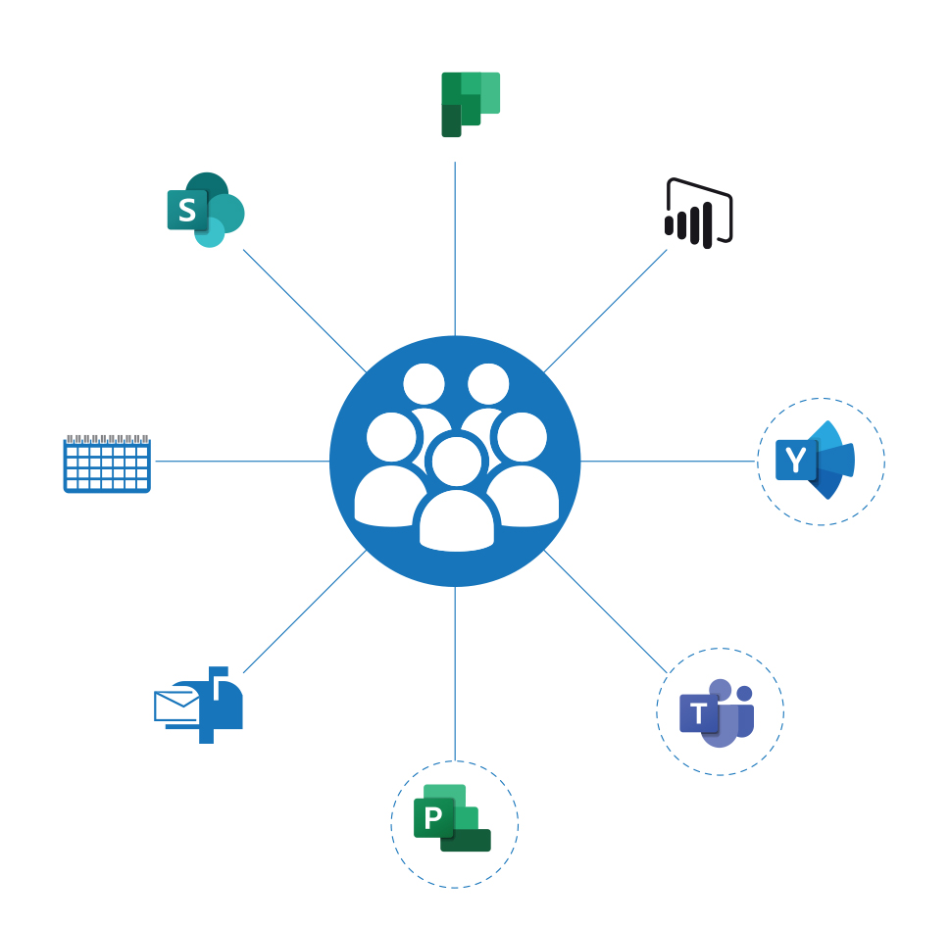
Examine groups in Microsoft 365
You can use groups to manage sets of users at the same time in Microsoft 365
Supported types of groups in Microsoft 365 include:
Microsoft 365 group
Distribution group
Mail-enabled security group
Security group
Dynamic distribution group (Exchange only)

Slide 28
Create and manage groups in Microsoft 365
You can use the Microsoft 365 admin center or Windows PowerShell to create a security group in the Microsoft 365
To ensure that you create and manage your groups correctly, you should consider the following best practices:
Keep your group naming convention simple but clear
Create policies and procedures for ongoing group maintenance
Add users to security groups and then add those security groups to the default groups rather than adding individual users to the default groups
Maintain a consistent and well-defined account provisioning process

Slide 29
Create dynamic groups using Azure rule builder
Organizations can use rules to determine group membership. Rules can be based on user or device properties in Azure AD
Microsoft 365 supports dynamic membership for Security groups and Microsoft 365 Groups
When an attribute changes for a user or device, the system examines all dynamic group rules in the organization for membership changes It then adds or removes users and devices if they meet the conditions for a group
The following rules govern dynamic group membership:
You can't manually add or remove a member of a dynamic group
You can create a dynamic group for devices or users, but you can't create a rule that contains both users and devices
You can't create a device group based on the user attributes of the device owner. Device membership rules can only reference device attributes

Slide 30
Create a Microsoft 365 group naming policy
A group naming policy enforces a consistent naming strategy for groups created by users Microsoft 365 applies the policy to the group name and group alias
A naming policy can help users identify the function of the group, membership, geographic region, or who created the group
Policies can block users from using specific words in group names and aliases You can enter a comma separated list of blocked words that the system blocks in group names and aliases
Organizations should consider the following best practices when developing a group naming policy:
Use short strings as suffixes
Use attributes with values
Don't be too creative. The system allows a maximum name length of 264 characters
Upload your organization-specific blocked words to restrict usage

Slide 31
Create groups in Exchange Online and SharePoint Online
You can use the Exchange admin center to create the following groups of users so you can send email to them all at the same time
Distribution group
Security group
Dynamic distribution group
SharePoint groups are created automatically when you create a site collection. A security group you create in SharePoint is only recognized by that SharePoint site collection
You don’t need to use security groups to be secure:
You can always grant user permissions and access to sites individually
But with security groups, you can easily manage larger groups of users
Notes:
Let's take a look at some frequently asked questions related to security groups:
Question: How is a security group different from security groups I create in SharePoint?
Answer: Security groups can be used with SharePoint, Exchange, MDM, Windows, and more. A security group you create in SharePoint is only recognized by that SharePoint site collection.
Question: Do I have to use security groups for my organization to be secure??
Answer: No. This is just one more way you can manage security for your organization. You can always grant user permissions and access to sites individually. But with security groups, you can easily manage larger groups of users.
Question: Can I send email to a security group?
Answer: Yes. But if you want to use groups for email and collaboration, it is recommended that you create an Office 365 group instead.

Slide 32
Knowledge Check
Test your knowledge by answering the Knowledge Check questions at the end of this Learn module

Slide 33
Summary
This module examined the following items related to managing groups in Microsoft 365:
Understand groups in Microsoft 365
Create and manage groups in Microsoft 365
Create dynamic groups using Azure rule builder
Create a Microsoft 365 group naming policy
Create groups in Exchange Online and SharePoint Online

Slide 34
Lab 1 – Configure your Microsoft 365 Tenant (continued)

Slide 35
Lab exercises (continued)
Exercise 2: Manage users and groups
Task 1
Create a user account for Adatum’s Enterprise Administrator
Task 2
Create and manage groups
Task 3
Recover groups using PowerShell

Slide 36
Module 4: Add a custom domain in Microsoft 365

Slide 37
Introduction
This module examines the following items that an organization should consider when implementing domain services:
Plan a custom domain for your Microsoft 365 deployment
Plan the DNS zones for a custom domain
Plan the DNS record requirements for a custom domain
Create a custom domain in Microsoft 365

Slide 38
Plan a custom domain for your Microsoft 365 deployment
Organizations should consider the following factors before adding custom domains to Microsoft 365:
Multiple Domains
Access to the DNS console
Subdomains
Not registering DNS
Domain numbers
Not changing all records
Domain adding order
DNS record propagation timings
DNS record hosting

Slide 39
Plan the DNS zones for a custom domain
When an organization owns a DNS zone, the Microsoft 365 setup wizard can:
Create the tenant with the organization’s custom domain, such as adatum.com
Instruct the organization on which DNS records it must add to the public DNS zone
Organizations use internal DNS zones configured on internal DNS servers so that internal clients can resolve computer names and services
Organizations use external, public DNS zones configured on Internet‑accessible DNS servers so that clients located on the Internet can resolve computer names and services
Organizations have the following options to host the DNS zone for a custom domain:
Have a third-party provider, such as GoDaddy, host the DNS zone for the custom domain
Host the DNS zone on-premises by using or deploying DNS servers

Slide 40
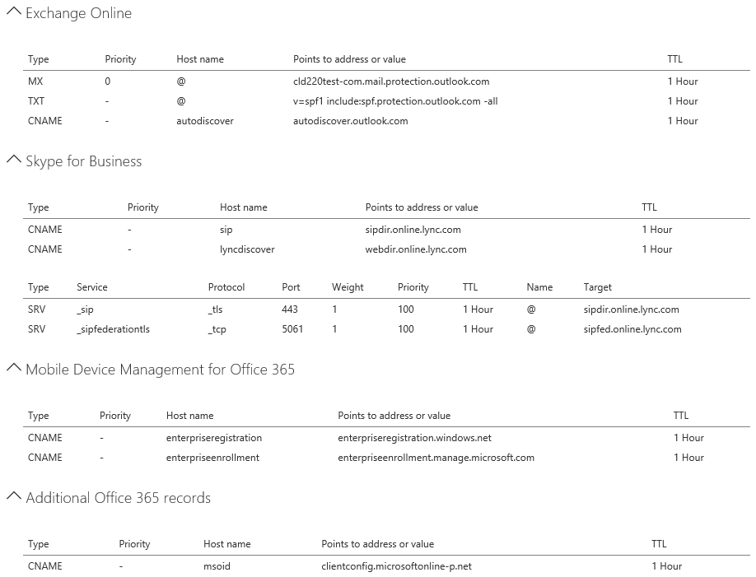
Plan the DNS record requirements for a custom domain
Microsoft 365 uses the following subset of DNS records:
DNS records for Exchange Online
DNS records for Skype for Business Online
DNS records for Mobile Device Management for Microsoft 365

Slide 41
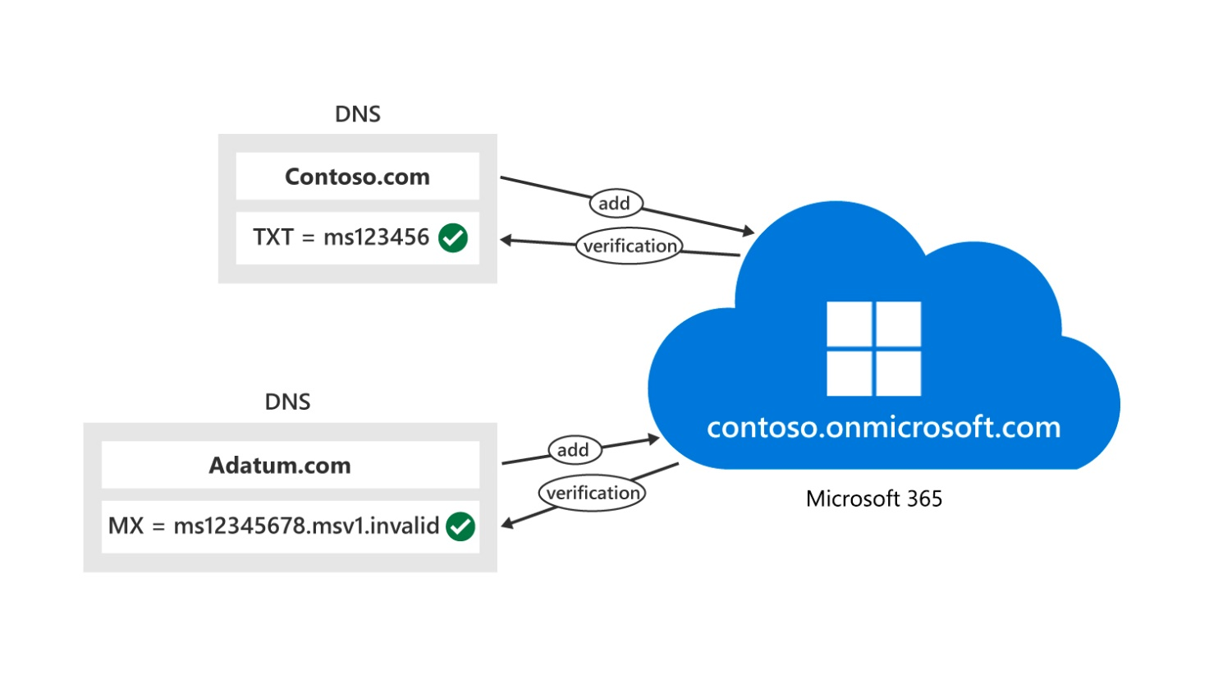
Create a custom domain in Microsoft 365
You must complete the following steps to add a custom domain to your organization’s Microsoft 365 tenant:
Verify that you have ownership of the domain
Verify that you have administrative access to manage DNS for the domain
Verify that you can make changes to the DNS records
Sign into the Microsoft 365 admin center
Confirm domain ownership for the domain
Change the default domain to the new domain
Add users and assign licenses
Finish configuring DNS
Public domains must point to Microsoft 365 to receive and use emails

Slide 42
Knowledge Check
Test your knowledge by answering the Knowledge Check questions at the end of this Learn module

Slide 43
Summary
This module examined the following items that must be considered when adding a custom domain in Microsoft 365:
Plan a custom domain for your Microsoft 365 deployment
Plan the DNS zones for a custom domain
Plan the DNS record requirements for a custom domain
Create a custom domain in Microsoft 365

Slide 44
Lab 1 – Configure your Microsoft 365 Tenant (continued)

Slide 45
Lab exercises (continued)
Exercise 3: Add a custom domain
Task 1
Add a custom domain

Slide 46
Module 5: Configure client connectivity to Microsoft 365

Slide 47
Introduction
This module examines the following items that an organization should consider when configuring client connectivity to Microsoft 365:
Understand how automatic client configuration works
Understand which DNS records are required for automatic client configuration
Configure Outlook clients
Troubleshoot client connectivity

Slide 48
Examine how automatic client configuration works
Microsoft Outlook includes an Autodiscover feature that automatically configures Outlook to connect to Exchange Online without the need to manually configure the user connection setting
Outlook users receive their required connection settings from either Exchange Online or their on-premises Exchange Server the first time they sign in with their email address and password
Based on the email address information and Autodiscover record on the Internet-located DNS, the client locates the Autodiscover service in Microsoft 365

Slide 49
Explore the DNS records required for client configuration
For Outlook and Skype for Business clients to automatically locate the services in Microsoft 365 using the Autodiscover process, you must configure the appropriate DNS records on the publicly available DNS servers on the Internet
DNS record | Purpose | Value to use
CNAME (Exchange Online) | The Autodiscover service configures Outlook for users | Alias: Autodiscover Target: autodiscover.outlook.com
CNAME (Exchange federation) | The Autodiscover service configures Outlook for users in Exchange federation scenarios. This record is optional, and it is needed when you deploy Exchange in a hybrid configuration with Microsoft 365 | Alias: For example, Autodiscover.service.adatum.com Target: autodiscover.outlook.com
CNAME (Skype for Business Online) | Used by the Skype for Business clients to find the Skype for Business Online service in Microsoft 365 and sign in | Alias: sip Target: sipdir.online.lync.com
CNAME (Skype for Business Online) | Used by the Skype for Business mobile clients to find the Skype for Business Online service in Microsoft 365 and sign in | Alias: Lyncdiscover Target: webdir.online.lync.com

Slide 50
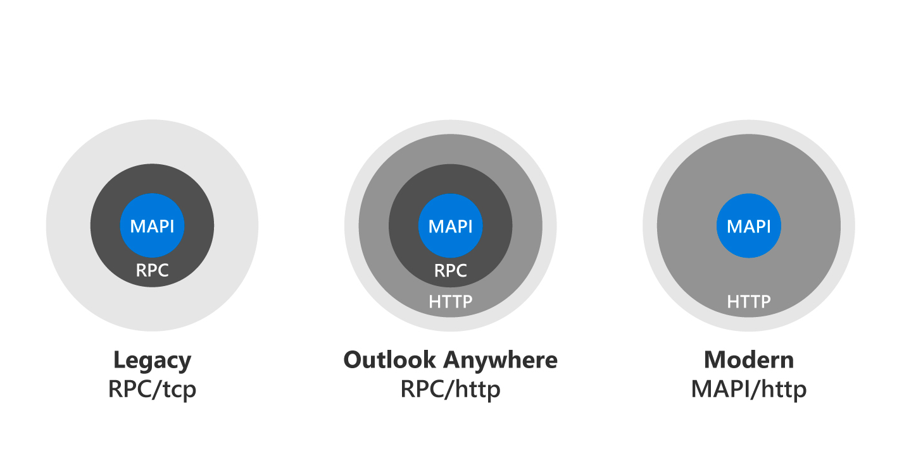
Configure Outlook clients
The connectivity protocols that Outlook uses to communicate with Exchange have changed over the past several years
Today, Outlook connects to Microsoft 365 by using Messaging Application Programming Interface (MAPI) over HTTP
MAPI over HTTP places the MAPI commands directly in HTTPS packets
Diagram showing the encapsulation of MAPI commands in RPC calls, MAPI commands in RPC calls in HTTP packages, and MAPI commands directly in HTTP packages. This is basically the progression from old to new protocols: from RPC/tcp to RPC/http to MAPI/http.
After Outlook connects to the Exchange server, the Exchange server determines whether the user’s mailbox is in an on-premises environment or in Microsoft 365

Slide 51
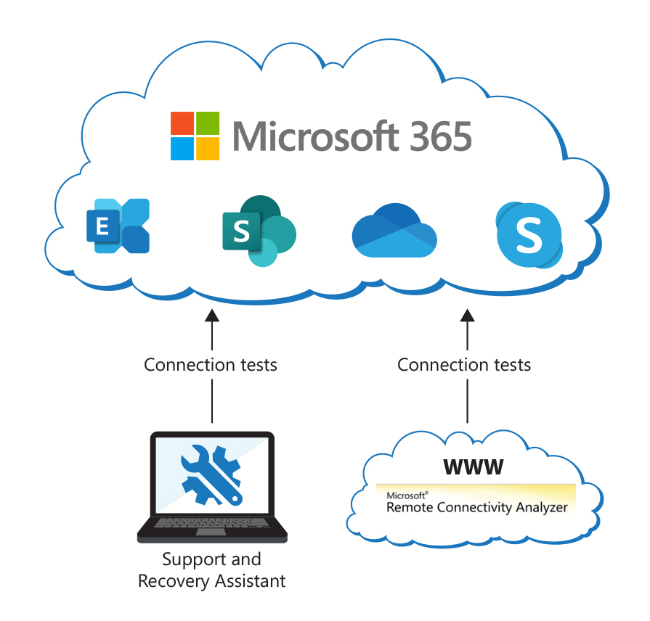
Troubleshoot client connectivity
Microsoft provides the following tools that you can use to analyze connectivity issues in Microsoft 365 deployments:
Microsoft Remote Connectivity Analyzer tool (RCA)
Microsoft 365 Support and Recovery Assistant tool (SaRA)
SaRA and the RCA perform similar tests, but from a different perspective. RCA connects from the Internet, while SaRA performs its tests from a client machine

Slide 52
Knowledge Check
Test your knowledge by answering the Knowledge Check questions at the end of this Learn module

Slide 53
Summary
This module examined the following items that must be considered when configuring client connectivity to Microsoft 365:
Understand how automatic client configuration works
Understand DNS records required for automatic client configuration
Configure Outlook clients
Troubleshooting client connectivity

Slide 54
Module 6: Learning Path Review

Slide 55
Discussion – Learning Path review
What are your key takeaways from this learning path, and why?
What are the key features discussed in this learning path that you foresee implementing at your organization?

Slide 56
Closing slide

