Slide 1
Learning Path 2: Manage your Microsoft 365 tenant

Slide 2
Learning Path agenda
Configure administrative roles in Microsoft 365
Lab 2-Exercise 1 – Manage administration delegation
Manage tenant health and services in Microsoft 365
Lab 2-Exercise 2 – Monitor and Troubleshoot Microsoft 365
Deploy Microsoft 365 Apps for enterprise
Lab 2-Exercise 3 – Install Microsoft 365 apps for enterprise
Analyze your Microsoft 365 workplace data using Microsoft Viva Insights
Learning Path Review
Notes:
Mention how this Learning Path also maps to the first certification exam study area, which is Microsoft 365 tenant administration.

Slide 3
Module 1: Configure administrative roles in Microsoft 365

Slide 4
Introduction
This module examines the following topics that provide the required prerequisite knowledge to effectively configure Microsoft 365 tenant roles:
Microsoft 365 permission model
Microsoft 365 admin roles and best practices
Assign admin roles to users in Microsoft 365
Delegate admin roles to partners
Manage permissions using administrative units in Azure AD
Elevate privileges

Slide 5
Explore the Microsoft 365 permission model
Microsoft 365 provides several predefined administrator roles that you can assign to users in your organization to ease administrative burdens
The permission model in Microsoft 365 on which administrator roles are based is referred to as Role-Based Access Control (RBAC )
Online services, such as Exchange Online and SharePoint Online, have their own permission models
There are other administrator roles available in the RBAC model (such as Global Administrator, Billing Administrator, and Password Administrator, among others)

Slide 6
Explore the Microsoft 365 admin roles
Security guidelines for assigning roles:
Only establish two to four global admins
Assign the least permissive role
Require multifactor authentication (MFA) for admins
Some commonly used Microsoft 365 admin center roles:
Billing administrator
Compliance administrator
Exchange administrator
Global administrator
Global reader
Groups administrator
Helpdesk administrator
License administrator
Message center reader
Office Apps administrator
Password administrator
Power Platform administrator

Slide 7
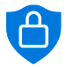
Assign admin roles to users in Microsoft 365
In Microsoft 365, administrator roles assign specific administrative functions to users
Each admin role maps to common business functions and gives permissions to do specific tasks in the Microsoft 365 admin center
The Microsoft 365 admin roles are not mutually exclusive – one or more admin roles can be assigned to a user
You can manage admin roles in Microsoft 365 using the Microsoft 365 admin center or Windows PowerShell
To assign admin roles in the Microsoft 365 admin center, you must be assigned the Global admin role
Global Administrator
Exchange Administrator
SharePoint Administrator
Security and Compliance Administrator
Teams Administrator
Individual service administrators can administer their services on the highest level
The Global admin role includes ALL the service admin roles, and not just the four shown in this example
Notes:
Mention how the diagram illustrates the relationship between the service admin roles and the Global admin role

Slide 8
Delegate admin roles to partners
If you don’t have in-house administrators, you can delegate your administration to a Microsoft partner
When you delegate administration to a partner, they receive the ability to specify administration roles for your organization when they create users on your behalf
Delegated administrators are restricted to the following two roles:
Full administration – same privileges as the Global admin role
Limited administration – same privileges as the Password admin role

Slide 9
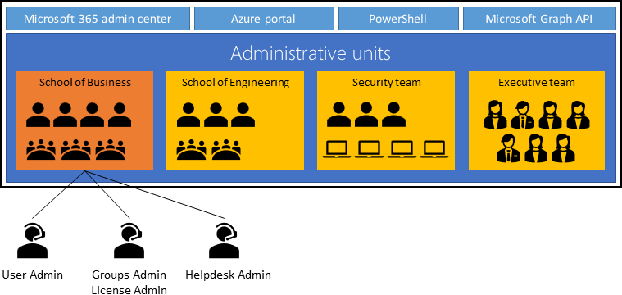
Manage permissions using administrative units in Azure Active Directory
An administrative unit is an Azure AD resource that can be a container for other Azure AD resources
An administrative unit can contain only users, groups, or devices
Administrative units restrict permissions in a role to any portion of your organization that you define
Administrative units, groups, and devices can be managed in:
Microsoft Entra admin center
PowerShell
Microsoft Graph API
Users can also be managed in those three resources, plus the Microsoft 365 admin center
It can be useful to restrict administrative scope by using administrative units in organizations that are made up of independent divisions
In this diagram, a university is made up of many autonomous schools. Each school has a team of IT admins who control access, manage users, and set policies for their school

Slide 10
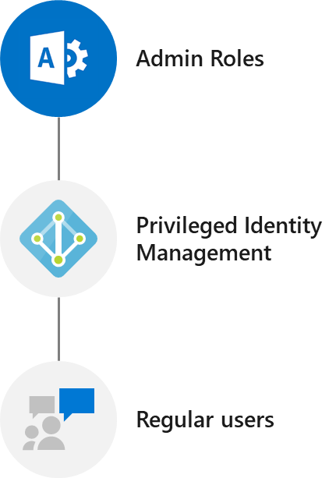
Elevate privileges using Azure AD Privileged Identity Management
Azure AD Privileged Identity Management enables you to manage, control, and monitor access within your organization
Azure AD Privileged Identity Management helps your organization:
See which users are assigned privileged roles to manage Azure resources, as well as which users are assigned administrative roles in Azure AD
Enable on-demand, “just in time” administrative access to Microsoft Online Services
See a history of administrator activation, including changes made
Get alerts about changes in administrator assignments
Require approval to activate Azure AD privileged admin roles
Review membership of administrative roles
Regular users can use PIM to elevate privileges and access the admin centers

Slide 11
Examine best practices when configuring administrative roles
Manage to least privilege - Grant your administrators exactly the permission they need to do their job. By limiting roles and scopes, you limit the resources at risk
Use Privileged Identity Management to grant just-in-time access – PIM only grants access for a specific time period. It removes access when the timeframe expires
Turn on MFA for all administrator accounts – Users have a 99.9% less likely chance of becoming compromised if they use MFA
Configure recurring access reviews to revoke unneeded permissions over time – Organizations should regularly audit their administrators to ensure only the right people have continued access
Limit the number of Global Administrators to less than five – Given the breadth of the Global Admin’s permissions, organizations should keep the attack surface low
Use groups for Azure AD role assignments and delegate the role assignment – Consider assigning roles to Azure AD groups instead of individual users
Use cloud native accounts for Azure AD roles – Avoid using on-premises synced accounts for Azure AD role assignments; compromised on-premises accounts can compromise Azure AD resources

Slide 12

Knowledge Check
Test your knowledge by answering the Knowledge Check questions at the end of this Learn module

Slide 13

Discussion – Implementation scenario
You have been hired as the Microsoft 365 Administrator at a marketing company that works with several enterprise-class organizations:
After reviewing the company’s current identity landscape, you noticed that there’s only one user who controls all functional security parameters for the business
You also discovered that users are never required to change their passwords
As the Microsoft 365 Administrator, what should you do to protect the company and create redundancy?
15 minutes…Go!
Notes:
Possible solution:
Set up a security group to break up administrative actions among more than one user. Also set up an additional Microsoft 365 Global administrator account to be used for emergency operations, and then change the “Password change” policy to every 60 days.

Slide 14
Summary
This module examined the following items that must be considered when configuring administrative roles in Microsoft 365:
Microsoft 365 permission model
Microsoft 365 admin roles and best practices
Assign admin roles to users in Microsoft 365
Delegate admin roles to partners
Manage permissions using administrative units in Azure AD
Elevate privileges using Azure AD privileged identity management

Slide 15
Lab 2 – Manage your Microsoft 365 tenant

Slide 16
Lab exercises
Exercise 1: Manage administration delegation
Task 1
Assign Delegated Administrators in the Microsoft 365 admin center
Task 2
Manage Delegated Administrators with Windows PowerShell
Task 3
Verify Delegated Administration

Slide 17
Module 2: Manage tenant health and services in Microsoft 365

Slide 18
Introduction
This module examines how to monitor your Microsoft 365 tenant health and services and respond to incidents accordingly
You’ll examine how to:
Monitor the health of your Microsoft 365 services
Monitor tenant health using: - Microsoft 365 Adoption Score - Microsoft 365 usage analytics
Develop an incident response plan
Request assistance from Microsoft

Slide 19
Monitor the health of your Microsoft 365 services
You can access the Service Health page in the Microsoft 365 admin center
The health of each online service displays one of the following statuses:
Investigating
Service degradation
Service interruption
Restoring service
Extended recovery
Investigation suspended
Service restored
False positive
Post-incident report published
The Microsoft 365 Health dashboard displays:
Critical alerts – any issues requiring attention
Service health and usage - current service health status of Microsoft 365 apps and services owned by the organization
Recommended actions - suggestions on what you can do to improve your organization’s health in the following areas:
Activate MFA
Enable monthly updates for Office
Share OneDrive training

Slide 20
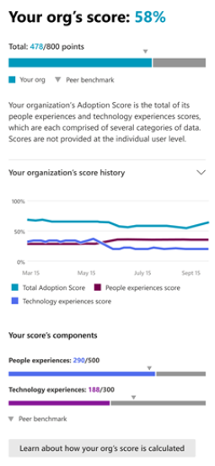
Monitor tenant health using Microsoft 365 Adoption Score
Adoption Score provides insights about how an organization uses Microsoft 365 and the technology experiences that support it
Microsoft Adoption Score provides metrics, insights, and recommendations in two areas:
People experiences – Quantifies how the organization works using the following Microsoft 365 categories: Content collaboration, Mobility, Communication, Meetings, and Teamwork
Technology experiences – Quantifies how the organization uses the following technology categories: Endpoint analytics, Microsoft 365 Apps health, and Network connectivity
An organization's Adoption Score is based on the combined scores of its People and Technology experiences categories:
There are 8 categories, each worth 100 points; therefore, the highest possible Adoption Score is 800
Assuming you earned 478 points (as shown in the screenshot), your adoption score is 478 out of 800 possible points, which equals 58% The score categories provide 28-day and 180-day views of the key activities
They also include metrics that identify underlying usage statistics and configurations

Slide 21
Monitor tenant health using Microsoft 365 usage analytics
Along with the Microsoft 365 Adoption Score, organizations can also monitor their tenant health by using Microsoft 365 usage analytics
Usage analytics enables organizations to:
Visualize and analyze Microsoft 365 usage data
Create custom reports
Share insights throughout the company
Gain insights into how specific regions or departments are using Microsoft 365
Microsoft 365 usage analytics data is available in the Activity reports in the Microsoft 365 admin center
It's also optionally available in the Microsoft Power BI template app (you must purchase a Power BI Pro license for this feature)
Data is available in the Microsoft 365 Activity reports for the last 7/30/90/180 days
Data is available in the Microsoft Power BI template on a monthly basis for up to 12 months

Slide 22

Develop an incident response plan
You should perform the following steps to develop an incident response plan:
Validate the incident and confirm that your environment is affected
Determine whether the incident is relevant to your company
Review for timeline checks once relevancy and degradation have been established
Develop a backup solution in case the service is degraded for longer than an acceptable timeframe
US
EU
Azure AD
Intune
Exchange Online
SharePoint Online
Teams
Yammer
Azure AD
Intune
Exchange Online
SharePoint Online
Teams
Yammer








!



Single services can be degraded dependent on the tenant location (for example, see the warning symbol for Exchange Online in the EU)

Slide 23
Request assistance from Microsoft
Microsoft Support provides global technical, pre-sales, billing, and subscription support with every Microsoft 365 subscription
Support is available online through the Microsoft 365 portal and by telephone for both paid and trial subscriptions
Technical support for Microsoft 365 subscriptions aids with basic installation, setup, and general technical usage
Microsoft assigns a severity level to a case when it’s opened. It’s based on an assessment of the issue type and customer impact. For example:
Sev A (Critical)
Sev B (High)
Sev C (Non-critical)

Slide 24
Knowledge Check
Test your knowledge by answering the Knowledge Check questions at the end of this Learn module

Slide 25
Summary
This module examined the following items that must be considered when managing tenant health and services in Microsoft 365:
How to monitor your tenant health and services using Microsoft 365 tools, including the Microsoft 365 Adoption Score and Microsoft 365 usage analytics
Develop an incident response plan
Request assistance from Microsoft related to basic installation, setup, and general technical usage

Slide 26
Lab 2 – Manage your Microsoft 365 tenant (continued)

Slide 27
Lab exercises (continued)
Exercise 2: Monitor and troubleshoot Microsoft 365
Task 1
Troubleshoot Mail Flow in Microsoft 365
Task 2
Monitor service health and analyze reports
Task 3
Submit a Help request to Microsoft Support

Slide 28
Module 3: Deploy Microsoft 365 Apps for enterprise

Slide 29
Introduction
Microsoft 365 Apps for enterprise (formerly Office 365 ProPlus) is intended to provide users with the most up-to-date tools to allow them to maximize their productivity
This module examines the following items that must be considered when managing Microsoft 365 Apps for enterprise deployments:
Validate app readiness using the Readiness Toolkit
Microsoft 365 Apps for enterprise deployment options
Manage cloud apps and app updates using the Microsoft 365 Apps admin center
Control how often their users get new features by specifying the update channel

Slide 30
Explore Microsoft 365 Apps for enterprise functionality
Microsoft 365 Apps for enterprise is a downloadable version of the Microsoft productivity suite. It includes:
Microsoft Word, Excel, PowerPoint, Outlook, Teams, Publisher, Access, OneDrive
Microsoft 365 Apps for enterprise is included in several Microsoft 365 subscriptions
The license assigned to a user determines what is available for download and use
Some Microsoft 365 plans can add subscriptions of Microsoft Visio and Microsoft Project
Microsoft 365 Apps for enterprise uses streaming deployment by using Click-to-Run technology

Slide 31
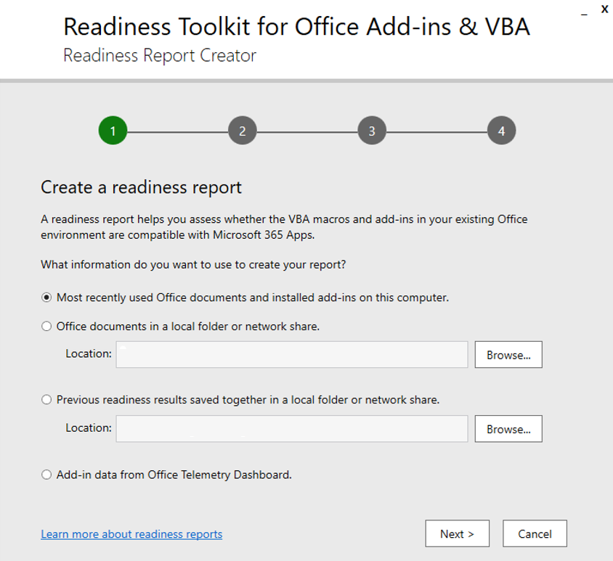
Explore your app compatibility by using the Readiness Toolkit
Most of today’s businesses have some version of Microsoft Office already implemented
Warning: Many companies have added Microsoft Visual Basic for Applications (VBA) macros and add-ins that can create problems when deploying Microsoft 365 Apps for enterprise
The Readiness Toolkit can help organizations identify compatibility issues with the VBA macros and add-ins they use with Office
The Readiness Toolkit includes a tool called the Readiness Report Creator
It’s an Excel spreadsheet that displays all the VBA macros and add-ins it scanned
It includes workbook tabs that display various readiness assessments of VBA macro compatibility

Slide 32
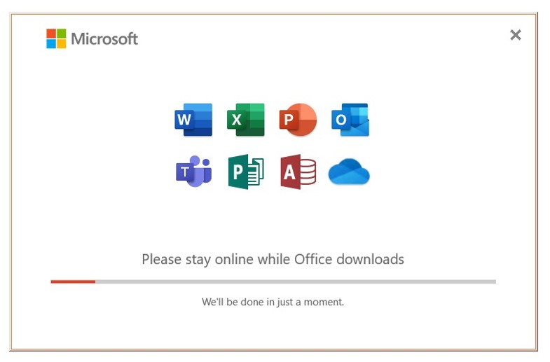
Complete a self-service installation of Microsoft 365 Apps for enterprise
Users can run self-service installations by signing into the Microsoft 365 portal and selecting the software installation option
In a user-driven deployment:
Office always streams from the Internet to the computer by using Click-to-Run technology; local source locations aren't supported
Users must have a Microsoft 365 account and be provisioned for Microsoft 365 Apps for enterprise
Users must have administrative rights to the local computer
Microsoft 365 Apps for enterprise installs Microsoft 365 updates automatically in the background from the Internet. You can't change this behavior
Obstacles to a successful self-service installation: Lack of IT expertise Bandwidth limitations Incorrect licenses Users without local admin rights

Slide 33
Deploy Microsoft 365 Apps for enterprise with Microsoft Configuration Manager
Microsoft Endpoint Manager is an integrated solution for managing all your devices
Starting in version 1910, Configuration Manager is now part of Microsoft Endpoint Manager
Configuration Manager scales for large environments and provides extensive control over installation, updates, and settings
It also has built-in features to make it easier and more efficient to deploy and manage Office
Steps on how to deploy Microsoft 365 Apps for enterprise with Microsoft Configuration Manager:
Review and update your Configuration Manager infrastructure
Review your collections
Create and deploy the Office application to the pilot group
Create and deploy the Office application to the broad group
Review exit criteria

Slide 34
Deploy Microsoft 365 Apps for enterprise from the cloud
Microsoft 365 Apps for enterprise can be deployed to client computers from the Office Content Delivery Network (CDN) by using the Office Deployment Tool (ODT)
The CDN optimizes performance for users by:
Distributing frequently accessed objects like images and JavaScript files over a high-speed global network
Reducing page load time
Providing access to hosted objects as close as possible to the user
The ODT performs the following tasks:
Download Office source files
Install or remove Click-to-Run or customize installations
Apply software update policies
Steps to deploy Microsoft 365 Apps for enterprise from the Office CDN in the cloud:
Download the Office Deployment Tool
Create a configuration file for the pilot group
Create a configuration file for the broad group
Deploy Office to the pilot group
Deploy Office to the broad group

Slide 35
Deploy Microsoft 365 Apps for enterprise from a local source
When an organization deploys Microsoft 365 Apps for enterprise from a local source, it must first download the software to a shared folder on its local network
The organization then uses the Office Deployment Tool (ODT) to deploy the applications from the shared folder
Steps required to deploy Microsoft 365 Apps for enterprise from a local source are:
Create shared folders for Office installation files
Download the Office Deployment Tool
Create a configuration file for the pilot group
Create a configuration file for the broad group
Download the Office installation package for the pilot group
Download the Office installation package for the broad group
Deploy Office to the pilot group
Deploy Office to the broad group
Note: Steps 1, 5 and 6 are NOT performed when deploying from the cloud
Notes:
When an organization deploys Microsoft 365 Apps for enterprise from a local source, it must first download the software to a shared folder on its local network. The organization then uses the Office Deployment Tool (ODT) to deploy the applications from the shared folder.
The ODT is used to deploy Microsoft 365 Apps for enterprise from both the cloud and from a local source. The prior unit introduced you to the Office Deployment Tool. It also examined how to use the ODT to deploy Microsoft 365 Apps for enterprise from the cloud (the Office Content Delivery Network). Since you should now have a basic understanding of the ODT, this unit focuses on the steps used to deploy Microsoft 365 Apps for enterprise from a local source.

Slide 36
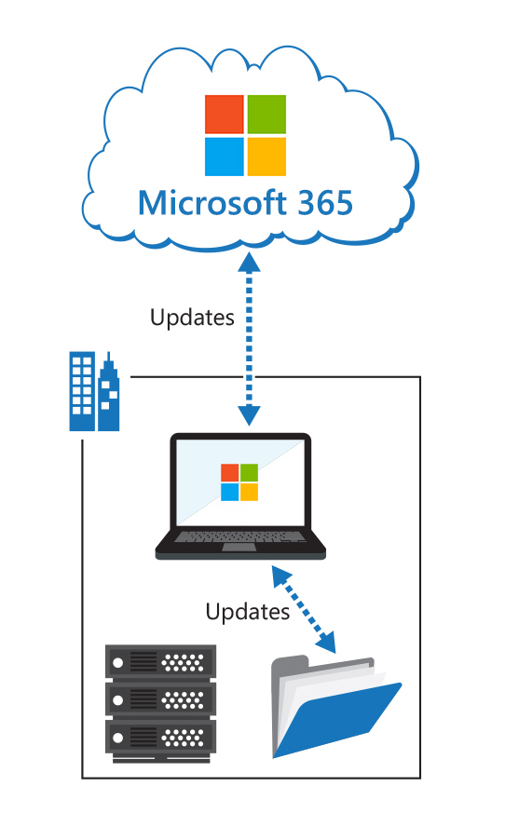
Manage updates to Microsoft 365 Apps for enterprise
Click-to-Run uses an optimized software-update model that provides unobtrusive background updates
Updating options include:
Automatic from cloud
Automatic from network
Rerun setup.exe by using Electronic Software Delivery (ESD)
Office clients can be on an outdated build for only 12 months
Administrators can configure update behavior by using the Office Deployment Tool configuration.xml
Microsoft 365 Apps for enterprise clients can be updated through GPO, or from a file share, or directly from Microsoft 365

Slide 37
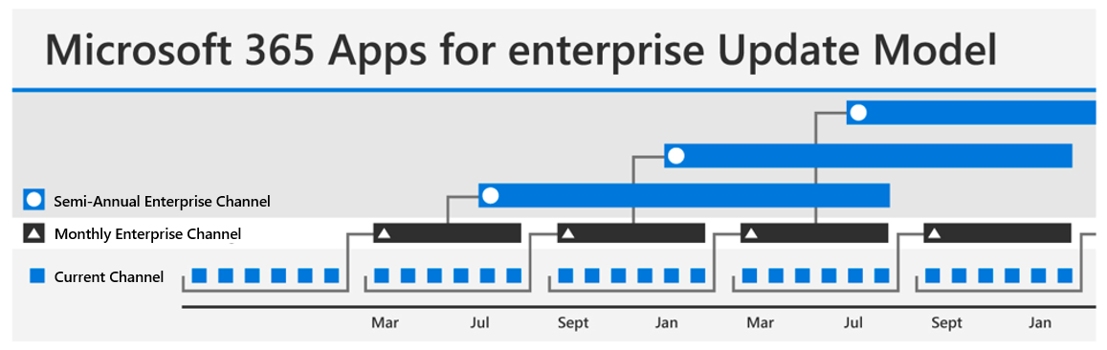
Explore the update channels for Microsoft 365 Apps for enterprise
Microsoft 365 Apps for enterprise applications are automatically updated when newer versions become available
There are three primary update branches:
Current Channel
Monthly Enterprise Channel
Semi-Annual Enterprise Channel
You can use three methods for applying update branches to users:
Using the Microsoft 365 admin center
Using the Office Deployment Tool Using Group Policy

Slide 38
Manage your cloud apps using the Microsoft 365 Apps admin center
The Microsoft 365 Apps admin center provides insights into various features that support app management. These features are:
Office cloud policy service - enables organizations to enforce policy settings for Microsoft 365 Apps for enterprise on a user's device
Office Customization Tool - creates the configuration files that are used to deploy Office in large organizations and that provide more control over an Office installation
Microsoft 365 Apps health - monitors reliability and performance metrics and provides custom guidance to help optimize and troubleshoot Microsoft 365 Apps on your client devices
Office Inventory - displays information about the state of Office installations on devices in your organization
Service update status – displays which devices have installed the latest security updates for Office
Servicing profile – automatically delivers monthly Office updates for specific users or groups

Slide 39
Discussion – Deploying Microsoft 365 Apps for enterprise
Microsoft 365 Apps for enterprise can be deployed using:
- Self-service installation
- Microsoft Configuration Manager
- From the cloud
- From a local source
Do you plan to deploy Microsoft 365 Apps for enterprise in your organization, and if so, how?
15 minutes…Go!

Slide 40
Knowledge Check
Test your knowledge by answering the Knowledge Check questions at the end of this Learn module

Slide 41
Discussion – Implementation scenario
You work for Fabrikam, Inc., who has just acquired a small competitor:
The newly acquired company uses a legacy operating systems (Windows 7 Home edition) and has been using a volume license for Office 2010
It also uses workgroups to manage its work environment
Fabrikam employs Microsoft 365, which it uses to manage all corporate-owned devices, as well as all personal devices that are used for company-related work
Given this information, what strategy would you recommend to update the newly acquired company to meet Fabrikam’s standards?
15 minutes…Go!
Notes:
Suggested actions - Set up Microsoft 365 to manage all devices with the use of Intune, then push an image to the synced devices that update them to Windows 10. From there, you can update Office 2010 on the legacy devices to Microsoft Apps for Enterprise through a group policy update.

Slide 42
Summary
This module examined the following items that must be considered when managing user-driven Microsoft 365 Apps for enterprise deployments:
Microsoft 365 Apps for enterprise (formerly Office 365 ProPlus) is intended to provide users with the most up-to-date tools to allow them to maximize their productivity
The Readiness Toolkit can help organizations identify compatibility issues with the VBA macros and add-ins they use with Office
Microsoft 365 Apps for enterprise deployment options, including:
Self-service installation
Using Microsoft Configuration Manager
Deployment from the cloud
Deployment from a local source
Companies can control how often their users get new features by specifying the update channel

Slide 43
Lab 2 – Manage your Microsoft 365 tenant (continued)

Slide 44
Lab Exercises
Exercise 3: Install Microsoft 365 Apps for enterprise
Task 1
Verify how licensing affects installing Microsoft 365 Apps for enterprise
Task 2
Verify how the global Office download setting affects installing Microsoft 365 Apps for enterprise
Task 3
Perform a User-Driven Installation of Microsoft 365 Apps for enterprise

Slide 45
Module 4: Analyze your Microsoft 365 workplace data using Microsoft Viva Insights

Slide 46
Introduction
Microsoft Viva Insights taps into Microsoft 365 email and calendar metadata, including to/from data, subject lines, and timestamps. Its goal is to show how an organization collaborates and spends time.
This module examines how Microsoft Viva Insights provides advanced analytics tools. In this module, you’ll learn about:
The analytical features of Microsoft Viva Insights
Creating custom analysis with Microsoft Viva Insights
Configuring Microsoft Viva Insights
The Microsoft 365 data sources used in Microsoft Viva Insights
Preparing organizational data in Microsoft Viva Insights

Slide 47
Examine the analytical features of Microsoft Viva Insights
Users can analyze and explore Microsoft 365 data in multiple ways using Microsoft Viva Insights:
The Home page displays high-level insights about your organizational data
The Analyze page enables more in-depth analysis with the Query designer, Business process analysis, and Peer analysis features
The Plans page works with personal insights, where available
Data sources
Microsoft Viva Insights processes collaboration data from Microsoft 365
It then maps descriptive employee attributes, usually from the organization’s HR system with the collaboration data
Organizational metrics
After the data sources are processed, employee data is de-identified and filtered
This process creates a large library of behavioral base metrics related to workplace behaviors, time use, and networks
Analysis outputs
The Home page displays insights about the most popular business outcomes based on specific organizational data
Leadership can use these insights to quickly identify work patterns requiring further investigation
Examples of themed business outcomes include:
Protect employee wellbeing
Peer analysis
Query designer

Slide 48
Create custom analysis with Microsoft Viva Insights
Organizations can use Viva Insights to create custom analytical queries. The main features that support custom analysis are:
Query designer
Peer analysis
Plans
Data sources
Exclusions

Slide 49
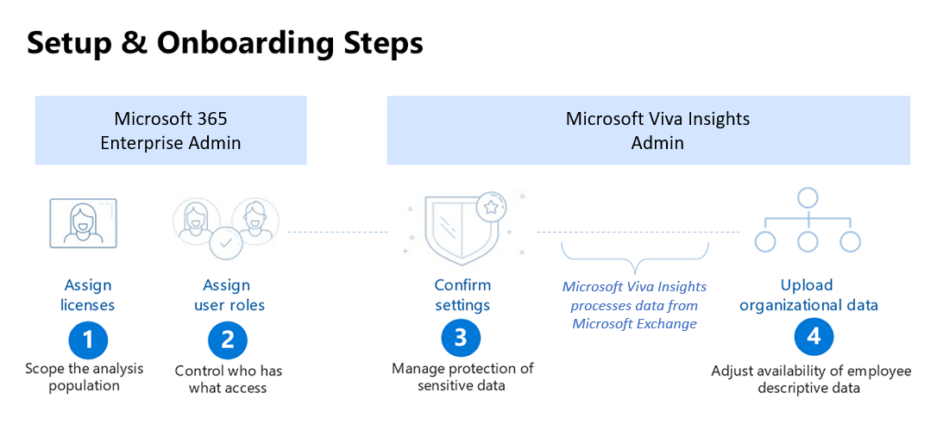
Configure Microsoft Viva Insights
Primary steps of setting up workplace analytics in Microsoft Viva Insights is a straightforward process:
Your Microsoft 365 or Azure Active Directory admin assigns the licenses and roles
The designated Viva Insights admin sets up the system defaults and privacy settings
The Viva Insights admin then prepares and uploads the organizational data
Microsoft Viva Insights validates the upload and then processes the data

Slide 50
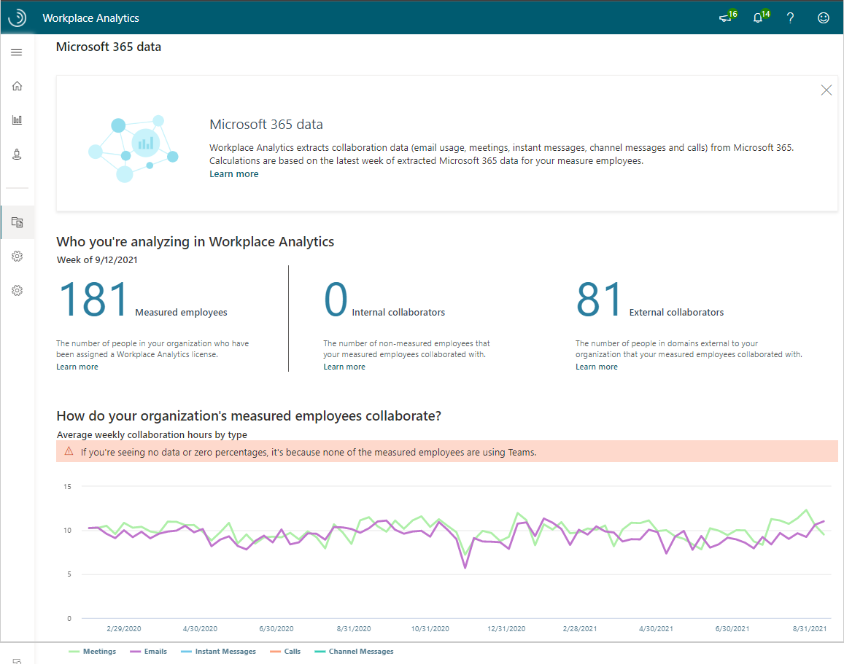
Examine Microsoft 365 data sources used in Microsoft Viva Insights
Analysts can use the Microsoft 365 data page to look for data ranges that have:
Unexpected gaps in activity
Inconsistent or degraded data
Activity levels that are higher or lower than what might be considered normal for their organization
Users can view the following Microsoft 365 data:
Measured employees
Internal collaborators
External collaborators
Average weekly collaboration chart

Slide 51
Prepare organizational data in Microsoft Viva Insights
Organizational data supports Viva Insights analysis in many ways, including:
Group and filter collaboration results by employee attributes of interest
Create custom collaboration metrics
Understand time allocation across groups of employees
Compare collaboration data to business outcomes
Some representative organizational data categories include:
Background - employee type, full-time or part-time status, and tenure
Location – country/region, city, and building
Organization - business unit, cost center, division, and department
Role - function, job family, level, and grade
Outcomes - engagement score, performance rating, and sales-quota attainment
Organizational (HR) data is uploaded into Viva Insights as a .csv file
The initial organizational file should include one snapshot for each of the past 13 months to map to the initial historical collaboration data load
It should include descriptive organizational data for all employees in the company, even if they're not part of the analysis population
This design will help enrich the custom collaboration metrics

Slide 52
Knowledge Check
Test your knowledge by answering the Knowledge Check questions at the end of this Learn module

Slide 53
Summary
This module explored how organizations use Viva Insights to:
Examine the analytical features of Microsoft Viva Insights
Create custom analysis with Microsoft Viva Insights
Configure Microsoft Viva Insights
Examine the Microsoft 365 data sources used in Microsoft Viva Insights
Prepare organizational data in Microsoft Viva Insights

Slide 54
Module 5: Learning Path review

Slide 55
Discussion – Learning Path review
What are your key takeaways from this learning path, and why?
What are the key features discussed in this learning path that you foresee implementing at your organization?

Slide 56
Closing slide

