Slide 1
Learning Path 3: Implement Identity Synchronization

Slide 2
Learning Path agenda
Explore identity synchronization
Prepare for identity synchronization to Microsoft 365
Implement directory synchronization tools
Lab 3-Exercise 1 – Prepare for identity synchronization
Manage synchronized identities
Lab 3-Exercises 2 – Implement identity synchronization
Manage secure user access in Microsoft 365
Lab 3-Exercise 3 – Manage secure user access
Learning Path Review
Notes:
Mention how this Learning Path maps to the second certification exam study area, which is managing identity and access.

Slide 3
Module 1: Explore identity synchronization

Slide 4
Introduction
If you have an existing on-premises directory, such as Active Directory, you can integrate it with Azure Active Directory by synchronizing your identities from the on-premises directory to Microsoft 365 using a directory synchronization tool such as Azure AD Connect or Azure AD Connect Cloud Sync
This module examines the following features that drive identity synchronization in Microsoft 365:
Microsoft 365 identity models
Microsoft 365 authentication options
Directory synchronization

Slide 5
Examine identity models for Microsoft 365
Microsoft 365 uses Azure Active Directory (Azure AD) to manage identities and authentication
Azure AD is a cloud-based user identity and authentication service included with your Microsoft 365 subscription
Microsoft 365 includes two identity models:
Cloud-only identity. User accounts only exists in the organization’s Azure AD tenant
Hybrid identity. User accounts exist in an organization’s on-premises Active Directory Domain Services (AD DS). A copy is also maintained in the organization’s Azure AD tenant
With the hybrid identity model, you can select from two directory synchronization tools to keep the on-premises and cloud identities in sync:
Azure AD Connect. An on-premises solution, it checks for changes in on-premises AD and synchronizes them to Azure AD. It includes password hash synchronization, device registration, and Active Directory Federation Services (AD FS) integration. Organizations are responsible for maintaining this directory synchronization solution
Azure AD Connect Cloud-sync. A cloud-based solution that synchronizes user, group, and mail contact objects from on-premises AD to Azure AD. Microsoft is responsible for maintaining this directory synchronization solution

Slide 6
Examine authentication options for the hybrid identity model
Organizations can choose from the following authentication types when using the hybrid identity model:
Managed authentication. Azure AD handles the authentication process. There are two types of managed authentication:
Password hash synchronization (PHS). With PHS, Azure AD performs the authentication itself. PHS enables users to use the same username and password that they use on-premises
Pass-through authentication (PTA). With PTA, Azure AD has AD DS perform the authentication. This option is similar to password hash sync but provides a simple password validation using on-premises software agents for organizations with strong security and compliance policies
Federated authentication. Azure AD redirects the client computer requesting authentication to another identity provider
Each authentication method is examined in the following slides

Slide 7
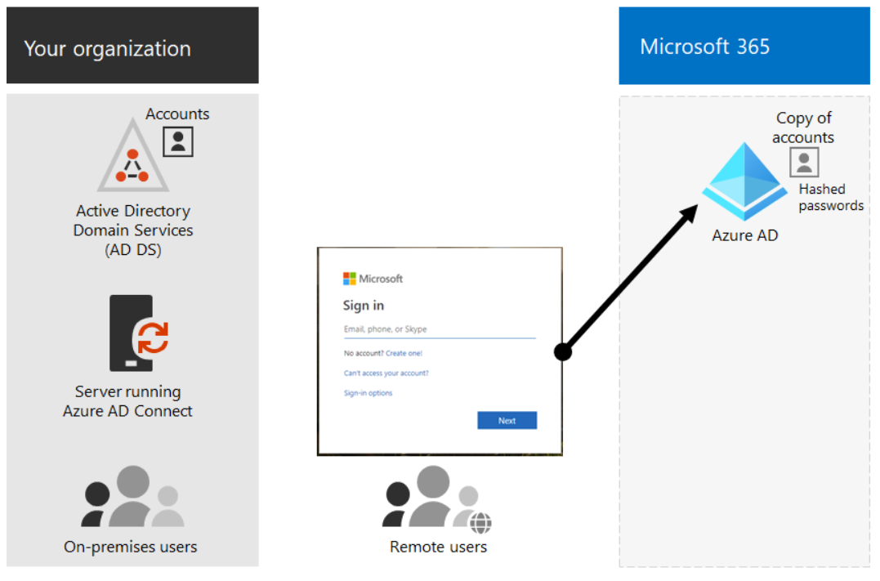
Examine authentication options for the hybrid identity model (continued)
Password hash synchronization (PHS):
Organizations synchronize their AD DS user accounts with Microsoft 365, and they manage their users on-premises Organizations don't have to deploy any extra infrastructure besides Azure AD Connect or Azure AD Connect Cloud Sync
PHS uses a secure, one-way hash synchronization process to protect the user's password
The password hash is encrypted during transmission and stored securely in Azure AD, which uses the hash for authentication purposes.
PHS never sends or stores the actual password in Azure AD, which helps protect against password-related attacks

Slide 8
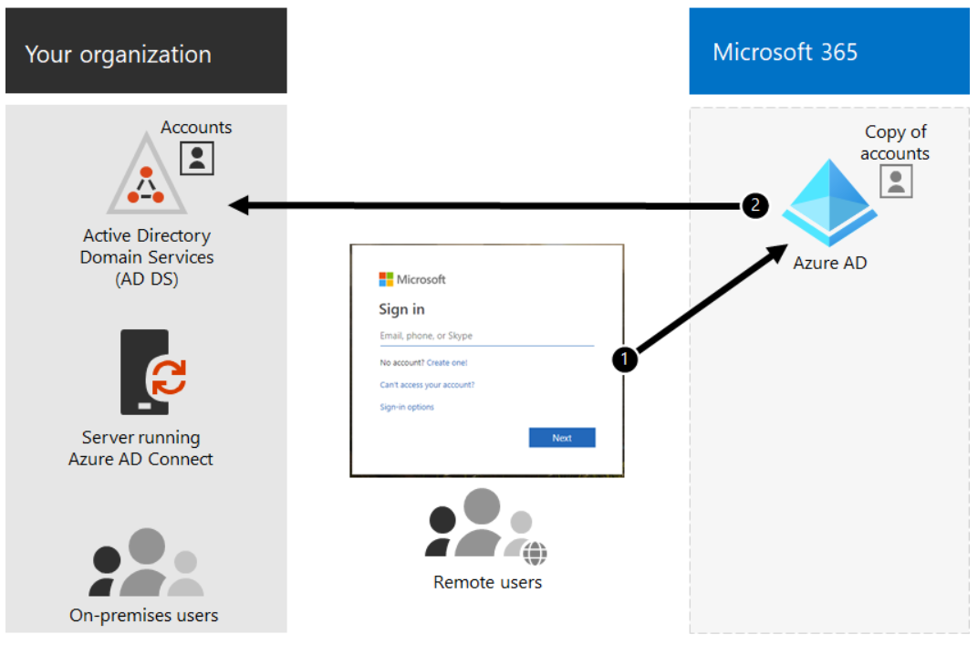
Examine authentication options for the hybrid identity model (continued)
Pass-through authentication (PTA):
PTA authenticates users by validating their on-premises Active Directory credentials against one or more lightweight software agents (Microsoft recommends three) running on one or more on-premises servers
With PTA, you synchronize AD DS user accounts with Microsoft 365, and you manage your users on-premises
When an organization enables PTA, users are redirected to the PTA agent to authenticate their credentials.
The agent validates the user's credentials against the on-premises Active Directory and returns the authentication results to Microsoft 365
PTA allows an organization’s users to sign into both on-premises and Microsoft 365 resources and applications using their on-premises account and password

Slide 9
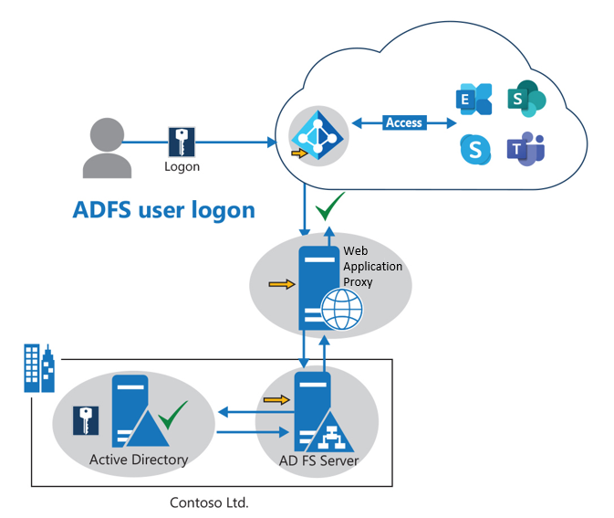
Examine authentication options for the hybrid identity model (continued)
Federated authentication
Azure AD hands off the authentication process to a separate trusted authentication system, such as Active Directory Federation Services (AD FS) or a third-party identity provider, to validate the user's sign-in
Federated authentication is primarily for large enterprise organizations with more complex authentication requirements
It synchronizes AD DS identities with Microsoft 365. It also requires that organizations manage their user accounts on-premises
With federated authentication, a user has the same password on-premises and in the cloud. As such, they don't have to sign in again to use Microsoft 365
Organizations can use their on-premises AD FS infra-structure or a third-party identity provider to authenticate their users for Microsoft 365 services
AD FS provides single sign-on, which hands over authentication control to the on-premises directory service. As a result, users authenticate against AD FS instead of Azure AD

Slide 10
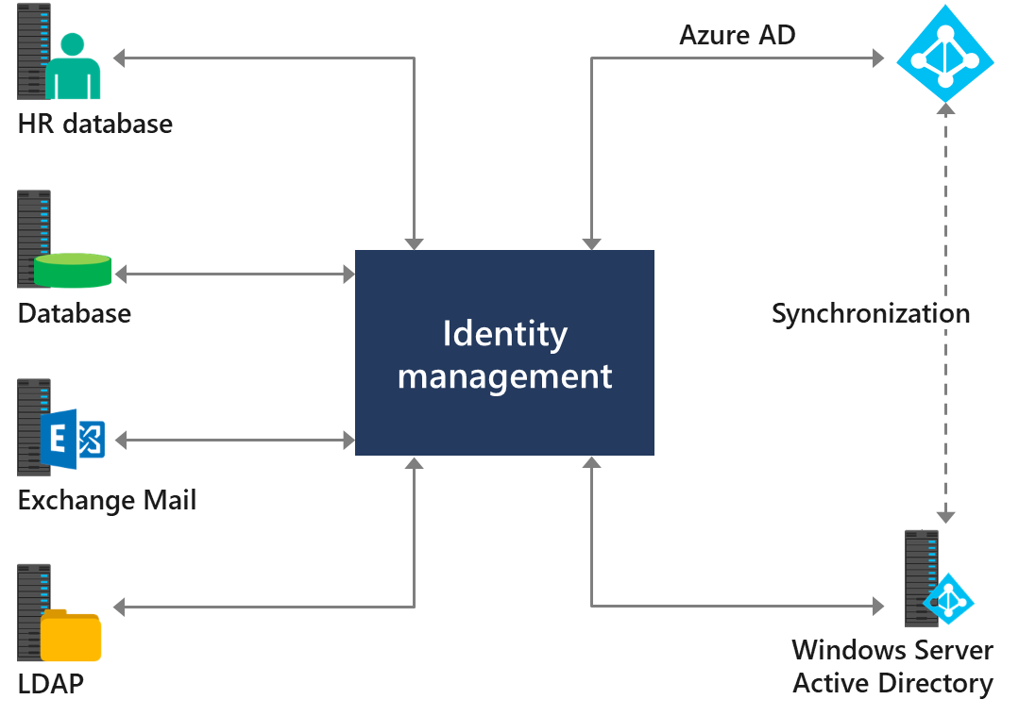
Explore directory synchronization
Directory synchronization is the synchronization of directory identities or objects between two different directories
With directory synchronization, organizations can take advantage of:
Hybrid identity
Single sign-on
Multifactor authentication
Conditional access
Common identity

Slide 11

Knowledge Check
Test your knowledge by answering the Knowledge Check questions at the end of this Learn module

Slide 12
Summary
This module examined the following items related to identity synchronization:
Microsoft 365 identity models
Microsoft 365 authentication options for the hybrid identity model
Directory synchronization

Slide 13
Module 2: Prepare for identity synchronization to Microsoft 365

Slide 14
Introduction
To plan your directory synchronization with Microsoft 365, you must understand the source directory, such as Active Directory, as well as other connected directories
This module examines the following items:
Directory synchronization
Azure AD Connect
Azure AD Connect Cloud Sync

Slide 15
Plan your Azure Active Directory deployment
For organizations that plan to synchronize identities between their on-premises directory service and Microsoft 365, they must first ensure their Azure Active Directory (Azure AD) deployment is properly configured
Primary phases in deploying Azure AD:
Phase 1: Build a foundation of security
Phase 2: Import users, enable synchronization, and manage devices
Phase 3: Manage applications
Phase 4: Audit privileged identities, complete an access review, and manage user lifecycle
Notes:
For organizations that plan to synchronize identities between their on-premises directory service and Microsoft 365, they must first ensure their Azure Active Directory (Azure AD) deployment is properly configured. A well-planned and executed identity infrastructure paves the way for secure access to your productivity workloads and data by known users and devices only.

Slide 16
Prepare for directory synchronization
Before synchronizing your on-premises Active Directory objects to Azure AD, you must prepare your environment by analyzing the following:
Active Directory preparation
Identify the source of authority
Clean-up the on-premises Active Directory
UPN suffixes
On-premises user objects in AD must have a UPN suffix configured
The UPN suffix must be correct for both the Active Directory domain and Microsoft 365
The primary SMTP email address of each user should be used as their UPN
Microsoft 365 IdFix tool results
The IdFix DirSync Error Remediation tool identifies and fixes most of the object synchronization errors in on-premises Active Directory forests

Slide 17
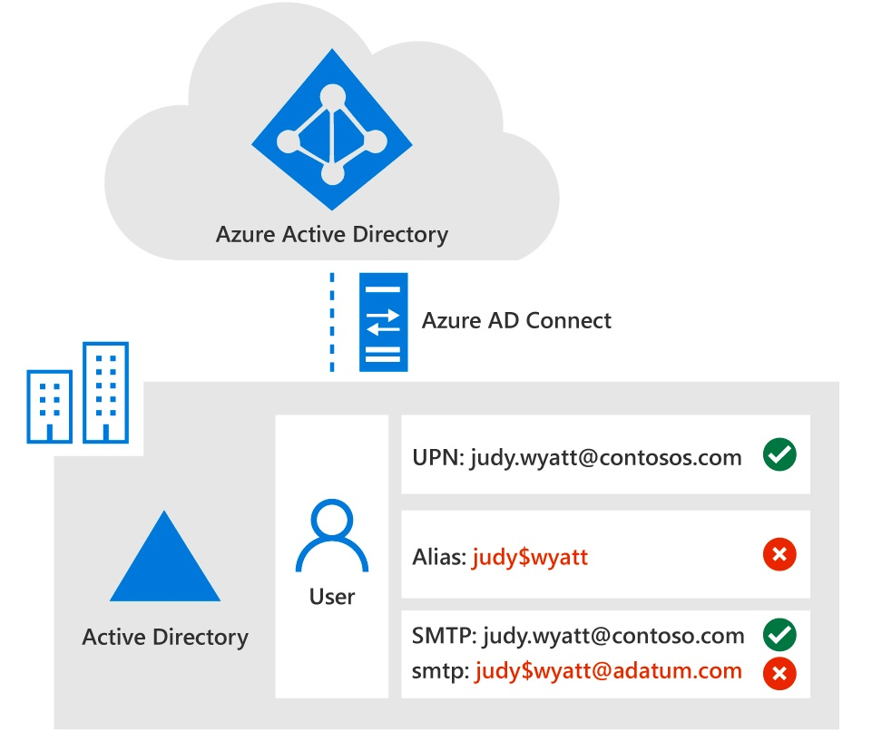
Choose your directory synchronization tool
There are two options to choose from to implement user account synchronization between on-premises AD and Azure AD:
Azure AD Connect sync
The provisioning configuration is stored and runs on the on-premises sync server
It’s based on older technology with a large on-premises footprint
Azure AD Connect Cloud Sync
The provisioning configuration is stored, configured, and runs in the cloud as part of the Azure AD provisioning service
It uses a lightweight agent design that requires a minimal on-premises footprint
It doesn’t support Exchange hybrid deployments
Synchronization using Azure AD Connect

Slide 18
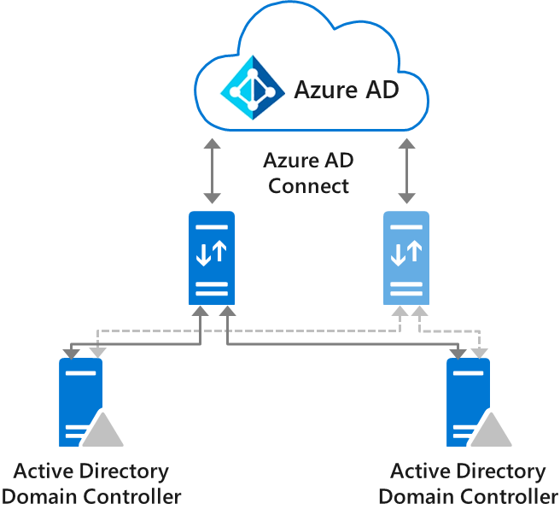
Plan for directory synchronization using Azure AD Connect
To start your planning, you should collect answers to the following questions:
On what server do you want to install Azure AD Connect?
Do you require an Azure AD Connect failover scenario?
Do you want to synchronize one or more on-premises Active Directories (or multiple forests)?
Do you want to synchronize all or just part of your Active Directory?
Do you want to synchronize all object attributes, or use specific filters?
Do you want to use advanced configuration features?
When planning for Azure AD Connect, you should plan for the following features during your preparation:
Azure AD Connect Server
Azure AD Connect Staging Server
Active Directory Federation Services for Azure AD Connect
The source anchor attribute
An Azure AD Connect Staging Server is an inactive server that takes over synchronization when the primary server fails

Slide 19
Plan for directory synchronization using Azure AD Connect Cloud Sync
Various on-premises and Azure Active Directory topologies that support Azure AD Connect Cloud Sync include:
Single forest, single Azure AD tenant
Multi-forest, single Azure AD tenant
Existing forest with Azure AD Connect, new forest with cloud provisioning
Piloting Azure AD Connect Cloud Sync in an existing hybrid AD forest
Organizations should keep the following information in mind when considering these topologies:
Users and groups must be uniquely identified across all forests
Matching across forests doesn't occur with Azure AD Connect Cloud Sync
A user or group must be represented only once across all forests
The source anchor for objects is chosen automatically. It uses the ms-DS-ConsistencyGuid if present; otherwise, it uses ObjectGUID
You can't change the attribute that's used for the source anchor
Notes:
Prerequisites for Azure AD Connect cloud sync
Organizations need the following to use Azure AD Connect Cloud Sync:
A group Managed Service Account (gMSA). Azure AD Connect Cloud Sync supports and uses a gMSA for running the lightweight Cloud Sync agent. A gMSA is a managed domain account that:
provides automatic password management.
provides simplified service principal name (SPN) management.
delegates the management to other administrators.
extends this functionality over multiple servers.
Domain Administrator or Enterprise Administrator credentials to create the Azure AD Connect Cloud Sync gMSA (group Managed Service Account) to run the agent service.
A hybrid identity administrator account for your Azure AD tenant that's not a guest user.
An on-premises server for the Cloud Sync agent with Windows 2016 or later. This server should be a tier 0 server based on the Active Directory administrative tier model. Installing the Cloud Sync agent on a domain controller is supported.
High availability refers to the Azure AD Connect Cloud Sync's ability to operate continuously without failure for a long time. By having multiple active Cloud Sync agents installed and running, Azure AD Connect Cloud Sync can continue to function even if one agent should fail. It's recommended that organizations have three active agents installed for high availability.
On-premises firewall configurations.

Slide 20
Knowledge Check
Test your knowledge by answering the Knowledge Check questions at the end of this Learn module

Slide 21
Summary
This module examined the key issues that organizations must consider when preparing for identity synchronization to Microsoft 365
Plan directory synchronization
Use Azure AD Connect sync for directory synchronization
Use Azure AD Connect Cloud Sync for directory synchronization

Slide 22
Module 3: Implement directory synchronization tools

Slide 23
Introduction
Once you have determined which directory synchronization tool best fits your organization, you’re ready to implement it.
This module examines the following tasks that must be completed to implement each directory sync tool:
Configure Azure AD Connect prerequisites
Configure Azure AD Connect
Monitor synchronization services using Azure AD Connect Health
Configure Azure AD Connect Cloud Sync prerequisites
Configure Azure AD Connect Cloud Sync

Slide 24
Configure Azure AD Connect prerequisites
Organizations must satisfy the following prerequisites before installing Azure AD Connect:
It must be installed on a domain-joined server running Windows Server 2016 or later. The server must be using Windows Server standard edition or better
The Azure AD Connect server must have a full GUI installed. Installing Azure AD Connect on Windows Server Core isn't supported
The minimum .NET Framework version required is 4.6.2. Newer versions of .NET are also supported
If AD FS is being deployed:
The servers where AD FS or Web Application Proxy are installed must be Windows Server 2012 R2 or later
Windows remote management must be enabled on these servers for remote installation
You must configure TLS/SSL certificates and name resolution
Breaking and analyzing traffic between Azure AD Connect and Azure AD isn't supported as this may disrupt the service

Slide 25
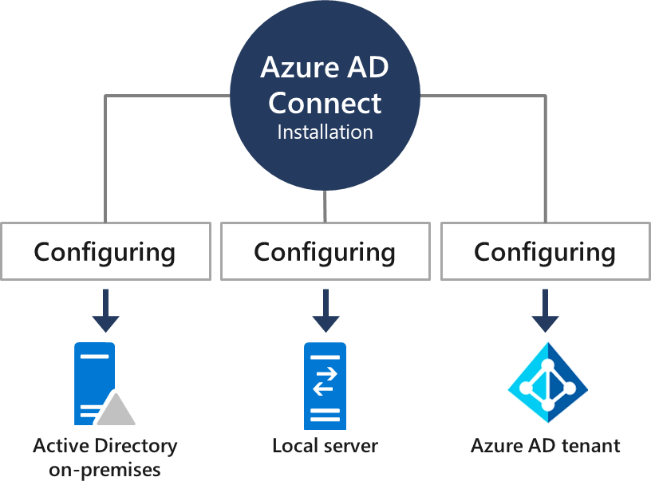
Configure Azure AD Connect
You can install Azure AD Connect using either Express Setup or Custom Setup
Express Setup should be used in the following scenarios:
You have a single Active Directory forest
Users sign-in with the same password using password hash synchronization
Custom Setup should be used in the following scenarios:
You have multiple forests
You customize your sign-in option, such as AD FS for federation
You use a non-Microsoft identity provider
You customize synchronization features, such as filtering and writeback
An Azure AD Connect server installation performs 3 primary operations: Configuring Active Directory, Azure AD, and the local machine for identity synchronization

Slide 26
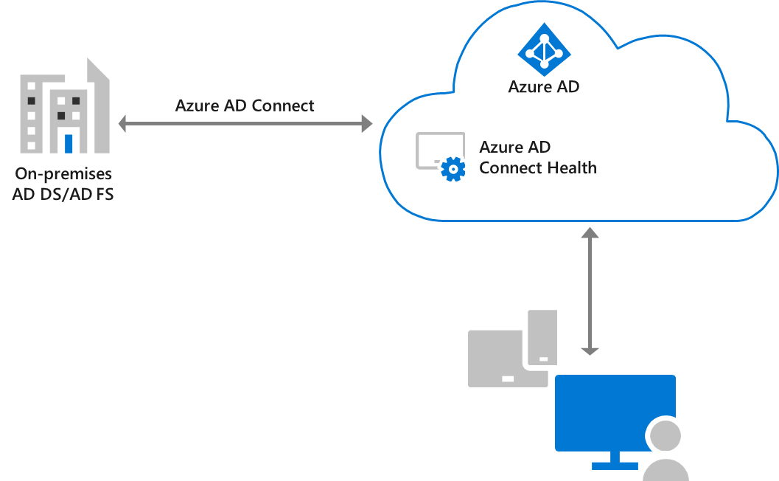
Monitor synchronization services using Azure AD Connect Health
Azure AD Connect Health helps organizations monitor their on-premises identity infrastructure and the synchronization services available through Azure AD Connect
It enables organizations to view:
Alerts and email notifications
Performance monitoring
Usage analytics
Configuration settings
This is accomplished by using an agent that’s installed on the targeted servers and connects to Microsoft 365

Slide 27
Configure Azure AD Connect Cloud Sync prerequisites
Organizations must complete the following prerequisites before installing Azure AD Connect Cloud Sync:
Create the Azure AD Connect Cloud Sync gMSA (group Managed Service Account) to run the agent service
Create a hybrid identity administrator account for your Azure AD tenant that isn't a guest user
Identify a Windows Server 2016 or later on-premises server for the provisioning agent
Establish high availability that enables Azure AD Connect Cloud Sync to operate continuously without failure for a long time
Complete on-premises firewall configurations

Slide 28
Configure Azure AD Connect Cloud Sync
Organizations must complete the following steps to install Azure AD Connect Cloud Sync:
Install the Azure AD Connect provisioning agent
Verify the agent is installed
Verify the agent is running
Configure Azure AD Connect Cloud Sync provisioning

Slide 29
Knowledge Check
Test your knowledge by answering the Knowledge Check questions at the end of this Learn module

Slide 30
Summary
This module examined the following items related to implementing Microsoft’s directory synchronization tools:
Configure Azure AD Connect prerequisites
Configure Azure AD Connect
Monitor synchronization services using Azure AD Connect Health
Configure Azure AD Connect Cloud Sync prerequisites
Configure Azure AD Connect Cloud Sync

Slide 31
Lab 3 – Manage Identity Synchronization

Slide 32
Lab exercises
Exercise 1: Prepare for identity synchronization
Task 1
Configure your UPN suffix
Task 2
Prepare problem user accounts
Task 3
Run the IdFix tool and fix identified issues
Task 4
Prepare for Directory Synchronization

Slide 33
Module 4: Manage synchronized identities

Slide 34
Introduction
When Azure AD Connect is configured, managing synchronized identities involves managing user identities and groups in Microsoft 365 with Azure AD Connect, and maintaining directory synchronization
This module examines how to:
Manage users with directory synchronization
Manage groups with directory synchronization
Use Azure AD Connect synchronized security groups
Troubleshoot directory synchronization

Slide 35
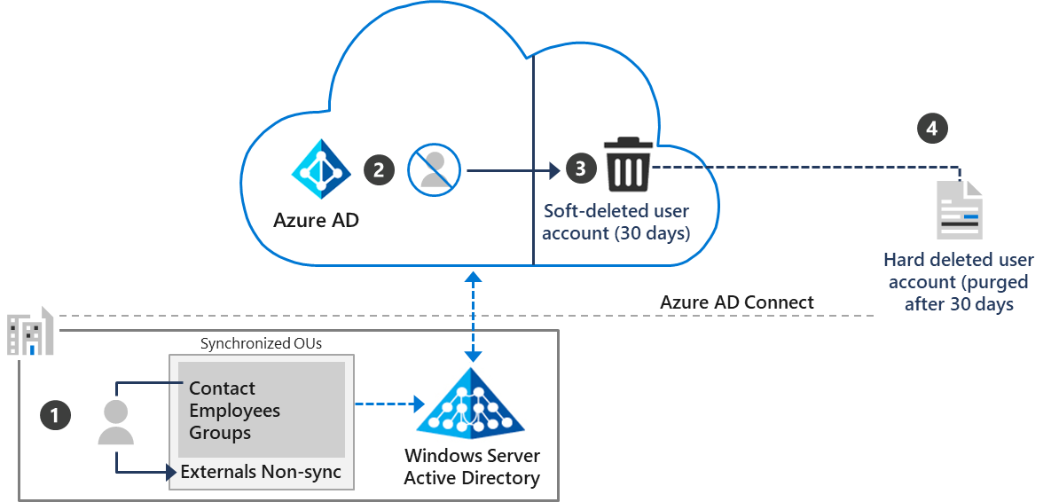
Manage users with directory synchronization
The following management tasks help ensure users synchronize efficiently and that you successfully deploy Azure AD Connect:
Manage user accounts
Recover a user account that was accidentally deleted
Recover from unsynchronized deletes
Enhanced user management
Moving an out-of-sync AD user triggers Azure AD Connect to soft-delete the Azure AD user. After 30 days, it’s purged and deleted permanently. Managing the OU scope is vital because if users or groups are moved out of scope, Azure AD can’t see them anymore, which triggers the deletion of the connected Azure AD object.

Slide 36
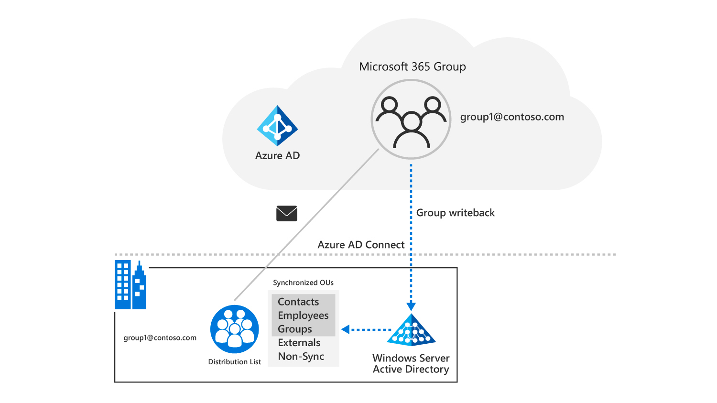
Manage groups with directory synchronization
Once you use Azure AD Connect to implement directory synchronization between your on-premises Active Directory and Azure AD, all group membership must be managed in your on-premises Active Directory
The group writeback feature writes Microsoft 365 groups from Azure AD to on-premises Active Directory, similar to the user writeback feature
Synchronized groups from Azure AD to on-premises Active Directory also include group membership if the user accounts are created in your on-premises Active Directory
New Microsoft 365 groups receive a distribution list on-premises for routing purposes whenever group writeback is activated

Slide 37
Use Azure AD Connect Sync Security Groups to help maintain directory synchronization
During setup, Azure AD Connect automatically creates Azure AD Connect Sync Security Groups
You can use these groups to:
Assign a user temporary permission to run a manual synchronization
Use Azure AD Connect to troubleshoot directory synchronization issues
Azure AD Connect Sync security groups include:
ADSyncAdmins
ADSyncOperators
ADSyncBrowse
ADSyncPasswordSet
These groups are created as local groups on domain-joined servers, or as domain groups when you install Azure AD Connect on a domain controller

Slide 38
Configure object filters for directory synchronization
Object filter configurations:
The filtering configuration is retained when you install or upgrade to a newer version of Azure AD Connect
If an organization has more than one forest, it must apply the filtering configuration to every forest
Deleting objects through object filtering:
If you delete many objects due to filtering (500 by default), you must follow the verification steps to allow the delete objects to go through to Azure AD
If user objects were inadvertently deleted in Azure AD because of a filtering error, you can recreate the user objects in Azure AD
Disable the scheduled task:
Before you start making changes to filtering, you must first disable the scheduled task that triggers a synchronization cycle every 30 minutes
This task must be disabled so that you don't accidentally export changes that you haven't yet verified to be correct

Slide 39
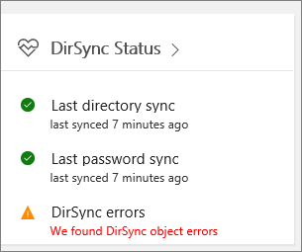
Troubleshoot directory synchronization
Typical issues that can lead to problems with synchronization include:
Authentication errors
Inadvertently deactivating directory synchronization
Unexpected changes in Active Directory that affect OU scoping or attribute filtering
Corrupted on-premises Active Directory that requires directory recovery
Duplicate attributes that must be unique
Troubleshooting tasks and tools include:
Deactivate and reactivate directory synchronization
View directory synchronization errors in the Microsoft 365 admin center
Identity synchronization and duplicate attribute resiliency
Unhealthy Identity Synchronization Notification
Directory Synchronization Troubleshooter
Synchronization Service Manager
Troubleshoot password synchronization with Azure AD Connect

Slide 40
Knowledge Check
Test your knowledge by answering the Knowledge Check questions at the end of this Learn module

Slide 41

Discussion – Identity cloud solution best practices
What type of best practices should you consider when transitioning to an Identity cloud solution?
Are there any considerations that should take precedence over another?
15 minutes…Go!
Notes:
Suggested best practices: Determine Naming best practices and then identify special attributes. By defining Naming best practices, you create a unified naming convention that reduces issues when migrating to the cloud.
In addition, you should identify special attributes that can be added during the migration.

Slide 42
Summary
This module examined the following items related to managing synchronized identities:
Manage users with directory synchronization
Manage groups with directory synchronization
Use Azure AD Connect synchronized security groups
Configure object filters for directory synchronization
Troubleshoot directory synchronization

Slide 43
Lab 3 – Manage Identity Synchronization (continued)

Slide 44
Lab exercises (continued)
Exercise 2: Implement identity synchronization
Task 1
Install Azure AD Connect and initiate synchronization
Task 2
Create group accounts to test synchronization
Task 3
Change group membership to test synchronization
Task 4
Force a manual synchronization
Task 5
Validate the results of directory synchronization

Slide 45
Module 5: Manage secure user access in Microsoft 365

Slide 46
Introduction
Organizations must ensure that access to their company data in Microsoft 365 is always secure, and that data is protected from unauthorized access. Configuring secure password policies is essential to this task.
This module examines the following password management tools that provide data and access protection:
Password policies and authentication
Azure AD Pass-Through Authentication (PTA) and Multi-Factor Authentication (MFA)
Passwordless sign-in with Microsoft Authenticator
Self-service Password Management and Windows Hello for Business
Azure AD Smart Lockout and Conditional access policies
Azure AD Security Defaults

Slide 47
Manage user passwords
In Microsoft 365, the default password expiration policy includes the following settings:
User passwords do not expire
Users receive notification of impending password expiration 14 days before it occurs
You can change both settings in the Microsoft 365 admin center
If necessary, you can reset a password for one or more users on the Active users page
If you forget your own administrator password, the two available options are:
Ask another administrator to reset it for you
Reset the password yourself
Azure AD Password Protection defends against password spray attacks
It efficiently blocks all known weak passwords likely to be used in password spray attacks
This protection is based on real-world security telemetry data from Azure AD to build the global banned password list

Slide 48
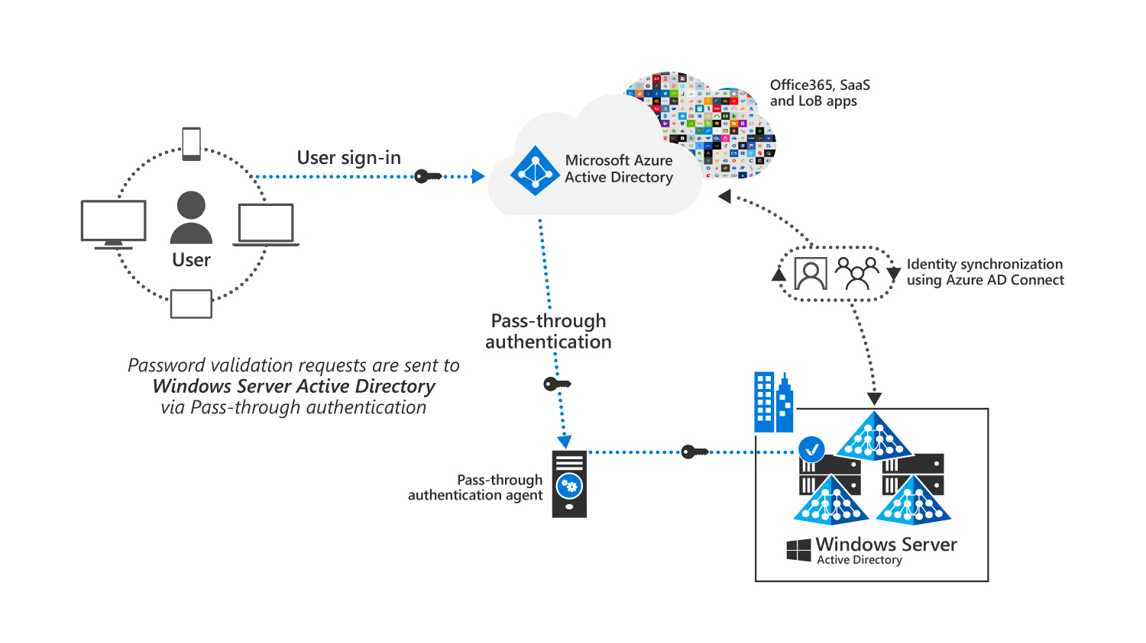
Enable pass-through authentication
Azure AD Pass-Through Authentication (PTA) helps ensure that password validation for services that rely on Azure AD is always performed against an on-premises Active Directory
Azure AD Pass-Through Authentication is configured by using Azure AD Connect
It uses an on-premises agent that listens for external password validation requests
The server that runs the on-premises agent for PTA should be joined to the Active Directory domain where users are located

Slide 49
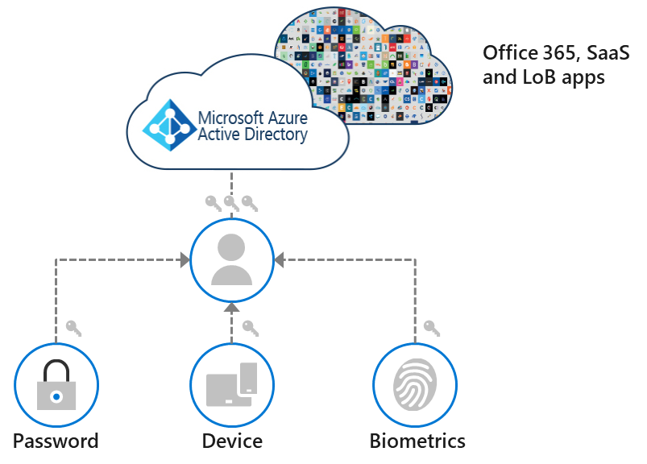
Enable multifactor authentication
Azure AD Multi-factor Authentication (MFA) helps increase security by requesting users provide a username and a password when signing in and then using a second authentication method
The second authentication method may be acknowledging a phone call, text message, or an app notification on a mobile phone
You can also enable users who authenticate from a federated, on-premises directory for MFA
Microsoft 365 provides multiple ways to enable MFA:
Conditional access
Security Defaults
Microsoft 365 admin center
Different authentication factors include:
Something the user knows (password)
Something the user owns (mobile device)
Something the user is (biometrics)

Slide 50
Enable passwordless sign-in with Microsoft Authenticator
Microsoft Authenticator is a mobile app developed by Microsoft. It provides an extra layer of security for user accounts by enabling two-factor authentication
Microsoft Authenticator works by generating either a time-based one-time password (TOTP) or a push notification that requires user approval
The specific authentication method used by Microsoft Authenticator depends on the service provider and the user's settings
In general, push notifications are the preferred method due to their speed, security, and convenience
The Microsoft Authenticator app is available for free on both iOS and Android devices
For an Android device, you must register the device that runs Microsoft Authenticator to an individual user
For an iOS device, you must register the device with each tenant where you use the device

Slide 51
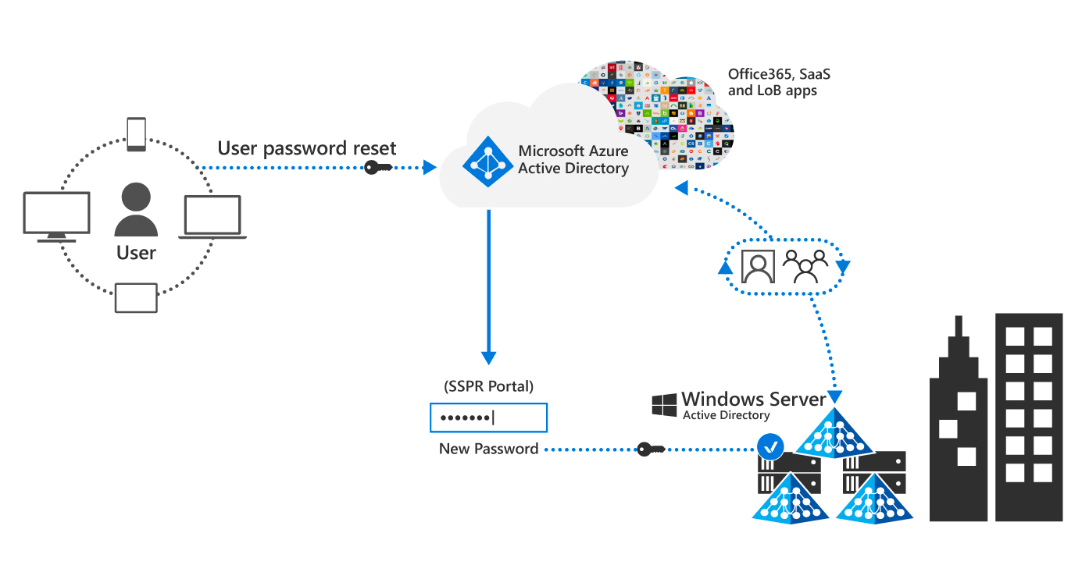
Explore self-service password management
Self-service password reset (SSPR) allows users to reset their own password without requiring intervention by an administrator
SSPR is NOT enabled by default
To reset a password, users must authenticate their identity first
If an administrator wants to use SSPR, they must use two verification methods, and they aren’t able to use security questions
If you purchase Azure AD Premium, it includes the ability to write back passwords, which enables you to implement SSPR for synchronized identities and federated identities
A user can do a self-service password reset, at which point the new password is synchronized over Azure AD Connect, although it doesn’t follow the same scheduler.
The password hash follows the dotted blue line with the key (passing the same way), but it doesn’t end in the bubble; instead, it goes all the way through to the Windows Server AD.

Slide 52
Explore Windows Hello for Business
Windows Hello for Business is a Windows 10 and 11 feature that provides a secure and seamless way for users to authenticate to their devices, applications, and networks using biometric and PIN-based methods instead of traditional passwords
Users sign-in to their devices and applications using either their face, fingerprint, or PIN, depending on the capabilities of the device and the authentication method configured by the organization
Windows Hello for Business stores the biometric data securely on the device itself, and other applications or the network can't access it
This design is more secure than using passwords, which are stored on a server that can be breached
Windows Hello for Business integrates with Active Directory and Azure Active Directory to provide a single sign-on experience across multiple devices and applications
This design allows users to access their resources securely and conveniently, without the need to remember multiple usernames and passwords

Slide 53
Implement Azure AD Smart Lockout
Smart Lockout locks out bad actors who are trying to guess your users’ passwords or use brute-force methods to log into your system
Smart Lockout can recognize sign-ins coming from valid users and treat them differently from sign-ins by attackers and other unknown sources
By default, after 10 failed sign-in attempts, Smart Lockout locks the account from sign-in attempts for one minute
The account will lock again after each subsequent failed sign-in attempt, for one minute at first and longer in subsequent attempts
These settings are all customizable, but this does require paid Azure AD licenses for your users
Smart Lockout uses “familiar location versus unfamiliar location” algorithms to differentiate between a bad actor and the genuine user

Slide 54
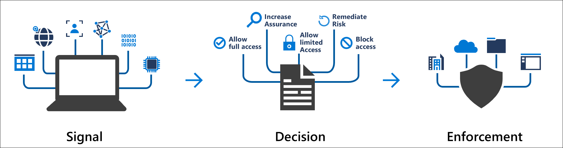
Implement Conditional Access policies
Azure Active Directory Conditional Access brings signals together to make decisions and enforce organizational policies
Conditional Access is at the heart of the new identity-driven control plane
Conditional Access works with Intune device configuration and compliance policies, and with Intune Application protection policies:
Device-based Conditional Access
App-based Conditional Access
Conditional Access policies aren't set for your tenant by default
You can target Conditional Access policies to the cloud PC first-party app by using either Azure or Microsoft Endpoint Manager

Slide 55
Explore Security Defaults in Azure AD
Azure Active Directory (Azure AD) includes a set of preconfigured security settings called Security Defaults
Security Defaults provide a basic level of security that’s an excellent starting point for organizations just getting started with Azure AD
Azure AD Premium licenses provide more advanced security features than what’s in Security Defaults
Security Defaults may not be the right fit for organizations with Azure AD Premium licenses
When an organization enables Security Defaults, the system automatically enables the following security features for all users in its Azure AD tenant:
Multifactor authentication (MFA) for all users
Block legacy authentication protocols
Require users to register for Azure AD Multi-Factor Authentication when necessary
Require administrators to perform MFA
Protect privileged activities like access to the Microsoft Entra admin center
WARNING: Organizations can't use Security Defaults if they currently use Conditional Access policies
Conditional Access and Security Defaults are mutually exclusive - you can use one but not the other
Notes:
Prerequisites for Azure AD Connect cloud sync
Organizations need the following to use Azure AD Connect Cloud Sync:
A group Managed Service Account (gMSA). Azure AD Connect Cloud Sync supports and uses a gMSA for running the lightweight Cloud Sync agent. A gMSA is a managed domain account that:
provides automatic password management.
provides simplified service principal name (SPN) management.
delegates the management to other administrators.
extends this functionality over multiple servers.
Domain Administrator or Enterprise Administrator credentials to create the Azure AD Connect Cloud Sync gMSA (group Managed Service Account) to run the agent service.
A hybrid identity administrator account for your Azure AD tenant that's not a guest user.
An on-premises server for the Cloud Sync agent with Windows 2016 or later. This server should be a tier 0 server based on the Active Directory administrative tier model. Installing the Cloud Sync agent on a domain controller is supported.
High availability refers to the Azure AD Connect Cloud Sync's ability to operate continuously without failure for a long time. By having multiple active Cloud Sync agents installed and running, Azure AD Connect Cloud Sync can continue to function even if one agent should fail. It's recommended that organizations have three active agents installed for high availability.
On-premises firewall configurations.

Slide 56
Investigate authentication issues using sign-in logs
The Azure AD portal provides administrators with access to three activity logs:
Sign-in logs
Audit logs
Provisioning logs
Administrators can use the sign-in logs to find answers to questions like:
What is the sign-in pattern of a user?
How many users have signed in over a week?
What’s the status of these sign-ins?
The Sign-in log includes:
A customizable default view Sign-in activity filters
Error codes Sign-in data shortcuts
Failure reasons Authentication details

Slide 57
Knowledge Check
Test your knowledge by answering the Knowledge Check questions at the end of this Learn module

Slide 58
Summary
This module examined the following items related to password management in Microsoft 365:
Password policies and authentication
Azure AD Pass-Through Authentication (PTA) and Multi-Factor Authentication (MFA)
Passwordless sign-in with Microsoft Authenticator
Self-service Password Management and Windows Hello for Business
Azure AD Smart Lockout and Conditional access policies
Azure AD Security Defaults
Sign-in logs

Slide 59
Lab 3 – Manage Identity Synchronization (continued)

Slide 60
Lab Exercises
Exercise 3: Manage secure user access
Task 1
Deploy Azure AD Pass-Through Authentication
Task 2
Deploy Azure AD Smart Lockout

Slide 61
Module 6: Learning Path Review

Slide 62
Discussion – Learning Path review
What are your key takeaways from this learning path, and why?
What are the key features discussed in this learning path that you foresee implementing at your organization?

Slide 63
Closing slide

