Slide 1
Learning Path 5: Manage your security services in Microsoft 365 Defender

Slide 2
Learning Path agenda
Examine Exchange Online Protection
Examine Microsoft Defender for Office 365
Manage Safe Attachments
Lab 5-Exercise 1 – Implement a Safe Attachments policy
Managing Safe Links
Lab 5-Exercise 2 – Implement a Safe Links policy
Learning Path Review
Notes:
Mention how this Learning Path also maps to the third certification exam study area, which is managing Microsoft 365 security.

Slide 3
Module 1: Examine Exchange Online Protection

Slide 4
Introduction
Microsoft 365 tenants that have mailboxes hosted in Exchange Online rely on the Exchange Online Protection (EOP) service to route inbound and outbound mail and provide anti-malware pipeline protection
This module examines the following EOP features:
EOP technologies that block spam, bulk email, and malware before mail arrives in users’ mailboxes
EOP protection against phishing, spoofing, and outbound spam filtering

Slide 5
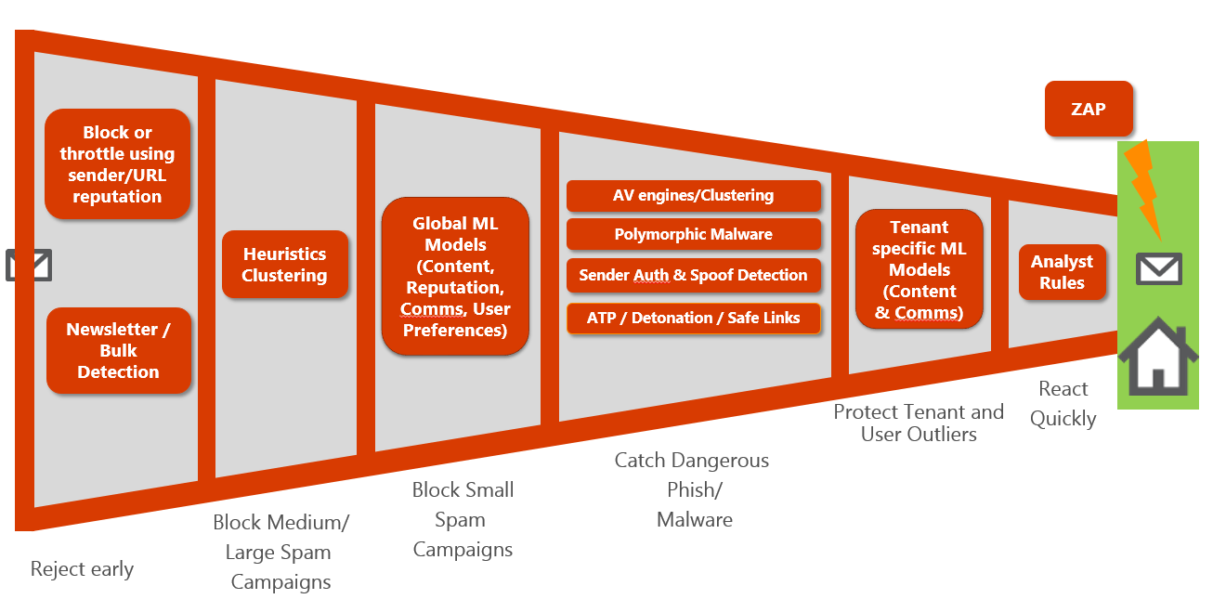
Examine the anti-malware pipeline
Before mail enters the Microsoft 365 network and is processed by EOP, techniques such as IP and sender reputation, combined with heuristics catch a sizeable amount of spam and bulk email at the first entry point in Microsoft 365
After that, the email is scanned by multiple signature-based anti-virus scanners
Next, EOP scans individual files using a reputation block
Heuristic clustering is used to identify mail as suspicious simply based on an analysis of delivery patterns
Once these signals are collected, the results are run through a machine-learning (ML) model
If Microsoft Defender for Office 365 is enabled in the tenant, it extends the protection of EOP with Zero-hour auto purge (ZAP, see next unit)
Notes:
An organization can configure anti-malware policies in the Microsoft 365 Defender portal. It can also configure anti-malware policies in Exchange Online PowerShell for Microsoft 365 organizations with mailboxes in Exchange Online.

Slide 6
Detect messages with spam or malware using Zero-hour auto purge
Zero-hour auto purge (ZAP) is an email protection feature in the Exchange Online Protection service that detects messages with spam or malware that previously went undetected and were delivered to users’ Inboxes
ZAP mitigates this situation by continually monitoring updates to the Microsoft 365 spam and malware signatures and can identify previously undetected malicious messages already in users’ Inboxes
If the recipients haven’t read the messages that ZAP has identified as spam, then ZAP moves the messages to their Junk email folder
For newly detected malware, ZAP removes the attachments from the email message, regardless if the mail was read or not
Notes:
ZAP for malware is enabled by default in anti-malware policies.
ZAP for phishing is enabled by default in anti-spam policies. The default action for the Phishing email filtering verdict is Quarantine message.
ZAP for high confidence phish is enabled by default.
ZAP is enabled in anti-spam policies by default. The default action for the Spam filtering verdict is Move message to Junk Email folder.
If a phishing or spam signal is received for these types of messages, and the filtering verdict in the anti-spam policy is set to take some action on the message (Move to Junk, Redirect, Delete, or Quarantine), then ZAP will default to a Move to Junk action.

Slide 7
Explore anti-spoofing protection provided by Exchange Online Protection
Spoofing is the fraudulent practice of sending emails purporting to be from reputable companies
Exchange Online Protection includes features to help protect the organizations from spoofed (forged) senders
Five anti-spoofing technologies are available in EOP:
Email authentication
Spoof intelligence insight
Allow or block spoofed senders in the Tenant Allow/Block List
Anti-phishing policies
Spoof detections report
Microsoft differentiates between two different types of spoofed messages:
Intra-org spoofing. The sender and recipient domains are the same, or they’re accepted domains that belong to the same organization
Cross-domain spoofing. The sender and recipient domains are different and have no relationship to each other (also known as external domains)

Slide 8
Explore other anti-spoofing protection
By design, the SMTP protocol supports spoofing, which is when a domain user sends messages on behalf of another domain
EOP has the following built-in email authentication techniques designed to detect legitimate cases of spoofing while shielding organizations from the illegitimate ones
Sender Policy Framework
SPF verifies the domain from which emails are sent
SPF protects companies from phishers who spoofed the 5321.MailFrom address
Domain Keys Identified Mail
DKIM helps prevent attackers from sending messages that look like they came from your domain
DKIM adds a digital signature to email message headers
Domain-based Message and Reporting Compliance
DMARC protects companies from phishers who spoofed the 5322.From email address
SPF only checks for spoofed 5321.MailFrom addresses
SPF + DMARC provides complete address verification

Slide 9
Examine outbound spam filtering
Spam protection starts by containing and filtering junk email. The following anti-spam technologies are useful when you want to allow or block messages based on the message envelope:
Connection filtering. Identifies good and bad email source servers early in the inbound email connection through the IP allowlist, IP blocklist, and Microsoft’s safe list
Spam (content) filtering. EOP classifies messages based on spam filtering verdicts:
Spam Bulk email High confidence phishing email
High confidence spam Phishing email
Outbound spam filtering. EOP ensures that users don't send spam, either in outbound message content or by exceeding outbound message limits
Spoof intelligence. EOP examines forgery of the From header in the message body. This protection is expanded by implementing spoof intelligence in the Microsoft 365 Defender portal

Slide 10

Knowledge Check
Test your knowledge by answering the Knowledge Check questions at the end of this Learn module

Slide 11
Summary
This module examined the following items related to Exchange Online Protection:
How EOP analyzes email to provide anti-malware pipeline protection
Mechanisms used by EOP to filter spam and malware
Solutions that provide extra protection against phishing and spoofing
Allow or block messages using outbound spam filtering

Slide 12
Module 2: Examine Microsoft Defender for Office 365

Slide 13
Introduction
Microsoft Defender for Office 365 extends the protection provided by EOP by filtering targeted attacks that might pass through EOP’s line of defenses
This module examines the following key features provided by Microsoft Defender for Office 365:
Climb the security ladder from EOP
Expand EOP using Safe Attachments and Safe Links
Manage spoofed intelligence
Outbound spam filtering policies
Unblock users from sending email

Slide 14
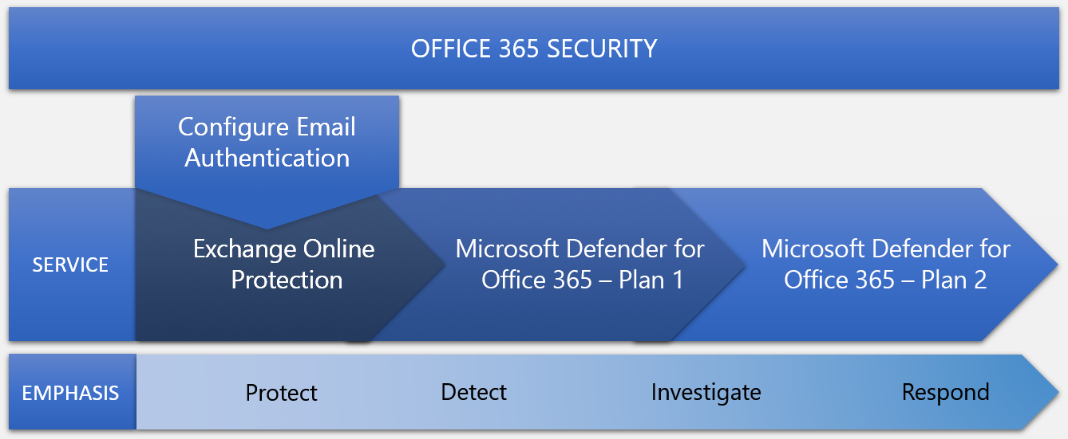
Climb the security ladder from EOP to Microsoft Defender for Office 365
Microsoft Defender for Office 365 security contains three main security services tied to your subscription type:
Exchange Online Protection (EOP)
Microsoft Defender for Office 365 Plan 1
Microsoft Defender for Office 365 Plan 2

Slide 15
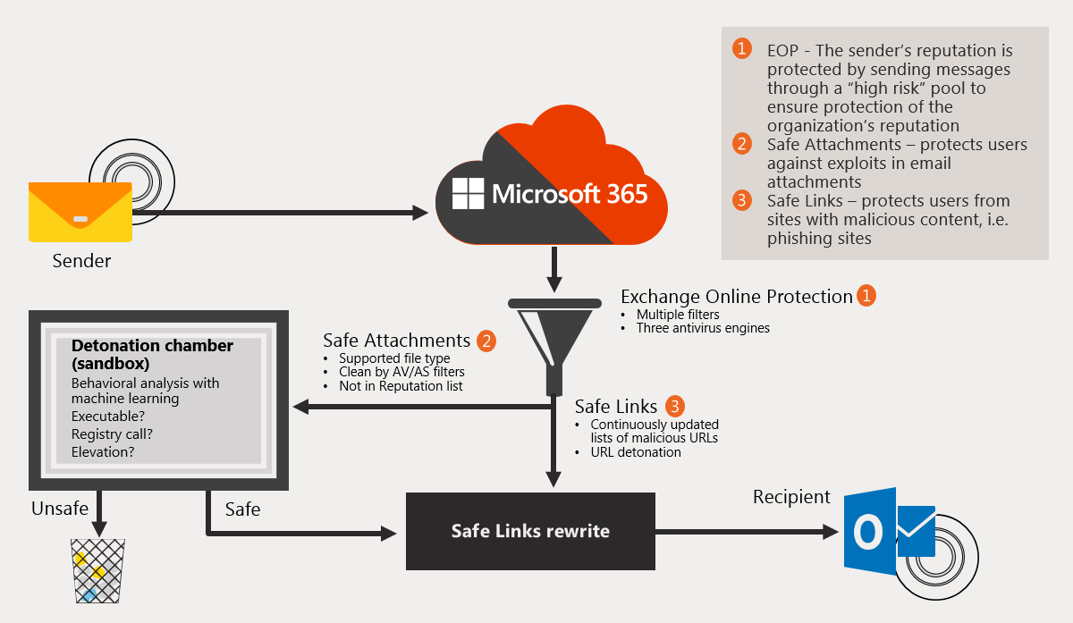
Expand EOP protections by using Safe Attachments and Safe Links
Once email passes through the front-line defenses provided by EOP, it’s further analyzed by Microsoft Defender for Office 365’s Safe Attachments and Safe Links features for anything suspicious
Safe Attachments. Analyzes attachments by detonating them in a hypervisor sandbox environment
Safe Links. Checks any URLs that are embedded in the message body

Slide 16
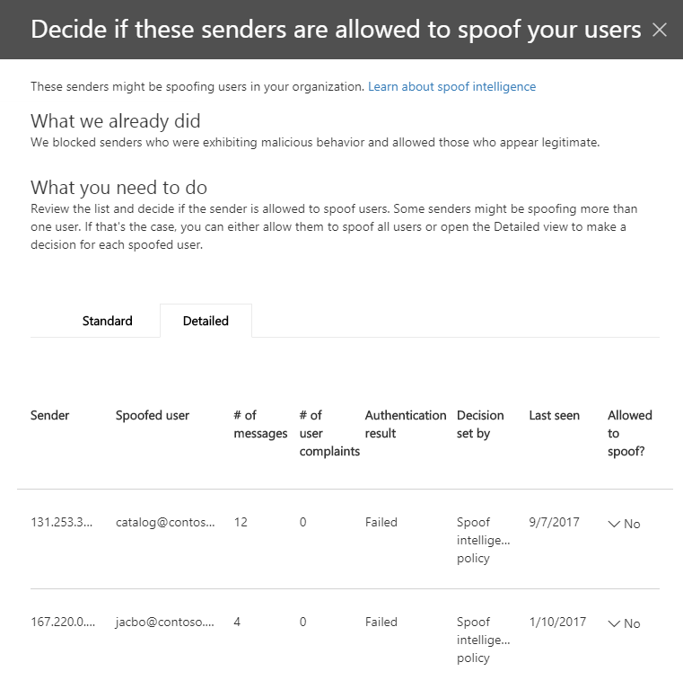
Manage spoofed intelligence
Spoof Intelligence enables an organization to review senders who are spoofing its domain
The organization can then choose to either allow the sender to continue or to block the sender
Spoof Intelligence is available to organizations that have Microsoft 365 Enterprise E5 or have purchased Microsoft Defender for Office 365 licenses
The Spoof Intelligence policy is automatically created, enabled by default, and enforced by Microsoft 365

Slide 17
Configure outbound spam filtering policies
Outbound spam from a user typically indicates a compromised account
EOP uses outbound spam policies as part of an organization's overall defense against spam
For greater granularity, an organization can also create custom outbound spam policies that apply to specific users, groups, or domains
You can configure outbound spam policies in the Microsoft 365 Defender portal or in PowerShell

Slide 18
Unblock users from sending email
If a user exceeds a sending limit:
The user is added to the Restricted users page in the Microsoft 365 Defender portal, which blocks the user from sending email
The user can still receive email
If the user later tries to send email, the message is returned in a non-delivery report (also known as an NDR, or bounce message)
There are two ways in which an administrator can unblock a user so they can resume sending email:
Remove the user from the Restricted users page in the Microsoft 365 Defender portal
Through Exchange Online PowerShell
You can unlock a user in the Microsoft 365 Defender portal or in PowerShell

Slide 19
Knowledge Check
Test your knowledge by answering the Knowledge Check questions at the end of this Learn module

Slide 20
Summary
This module examined the following items related to Microsoft Defender for Office 365:
Microsoft Defender for Office 365 contains three main security services tied to an organization’ subscription type:
Exchange Online Protection (EOP)
Microsoft Defender for Office 365 Plan 1
Microsoft Defender for Office 365 Plan 2
Safe Attachments and Safe Links analyze email for anything suspicious once email passes through the front-line defenses provided by EOP
Spoof Intelligence enables an organization to allow or block senders who are spoofing its domain
Organizations can create custom outbound spam policies that apply to specific users, groups, or domains

Slide 21
Module 3: Manage Safe Attachments

Slide 22
Introduction
This module examines how to manage Safe Attachments in your Microsoft 365 tenant by:
Creating and modifying a Safe Attachments policy in the Microsoft 365 Defender portal
Creating a Safe Attachments policy by using Windows PowerShell
Configuring a Safe Attachments policy
Implementing a transport rule to bypass Safe Attachments scanning

Slide 23
Protect users from malicious attachments by using Safe Attachments
Safe Attachments is a feature in Microsoft Defender for Office 365.
Safe Attachments analyzes attachments that are common targets for malicious content
How Safe Attachments works:
It opens every attachment of a supported file type in a special hypervisor environment
It tests each attachment by checking to see if it’s malicious
Attachments are executed, or “detonated” in virtual environments that run different versions of the Windows OS
Attachments are then analyzed to see if they execute malicious behavior
It takes appropriate action on malicious attachments (see next unit for possible actions)

Slide 24
Create Safe Attachment policies in Microsoft Defender for Office 365
To create a Safe Attachments policy, you must be assigned either the Organization Management or Hygiene Management role
Safe Attachments policy settings include:
Safe Attachments unknown malware response:
Off. Attachments aren't scanned for malware by Safe Attachments
Monitor. Delivers messages with attachments and then tracks what happens with detected malware
Block. Prevents messages with detected malware attachments from being delivered
Replace. Removes detected malware attachments and notifies recipients that attachments have been removed
Dynamic Delivery. Delivers messages immediately, but replaces attachments with placeholders until Safe Attachments scanning is complete
Redirect messages with detected attachments. Messages that contain malware attachments for analysis and investigation are sent to a specified email address
Apply the Safe Attachments detection response if scanning can't complete (timeout or errors). The action specified by the Safe Attachments unknown malware response option is taken on messages even when Safe Attachments scanning can't complete

Slide 25
Create Safe Attachments policies using Windows PowerShell
If you want to do this: | Use this cmdlet:
View your Safe Attachments policy settings | Get-SafeAttachmentPolicy
Edit an existing Safe Attachments policy | Set-SafeAttachmentPolicy
Create a new custom Safe Attachments policy | New-SafeAttachmentPolicy
Delete a custom Safe Attachments policy | Remove-SafeAttachmentPolicy
View your Safe Attachments rule settings | Get-SafeAttachmentRule
Edit an existing attachments link rule | Set-SafeAttachmentRule
Create a new custom Safe Attachments rule | New-SafeAttachmentRule
Delete a custom Safe Attachments rule | Remove-SafeAttachmentRule
When using PowerShell to create a policy, you must create the policy before the rule
The policy must be created first so that you can later assign it to the rule
If you create the rule first, you won't have a policy to assign to it

Slide 26
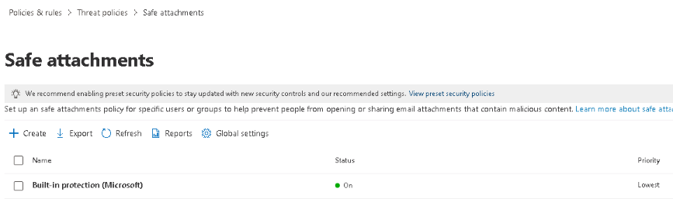
Modify an existing Safe Attachments policy
Use the Microsoft 365 Defender portal to modify the default policy created by Microsoft to enable Safe Attachments in Office documents, as well as customized policies
Policies are assigned a priority that’s based on the order in which they’re created
The first policy created is assigned priority 0, which is the highest priority
The next policy created is assigned priority 1, and so on
A lower priority number indicates a higher priority for the policy (priority 0 is the highest)
In Microsoft 365 Defender, you can only change the priority of the Safe Attachments policy after you create it

Slide 27
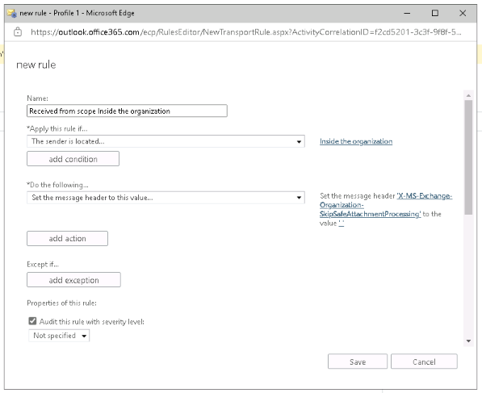
Create a transport rule to bypass a Safe Attachments policy
Sometimes it’s useful to allow mail to flow without delay from internal senders, scanners, faxes, and smart hosts that send attachments that are known to be safe and from a trusted source
To bypass Safe Attachments scanning, you can create a transport rule, also known as a mail flow rule, in the Exchange admin center

Slide 28

Examine the end-user experience with Safe Attachments
The end-user experience varies depending on the Safe Attachments option used:
Block attachments
Prevents delivery of the entire message
User receives a notification message indicating a message with a malicious attachment was blocked
Replace attachments
Replaces the attachment in the message with an icon of a red warning sign
If the user hovers over the icon, a message appears that indicates the system detected malware in the attachment, which it then blocked
The user can still access the original message body, but the system removed the malware threat
Dynamic delivery
Provides the best user experience as it delivers the message without delay
Replaces the attachment with a placeholder attachment that notifies the user the system is scanning the original attachment for malware
If the attachment is clean, Safe Attachments reattaches it to the original message in the user’s Inbox
If the attachment is infected, Safe Attachments replaces the placeholder attachment on the message with a new attachment indicating the original attachment was infected with malware

Slide 29
Knowledge Check
Test your knowledge by answering the Knowledge Check questions at the end of this Learn module

Slide 30
Summary
This module examined the following items related to managing Safe Attachment policies:
Creating and modifying a Safe Attachments policy in the Microsoft 365 Defender portal
Creating a Safe Attachments policy by using Windows PowerShell
Configuring a Safe Attachments policy
Implementing transport rules to bypass Safe Attachments scanning
Understanding the end-user experience

Slide 31
Lab 5 – Manage Microsoft 365 Security Services

Slide 32
Lab exercises
Exercise 1: Implement a Safe Attachments policy
Task 1
Create a Safe Attachment policy and turn on Microsoft Defender for Office 365

Slide 33
Module 4: Manage Safe Links

Slide 34
Introduction
This module examines how to manage Safe Links in your Microsoft 365 tenant by:
Creating and modifying a Safe Links policy in the Microsoft 365 Defender portal
Creating a Safe Links policy by using Windows PowerShell
Configuring a Safe Links policy to take certain actions
Implementing a transport rule to disable the Safe Links functionality

Slide 35
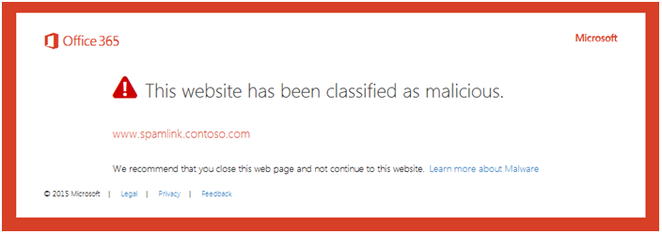
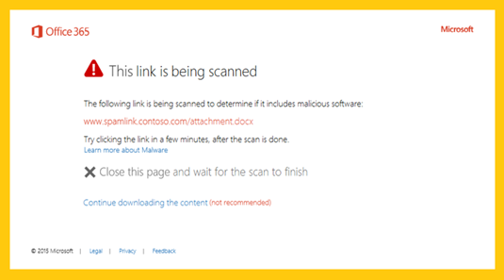
Protect users from malicious URLs by using Safe Links
Safe Links is a feature in Microsoft Defender for Office 365 that protects users from malicious URLs that are commonly used in phishing attacks to extract sensitive information from a user
When a user selects a link in a message or document, Safe Links checks to see if the link is malicious:
It redirects the URL to a secure server in the Microsoft 365 environment
The server checks the URL against a list of known malicious web sites

Slide 36
Create Safe Links policies in Microsoft Defender for Office 365
To create a Safe Links policy, you must be assigned either the Organization Management or Hygiene Management role
When you enable Microsoft Defender for Office 365 in your tenant, the system automatically creates a default Safe Links policy that applies to everyone in the organization
You can create custom Safe Links policies with settings that meet your business needs
Safe Links policy settings include:
Apply Safe Links to email messages sent within the organization
Apply real-time URL scanning for suspicious links and links that point to files
Wait for URL scanning to complete before delivering the message
Do not rewrite URLs, do checks through SafeLinks API only
Track user clicks
Let users click through to the original URL
Display the organization branding on notification and warning pages
Recipient filters
Priority

Slide 37
Create Safe Links policies using Windows PowerShell
If you want to do this: | Use this cmdlet:
View your Safe Links policy settings | Get-SafeLinksPolicy
Edit an existing Safe Links policy | Set-SafeLinksPolicy
Create a new custom Safe Links policy | New-SafeLinksPolicy
Remove a custom Safe Links policy | Remove-SafeLinksPolicy
View your Safe Links rule settings | Get-SafeLinksRule
Edit an existing Safe Links rule | Set-SafeLinksRule
Create a new custom Safe Links rule | New-SafeLinksRule
Remove a custom Safe Links rule | Remove-SafeLinksRule
When using PowerShell to create a policy, you must create the policy before the rule
The policy must be created first so that you can later assign it to the rule
If you create the rule first, you won't have a policy to assign to it

Slide 38
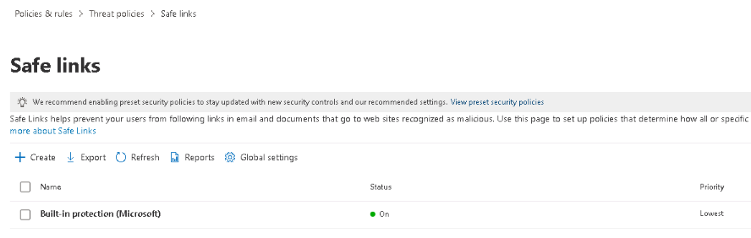
Modify an existing Safe Links policy
You use the Microsoft 365 Defender portal to modify the default policy created by Microsoft to enable Safe Links in Office documents, as well as customized policies
Policies are assigned a priority that’s based on the order in which they’re created
The first policy created is assigned priority 0, which is the highest priority
The next policy created is assigned priority 1, and so on
A lower priority number indicates a higher priority for the policy (priority 0 is the highest)
In Microsoft 365 Defender, you can only change the priority of the Safe Links policy after you create it

Slide 39
Create a transport rule to bypass a Safe Links policy
You can create a transport rule to bypass Safe Links, just like you can to bypass Safe Attachments
Transport rules are created in the Exchange admin center
You can choose from several options to determine when the rule should be applied, such as:
Where the sender is located
What’s included in the sender address
Specific senders, receivers, or distribution group members
Attachment types

Slide 40
Examine the end-user experience with Safe Links
Safe Links works in email by executing the following steps:
Someone sends a user an email message that contains a URL to a web site
The message flows through the anti-malware pipeline, and assuming it passes through all the initial checks, it eventually arrives in the recipient’s Inbox
The user opens the message and selects the link
When the user selects the link, the URL is redirected to a secure server that checks the URL against a block list of known malicious web sites:
If the link is safe, the user’s browser navigates to the target web site
If the link is malicious, the user’s browser displays a warning page

Slide 41
Knowledge Check
Test your knowledge by answering the Knowledge Check questions at the end of this Learn module

Slide 42
Summary
This module examined the following items related to managing Safe Links policies:
Creating and modifying a Safe Links policy in the Microsoft 365 Defender portal
Creating a Safe Links policy by using Windows PowerShell
Configuring a Safe Links policy to take certain actions
Implementing a transport rule that can disable the Safe Links functionality
Understanding the end-user experience with Safe Links

Slide 43
Lab 5 – Manage Microsoft 365 Security Services (continued)

Slide 44

Lab exercises (continued)
Exercise 2: Implement a Safe Links policy
Task 1
Create a Safe Links policy
After finishing Task 1, you must wait at least 30 minutes before you can perform Task 2. This is the time needed for the policy you created to propagate through the system.
After finishing Task 1, proceed to the next module.
Task 2
Validate the Safe Links policy
You will complete this task after your instructor finishes lecturing the next module.

Slide 45
Module 5: Learning Path Review

Slide 46
Discussion – Learning Path review
What are your key takeaways from this learning path, and why?
What are the key features discussed in this learning path that you foresee implementing at your organization?

Slide 47
Closing Slide

