Slide 1
Learning Path 6: Implement Threat Protection by using Microsoft 365 Defender

Slide 2
Learning Path agenda
Explore threat intelligence in Microsoft 365 Defender
Lab 6-Exercises 1-4 – Implement Threat Intelligence
Implement app protection by using Microsoft Defender for Cloud Apps
Implement endpoint protection by using Microsoft Defender for Endpoint
Implement threat protection by using Microsoft Defender for Office 365
Lab 6-Exercises 5-6 – Implement Threat Intelligence
Learning Path Review
Notes:
Mention how this Learning Path also maps to the third certification exam study area, which is managing Microsoft 365 security.

Slide 3
Module 1: Explore threat intelligence in Microsoft 365 Defender

Slide 4
Introduction
This module examines how to manage the Microsoft 365 threat intelligence features that provide organizations with insight and protection against the internal and external cyber-attacks that threaten their tenants.
Microsoft Intelligent Security Graph
How Microsoft 365 Defender uses alerts
Automated investigation and response
Threat hunting
Threat analytics and reports

Slide 5
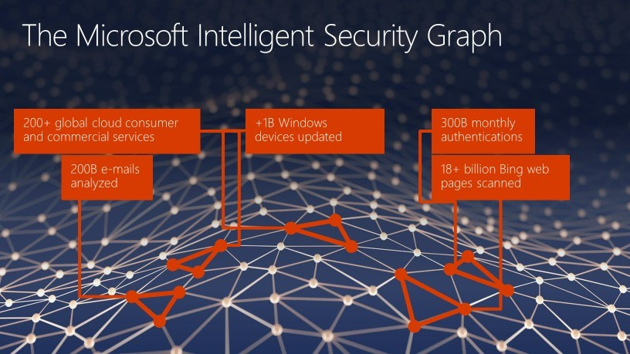
Explore Microsoft Intelligent Security Graph
To help customers focus on breach prevention and spend less on breach recovery, Microsoft has created the Microsoft Intelligent Security Graph
The Microsoft Intelligent Security Graph powers threat intelligence in Microsoft 365 by consuming billions of signals
The signals that are obtained from the Intelligent Security Graph, plus additional third-party feeds, are fed into Microsoft’s three major platforms: Windows, Azure, and Microsoft 365

Slide 6
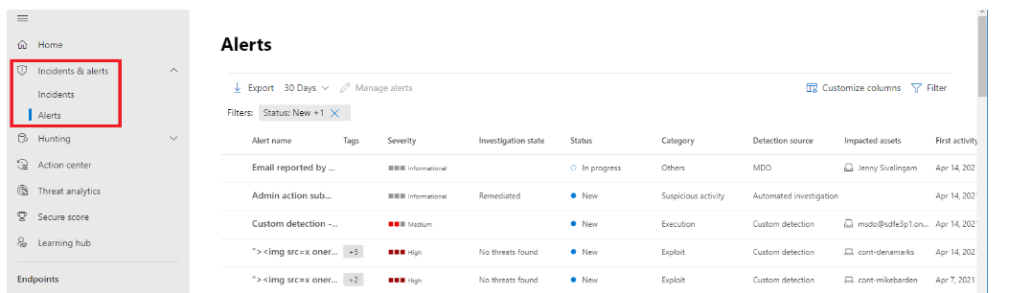
Explore alert policies in Microsoft 365
Alerts are the basis of all incidents and indicate the occurrence of malicious or suspicious events in your environment
Alerts are typically part of a broader attack and provide clues about an incident
The Microsoft 365 Defender portal enables you to analyze, manage, and resolve alerts
Notes:
In Microsoft 365 Defender, related alerts are aggregated together to form incidents. Incidents will always provide the broader context of an attack. However, analyzing alerts can be valuable when deeper analysis is required.
Filter
You can filter alerts according to these criteria:
Severity
Status
Service sources
Entities (the impacted assets)
Automated investigation state
Analyze an alert
An alert page is composed of these sections:
Alert story. This section describes the chain of events and alerts related to this alert in chronological order.
Summary details
Alert sources
Analyze affected assets
Trace an alert's role in the alert story
View more alert information on the details page
Manage alerts
The Manage alert pane allows you to view or specify:
The alert status (New, Resolved, In progress).
The user account that has been assigned the alert.
The alert's classification:
Not set (the default).
True positive with a type of threat. Use this classification for alerts that accurately indicate a real threat. Specifying the threat type helps your security team see threat patterns and act to defend your organization from them.
Informational, expected activity with a type of activity. Use the options in this category to classify alerts for security tests, red team activity, and expected unusual behavior from trusted apps and users.
False positive for types of alerts that were created even when there is no malicious activity. Classifying alerts as false positive helps Microsoft 365 Defender improve its detection quality.
A comment on the alert.
Resolve an alert
Once you're done analyzing an alert and it can be resolved, go to the Manage alert pane for the alert or similar alerts and mark the status as Resolved. Then classify the resolution as one of the following types:
True positive. Also enter a type of threat.
Informational, expected activity. Also enter a type of activity.
False positive.

Slide 7
Run automated investigations and responses
Automated investigation and response (AIR) capabilities enable organizations to automatically investigate well-known threats
Security operations teams can feel overwhelmed by the sheer volume of threats they must monitor and protect against
AIR capabilities enable security teams to dramatically increase their company's capacity to deal with security alerts and incidents
AIR capabilities help security operations teams complete the following steps:
Determine whether a threat requires action
Take or recommend any necessary remediation actions against the identified threat
Determine whether other investigations should occur, and what they should do
Repeat the process as necessary for other alerts
Not every alert triggers an automated investigation, and not every investigation results in automated remediation actions - It depends on how AIR is configured for an organization

Slide 8
Explore threat hunting with Microsoft Threat Protection
What is threat hunting?
Cyberthreat hunting is a proactive cybersecurity activity
Its goal is to find threats that are either buried under massive quantities of security signals and alert data, or aren't flagged by security products
Threat hunting lets analysts work with established baselines and highlight behavior that may be interesting or suspicious
Threat hunting in Microsoft Threat Protection
The threat hunting capabilities in Microsoft Threat Protection enable you to find threats across your users, endpoints, email, productivity tools, and apps
Microsoft Threat Protection itself is made possible by the power of the Azure cloud coupled with insights from the Microsoft Intelligent Security Graph
Microsoft Threat Protection's threat hunting capabilities enable security analysts to:
Effectively access and handle large sets of data
Automate monitoring of interesting matches to new data

Slide 9
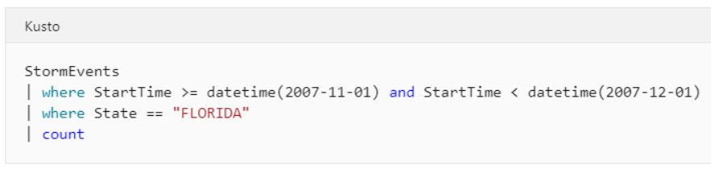
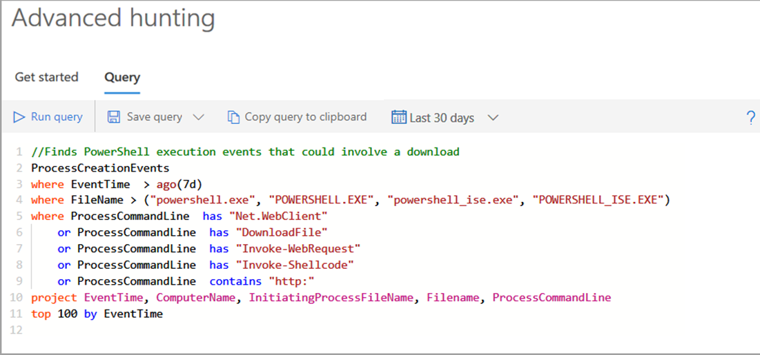
Explore advanced threat hunting in Microsoft 365 Defender
Advanced hunting in Microsoft 365 Defender is a query-based threat-hunting tool that lets you explore up to 30 days of raw data
Advanced hunting data can be categorized into two distinct types:
Event or activity data
Entity data
Advanced hunting is based on the Kusto query language
Notes:
Advanced hunting enables you to proactively hunt for threats across:
Devices managed by Microsoft Defender for Endpoint.
Emails processed by Microsoft 365.
Cloud app activities, authentication events, and domain controller activities tracked by Microsoft Cloud App Security and Microsoft Defender for Identity.

Slide 10
Explore threat analytics in Microsoft 365
View the threat analytics dashboard
The threat analytics dashboard summarizes threats into the following categories:
Latest threats
High-impact threats
Highest exposure
View a threat analytics report
Each threat analytics report provides information in several tabs:
Overview
Analyst report
Related incidents
Impacted assets
Prevented email attempts
Exposure & mitigations
Notes:
Threat analytics is our in-product threat intelligence solution from expert Microsoft security researchers. It's designed to assist security teams to be as efficient as possible while facing emerging threats, such as:
Active threat actors and their campaigns
Popular and new attack techniques
Critical vulnerabilities
Common attack surfaces
Prevalent malware
View the threat analytics dashboard
The threat analytics dashboard highlights the reports that are most relevant to your organization. It summarizes the threats in the following sections:
Latest threats. Lists the most recently published or updated threat reports, along with the number of active and resolved alerts.
High-impact threats. Lists the threats that have the greatest effect on your organization. This section lists threats with the highest number of active and resolved alerts first.
Highest exposure. Lists threats with the highest exposure levels first. The exposure level of a threat is calculated using two pieces of information:
How severe the vulnerabilities associated with the threat are.
How many devices in the organization could be exploited by those vulnerabilities.
View a threat analytics report
Overview tab: Quickly understand the threat, assess its impact, and review defenses
Analyst report tab: Get expert insight from Microsoft security researchers
Related incidents tab: View and manage related incidents
Impacted assets tab: Get list of impacted devices and mailboxes
Prevented email attempts tab: View blocked or junked threat emails
Exposure and mitigations tab: Review list of mitigations and the status of your devices

Slide 11
Identify threat issues using Microsoft Defender reports
The Microsoft 365 Defender portal includes the following reports that identify threat issues:
License report - provides information about licenses your organization has purchased and is using
Security report - provides information about your company's identities, devices, and apps
Threat protection report - provides information about alerts and alert trends, including unresolved alerts and their classification
Device health and compliance report - provides information about device health and trends, along with the status of Microsoft Defender Antivirus
Vulnerable devices report - provides information about devices and trends, including devices that had alerts over the past 30 days
Web protection report - shows attempts to access phishing sites, malware vectors, exploit sites, untrusted or low-reputation sites, and explicitly blocked sites
Firewall report - shows blocked inbound, outbound, and app connections, plus remote IPs connected by multiple devices and remote IPs with the most connection attempts
Device control report - shows information about media usage
Notes:
Threat analytics is our in-product threat intelligence solution from expert Microsoft security researchers. It's designed to assist security teams to be as efficient as possible while facing emerging threats, such as:
Active threat actors and their campaigns
Popular and new attack techniques
Critical vulnerabilities
Common attack surfaces
Prevalent malware
View the threat analytics dashboard
The threat analytics dashboard highlights the reports that are most relevant to your organization. It summarizes the threats in the following sections:
Latest threats. Lists the most recently published or updated threat reports, along with the number of active and resolved alerts.
High-impact threats. Lists the threats that have the greatest effect on your organization. This section lists threats with the highest number of active and resolved alerts first.
Highest exposure. Lists threats with the highest exposure levels first. The exposure level of a threat is calculated using two pieces of information:
How severe the vulnerabilities associated with the threat are.
How many devices in the organization could be exploited by those vulnerabilities.
View a threat analytics report
Overview tab: Quickly understand the threat, assess its impact, and review defenses
Analyst report tab: Get expert insight from Microsoft security researchers
Related incidents tab: View and manage related incidents
Impacted assets tab: Get list of impacted devices and mailboxes
Prevented email attempts tab: View blocked or junked threat emails
Exposure and mitigations tab: Review list of mitigations and the status of your devices

Slide 12

Knowledge Check
Test your knowledge by answering the Knowledge Check questions at the end of this Learn module

Slide 13
Summary
This module examined the following features of Microsoft 365 Threat Intelligence:
Microsoft Intelligent Security Graph
How Microsoft 365 Defender uses alerts
Automated investigation and response (AIR)
Threat hunting
Threat analytics and reports

Slide 14
Lab 6 – Implement Threat Intelligence

Slide 15
Lab exercises
Exercise 1: Prepare for Alert Policies
Task 1
Assign RBAC role to MOD Administrator account
Exercise 2: Implement a Mailbox Permission Alert
Task 1
Configure a Mailbox Permission Alert
Task 2
Validate the Mailbox Permission Alert
Exercise 3: Implement a SharePoint Permission Alert
Task 1
Configure a SharePoint Permission Alert
Task 2
Validate the SharePoint Permission Alert
Exercise 4: Test the Default eDiscovery Alert
Task 1
Review the Default eDiscovery Alert
Task 2
Validate the Default eDiscovery Alert

Slide 16
Module 2: Implement app protection by using Microsoft Defender for Cloud Apps

Slide 17
Introduction
Microsoft Defender for Cloud Apps is a Cloud Access Security Broker (CASB) that supports various deployment modes including log collection, API connectors, and reverse proxy.
This module examines:
Microsoft Defender for Cloud Apps features
Deploying Microsoft Defender for Cloud Apps
Controlling your Cloud Apps with policies
Configuring Cloud Discovery in Microsoft Defender for Cloud Apps
Troubleshooting Microsoft Defender for Cloud Apps

Slide 18
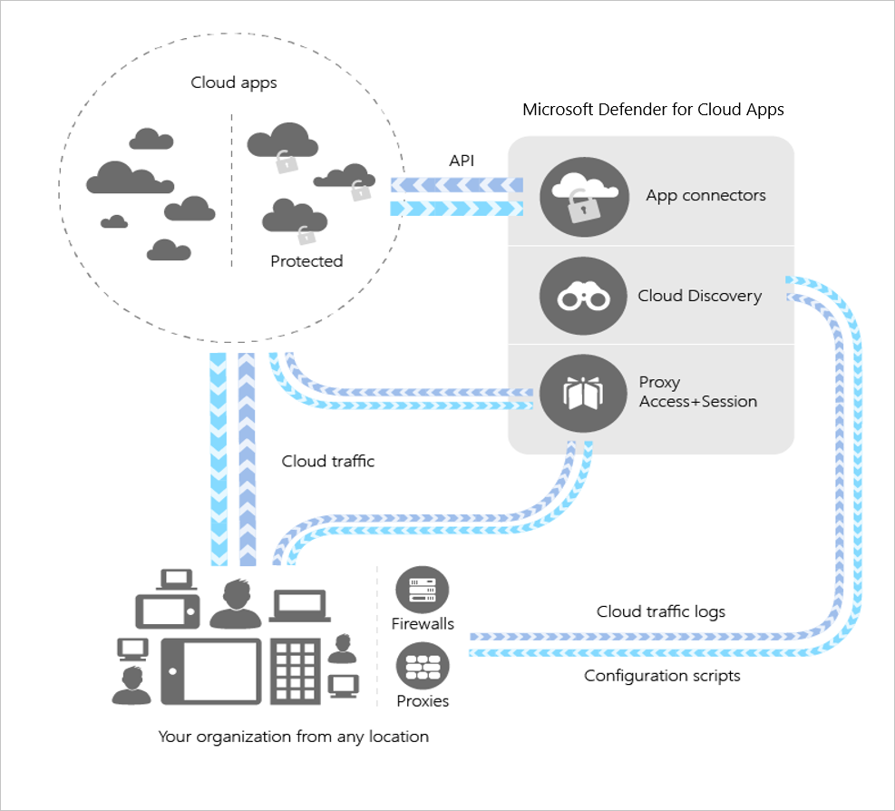
Explore Microsoft Defender for Cloud Apps
The Defender for Cloud Apps framework provides the following threat intelligence protection:
Discover and control the use of Shadow IT
Protect your sensitive information anywhere in the cloud
Protect against cyberthreats and anomalies
Assess the compliance of your cloud apps
Microsoft Defender for Cloud Apps architecture enables:
Cloud Discovery
Sanctioning and unsanctioning an app
App connectors
Conditional Access App Control protection
Policy control
Notes:
Microsoft Defender for Cloud Apps is a Cloud Access Security Broker (CASB) that supports various deployment modes including log collection, API connectors, and reverse proxy. It provides rich visibility, control over data travel, and sophisticated analytics to identify and combat cyberthreats across all your Microsoft and third-party cloud services.
Why do I need a CASB?
As an organization, you need to protect your users and confidential data from the different methods employed by malicious actors. In general, CASBs should help you do this by providing a wide array of capabilities that protect your environment across the following pillars:
Visibility: detect all cloud services; assign each a risk ranking; identify all users and third-party apps able to log in
Data security: identify and control sensitive information (DLP); respond to sensitivity labels on content
Threat protection: offer adaptive access control (AAC); provide user and entity behavior analysis (UEBA); mitigate malware
Compliance: supply reports and dashboards to demonstrate cloud governance; assist efforts to conform to data residency and regulatory compliance requirements
The Defender for Cloud Apps framework
Discover and control the use of Shadow IT: Identify the cloud apps, IaaS, and PaaS services used by your organization. Investigate usage patterns, assess the risk levels and business readiness of more than 25,000 SaaS apps against more than 80 risks. Start managing them to ensure security and compliance.
Protect your sensitive information anywhere in the cloud: Understand, classify, and protect the exposure of sensitive information at rest. Leverage out-of-the box policies and automated processes to apply controls in real time across all your cloud apps.
Protect against cyberthreats and anomalies: Detect unusual behavior across cloud apps to identify ransomware, compromised users or rogue applications, analyze high-risk usage and remediate automatically to limit the risk to your organization.
Assess the compliance of your cloud apps: Assess if your cloud apps meet relevant compliance requirements including regulatory compliance and industry standards. Prevent data leaks to non-compliant apps, and limit access to regulated data.

Slide 19
Deploy Microsoft Defender for Cloud Apps
Deploying Microsoft Defender for Cloud Apps requires the following tasks:
Set instant visibility, protection, and governance actions for your apps (Required). Connect apps to Microsoft Defender for Cloud Apps
Protect sensitive information with DLP policies (Recommended). Enable file monitoring and create file policies
Control cloud apps with policies (Required). Policies enable organizations to create governance actions and set data loss prevention and file-sharing controls
Set up Cloud Discovery (Required). Enables Microsoft Defender for Cloud Apps to view your cloud app use
Deploy Conditional Access App Control for catalog apps (Recommended). Access and session controls in Microsoft Defender for Cloud Apps work with both custom applications and apps from the Cloud app catalog
Personalize your experience (Recommended). Customize email settings, set admin notifications, and customize the score metrics
Organize the data according to your needs (Recommended). Create IP address tags and continuous reports and add domains for business units
Notes:
Prerequisites to deploying Microsoft Defender for Cloud Apps
An organization must be in compliance for licensing Microsoft Defender for Cloud Apps. To do so, it must obtain a license for every user protected by Microsoft Defender for Cloud Apps.
After you have a license for Microsoft Defender for Cloud Apps, you'll receive an email with activation information and a link to the Microsoft Defender for Cloud Apps portal.
To set up Microsoft Defender for Cloud Apps, you must be a Global Administrator or a Security Administrator in either Azure Active Directory or Microsoft 365. A user who's assigned an admin role will have the same permissions across all the cloud apps that your organization has subscribed to. This situation occurs regardless of where the role is assigned, whether it be in the Microsoft 365 admin center, or in the Azure classic portal, or by using the Azure AD module for Windows PowerShell.
To run the Microsoft Defender for Cloud Apps portal, use Internet Explorer 11, Microsoft Edge (latest), Google Chrome (latest), Mozilla Firefox (latest), or Apple Safari (latest).

Slide 20
Configure file policies in Microsoft Defender for Cloud Apps
Policies allow you to define the way you want your users to behave in the cloud
There are multiple types of policies that correlate to:
The different types of information you want to gather about your cloud environment
The types of remediation actions you may want to take
The Microsoft Defender for Cloud Apps engine combines three aspects under each policy:
Content scan based on preset templates or custom expressions
Context filters
Automated actions for governance and remediation
Notes:
Once an organization enables a policy, the policy continuously:
scans the organization's cloud environment.
identifies files that match the content and context filters that were configured by the organization.
applies the requested automated actions.
File policies detect and remediate any violations for at-rest information or when new content is created. Policies can be monitored using real-time alerts or using console-generated reports.
Policy types
Activity policy
Anomaly detection policy
OAuth app policy
Malware detection policy
File policy
Access policy
Session policy
App discovery policy
Cloud Discovery anomaly detection policy
Identifying risk
Access control
Compliance
Configuration control
Cloud Discovery
DLP
Privileged accounts
Sharing control
Threat detection
The following are examples of file policies that can be created:
Publicly shared files - Receive an alert about any file in your cloud that is publicly shared by selecting all files whose sharing level is public.
Publicly shared filename contains the organization's name - Receive an alert about any file that contains your organization's name and is publicly shared. Select files with a filename containing the name of your organization and which are publicly shared.
Sharing with external domains - Receive an alert about any file shared with accounts owned by specific external domains. For example, files shared with a competitor's domain. Select the external domain with which you want to limit sharing.
Quarantine shared files not modified during the last period - Receive an alert about shared files that no one modified recently, to quarantine them or choose to turn on an automated action. Exclude all the Private files that weren't modified during a specified date range. On Google Workspace, you can choose to quarantine these files, using the 'quarantine file' checkbox on the policy creation page.
Sharing with unauthorized users - Receive an alert about files shared with unauthorized group of users in your organization. Select the users for whom sharing is unauthorized.
Sensitive file extension - Receive an alert about files with specific extensions that are potentially highly exposed. Select the specific extension (for example, crt for certificates) or filename and exclude those files with private sharing level.

Slide 21
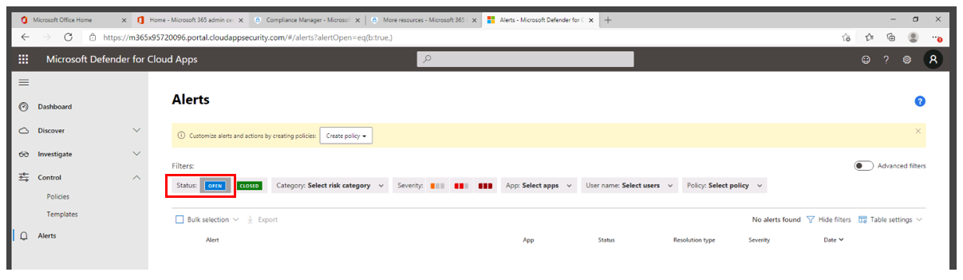
Manage and respond to alerts in Microsoft Defender for Cloud Apps
Determine the nature of the violation and the required response for each alert:
Filter the alerts by Alert type or by Severity
Select a specific alert
You can filter based on an app
Three types of violations:
Serious violations
Questionable violations
Authorized violations or anomalous behavior
Notes:
Alerts are the entry points to understanding your cloud environment more deeply. You might want to create new policies based on what you find. For example, you may see an administrator signing in from Greenland, and no one in your organization ever signed in from Greenland before. You can create a policy that automatically suspends an admin account when it's used to sign in from that location.
Monitor alerts
It's a good idea to review all of your alerts and use them as tools for modifying your policies. If harmless events are being considered violations to existing policies, refine your policies so that you receive fewer unnecessary alerts.
On the Microsoft Defender for Cloud Apps portal, select Alerts in the navigation pane.
On the Alerts page, in the Filters section, select Open for the resolution status. This section of the dashboard provides full visibility into any suspicious activity or violation of your established policies. It can help you safeguard the security posture you defined for your cloud environment.
You can follow these guidelines in deciding how to categorize the alert:
If legitimate use triggered the alert and it isn't a security issue, it could be one of these types:
Benign positive. The alert is accurate but the activity is legitimate. You can dismiss the alert and set the reason to Actual severity is lower or Not interesting.
False positive. The alert is inaccurate. Dismiss the alert and set the reason to Alert is not accurate.
If any use triggered the alert and it's a security issue, then it will be:
True positive. If the alert is related to an actual risky event that was either committed maliciously or unintentionally by an insider or outsider, you should set the event to Resolve after all appropriate action has been taken to remediate the event.
If there's too much noise to determine the legitimacy and accuracy of an alert, dismiss it and set the reason to Too many similar alerts.
Alert types
Activity policy violation
File policy violation
Compromised account
Inactive account
New admin user
New admin location
New location
New discovered service
Suspicious activity
Use of personal account

Slide 22
Configure Cloud Discovery in Microsoft Defender for Cloud Apps
Cloud Discovery analyzes traffic logs against the Microsoft Defender for Cloud Apps catalog of over 25,000 cloud apps
The apps are ranked and scored based on more than 90 risk factors
Provides ongoing visibility into cloud use, Shadow IT, and the risk Shadow IT poses into an organization
Organizations can generate the following types of reports in Cloud Discovery:
Snapshot reports
Continuous reports
Reports created using the Cloud Discovery API
The process of generating a risk assessment consists of the following steps:
Upload web traffic logs from your network
Parse traffic data from the traffic logs
Analyze the traffic data
Generate a risk assessment report
Notes:
Cloud Discovery analyzes your traffic logs against the Microsoft Defender for Cloud Apps catalog of over 25,000 cloud apps. The apps are ranked and scored based on more than 90 risk factors. This design provides you with ongoing visibility into cloud use, Shadow IT, and the risk Shadow IT poses into your organization.
Snapshot and continuous risk assessment reports
Organizations can generate the following types of reports in Cloud Discovery:
Snapshot reports. Provides ad-hoc visibility on a set of traffic logs you manually upload from your firewalls and proxies.
Continuous reports. Analyze all logs that are forwarded from your network using Microsoft Defender for Cloud Apps. They provide improved visibility over all data, and automatically identify anomalous use using either the Machine Learning anomaly detection engine or by using custom policies that you define. These reports can be created by connecting in the following ways:
Microsoft Defender for Endpoint integration. Microsoft Defender for Cloud Apps integrates with Microsoft Defender for Endpoint natively, to simplify rollout of Cloud Discovery, extend Cloud Discovery capabilities beyond your corporate network, and enable machine-based investigation.
Log collector. Log collectors enable you to easily automate log upload from your network. The log collector runs on your network and receives logs over Syslog or FTP.
Secure Web Gateway (SWG). If you work with both Microsoft Defender for Cloud Apps and one of the following SWGs, you can integrate the products to enhance your security Cloud Discovery experience:
Zscaler integration
iboss integration
Corrata integration
Menlo Security integration
When Microsoft Defender for Cloud Apps and a Secure Web Gateway are integrated together, they provide seamless deployment of Cloud Discovery, automatic blocking of unsanctioned apps, and risk assessment directly in the SWG's portal.
Reports created using the Cloud Discovery API. Use the Cloud Discovery API to automate traffic log upload and generate an automated Cloud Discovery report and risk assessment. You can also use the API to generate block scripts and streamline app controls directly to your network appliance.
Log process flow: From raw data to risk assessment
The process of generating a risk assessment consists of the following steps.
Upload. Web traffic logs from your network are uploaded to the portal.
Parse. Defender for Cloud Apps parses and extracts traffic data from the traffic logs with a dedicated parser for each data source.
Analyze. Traffic data is analyzed against the Cloud App Catalog to identify more than 25,000 cloud apps and to assess their risk score. Active users and IP addresses are also identified as part of the analysis.
Generate report. A risk assessment report of the data extracted from log files is generated.
The process takes between a few minutes to several hours depending on the amount of data processed.
Using traffic logs for Cloud Discovery
Cloud Discovery uses the data in your traffic logs. The more detailed your log, the better visibility you get. Cloud Discovery requires web-traffic data with the following attributes:
Date of the transaction
Source IP
Source user - highly recommended
Destination IP address
Destination URL recommended (URLs provide higher accuracy for cloud app detection than IP addresses)
Total amount of data (data information is highly valuable)
Amount of uploaded or downloaded data (provides insights about the usage patterns of the cloud apps)
Action taken (allowed/blocked)
To successfully generate a Cloud Discovery report, your traffic logs must meet the following conditions:
Data source is supported.
Log format matches the expected standard format (format checked upon upload by the Log tool).
Events aren't more than 90 days old.
The log file is valid and includes outbound traffic information.

Slide 23
Troubleshoot Cloud Discovery in Microsoft Defender for Cloud Apps
Microsoft Defender for Endpoint integration
Log parsing errors
Log collector errors
Discovery dashboard errors

Slide 24
Knowledge Check
Test your knowledge by answering the Knowledge Check questions at the end of this Learn module

Slide 25
Summary
This module examined the following features related to implementing Microsoft Defender for Cloud Apps:
Microsoft Defender for Cloud Apps features and functionality
Deploying Microsoft Defender for Cloud Apps
Controlling your Cloud Apps with Policies
Configuring Cloud Discovery in Microsoft Defender for Cloud Apps
Troubleshooting Microsoft Defender for Cloud Apps

Slide 26
Module 3: Implement endpoint protection by using Microsoft Defender for Endpoint

Slide 27
Introduction
This module examines the following key features of Microsoft Defender for Endpoint, which is an industry-leading, cloud-powered endpoint security solution:
Vulnerability management
Attack surface reduction
Next generation protection
Endpoint detection and response
Auto investigation and remediation

Slide 28
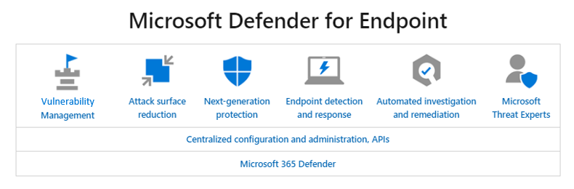
Explore Microsoft Defender for Endpoint
Combination of technologies:
Endpoint behavioral sensors
Cloud security analytics
Threat intelligence
Plan your Microsoft Defender for Endpoint deployment:
Identify your architecture
Select the deployment method
Configure Endpoint capabilities
Notes:
Microsoft Defender for Endpoint is an enterprise endpoint security platform designed to help enterprise networks prevent, detect, investigate, and respond to advanced threats.
Microsoft Defender for Endpoint uses the following combination of technology built into Windows 10 and Microsoft's robust cloud service:
Endpoint behavioral sensors. These sensors are embedded in Windows 10. They begin by collecting and processing behavioral signals from the operating system. They then send this sensor data to an organization's private, isolated, cloud instance of Microsoft Defender for Endpoint.
Cloud security analytics. Enterprise cloud products (such as Microsoft 365) and online assets apply big-data, device learning, and unique Microsoft optics across the Windows ecosystem. Behavioral signals are translated into insights, detections, and recommended responses to advanced threats.
Threat intelligence. Microsoft hunters and security teams generate threat intelligence. This information is then augmented by threat intelligence provided by partners. Threat intelligence enables Microsoft Defender for Endpoint to:
Identify attacker tools, techniques, and procedures.
Generate alerts when they're observed in collected sensor data.
Microsoft Defender for Endpoint is a service of Microsoft 365 Defender. Under the Microsoft 365 Defender umbrella are centralized configuration and administration APIs, followed by the Microsoft Defender for Endpoint services. These capabilities are outlined below:
Threat & Vulnerability Management.
Attack surface reduction.
Next-generation protection.
Endpoint detection and response.
Automated investigation and remediation.
Microsoft Secure Score for Devices.
Microsoft Threat Experts.
Centralized configuration and administration, APIs.
Integration with Microsoft solutions.
Microsoft 365 Defender.
Plan your Microsoft Defender for Endpoint deployment
Plan your Microsoft Defender for Endpoint deployment so that you can maximize the security capabilities within the suite and better protect your enterprise from cyber threats.
This solution provides guidance on how to identify your environment architecture, select the type of deployment tool that best fits your needs, and guidance on how to configure capabilities.
Identify architecture
Identify which architecture best represents your enterprise:
Cloud-native
Co-management
On-premises
Evaluation and local onboarding
Select deployment method
Select your preferred deployment tool:
Local script (up to 10 devices)
Group policy
Microsoft Endpoint Manager / Mobile Device Manager
Microsoft Endpoint Configuration Manager
Azure Defender
Script
Configure capabilities
Configure the following capabilities:
Endpoint detection & response
Next-generation protection
Attack surface reduction

Slide 29
Configure Microsoft Defender for Endpoint in Microsoft Intune
To be successful, you'll use the following configurations in concert:
Establish a service-to-service connection between Microsoft Intune and Microsoft Defender for Endpoint
Use a device configuration profile to onboard devices with Microsoft Defender for Endpoint
Use a device compliance policy to set the level of risk you want to allow
Use a conditional access policy to block users from accessing corporate resources from devices that are noncompliant
Notes:
Organizations can integrate Microsoft Defender for Endpoint with Microsoft Intune as a Mobile Threat Defense solution. Integration can help prevent security breaches and limit the effect of breaches within an organization.
Microsoft Defender for Endpoint works with devices that run:
Android
iOS/iPadOS
Windows 10
Windows 11
Prerequisites to integrating Microsoft Defender for Endpoint and Microsoft Intune
To use Microsoft Defender for Endpoint with Microsoft Intune, an organization must have the following subscriptions:
Microsoft Defender for Endpoint. This subscription provides you access to the Microsoft Defender Security Center (ATP portal). For Defender for Endpoint licensing options, see Licensing requirements in Minimum requirements for Microsoft Defender for Endpoint and How to set up a Microsoft 365 E5 Trial Subscription.
Microsoft Intune. This subscription provides access to Intune and the Microsoft Endpoint Manager admin center. For Intune licensing options, see Microsoft Intune licensing.

Slide 30
Onboard devices in Microsoft Defender for Endpoint
Examine the following steps to onboard devices and configure compliance and conditional access policies:
Onboard devices that run Android, iOS/iPadOS, and Windows 10/11
Use compliance policies to set device risk levels
Use conditional access policies to block devices that exceed your expected risk levels
Android and iOS/iPadOS use app protection policies that set device risk levels. App protection polices work with both enrolled and unenrolled devices

Slide 31
Manage endpoint vulnerabilities with Microsoft Defender Vulnerability Management
Organizations can reduce cyber security risk by implementing the following features in Microsoft Defender Vulnerability Management:
Asset discovery and inventory – Applies built-in and agentless scanners to continuously monitor and detect risk in an organization, even when devices aren’t connected to the corporate network
Vulnerability and configuration assessment - Assesses an organization's cyber exposure with the following advanced vulnerability and configuration assessment tools:
Security baselines assessment
Visibility into software and vulnerabilities
Network share assessment
Threat analytics and event timelines
Browser extensions
Digital certificates
Risk-based intelligent prioritization - Prioritizes the biggest vulnerabilities on an organization’s most critical assets through the following features:
Focuses on emerging threats
Pinpoints active breaches
Protects high-value assets
Remediation and tracking - Enables security and IT administrators to collaborate and seamlessly remediate issues with the following built-in workflows:
Remediation requests sent to IT
Block vulnerable applications
Alternate mitigations
Real-time remediation status
Notes:
Once devices are discovered, an organization can:
Onboard unmanaged endpoints to the service, increasing the security visibility on them.
Reduce the attack surface by identifying and assessing vulnerabilities, and detecting configuration gaps.
Discovery methods
There are two modes of discovery available:
Basic discovery.
Standard discovery (recommended).
Device inventory
Devices that have been discovered but haven't been onboarded and secured by Microsoft Defender for Endpoint will be listed in the device inventory within the Microsoft Endpoint Manager admin center.
To assess these devices, you can use a filter in the device inventory list called Onboarding status. This filter can have any of the following values:
Onboarded.
Can be onboarded.
Unsupported.
Insufficient information.
Network device discovery
The large number of unmanaged network devices deployed in an organization creates a large surface area of attack. They also represent a significant risk to the entire enterprise. The network discovery capability within Microsoft Defender for Endpoint helps organizations ensure their network devices are discovered, accurately classified, and added to their asset inventory.
The Threat and Vulnerability Management capability within Microsoft Defender for Endpoint then provides integrated workflows to secure the following discovered information:
switches
routers
WLAN controllers
firewalls
VPN gateways
Device discovery integrations
Microsoft Defender for Endpoint addresses the challenge of gaining enough visibility for organizations to locate, identify, and secure their complete OT/IOT asset inventory. It does so by supporting the following integrations:
Corelight.
Microsoft Defender for IoT.
Configure device discovery
As previously noted, device discovery can be configured to be on standard or basic mode. Organizations should use the standard option to actively find devices in their networks. This option will better guarantee the discovery of endpoints and provide richer device classification.
Exclude devices from being actively probed in standard discovery
Some organizations have devices on their network that shouldn't be actively scanned. For example, devices that are used as honeypots for another security tool. In these cases, an organization can define a list of exclusions to prevent these devices from being scanned.
Select networks to monitor
When Microsoft Defender for Endpoint analyzes a network, it determines if the network is:
a corporate network that must be monitored.
a non-corporate network that can be ignored.
A filter can be applied to view any of the following network discovery states:
Monitored networks. Networks where device discovery is performed.
Ignored networks. This network will be ignored and device discovery won't be performed on it.
All. Both monitored and ignored networks will be displayed.
Configure the network monitor state
Organizations can control where device discovery takes place. Monitored networks are where device discovery will be performed. These networks are typically corporate networks. You can also choose to ignore networks or select the initial discovery classification after modifying a state.
Selecting the initial discovery classification means to apply the default system-made network monitor state.
Selecting the default system-made network monitor state means that:
networks that were identified to be corporate will be monitored.
networks that were identified as non-corporate will be automatically ignored.
Explore devices in the network
You can use the advanced hunting (Kusto) query to get more context about each network name described in the networks list.
Get information on device
You can use the advanced hunting (Kusto) query to get the latest complete information on a specific device.
Vulnerability assessment on discovered devices
Vulnerabilities and risks on your devices as well as other discovered unmanaged devices in the network are part of the current Threat and Vulnerabilities Management flows under "Security Recommendations". They're represented in entity pages across the portal.
Use advanced hunting on discovered devices
Organizations can use advanced hunting queries to gain visibility on discovered devices.
Query network related information
Device discovery uses Microsoft Defender for Endpoint onboarded devices as a network data source to attribute activities to non-onboarded devices. The network sensor on the Microsoft Defender for Endpoint onboarded device identifies two new connection types:
ConnectionAttempt. An attempt to establish a TCP connection.
ConnectionAcknowledged. An acknowledgment that a TCP connection was accepted.
When a non-onboarded device attempts to communicate with an onboarded Microsoft Defender for Endpoint device, the attempt will:
generate a DeviceNetworkEvent.
display the non-onboarded device activities on the onboarded device timeline and through the Advanced hunting DeviceNetworkEvents table.

Slide 32
Manage device discovery and vulnerability assessment
Microsoft Defender for Endpoint provides a device discovery capability that enables organizations to discover:
Enterprise endpoints (workstations, servers and mobile devices) that aren't yet onboarded to Microsoft Defender for Endpoint
Network devices like routers and switches
IoT devices like printers and cameras
The device discovery feature includes:
Discovery methods
Device inventory
Network device discovery
Device discovery integrations
Configure device discovery
Exclude devices from being actively probed in standard discovery
Select networks to monitor
Configure the network monitor state
Explore devices in the network
Get information on a device
Vulnerability assessment on discovered devices
Advanced hunting on discovered devices
Query network related information
Notes:
Once devices are discovered, an organization can:
Onboard unmanaged endpoints to the service, increasing the security visibility on them.
Reduce the attack surface by identifying and assessing vulnerabilities, and detecting configuration gaps.
Discovery methods
There are two modes of discovery available:
Basic discovery.
Standard discovery (recommended).
Device inventory
Devices that have been discovered but haven't been onboarded and secured by Microsoft Defender for Endpoint will be listed in the device inventory within the Microsoft Endpoint Manager admin center.
To assess these devices, you can use a filter in the device inventory list called Onboarding status. This filter can have any of the following values:
Onboarded.
Can be onboarded.
Unsupported.
Insufficient information.
Network device discovery
The large number of unmanaged network devices deployed in an organization creates a large surface area of attack. They also represent a significant risk to the entire enterprise. The network discovery capability within Microsoft Defender for Endpoint helps organizations ensure their network devices are discovered, accurately classified, and added to their asset inventory.
The Threat and Vulnerability Management capability within Microsoft Defender for Endpoint then provides integrated workflows to secure the following discovered information:
switches
routers
WLAN controllers
firewalls
VPN gateways
Device discovery integrations
Microsoft Defender for Endpoint addresses the challenge of gaining enough visibility for organizations to locate, identify, and secure their complete OT/IOT asset inventory. It does so by supporting the following integrations:
Corelight.
Microsoft Defender for IoT.
Configure device discovery
As previously noted, device discovery can be configured to be on standard or basic mode. Organizations should use the standard option to actively find devices in their networks. This option will better guarantee the discovery of endpoints and provide richer device classification.
Exclude devices from being actively probed in standard discovery
Some organizations have devices on their network that shouldn't be actively scanned. For example, devices that are used as honeypots for another security tool. In these cases, an organization can define a list of exclusions to prevent these devices from being scanned.
Select networks to monitor
When Microsoft Defender for Endpoint analyzes a network, it determines if the network is:
a corporate network that must be monitored.
a non-corporate network that can be ignored.
A filter can be applied to view any of the following network discovery states:
Monitored networks. Networks where device discovery is performed.
Ignored networks. This network will be ignored and device discovery won't be performed on it.
All. Both monitored and ignored networks will be displayed.
Configure the network monitor state
Organizations can control where device discovery takes place. Monitored networks are where device discovery will be performed. These networks are typically corporate networks. You can also choose to ignore networks or select the initial discovery classification after modifying a state.
Selecting the initial discovery classification means to apply the default system-made network monitor state.
Selecting the default system-made network monitor state means that:
networks that were identified to be corporate will be monitored.
networks that were identified as non-corporate will be automatically ignored.
Explore devices in the network
You can use the advanced hunting (Kusto) query to get more context about each network name described in the networks list.
Get information on device
You can use the advanced hunting (Kusto) query to get the latest complete information on a specific device.
Vulnerability assessment on discovered devices
Vulnerabilities and risks on your devices as well as other discovered unmanaged devices in the network are part of the current Threat and Vulnerabilities Management flows under "Security Recommendations". They're represented in entity pages across the portal.
Use advanced hunting on discovered devices
Organizations can use advanced hunting queries to gain visibility on discovered devices.
Query network related information
Device discovery uses Microsoft Defender for Endpoint onboarded devices as a network data source to attribute activities to non-onboarded devices. The network sensor on the Microsoft Defender for Endpoint onboarded device identifies two new connection types:
ConnectionAttempt. An attempt to establish a TCP connection.
ConnectionAcknowledged. An acknowledgment that a TCP connection was accepted.
When a non-onboarded device attempts to communicate with an onboarded Microsoft Defender for Endpoint device, the attempt will:
generate a DeviceNetworkEvent.
display the non-onboarded device activities on the onboarded device timeline and through the Advanced hunting DeviceNetworkEvents table.

Slide 33
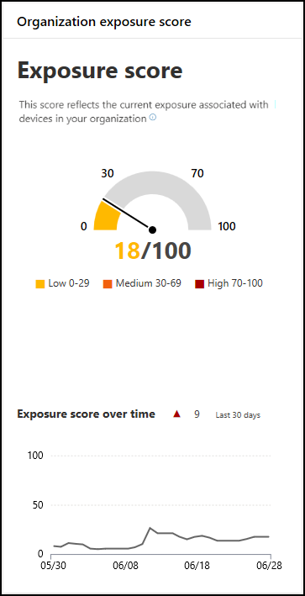
Reduce your threat and vulnerability exposure
An organization's exposure score reflects how vulnerable it is to cybersecurity threats
The score is displayed in the Vulnerability Management dashboard of the Microsoft 365 Defender portal
Each device in an organization is scored based on three factors:
Threat
Breach likelihood
Business value
The Microsoft 365 Defender portal includes:
Security recommendations with remediation actions
Changes in device exposure or effect
File exceptions for security recommendations
Report an inaccurate recommendation
Notes:
An organization's exposure score is visible in the Threat and Vulnerability Management dashboard of the Microsoft 365 Defender portal. It reflects how vulnerable your organization is to cybersecurity threats. A low exposure score means your devices are less vulnerable from exploitation. An organization's enterprise and security administrators should:
Quickly understand and identify high-level takeaways about the state of security in their organization.
Detect and respond to areas that require investigation or action to improve the current state.
Communicate with peers and management about the effect of security efforts.
The exposure scorecard gives an organization a high-level view of its exposure score's trend over time. Any spikes in trend line provide a visual indication of a high cybersecurity threat exposure that needs further investigation.
The exposure score is broken down into the following levels:
0-29. Low exposure score.
30-69. Medium exposure score.
70-100. High exposure score.
Reduce your threat and vulnerability exposure
Cybersecurity weaknesses identified in an organization are mapped to actionable security recommendations and prioritized by their effect. Prioritized recommendations help shorten the time to mitigate or remediate vulnerabilities and drive compliance.
Organizations can lower their threat and vulnerability exposure by remediating the issues based on prioritized security recommendations.
Security recommendations - threat and vulnerability management
Each device in the organization is scored based on three important factors. These factors help customers focus on the right things at the right time:
Threat. Characteristics of the vulnerabilities and exploits in your organizations' devices and breach history. Based on these factors, the security recommendations show the corresponding links to:
Active alerts
Ongoing threat campaigns
Their corresponding threat analytic reports
Breach likelihood. The organization's security posture and resilience against threats.
Business value. The organization's assets, critical processes, and intellectual properties.
The Security recommendations page can be accessed in two ways:
Threat and Vulnerability Management navigation menu in the Microsoft 365 Defender portal. Select Recommendations. The page contains a list of security recommendations for the threats and vulnerabilities found in the organization.
Top security recommendations in the Threat and Vulnerability Management dashboard. In a given day as a Security Administrator, you can take a look at the threat and vulnerability management dashboard to see your exposure score side by side with your Microsoft Secure Score for Devices. The goal is to lower your organization's exposure from vulnerabilities, and increase your organization's device security to be more resilient against cybersecurity threat attacks. The top security recommendations list can help you achieve that goal.
Security recommendations overview
The Security recommendations page displays the following information:
Number of weaknesses found
Related components
Threat insights
Number of exposed devices
Status
Remediation type
Remediation activities
Effect to your exposure score and Microsoft Secure Score for Devices
Associated tags

Slide 34
Knowledge Check
Test your knowledge by answering the Knowledge Check questions at the end of this Learn module

Slide 35
Summary
This module examined the following features related to implementing Microsoft Defender for Endpoint:
Vulnerability Management
Attack surface reduction
Next generation protection
Endpoint detection and response
Auto investigation and remediation

Slide 36
Module 4: Implement threat protection by using Microsoft Defender for Office 365

Slide 37
Introduction
In this module, you'll examine additional threat protection features provided by Microsoft Defender for Office 365
This module examines:
Microsoft Defender for Office 365 protection stack
Threat Explorer
Threat Tracker widgets and views
Attack simulation training

Slide 38
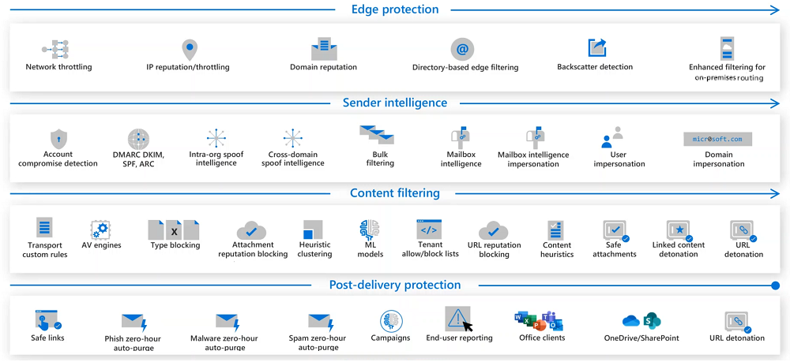
Explore the Microsoft Defender for Office 365 protection stack
The Microsoft Defender for Office 365 protection stack provides four layers of security protection to all incoming messages, as shown in the following diagram
Notes:
The Edge protection layer
The Edge protection layer is the first point of contact for an inbound message. It's made up of edge blocks that run automatically. Each edge block handles a different aspect of protection - from network and IP reputation throttling through directory-based edge filtering and backscatter detection.
The Edge protection layer consists of the following edge blocks:
Network throttling
IP reputation and throttling
Domain reputation
Directory-based edge filtering
Backscatter detection)
Enhanced Filtering for on-premises routing
The Sender intelligence layer
The next layer in the protection stack is Sender intelligence. The focus of this layer is identifying the validity of the message sender. This layer checks each message for the following issues:
Indicators of a compromised account
Spam
Spoofing
Whether the email sender is authorized and authenticated
The mailbox behaves within tolerance
The Content filtering layer
The next layer in the protection stack is Content filtering. The primary focus of this layer is to check the content of the mail. In doing so, it looks for suspicious message structure and word frequency, hyperlinks, and attachments. Each email is subject to several checks, from mail flow rules to heuristics and machine learning models.
The Post-delivery protection layer
The last layer in the protection stack is Post-delivery protection. This persistent layer manages how users interact with files and links not just in their mailboxes, but across other collaborative tools like Microsoft Teams.

Slide 39
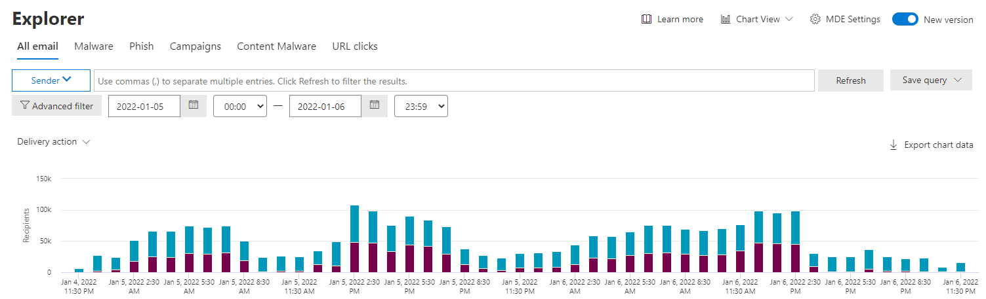
Investigate security attacks by using Threat Explorer
Threat Explorer provides a color-coded chart that represents attacks that are targeted at your organization
Threat Explorer enables security analysts and administrators to drill down and understand details related to threats targeting their tenant
The default view displays malware by threat family

Slide 40
Identify cybersecurity issues by using Threat Trackers
Threat Trackers are informative widgets and views that provide intelligence on different cybersecurity issues that may impact your company
Most tracker pages include:
Trending
Widgets
A quick link in the Actions column
Available Threat Trackers include:
Noteworthy trackers
Trending trackers
Tracked queries
Saved queries

Slide 41
Prepare for attacks with Attack simulation training
Attack simulation training in Microsoft Defender for Office 365 lets an organization run benign cyberattack simulations to test its security policies and practices and train employees
Key requirements for running the Attack Simulator training include:
The organization must have Microsoft 365 E5 or Microsoft Defender for Office 365 Plan 2
The person running the Attack simulation training must be a Microsoft 365 Global administrator or Security administrator
The organization’s email must be hosted in Exchange Online
Steps to run Attack simulation training:
Select a social engineering (simulation) technique
Select a payload
Audience targeting
Assign training
Launch details and review
Notes:
Supporting videos for instructor or student use:
Attack Simulator in Office 365
https://youtu.be/5jWGU2VM3SI

Slide 42
Knowledge Check
Test your knowledge by answering the Knowledge Check questions at the end of this Learn module

Slide 43
Summary
This module examined the following features related to implementing Microsoft Defender for Office 365:
Microsoft Defender for Office 365 protection stack
Threat Explorer
Threat Tracker widgets and views
Attack simulation training

Slide 44
Lab 6 – Implement Threat Intelligence (continued)

Slide 45
Lab exercises
Exercise 5: Conduct a Spear Phishing attack using Attack simulation training
Task 1
Enable Multifactor Authentication for the Global Admin
Task 2
Configure and launch a Spear Phishing attack
Task 3
Review the Spear Phishing results
Exercise 6: Conduct Password attacks using Attack simulation training
Task 1
Configure and launch a Drive-by URL attack
Task 2
Review the Brute Force results
Task 3
Configure and launch a Password Spray attack
Task 4
Review the Password Spray results
Task 5
Disable Multifactor Authentication for the Global Admin

Slide 46
Module 5: Learning Path Review

Slide 47
Discussion – Learning Path review
What are your key takeaways from this learning path, and why?
What are the key features discussed in this learning path that you foresee implementing at your organization?

Slide 48
Closing

