Slide 1
Learning Path 8: Implement compliance in Microsoft 365

Slide 2
Learning Path agenda
Explore compliance in Microsoft 365
Implement Microsoft Purview Insider Risk Management
Implement Microsoft Purview Information Barriers
Explore Microsoft Purview Data Loss Prevention
Implement Microsoft Purview Data Loss Prevention
Lab 8 - Implement DLP Policies
Learning Path Review
Notes:
Mention how this Learning Path also maps to the fourth and final certification exam study area, which is managing Microsoft 365 compliance.

Slide 3
Module 1: Explore compliance in Microsoft 365

Slide 4
Introduction
Microsoft 365 includes tools that help organizations ensure their regulatory compliance
This module examines:
Planning for security and compliance in Microsoft 365 and Microsoft Purview
Managing compliance requirements using Compliance Manager
Analyzing the Microsoft Compliance Score

Slide 5
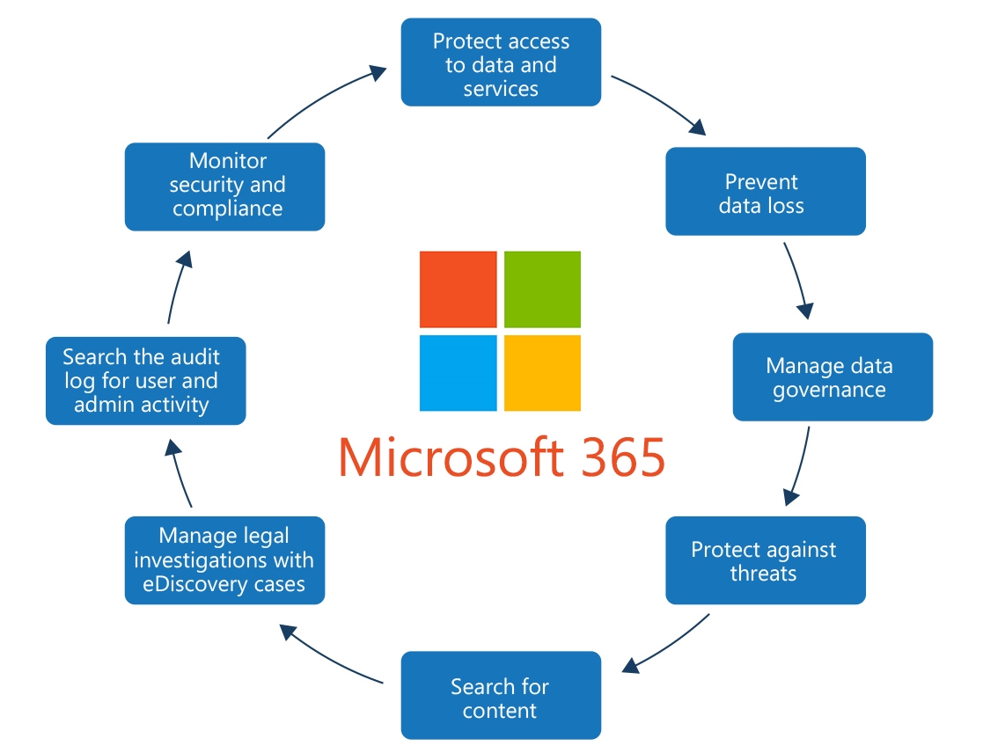
Plan for security and compliance in Microsoft 365
Microsoft 365’s Enterprise Mobility + Security suite is designed to help organizations achieve the appropriate level of protection
You should perform the following steps when planning for security and compliance in Microsoft 365:
Review capabilities
Check your Secure Score
Plan access protection for identity and devices
Plan data protection based on data sensitivity
Use the Microsoft Purview compliance portal
Use beginning-to-end security scenarios as starting points
Diagram showing all the security considerations required to protect the data inside Microsoft 365

Slide 6
Plan your beginning compliance tasks in Microsoft Purview
Identifying and managing compliance risks is critical to safeguarding data
This can be accomplished in Microsoft Purview by completing the following tasks:
Configure compliance permissions
Know your state of compliance
Enable auditing for your organization
Create policies to alert you about potential compliance issues
Classify and protect sensitive data
Configure retention policies
Configure sensitive information and offensive language policies
See what's happening with your sensitive items

Slide 7
Manage your compliance requirements with Compliance Manager
Microsoft Purview Compliance Manager is designed to help organizations manage their compliance requirements with greater ease and convenience
Compliance Manager can help an organization complete the following steps:
Take inventory of its data protection risks
Manage the complexities of implementing controls
Stay current with regulations and certifications
Report to auditors
Compliance Manager helps to simplify compliance and reduce risk by providing:
Pre-built assessments for common industry and regional standards and regulations, or custom assessments to meet an organization‘s unique compliance needs
Workflow capabilities to help organizations efficiently complete their risk assessments through a single tool
Detailed step-by-step guidance on suggested improvement actions to help organizations follow the standards and regulations that are most relevant for them
A risk-based compliance score to help organizations understand their compliance posture by measuring their progress in completing improvement actions

Slide 8
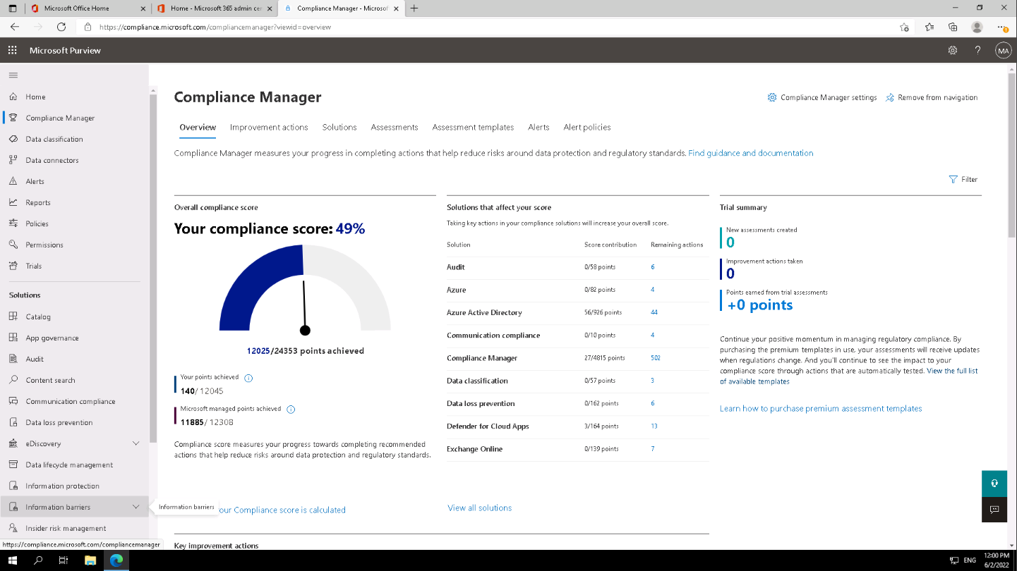
Examine the Compliance Manager dashboard
Screenshot of the top portion of the Compliance Manager dashboard, which shows:
The company's overall compliance score
Key improvement actions that are suggested for improving the company's state of compliance

Slide 9
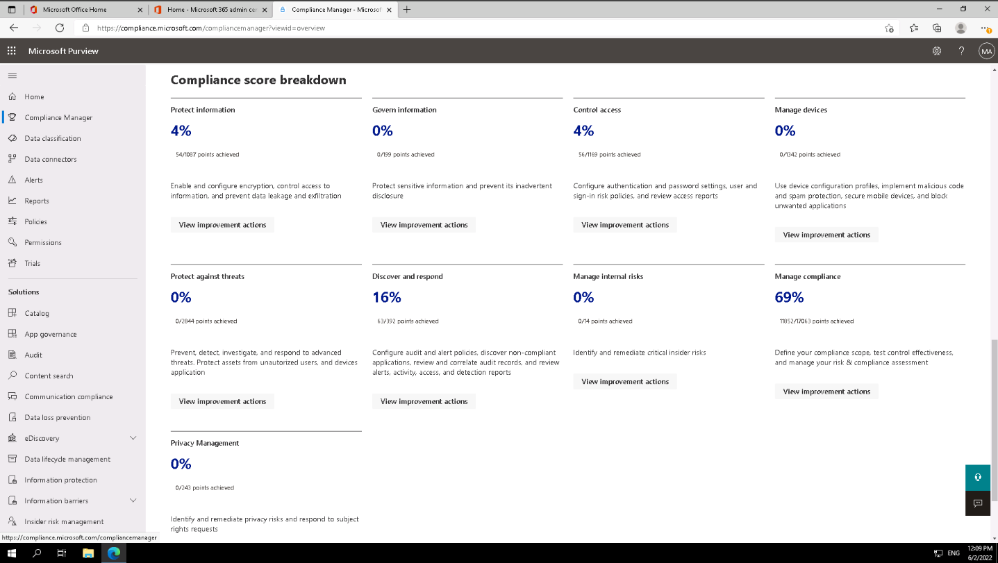
Examine the Compliance Manager dashboard (continued)
Screenshot of the bottom portion of the Compliance Manager dashboard, which shows:
The breakdown of the company's compliance score by each compliance category
The areas doing well and the areas needing improvement

Slide 10
Analyze the Microsoft Compliance Score
The Microsoft Compliance Score measures a company's progress in completing recommended improvement actions within controls
Its purpose is to help an organization understand its compliance posture and help it prioritize actions based on their potential to reduce risk
An organization’s initial score is based on the Microsoft 365 data protection baseline, which is a set of controls that includes common industry regulations and standards
An organization then accrues points as it completes recommended improvements – some actions are Microsoft-managed actions; others are customer-managed actions
Each action has a different impact on an organization’s score, depending on the potential risks involved
The score can help prioritize which action to focus on to improve your overall compliance posture:
The sum of points earned by taking improvement actions is the control score
The sum of your control scores is the assessment score
The sum of your improvement action scores is your overall compliance score

Slide 11

Knowledge Check
Test your knowledge by answering the Knowledge Check questions at the end of this Learn module

Slide 12
Summary
This module examined the following items related to compliance in Microsoft 365:
Planning for security and compliance in Microsoft 365 and Microsoft Purview
Managing compliance requirements using Compliance Manager
Analyzing the Microsoft Compliance Score

Slide 13
Module 2: Implement Microsoft Purview Insider Risk Management

Slide 14
Introduction
This module explores Microsoft Purview Insider Risk Management, including:
Insider risk management planning
Insider risk management policies
Insider risk management activities and alerts
Insider risk management cases

Slide 15
Explore insider risk management
Microsoft Purview Insider Risk Management helps organizations quickly identify, triage, and act on malicious or inadvertent activities
By using logs from Microsoft 365 and Microsoft Graph, insider risk management allows you to define specific policies to identify risk indicators and mitigate these risks
To get started with Microsoft Purview Insider Risk Management:
Turn on auditing
Get permissions to user risk management
Choose policy indicators
Scan for potential insider risks
Assign permissions to others
Create your first policy
Insider risk case
Policy
Alerts
Triage
Investigate
Action
Collaboration
Compliance, Human Resources, Legal, Security
Insider risk management uses this workflow, which identifies and resolves internal risk activities and compliance issues

Slide 16
Plan for insider risk management
An organization should identify the appropriate stakeholders who will be members of its insider risk management team
Different geographic and organizational areas may have compliance and privacy requirements that are different from other areas of an organization
Organizations that want to manage insider risk management policies and alerts must assign users to specific role groups to manage different sets of insider risk management features
Organizations should use a single role group or multiple role groups to best fit its compliance management requirements
Organizations should ensure they always have at least one user in the Insider Risk Management or Insider Risk Management Admin role groups
Organizations should test its policies with a small set of production users while conducting the necessary compliance, privacy, and legal reviews

Slide 17
Explore insider risk management policies
Insider risk management policies determine:
The users that are in-scope
The types of risk indicators that are configured for alerts
Policies also support content priorities. By doing so, an organization can focus policy conditions on multiple or specific Microsoft Teams, SharePoint sites, data sensitivity types, and data labels
Insider risk management templates are pre-defined policy conditions that define the types of risk indicators and risk scoring model used by the associated policy
Each policy must have a template assigned in the policy creation wizard
Insider risk management supports up to five policies for each policy template
The Policy tab on the Microsoft Purview Insider Risk Management dashboard enables an organization to quickly:
Review its policies
Review the health of policies
Manually add users to policies
View the status of alerts associated with each policy

Slide 18
Create insider risk management policies
Triggering events are prerequisites that determine if a user is active for an insider risk management policy
Policy prerequisites are required items so that the policy receives the signals or activities necessary to evaluate risk
When an organization creates an insider risk management policy in the policy wizard, it can choose from the following priorities:
SharePoint sites
Sensitive information types
Sensitivity labels
File extensions
To create a new insider risk management policy, you'll use the policy wizard in the Microsoft Purview Insider Risk Management solution

Slide 19
Investigate insider risk management activities and alerts
Investigating risky user activities is an important first step in minimizing insider risks for an organization
Risks can include:
Activities that generate alerts from insider risk management policies
Risks from activities that are detected by policies but don't immediately create an insider risk management alert for users
Organizations can investigate these types of activities by using the User activity reports and the Alert dashboard
User activity reports allow an organization to examine activities for specific users for a defined time period
The organization can view reports without having to temporarily or explicitly assign the users to an insider risk management policy
Insider risk management alerts are automatically generated by risk indicators defined in insider risk management policies
Alerts give compliance analysts and investigators an all-up view of the current risk status

Slide 20
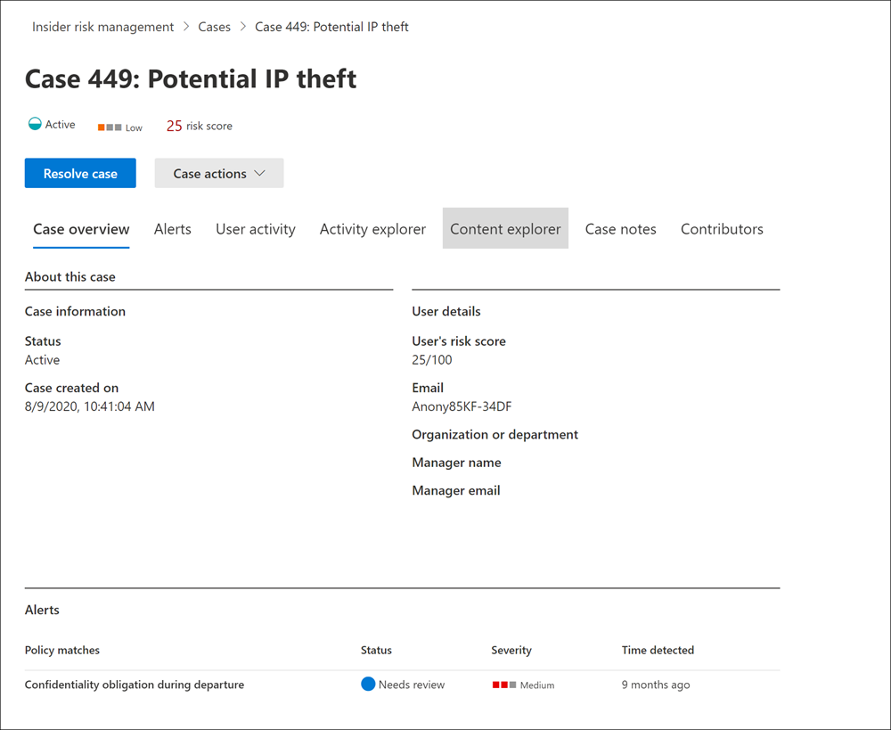
Explore insider risk management cases
Cases are the heart of insider risk management
They enable organizations to deeply investigate and act on issues generated by risk indicators defined in their policies
The Cases dashboard enables an organization's investigators and risk analysts to view and act on cases
Risk analysts and investigators also use cases to centralize review feedback and notes and to process case resolution
The Case overview tab summarizes the case details for risk analysts and investigators

Slide 21
Knowledge Check
Test your knowledge by answering the Knowledge Check questions at the end of this Learn module

Slide 22
Summary
This module examined the following items related to Microsoft Purview Insider Risk Management:
Insider risk management planning
Insider risk management policies
Insider risk management activities and alerts
Insider risk management cases

Slide 23
Module 3: Implement Microsoft Purview Information Barriers

Slide 24
Introduction
Microsoft Purview Information Barriers enable administrators to restrict communication and collaboration between certain teams to safeguard internal information
This module examines:
How to configure information barriers
Information barriers in Microsoft Teams
Information barriers in OneDrive
Information barriers in SharePoint Online

Slide 25
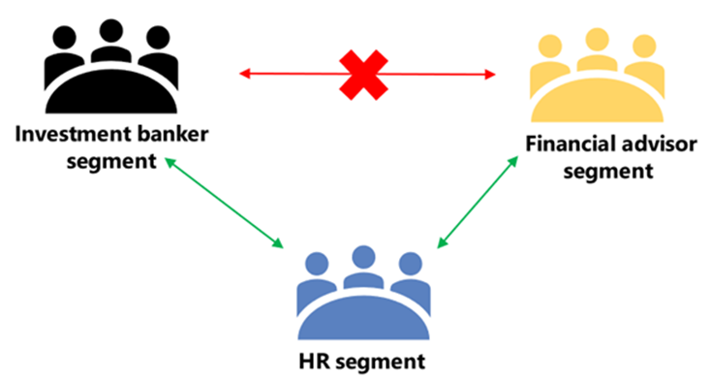
Explore Microsoft Purview Information Barriers
Information barriers are policies that restrict communication between certain groups within an organization
Information barrier policies only apply to SharePoint Online, Microsoft Teams, and OneDrive services
Information barrier policies can be used in different kinds of scenarios, including:
Prohibiting communication or file sharing between users on different teams
Prohibiting calling or online chat between users in certain groups within the organization
Restricting a user to only call or chat online with a specific team
Restricting file sharing or access to a certain site by anyone outside a specific team
A visual representation of how an information barrier policy works
Notes:
Note
Information barriers only support two-way restrictions. With this type of restriction, users from team A can't initiate communication with team B, and users from team B can't initiate communication with team A. One-way restrictions (where users from team A can't initiate communications with team B, but users from team B can initiate communication with team A) aren't supported.

Slide 26
Explore Microsoft Purview Information Barriers (continued)
How do information barrier policies work in each solution?
Microsoft Teams
Information barrier policies determine and prevent the following types of unauthorized communications:
Searching for a user
Adding a member to a team
Starting a chat session with someone
Starting a group chat
Inviting someone to join a meeting
Sharing a screen
Placing a call
Sharing a file with another user
Access to file through sharing link
SharePoint Online and OneDrive
Information barrier policies determine and prevent the following types of unauthorized collaborations:
Adding a member to a site
Accessing site or content by a user
Sharing site or content with another user
Searching a site

Slide 27
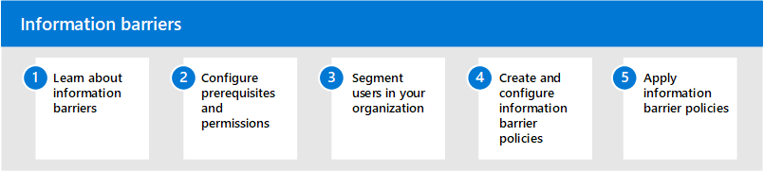
Configure information barriers in Microsoft Purview
Organizations should consider the following questions before configuring information barrier policies:
What are the legal or industry regulations regarding the groups inside your organization?
Are there any groups that should be prevented from communicating with another group?
Are there any groups that should be allowed to communicate only with one or two other groups?
Organizations should complete the following steps to configure information barriers

Slide 28
Examine information barriers in Microsoft Teams
The Shared channels feature in Microsoft Teams is supported by information barriers
Depending on the type of sharing, information barriers policies may restrict sharing in certain ways
For Microsoft Teams, information barriers can determine and prevent the following types of unauthorized collaborations:
Adding a user to a team or channel
User access to team or channel content
User access to 1:1 and group chats
User access to meetings
Prevents lookups and discovery; users won't be visible in the people picker
Information barrier policies are activated when the following Teams events take place:
Members are added to a team
A new chat is requested.
A user is invited to join a meeting
A screen is shared between two or more users
A user places a phone call in Teams
Guests are added in Teams

Slide 29
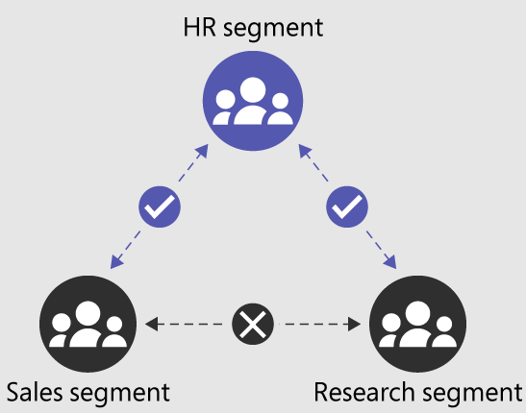
Examine information barriers in OneDrive
Information barriers in OneDrive can determine and prevent the following kinds of unauthorized collaborations:
User access to OneDrive or stored content
Sharing OneDrive or stored content with other users
When an organization uses information barriers with OneDrive, the following information barrier modes are supported:
Open
Owner Moderated
Explicit
Inferred

Slide 30
Examine information barriers in SharePoint
Information barriers in SharePoint can determine and prevent the following kinds of unauthorized collaborations:
Adding a user to a site
User access to a site or site content
Sharing a site or site content with other users
When an organization uses information barriers with SharePoint, the following information barrier modes are supported:
Open
Owner Moderated (preview)
Explicit
Inferred

Slide 31
Knowledge Check
Test your knowledge by answering the Knowledge Check questions at the end of this Learn module

Slide 32
Summary
This module examined the following items related to Microsoft Purview Information Barriers:
How to configure information barriers in Microsoft Purview
Information barriers in Microsoft Teams
Information barriers in OneDrive
Information barriers in SharePoint Online

Slide 33
Module 4: Explore Microsoft Purview Data Loss Prevention

Slide 34
Introduction
Data loss prevention (DLP) is a security feature that protects sensitive data in email, SharePoint content, and Office files from being accidentally or intentionally shared with unauthorized users
This module examines:
DLP fundamentals in Exchange and SharePoint
Endpoint data loss prevention
DLP policies
DLP reporting tools

Slide 35
Examine data loss prevention
In Microsoft Purview, data loss prevention is implemented by defining and applying DLP policies
DLP detects sensitive items by using deep content analysis, not by just a simple text scan
DLP also uses machine learning algorithms and other methods to detect content that matches an organization’s DLP policies
DLP is just one of the Microsoft Purview tools that organizations can use to help protect their sensitive items wherever their users live or travel
A Microsoft Purview DLP implementation typically follows these major phases:
Phase 1 - Plan for DLP
Phase 2 - Prepare for DLP
Phase 3 - Deploy your policies in production

Slide 36
Explore Endpoint data loss prevention
Endpoint data loss prevention (Endpoint DLP) extends the activity monitoring and protection capabilities of Microsoft Purview DLP to sensitive items that are physically stored on Windows 10, Windows 11, and macOS devices
Devices that were onboarded through Microsoft Defender for Endpoint can have device monitoring turned on to use Endpoint DLP
Endpoint DLP enables organizations to audit and manage the following types of activities users take on sensitive items:
Upload to cloud service, or access by unallowed browser
Copy to another app, process, or item
Copy to USB removable media
Copy to a network share
Print a document
Copy to a remote session
Copy to a Bluetooth device
Create an item
Rename an item

Slide 37
Examine DLP policies
A DLP policy combines different search patterns to look for, locations to protect or exclude, conditions, and actions
After an organization creates DLP policies, it can activate them to examine different locations, such as:
Exchange email
SharePoint sites
OneDrive accounts
An organization can also create a DLP policy and choose not to activate it. Instead, it may choose to run it in test mode
Microsoft Purview provides the following reports to help organizations monitor and audit their DLP policies:
DLP policy matches
DLP false positive and override

Slide 38
View DLP policy results
DLP reports a vast amount of information into Microsoft Purview from monitoring, policy matches and actions, and user activities
The customer content first goes into the Microsoft Purview compliance portal Audit Logs
It's then processed, and finally makes its way to different reporting tools
Organizations can use the DLP Alerts dashboard to:
Configure DLP alerts
Review them
Triage them
Track their resolution
The DLP reports show broad trends over time
DLP Activity Explorer enables organizations to review activity related to content that contains sensitive information or has labels applied

Slide 39
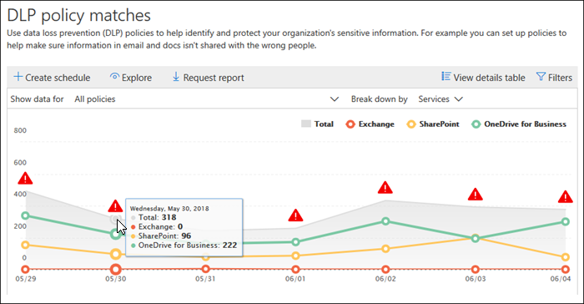
Explore DLP reports
The DLP reports in the Microsoft Purview compliance portal enable organizations to quickly view the following information:
DLP policy matches
DLP incidents
DLP false positives and overrides
You must be assigned one of the following roles to view DLP reports:
Security Reader
View-Only DLP Compliance Management
View-Only Recipients

Slide 40
Knowledge Check
Test your knowledge by answering the Knowledge Check questions at the end of this Learn module

Slide 41
Summary
This module examined the following items related to Microsoft Purview Data Loss Prevention:
DLP fundamentals in Exchange and SharePoint
Endpoint data loss prevention
DLP policies
DLP reporting tools

Slide 42
Module 5: Implement Microsoft Purview Data Loss Prevention

Slide 43
Introduction
In Microsoft 365, data loss prevention (DLP) is implemented by defining and applying DLP policies
This module examines how to:
Create a DLP implementation plan
Implement Microsoft Purview's default DLP policies
Create a custom DLP policy
Create policy tips for users when a DLP rule applies
Configure email notifications for DLP policies

Slide 44
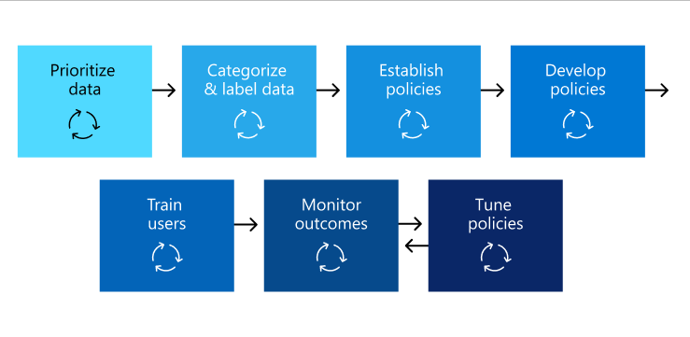
Plan to implement Microsoft Purview Data Loss Protection
Common steps to plan a Microsoft Purview DLP implementation include:
Identify stakeholders
Describe categories of sensitive information to protect
Set goals
Create an implementation plan
Map out path from start to end state
Discover sensitive items
Plan DLP policies
Plan for prerequisites
Deploy DLP policies
Train end-users
Review DLP requirements and update strategy
Diagram showing a set of steps that are commonly used to deploy DLP

Slide 45
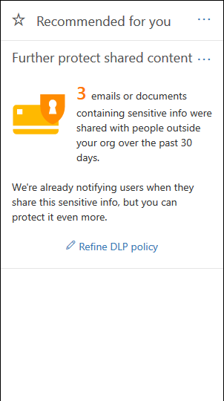
Implement Microsoft Purview’s default DLP policies
Microsoft Purview includes two default DLP policies that protect sensitive information
The first default DLP policy is:
Default policy for devices - This default DLP policy notifies an organization when email or documents containing sensitive information are shared with someone outside the organization
This recommendation is displayed in a tile on the Home page of the Microsoft Purview compliance portal (see diagram)
This tile enables an organization to quickly view when and how much sensitive information was shared.
The default DLP policy can be edited as it’s fully customizable
It can also be turned off or deleted so that users no longer receive policy tips or email notifications

Slide 46
Implement Microsoft Purview’s default DLP policies (continued)
The second default DLP policy is:
Default policy for Teams - This default DLP policy applies to chat and channel messages in Microsoft Teams
This default DLP policy tracks sensitive information shared internally and externally to the organization
This policy is turned on by default for all users of the tenant
It doesn't generate any policy tips for end users
It does generate an Alert event and triggers a low severity email to an administrator, who you must add in the policy
Administrators can view the activities and edit the policy's details in the Microsoft Purview compliance portal
The default DLP policies check for the following types of sensitive information:
Credit Card Number
Content containing source code (as matched by Microsoft’s Source Code trainable classifier)
Content matching Microsoft’s U.S HIPAA Enhanced template
Content containing the organization’s intellectual property (as matched by Microsoft's trainable classifiers related to IP, Project Documents, Mergers and Acquisitions files, Software Product Development files, IT Infrastructure and Network Security documents, and Strategic planning documents)

Slide 47
Design a custom DLP policy
Organizations should complete the following steps when designing a custom DLP policy:
Complete the steps in the prior unit on how to plan for data loss prevention
Understand all the components of a DLP policy and how each one influences the behavior of a policy
Familiarize yourself with what the DLP policy templates include
Develop your policy intent statement with your key stakeholders
Determine how this policy fits into your overall DLP policy strategy
Map the items in your policy intent statement to configuration options
Decide which policy template you'll start from, predefined or custom
Go through the template and assemble all information required before you create the policy
Document the configuration of all the policy settings and review them with your stakeholders
Create a draft policy and refer back to your policy deployment plan

Slide 48
Create a custom DLP policy from a template
The easiest way to get started with DLP policies is to use one of the templates included in the Microsoft Purview compliance portal
Microsoft 365 includes over 40 ready-to-use templates that can help an organization meet a wide range of common regulatory and business policy needs
Organizations can fine-tune a template by modifying any of its existing rules or adding new ones
You create a DLP policy from scratch by choosing the Custom template, which has no default rules
The DLP Compliance Management role provides the permissions necessary to create DLP policies

Slide 49
Configure email notifications for DLP policies
When an organization creates a DLP policy, it can configure the user notifications to:
Send an email notification that describes the issue to the people it chooses
Display a policy tip for content that conflicts with the DLP policy
When an organization creates a DLP policy, it can enable User notifications
When this setting is enabled, Microsoft 365 sends out both email notifications and policy tips
You can customize who notification emails are sent to, the email text, and the policy tip text
Default email notifications have a Subject line that begins with the action taken
An organization can create a custom email notification instead of sending the default email notification to its end-users or administrators

Slide 50
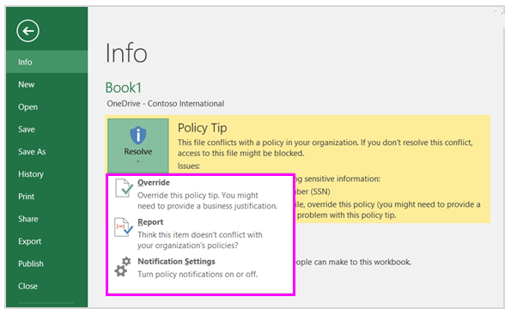
Configure policy tips for DLP policies
For each rule in a DLP policy, an organization can configure policy tips to:
Notify the person the content conflicts with a DLP policy
Allow the person to override the DLP policy or report a false positive
Policy tips appear in different places:
OneDrive for Business sites
SharePoint Online sites
Outlook on the web and Outlook 2013 and later
Exchange admin center
Microsoft Purview compliance portal
Excel, PowerPoint, and Word
Screenshot of an Excel file showing a DLP policy tip with the option to Override or Report a false positive

Slide 51
Knowledge Check
Test your knowledge by answering the Knowledge Check questions at the end of this Learn module

Slide 52
Summary
This module examined the following items related to implementing Microsoft Purview Data Loss Prevention:
Create a DLP implementation plan
Implement Microsoft Purview's default DLP policies
Create a custom DLP policy
Create policy tips for users when a DLP rule applies
Configure email notifications for DLP policies

Slide 53
Lab 8 – Implement DLP Policies

Slide 54
Lab exercises
Exercise 1 – Manage DLP Policies
Task 1
Create a DLP policy with custom settings
Exercise 2 – Test the DLP Policy
Task 1
Test the first DLP Policy rule
Task 2
Test the second DLP Policy rule

Slide 55
Module 6: Learning Path review

Slide 56
Discussion – Learning Path review
What are your key takeaways from this learning path, and why?
What are the key features discussed in this learning path that you foresee implementing at your organization?

Slide 57
Closing Slide

