Slide 1
Linear Equations
Understanding the Mathematics
Richard Hunt
Teacher of Computer Science

Slide 2

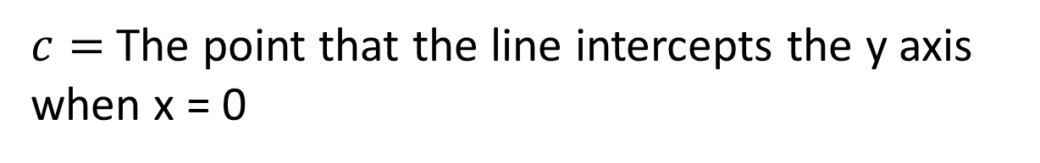
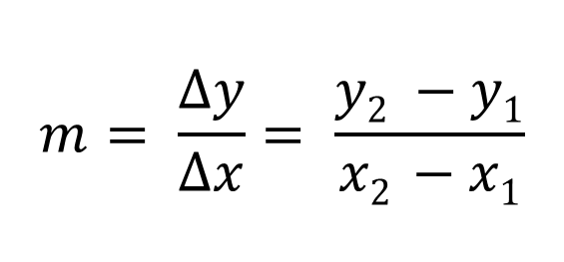
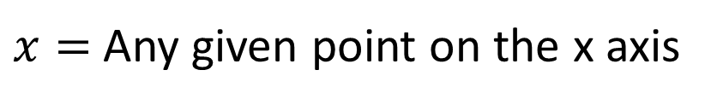
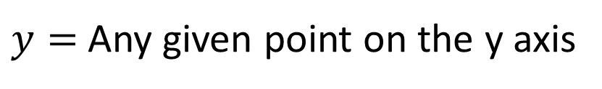
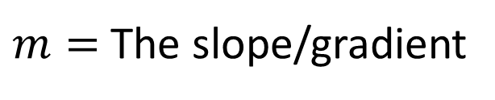
Equations Used
$m=$The slope/gradient
$y=$ Any given point on the y axis
$x=$ Any given point on the x axis
$$m= \frac{Δy}{Δx}= \frac{y2 −y1}{x2 −x1}$$
$c=$ The point that the line intercepts the y axis when x = 0
y
$$y=mx+c$$
m
c
x

Slide 3

$$m= \frac{Δy}{Δx}= \frac{y2 −y1}{x2 −x1}$$
We can use the above equation to work out the slope (m) of a line, if we know at least two pairs of x, y coordinates.
This chart is made of four pairs of coordinates.
x | y
1 | 2
2 | 4
3 | 6
4 | 8

Slide 4

$$m= \frac{Δy}{Δx}= \frac{y2 −y1}{x2 −x1}$$
Pick a single point and put the values into the equation.
$$m= \frac{y2 −y1}{x2 −x1}$$
x = 2, y = 4

Slide 5

$$m= \frac{Δy}{Δx}= \frac{y2 −y1}{x2 −x1}$$
Pick a single point and put the values into the equation.
$$m= \frac{y2 −41}{x2 −21}$$
x = 2, y = 4

Slide 6
$$m= \frac{Δy}{Δx}= \frac{y2 −y1}{x2 −x1}$$
Pick a the next point along and put the values into the equation.
$$m= \frac{y2 −41}{x2 −21}$$
x = 3, y = 6

Slide 7

$$m= \frac{Δy}{Δx}= \frac{y2 −y1}{x2 −x1}$$
Pick a the next point along and put the values into the equation.
$$m= \frac{62 −41}{32 −21}$$
x = 3, y = 6

Slide 8

$$m= \frac{Δy}{Δx}= \frac{y2 −y1}{x2 −x1}$$
Pick a the next point along and put the values into the equation.
$$m= \frac{2}{1}$$

Slide 9


$$m= \frac{Δy}{Δx}= \frac{y2 −y1}{x2 −x1}$$
Pick a the next point along and put the values into the equation.
$$m= \frac{2}{1}$$
$Δy$= 2
The value you get is also conveniently the distance measured along the x, and y coordinates.
$Δx$= 1

Slide 10


$$m= \frac{Δy}{Δx}= \frac{y2 −y1}{x2 −x1}$$
Pick a the next point along and put the values into the equation.
$$= \frac{2}{1}$$
$$2$$
This gave us the value of two, but you could try other charts to see how this works.

Slide 11
As a Computational function
function findGradient(x1, x2, y1, y2){
yChange = y2 – y1
xChange = x2 – x1
return (yChange / xChange)
}

Slide 12
Calling the function with values
gradient = findGradient(2, 3, 4, 6)
function findGradient(2, 3, 4, 6){
yChange = 6 – 4;
xChange = 3 – 2;
return (2 / 1);
}

Slide 13
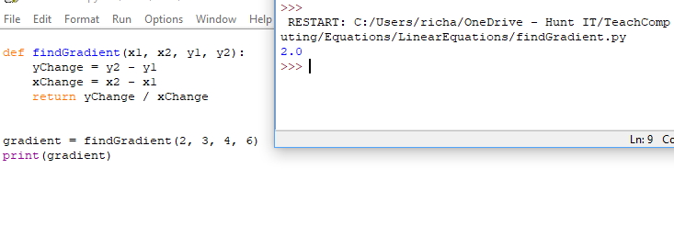
Coded in Python
The function coded in Python.

Slide 14

$$y=mx+c$$
In this equation the aim is to find out the y coordinate of any given x coordinate if we don’t know it.
We can find the value of y if we know three pieces of information.
c, the point that the line will cross the y axis when x = 0.
x, any given point on the x axis.
m, the gradient.

Slide 15
$$y=mx+c$$
This may seem strange so far, as it may appear illogical that we might have created a chart without knowing all the coordinates.
In some instances it may be not feasible to provide every possible coordinate needed.
Think about things like a cost over time.
Even if you set your x axis to be exactly 60 minutes, if the cost per minute was a number like £5.63 trying to plot exact y axis points for this is difficult, and not easy to work out by reading a chart.

Slide 16
$$y=mx+c$$
What we do then is find a value that starts the process, this starting value is c. In this example c will be 0, as at 0 minutes we have been charged nothing.
A we know c is also the point at which we intercept x at 0 we have two pieces of the equation.
c = 0
x = 0

Slide 17



$$y=mx+c$$
The next barrier is working out m, since we know the charge per minute is £5.63, we just need to apply this logic to the first equation we looked at.
$$m= \frac{y2 −y1}{x2 −x1}$$
This isn’t a trick.
The gradient really is the value we want to increase by each whole unit of x.
$$m= \frac{5.63 −0}{1 −0}$$
$$5.63= \frac{5.63}{1}$$

Slide 18
$$y=mx+c$$
We now have every single value for the equation to work out any value of y.
We have two constants (values that are always the same).
c = 0
m = 5.63
And one variable (a value that may change).
x = ?

Slide 19

$$y=mx+c$$
Let’s play with this equation by keeping the constants, but changing
The value of x.
Constants:
c = 0
m = 5.63
$$y=mx+c$$
Let x = 0
$$0=5.63∗0+0$$
Let x = 1
$$5.63=5.63∗1+0$$
Let x = 2
$$11.26=5.63∗2+0$$
Let x = 1.5
$$8.445=5.63∗1.5+0$$

Slide 20

$$y=mx+c$$
Say we had the same gradient but this time had a minimum charge
of £1.20, this would mean c becomes 1.20.
Constants:
c = 1.20
m = 5.63
$$y=mx+c$$
Let x = 0
$$1.20=5.63∗0+1.20$$
Let x = 1
$$6.83=5.63∗1+1.20$$
Let x = 2
$$12.46=5.63∗2+1.20$$
Let x = 1.5
$$9.645=5.63∗1.5+1.20$$
The starting point has now change to 1.20

Slide 21
As a Computational function
This is a for loop, with a counter.
It will start at the value of x₁, and count until it gets to x₂.
That’s our friendly equation.
This will plot a point for a chart, x, and y rounded (most likely to 2 decimal places).

Slide 22
Calling the function with values
lineDraw (0, 5, 5.63, 1.20)
0, 5, 5.63, 1.20
0
5
y := (5.63 * 0) + 1.20;

Slide 23
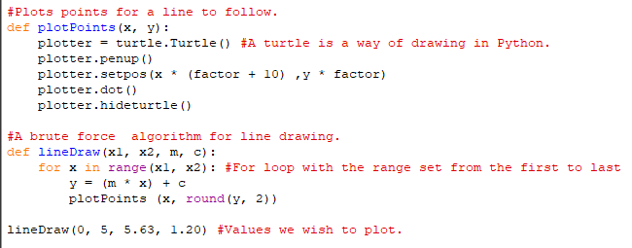
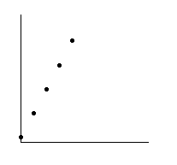
Python Algorithm
You should be able to draw a straight line through the points.

Slide 24
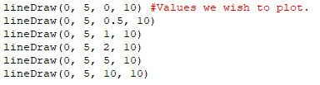
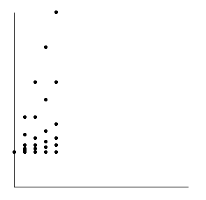
Python Algorithm - Continued
We can run the lineDraw() algorithm as many times as we need. Changing m will produce a different slope.

Slide 25
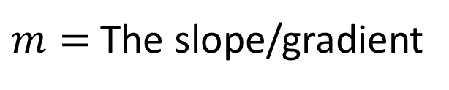
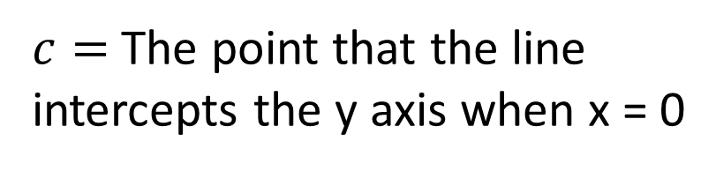
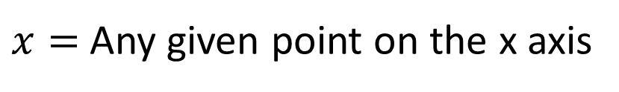
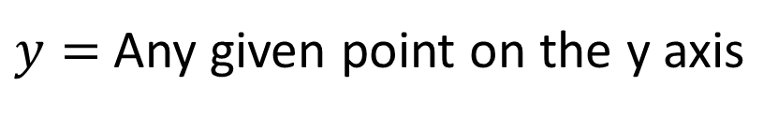
Think Point
Label the chart with:
$m=$The slope/gradient
$y=$ Any given point on the y axis
$x=$ Any given point on the x axis
$c=$ The point that the line intercepts the y axis when x = 0

