Slide 1
Install and Configure Power Supplies and Cooling
Lesson 2
Topic 2A
Notes:
Explain the importance of the power supply and cooling subsystem to reliable PC operation.

Slide 2
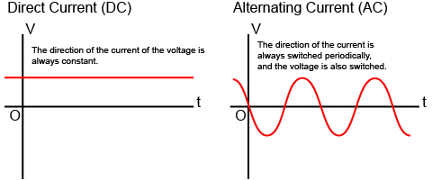
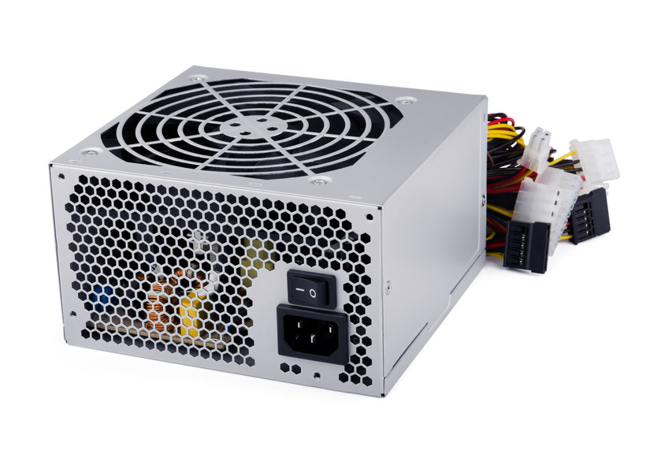
Power Supply Units
Power Supply Unit (PSU) components
  Alternating current (AC) to direct current (DC) conversion
  Filters and regulators
  Fans
Input volts AC (VAC)
  100-127 VAC (low-line), US/ Canada
  220-240 VAC (high-line), Europe
  Manual, auto-switching, and fixed PSU types
Image ©123RF.com
Notes:
Make sure students can distinguish input AC voltage and outlet socket requirements from DC output voltage and power requirements.

Slide 3
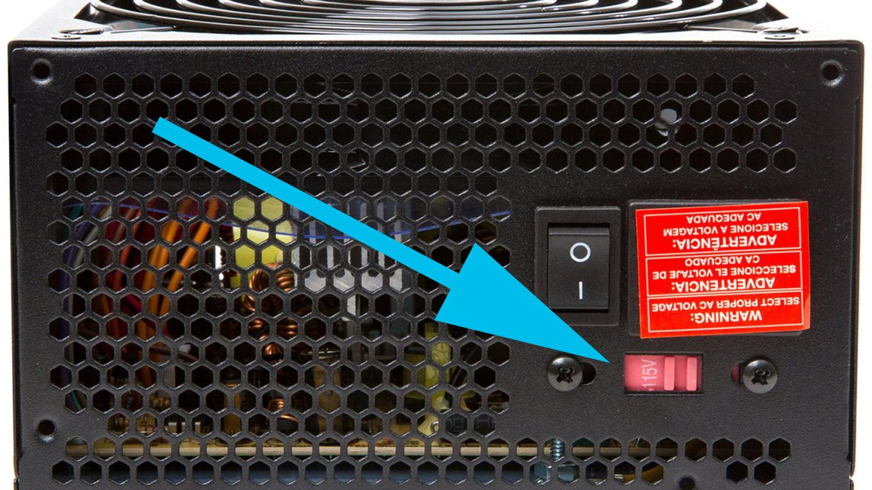
Manually switch between the different volt (120 and 230 V).
  Use multimeter.
Use auto-switching power supply.
Don’t plug a 120 V power supply into a 230 V power source!

Slide 4
Wattage Rating
Power requirement
  Volts DC (VDC) – How much force is pushing the electron. Potential difference between two points.
  Watts — Voltage (V) * Current (I)
Wattage rating
  Power efficiency
Output voltages
  3.3V, 5V, 12V rails
  Power distribution
Notes:
Discuss how to work out the power requirements of a custom PC or component upgrade.

