Slide 1
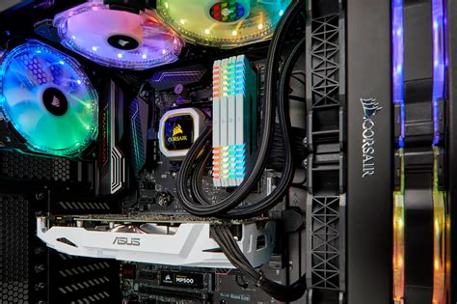
Liquid Cooling Systems
Water loop/tubing, pump, and reservoir
Water blocks and brackets
Radiators and fans
Image ©123RF.com

