Slide 1
Install and Configure System Memory
Lesson 2
Topic 2C
Notes:
Explain that “memory” refers to non-persistent storage. This means that the device must be powered on to retain information.

Slide 2
System RAM and Virtual Memory (Slide 1 of 2)
System memory
  Memory controller
  Volatile random access memory (RAM)
Virtual memory
  Pagefile/swap space
  Protected mode
Notes:
Explain how system memory provides a “workspace” for applications and data while the PC is switched on.

Slide 3
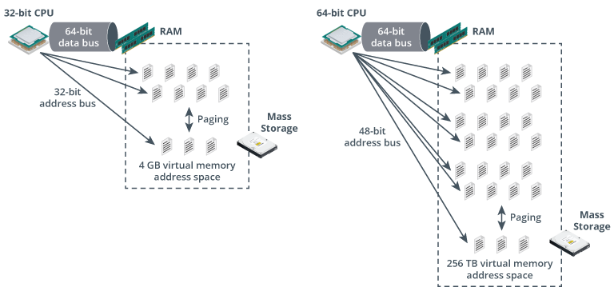
System RAM and Virtual Memory (Slide 2 of 2)
Image ©123RF.com
Notes:
Explain that virtual memory allows the PC to have a larger workspace than the amount of physical memory installed by using the disk drive. Note that the OS also uses the virtual address space to mediate access to the RAM devices and prevent conflicts between processes.

Slide 4
DDR
Can transfer twice in a single clock cycle. Twice as much then a SDR.
DDR3
Twice the data rate of DDR2.
Larger chip capacities – maximum 16 GB per DIMM.
No backwards compatibility.
DDR4
Speed increased over DDR3.
Maximum 64 GB Per DIMM
No backwards compatibility.
DDR5
Faster data transfers between the memory module and motherboard
Maximum of 64 GB per DIMM
Notes:
DDR5 has same pins as DDR4.

Slide 5
ECC RAM
Error correcting code (ECC)
  Adds 8-bit checksum to each transfer
  Can correct 1-bit errors
  Can detect 2/3/4-bit errors
Registered DIMM (RDIMM) versus UDIMM (UDIMM)
Compatibility issues
Notes:
ECC is more likely to be found on server systems than desktops, but it might be used in workstations.

Slide 6
System Memory
System RAM and Virtual Memory
Memory Modules
Multi-channel System Memory
ECC RAM
System Memory
Notes:
Take some time at the end of each topic to answer questions. You can use the review questions for discussion in class or set them for students to complete individually during or after class.

Slide 7
Lab Activity
Virtual Workbench Lab: Install RAM

