Slide 1
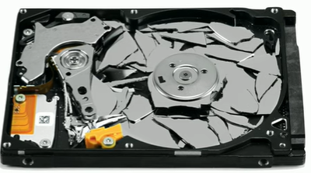
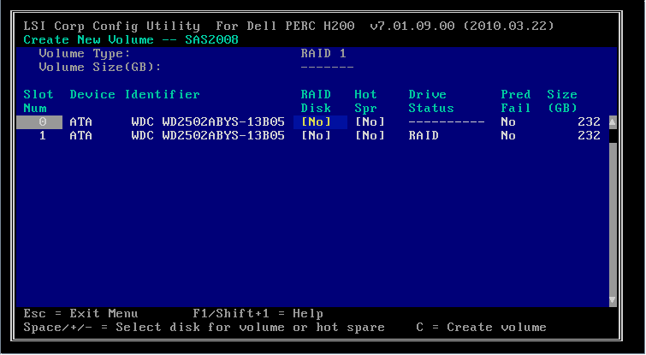
Redundant Array of Independent Disks
Fault tolerance
Drive configurations and RAID levels
Software versus hardware RAID
Image ©123RF.com
Notes:
Explain the importance of fault tolerance for the storage subsystem and discuss how RAID can be implemented in hardware.
https://www.liquidweb.com/kb/software-raid-vs-hardware-raid-a-tutorial/

Slide 2
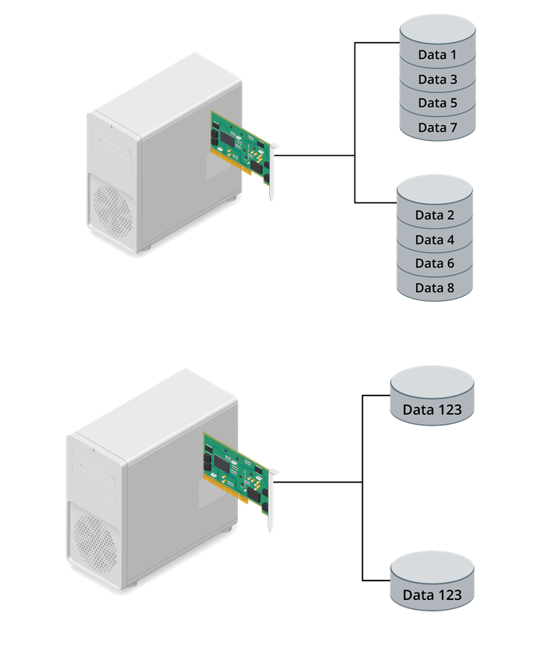
RAID 0 and RAID 1
RAID 0
  Disk striping for performance
  No fault tolerance
RAID 1
  Mirroring two disks for redundancy
  Only 50% disk capacity available to volume
Image ©123RF.com
Notes:
Ensure that students can distinguish the features and configuration of each RAID level. Students may find this section difficult, so be prepared to allocate extra time to it.

Slide 3
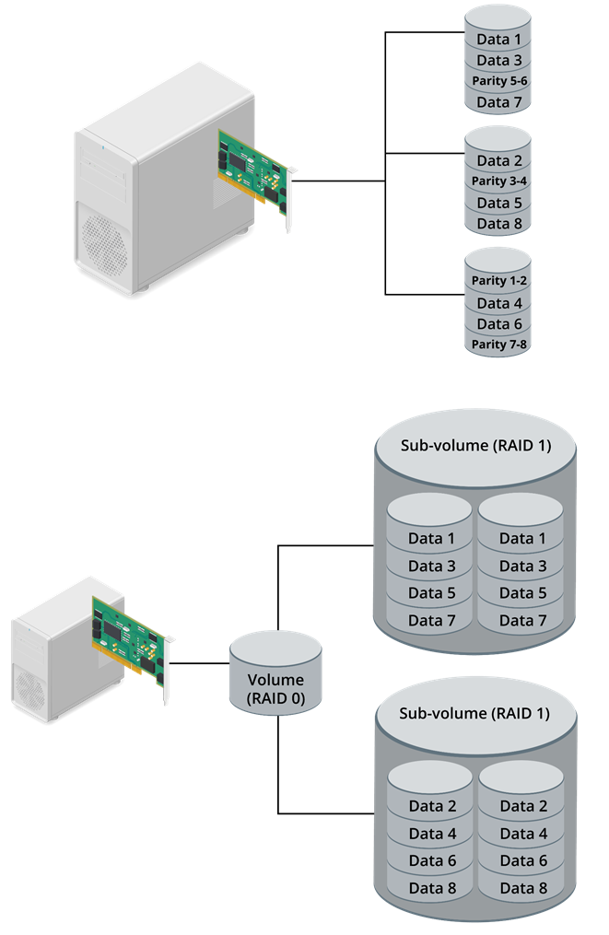
RAID 5 and RAID 10
RAID 5
  Distributed parity
  Can sustain single device failure
  Capacity depends on number of disks
RAID 10
  Stripe of mirrors requiring at least four disks
  Can sustain one device failure in each sub-volume
  Only 50% disk capacity available to volume
Image ©123RF.com
Notes:
Explain that RAID 5 uses parity information distributed between drives to recover from a single device failure. RAID 5 has better storage efficiency than mirroring.
RAID 10 is one of the most secure and best-performing RAID levels. The main drawback is cost.

Slide 4
Storage Devices
Mass Storage Devices
Solid-State Drives
Hard Disk Drives
Redundant Array of Independent Disks
RAID 0, RAID 1, RAID 5, and RAID 10
Removable Storage Drives
Optical Drives
Notes:
Take some time at the end of each topic to answer questions. You can use the review questions for discussion in class or set them for students to complete individually during or after class.

Slide 5
Lab Activity
Virtual Workbench Lab: Install and Configure SSD Storage

