Slide 1
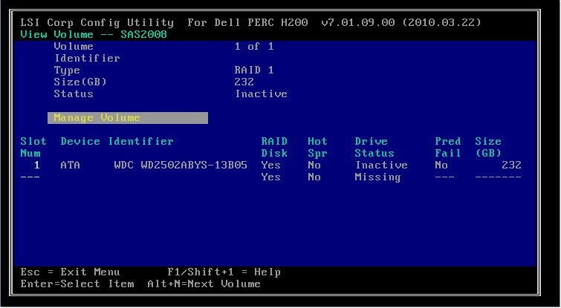
Troubleshoot RAID Failure
RAID array degraded
  Backup
  Replace failed device
RAID device not found
  Controller seating/cables/connectors
  Drivers
  RAID configuration utility

