Slide 1

ACT/SAT Trends in 2017-2019

Slide 2
PROBLEM STATEMENT
This project aims to:
Identify states that have decreasing ACT and SAT participation rates
Check the rate of participation for three different groups of states
Compare the participation rate of western, eastern and central states

Slide 3
Datasets
Datasets with participation rates for 51 states
For 2017, 2018 and 2019
For ACT and SAT

Slide 4
Highest and lowest participations
 | ACT |  |  | SAT
year | Minimum Participation | Maximum Participation |  | Minimum Participation | Maximum Participation
2017 | Maine |  | Alabama | Iowa | Connecticut
2018 | Maine |  | Alabama | North Dakota | Colorado
2019 | Maine |  | Alabama | North Dakota | Colorado

Slide 5
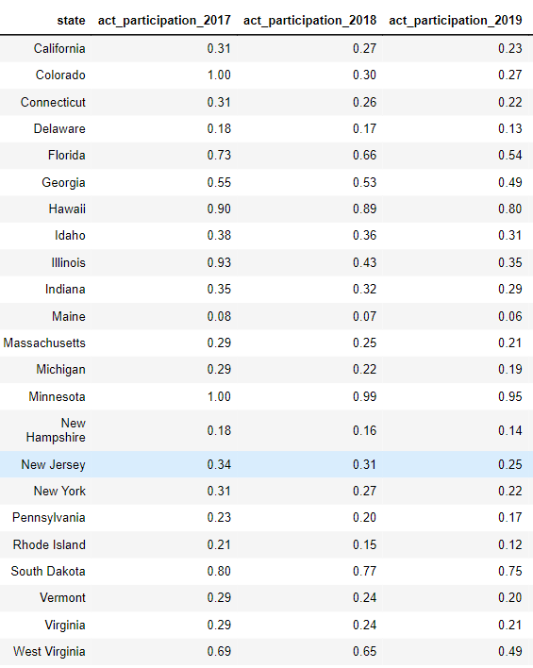
States with decreasing participation /ACT

Slide 6
States with decreasing participation /SAT

Slide 7
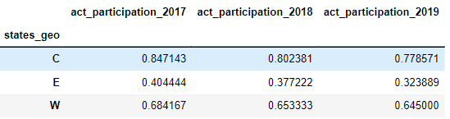
Average participation of west, east and center/ACT

Slide 8
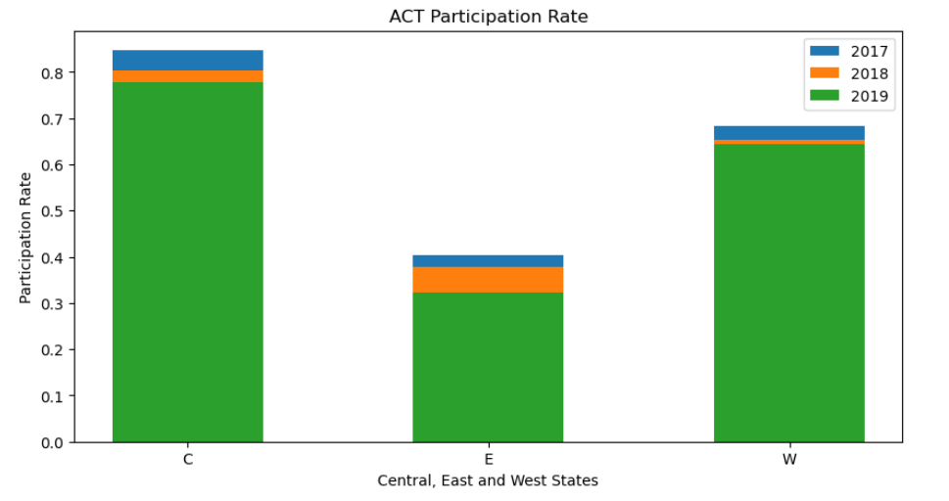
Average participation of west, east and center/ACT

Slide 9
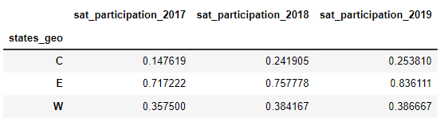
Average participation of west, east and center/SAT

Slide 10
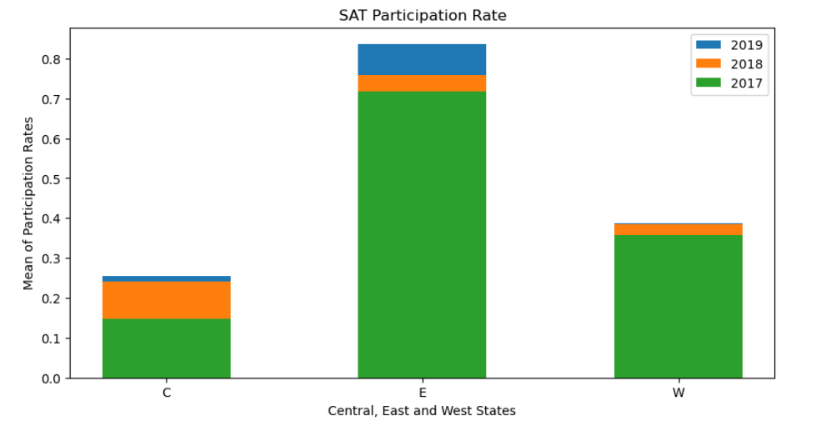
Average participation of west, east and center/SAT

Slide 11
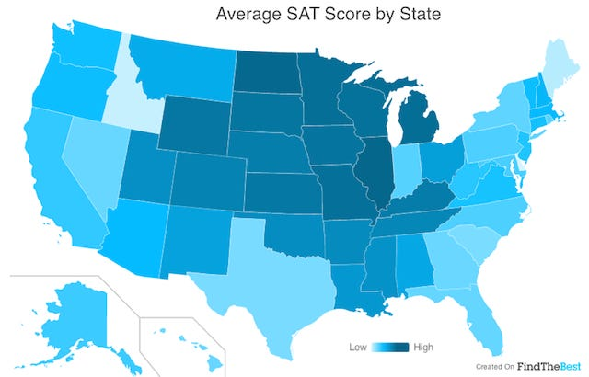
More trends
Central US with the highest Average SAT Score

Slide 12
RESOURCES
https://stackoverflow.com/
https://www.geeksforgeeks.org/
https://www.minotdailynews.com/news/local-news/2017/04/a-brief-history-of-the-sat-and-act/
https://pandas.pydata.org/

Slide 13
Thank you for your time

