Slide 1
“Cat and Dog Food Brand Analysis: Insights into Consumer Perceptions and Preferences on Reddit"
Katayoon Kaviani

Slide 2
Table of contents
01
02
03
04
05
06
Problem statement
Data collection and preparation
Exploratory data analysis
Recommendations
Model
Sentiment analysis

Slide 3
01
Problem Statement

Slide 4
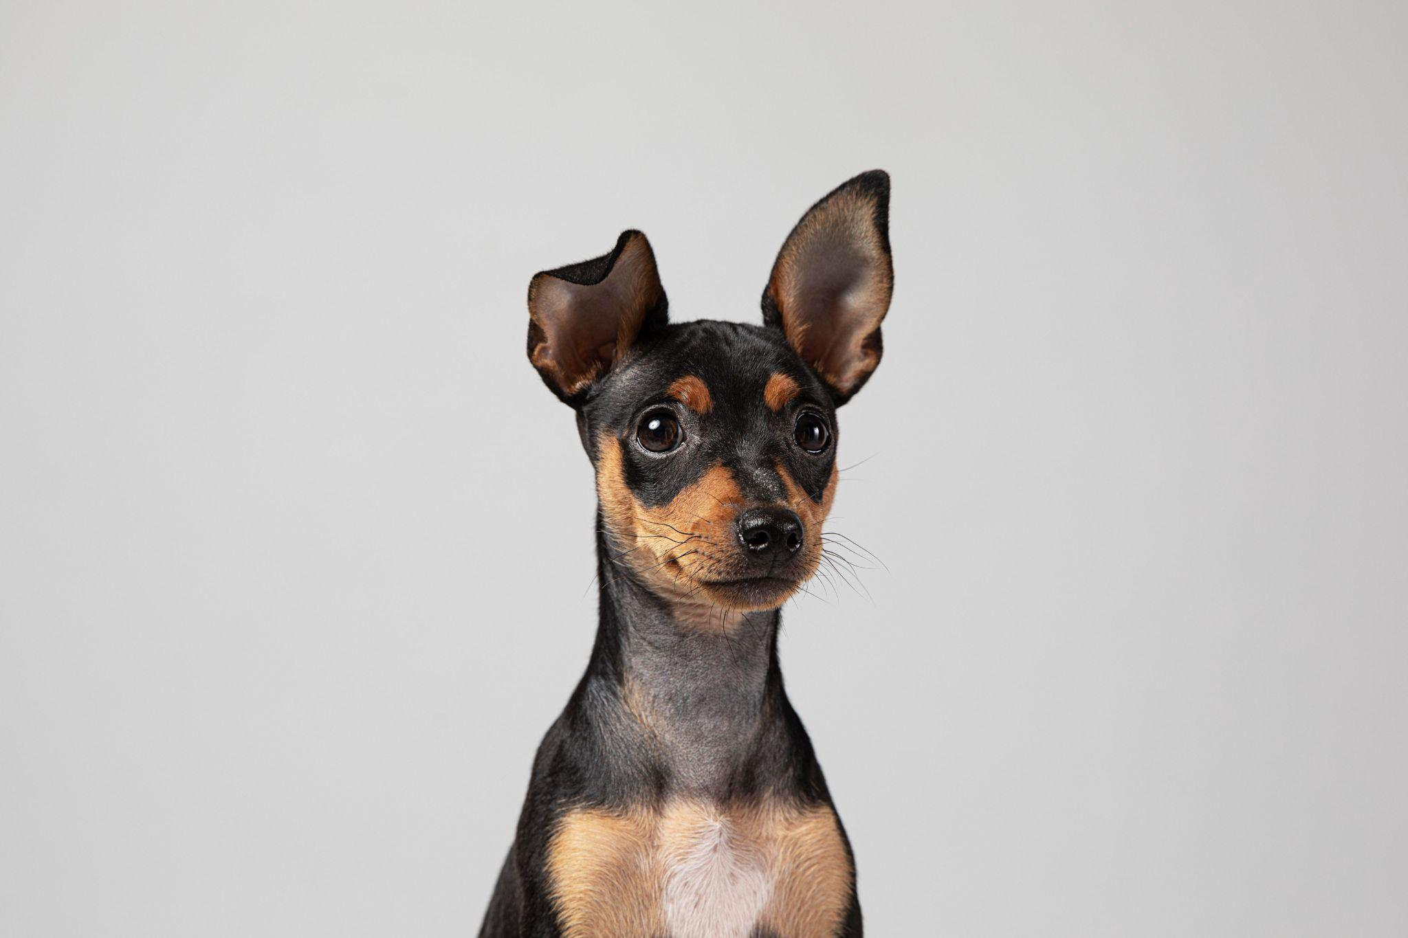
About the Project
Have you ever wondered what other pet owners think about the different pet food brands available on the market?
Are you curious about the most commonly discussed brands and the overall sentiment around them?
Notes:
Today we want to look into consumer perceptions and preferences regarding pet food. By analyzing posts from two subreddits, r/Cats and r/Dogs, I aim to identify popular pet food brands, extract key topics related to pet food discussions, and conduct sentiment analysis to determine overall consumer sentiment towards these brands. Additionally, I will use machine learning techniques to train a classifier model that can predict which subreddit a given post belongs to based on its content.

Slide 5
About the Project
r/dogs
r/cats
Notes:
Two subreddits used

Slide 6
02
Data collection and preparation

Slide 7
Data Collection and Preparation
Using Pushshift's API
Pulling both Posts and Comments and merging them
Vectorizing the text
Removing non-English words

Slide 8
03
Exploratory data analysis

Slide 9
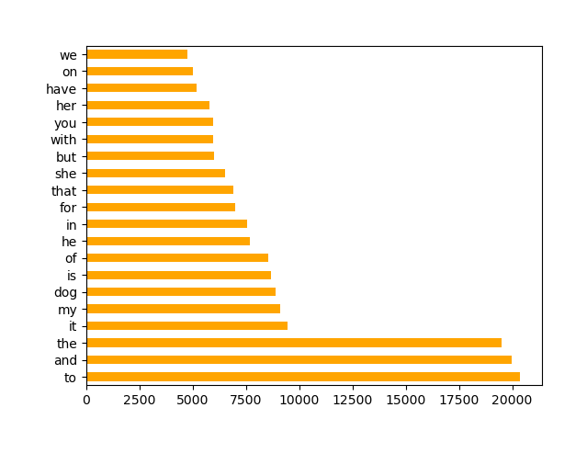
The most common words including stop words

Slide 10
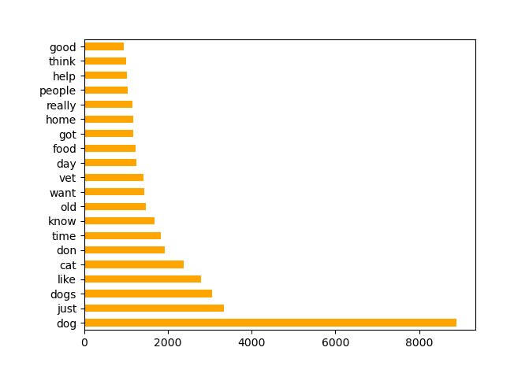
The most common words without stop words

Slide 11
Which food brands have been mentioned by users on subreddits?
- Acana - Nutro
- Advantage - Orijen
- American Journey - Pedigree
- Blue Buffalo - Purina
- Diamond Naturals - Royal Canin
- Eukanuba - Solid Gold
- Fromm - Wellness Core
- Iams
- Instinct
- Mars
- Merrick
- Natural Balance

Slide 12
Let’s look at some sentences!
r/Cats
“Purina dry food is much lower quality than Tiki cat where the first few ingredients were fish.”
“There has been a pet food Recall for Royal Canin!”
“I’m honestly about done with the wellness brand.”
I’m honestly about done with the wellness brand. Their customer service is not helpful and always insists they “haven’t changed their formula.”
r/Dogs
" was feeding him royal canin first but recently found out it has corn , Chicken byproducts , soy and wheat that's really bad for dogs should I still go with royal canin or switch to orijen or acana?“
“The current recommended food to feed is kibble that follows WSAVA guidelines. These brands are as follows: Purina, Royal Canin, Hill's Science Diet, Eukanuba, and Iams.”

Slide 13
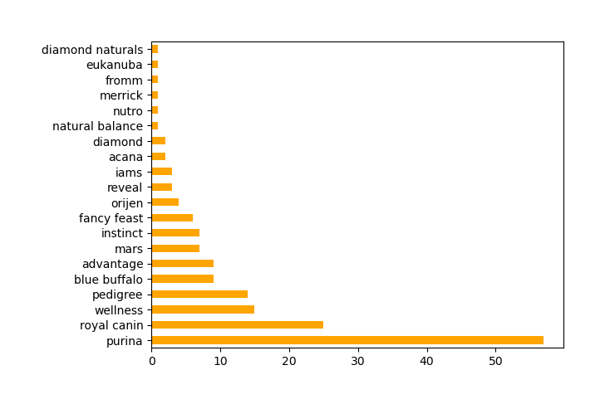
How many times each brand is mentioned?

Slide 14
04
Sentiment Analysis

Slide 15
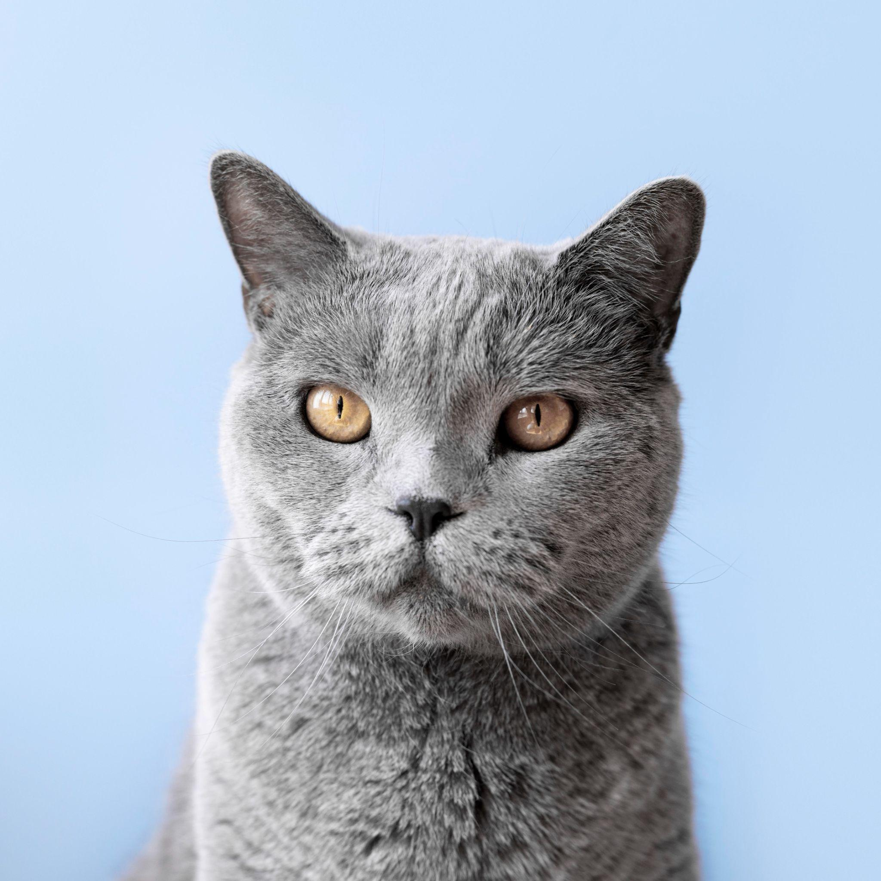
Do people have positive or negative opinions about each food brand on cats subreddit?

Slide 16
Brand | Overall Sentiment Score
Purina | -0.70
Blue Buffalo | -0.82
Instinct | -0.82
Tiki Cat | -0.23
Nutro | -0.82
Pedigree | -0.34
Wellness Core | -0.82
Mars | 0.16
Reveal | 0.55
Do people have positive or negative opinions about each food brand on cats subreddit?

Slide 17
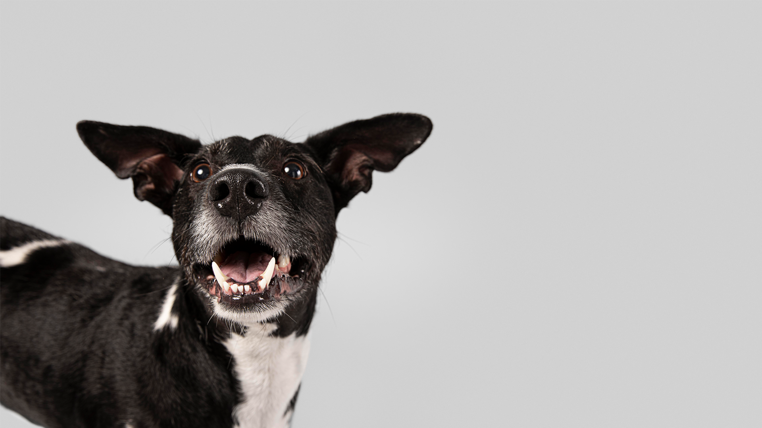
Do people have positive or negative opinions about each food brand on dogs subreddit?

Slide 18
Do people have positive or negative opinions about each food brand on dogs subreddit?
Brand | Overall Sentiment Score
Royal Canin | -0.07
Purina | 0.23
Blue Buffalo | 0.00
Orijen | -0.55
Acana | -0.32
Pedigree | 0.08
Advantage | 0.35
Reveal | 0.00
Instinct | 0.18

Slide 19
05
Model

Slide 20
Models
CountVectorizer and TfidfVectorizer used as transformers
MultinomialNB, RandomForestClassifier, LogisticRegression, LinearSVM and SVM as estimators

Slide 21
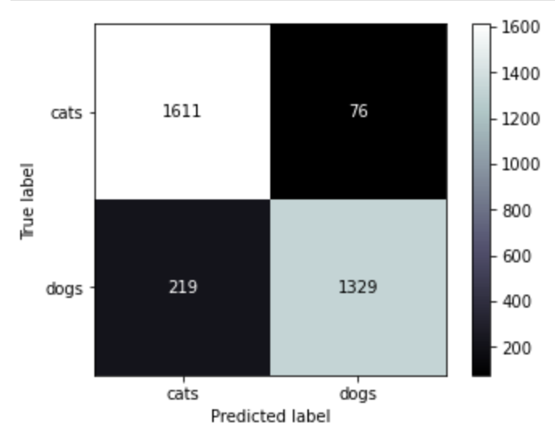
Accuracy Score

Slide 22
06
Recommendations

Slide 23
Recommendations
- Collecting more data to increase the sample size and improve the accuracy of the sentiment analysis.
- Experimenting with different sentiment analysis techniques or lexicons to see if they produce different results.
- Doing same analysis on other websites and reviews.
- Conducting further analysis to identify any patterns or trends in the sentiment scores for different pet food brands (e.g. do certain brands tend to have more positive sentiment among dog owners vs. cat owners?)

Slide 24
Thank you
Do you have any questions?
Please keep this slide for attribution

