Slide 1

Videogames against malaria
Learn through playing
Artificial Intelligence with Clinical Impact
Katherine Chulvi
Notes:
Today, I'd like to talk about an innovative project called MalariaSpot, which uses a video game as a diagnostic tool for malaria "
The creators of this great idea are from a research group at the Polytechnic University of Madrid.

Slide 2
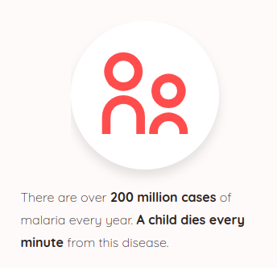
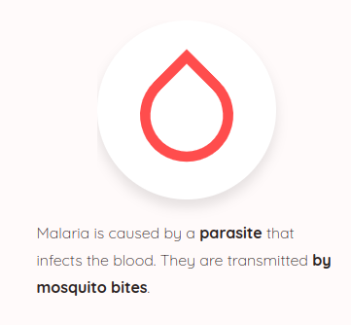
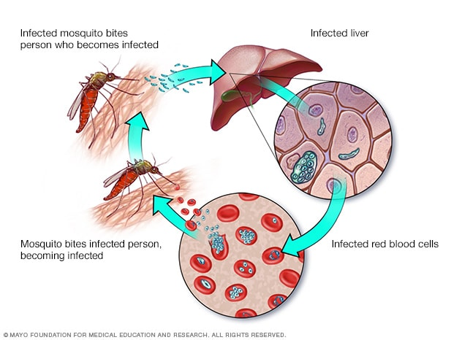
Malaria as a global health issue
Notes:
Every year, approximately one million people lose their lives due to malaria, a disease transmitted by the bite of infected mosquitoes.
"The lack of timely diagnosis is a serious challenge in the fight against malaria, as it hinders early and effective treatment of patients."

Slide 3
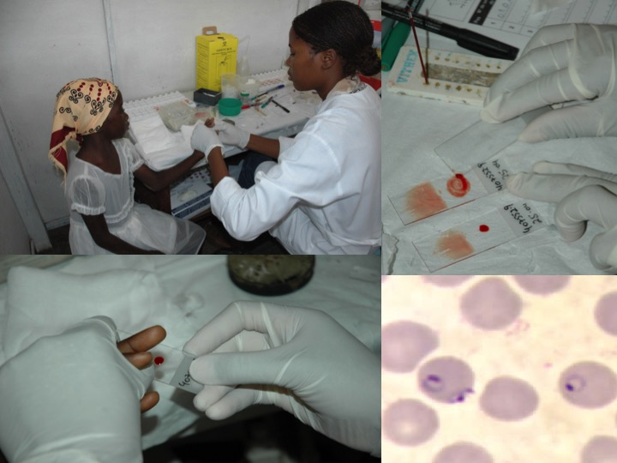
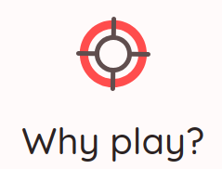
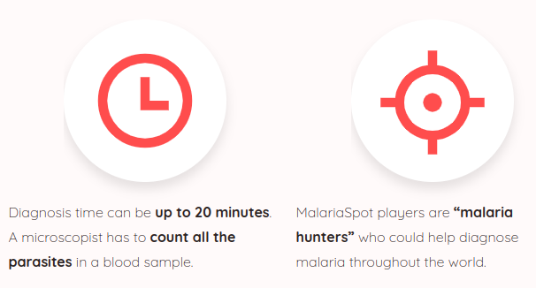
MalariaSpot
Notes:
How is malaria diagnosed?
- A blood sample is collected and examined under a microscope by a specialist. However, these microscopes are costly and require access to electricity. Furthermore, the diagnostic process typically takes a minimum of 20 minutes to analyze each sample.
To address this challenge, MalariaSpot emerges as an innovative project that uses a video game as a diagnostic tool."
"This video game is designed to be accessible to anyone, even without previous medical experience, thus allowing greater participation in disease detection."

Slide 4
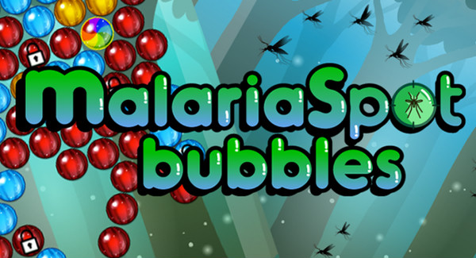
MalariaSpot Bubbles: The Game
Notes:
So, how does the video game work?
In MalariaSpot, players examine images of blood samples for signs of malaria infection."
"Each player marks possible infections by clicking on suspicious areas, and the collaboration of multiple players ensures an accurate assessment of the samples using the statistics."

Slide 5

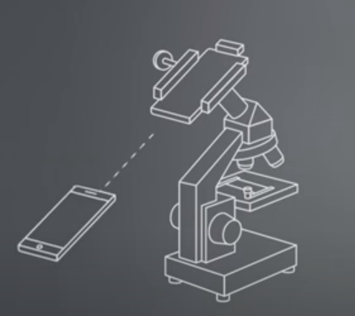
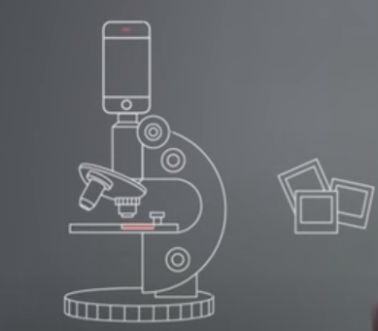


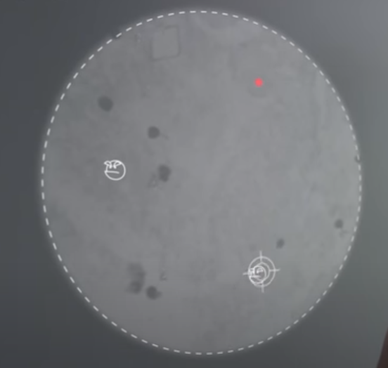
Technology and Future Applications
1 Pilot device
3 Upload samples
Smartphone attached to an optical system
All the samples collected are upload to an online platform
5 Collaborative
Diagnosis
2 Microscope
LOWCOST
4 Gamers
Images of the blood samples available to be analyzed by MalariaSpot players worldwide
Notes:
The project uses basically a mobile technology, with a pilot device combining a smart phone with a very simply optic system for sharing the images."
. Using 3D printing and a small motor, the samples are in movement while capturing images of various sections of the blood sample.
Then the images of blood samples are collected in the field and uploaded to internet and shared with players globally.
When a sufficient number of gamers have reviewed the same image, their collective analysis gives a diagnosis, which is then transmitted back to the field.
"This approach has the potential to expand to other diseases with similar diagnostic processes, such as tuberculosis.

Slide 6

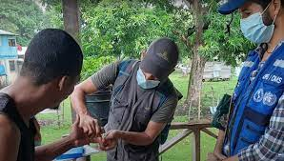
Gaming-based collaborative diagnostics, powered by AI, can make healthcare more available and ease the disease burden in underserved communities.
Notes:
The impact of MalariaSpot extends to areas where conventional diagnostics are difficult to obtain, such as rural and remote regions where resources are limited."

Slide 7




Collaborative Diagnostics
Astronomy
Biology
Solving Complex Problems
Locating planets using the Kepler probe.
Analyzing the 3D structure of proteins, akin to a three-dimensional Tetris game.
Locating the wreckage of the Malaysian plane that crashed into the ocean using satellite imagery..
Notes:
Collaborative Diagnostics. This method can be applied to blood analysis as well as radiography.
This technique has previously been employed to locate planets using the Kepler probe and to visualize the 3D structure of proteins,. It has also been used to locate the wreckage of the Malaysian plane that crashed into the ocean using satellite imagery.
The company spearheading the development of this method is called SPOTLAB, specializing in creating artificial intelligence with clinical impact.

Slide 8
Conclusions and Future
- MalariaSpot represents an innovative solution for the diagnosis of malaria.
- Collaborative technology using AI will continue to be an invaluable tool in the fight against diseases, expanding access to diagnosis and improving clinical outcomes.
Notes:
"In summary, MalariaSpot represents an innovative solution for the diagnosis of malaria and other diseases, with significant potential to improve global health."
"Looking to the future, collaborative technology will continue to be an invaluable tool in the fight against diseases, expanding access to diagnosis and improving clinical outcomes."

Slide 9

THANKS!
https://malariaspot.org/en/

