Slide 1
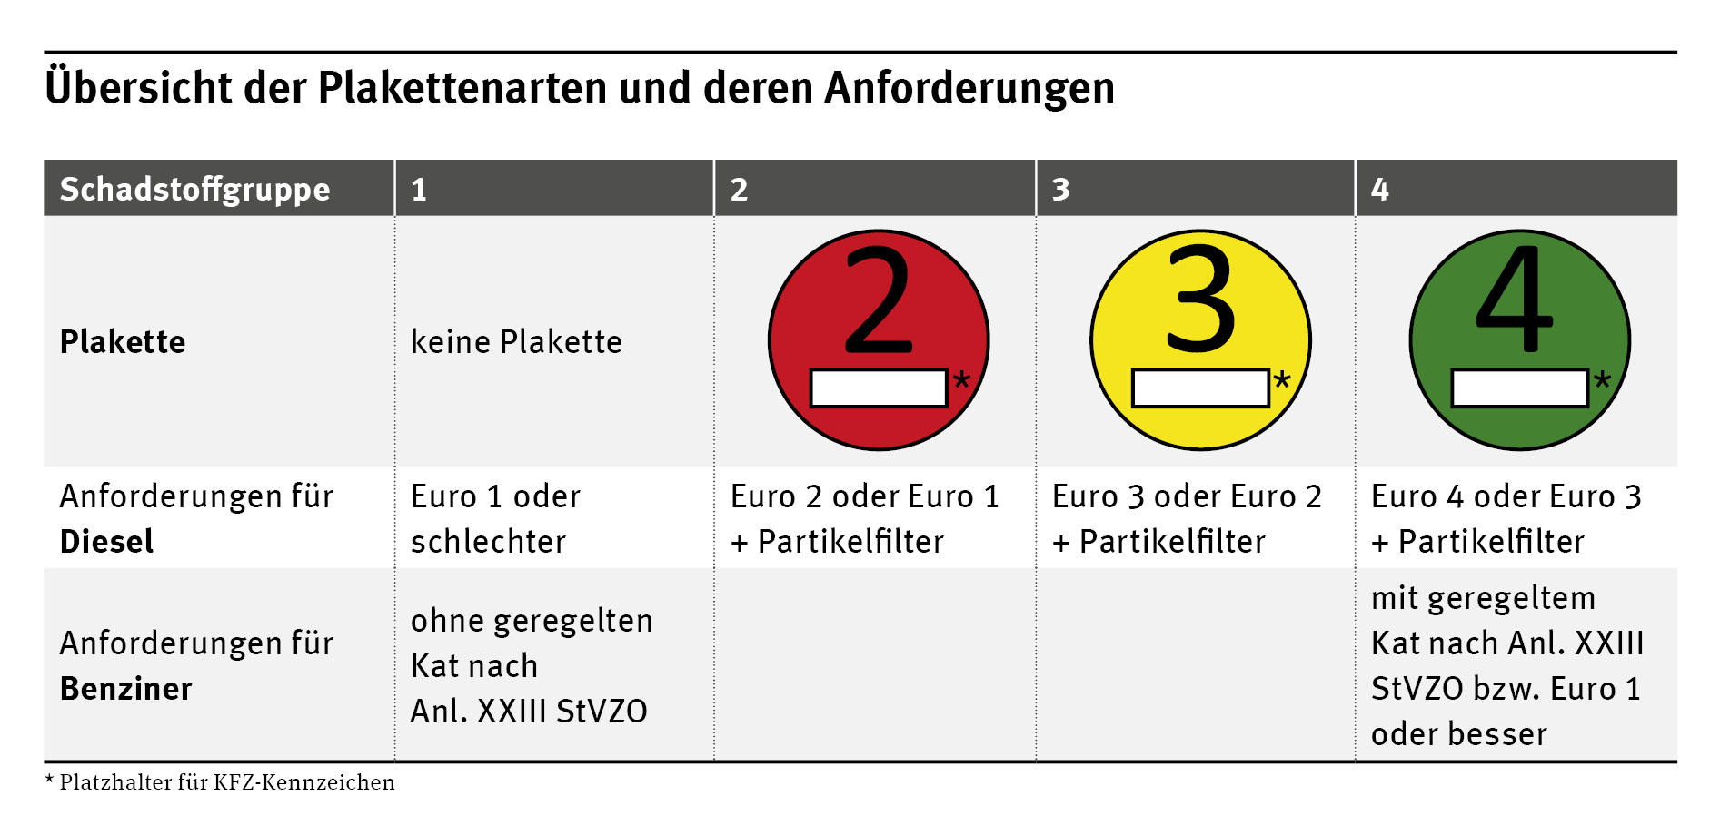
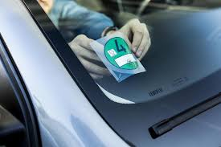
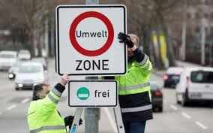
BERLIN AIR POLLUTION
Open Data Sources:
Green Badge (Grün Plakette):
- Berlin Open Data Portal
- European Enviroment Agency
- German Federal Environmental Agency (UBA)
- European Commission's Air Quality e-Reporting
(AQ e-Reporting) platform
What? → The "Grün Plakette" is a green sticker used in Germany to signify vehicles with low emissions, allowing them to enter restricted environmental zones within cities.
Gas emissions from vehicles:
- Carbon Dioxide (CO2)
- Carbon Monoxide (CO)
- Nitrogen Oxides (NOx)
- Unburned Hydrocarbons (HC)
- Particulate Matter (PM)
- Sulfur Oxides (SOx)
QUESTION
Since its implementation in 2008, has the presence of pollutants decreased in the restricted zones compared to expected levels?
WORKS OR NOT?

