Slide 1
LOW EMISSION ZONE
Mid Bootcamp Project
by Katherine Chulvi

Slide 2
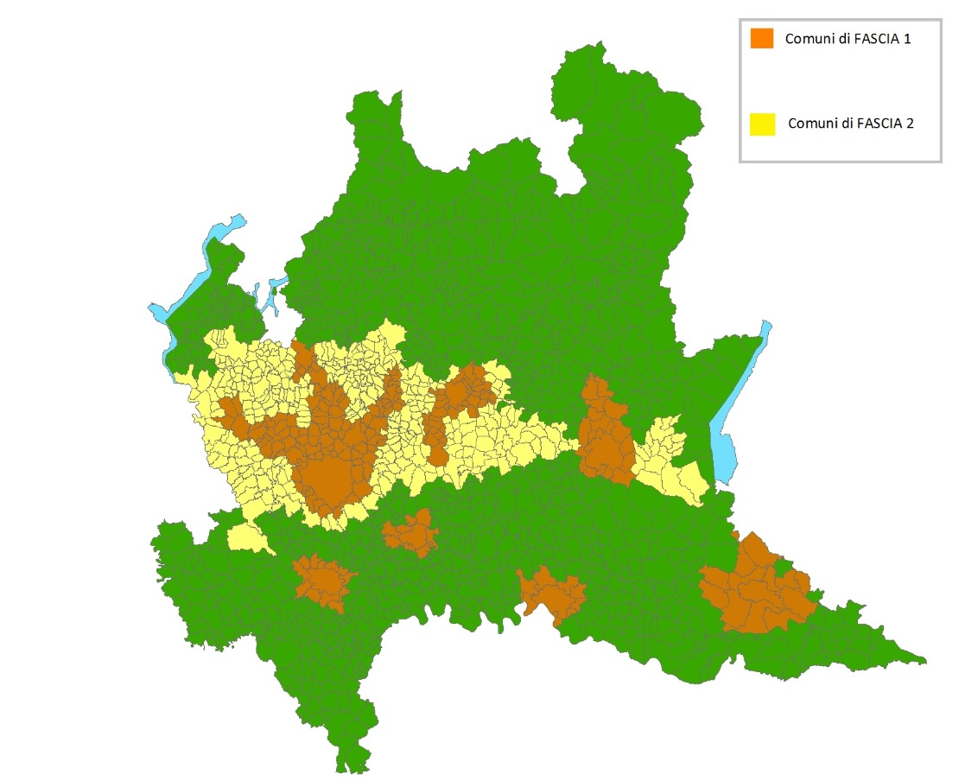
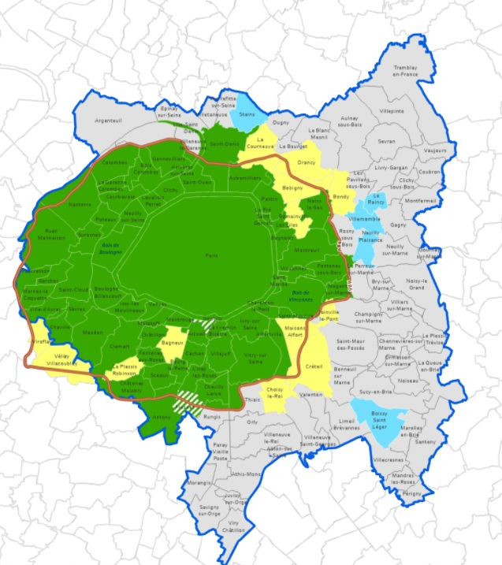
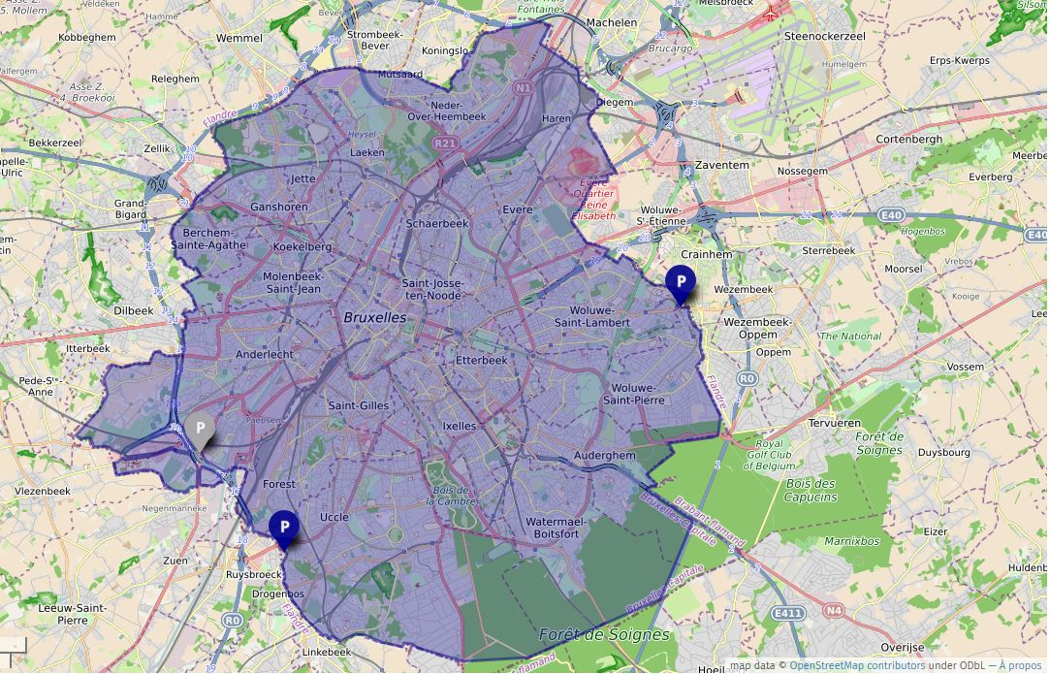
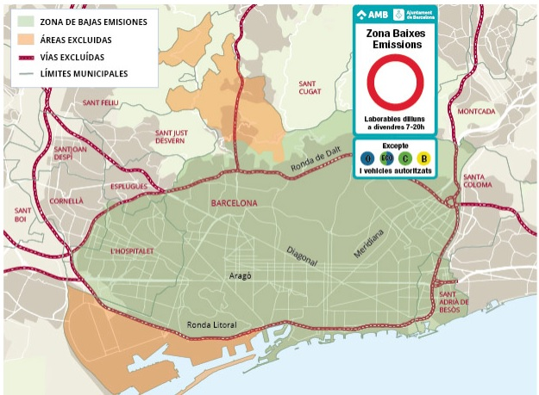
Introduction
Milan
Paris
Brussels
Barcelona
Notes:
Low Emission Zones (LEZs) are designated areas within cities and towns where the entry of high-polluting vehicles is restricted. Implemented as a strategy to meet EU Air Quality Standards, LEZ programs aim to reduce air pollution by limiting emissions of fine particles (PM2.5 and PM10), nitrogen dioxide (NO2), and ozone (O3). Originating in Sweden in 1996, LEZs have spread across Europe, with cities like London adopting them in 2007-2008. Today, they are recognized as effective measures for improving air quality and are increasingly prevalent in many EU countries.

Slide 3

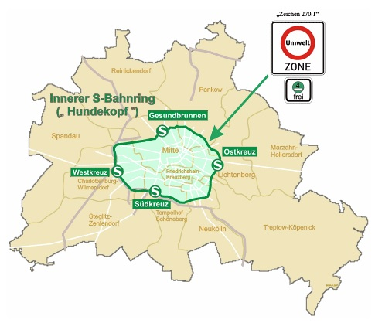


Introduction
Warsaw 2024
Berlin 2010
Notes:
In Berlin, the LEZ was established in 2010, and they did it by using the Green Badge (Grün Plakette). This green sticker (Euro 4) allows cleaner vehicles to enter restricted areas, while blocking older ones with yellow and red stickers (Euro 3 and Euro 2).
.

Slide 4
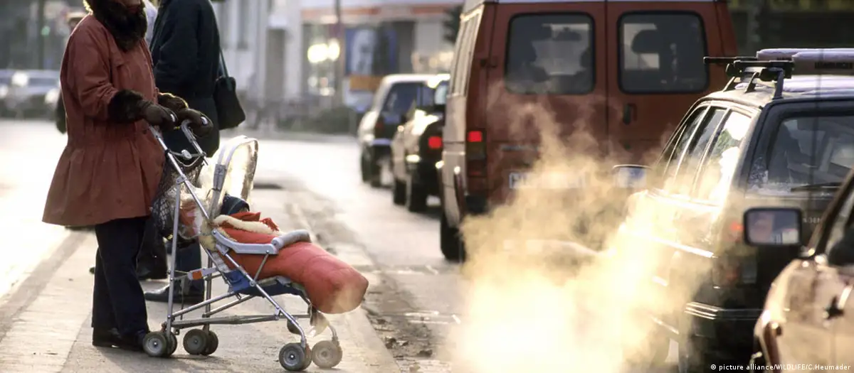
Objectives
“Grün Plakette”
- Examine the effect of Low Emission Zones (LEZs) on urban pollution levels.
- Provide guidance for future environmental policies and urban planning strategies.
Notes:
The objectives basically are to examine the effect of LEZ on urban population levels
And provide a guidanes for the future environmental policies and urban planning strategies
.

Slide 5
Methodology for Data Analysis
- Only numerical
- K-Nerest Neighbors (KNN)
- Linear Regression model
- One-sided hypothesis test
DataFrame
Berlin
Warsaw
Notes:
Utilization of two datasets for Berlin and Warsaw.
The datasets exclusively comprise numerical values.
Implementation of K-Nearest Neighbors (KNN) technique for handling missing values.
Application of linear regression model to explore relationships between variables.
Conducting one-sided hypothesis testing to assess the significance of identified relationships.
.

Slide 6
Results for Data Analysis
- Only numerical
- K-Nerest Neighbors (KNN)
- Linear Regression model
- One-sided hypothesis test
DataFrame
RESULTS
85% and 92% of the variability in the training and test data.
The mean [NO2] levels before 2010 are lower than the [NO2] levels from 2013 onwards.
Berlin
Warsaw
Pollution emission levels of some pollutants specially for [NO2]
Notes:
.

Slide 7
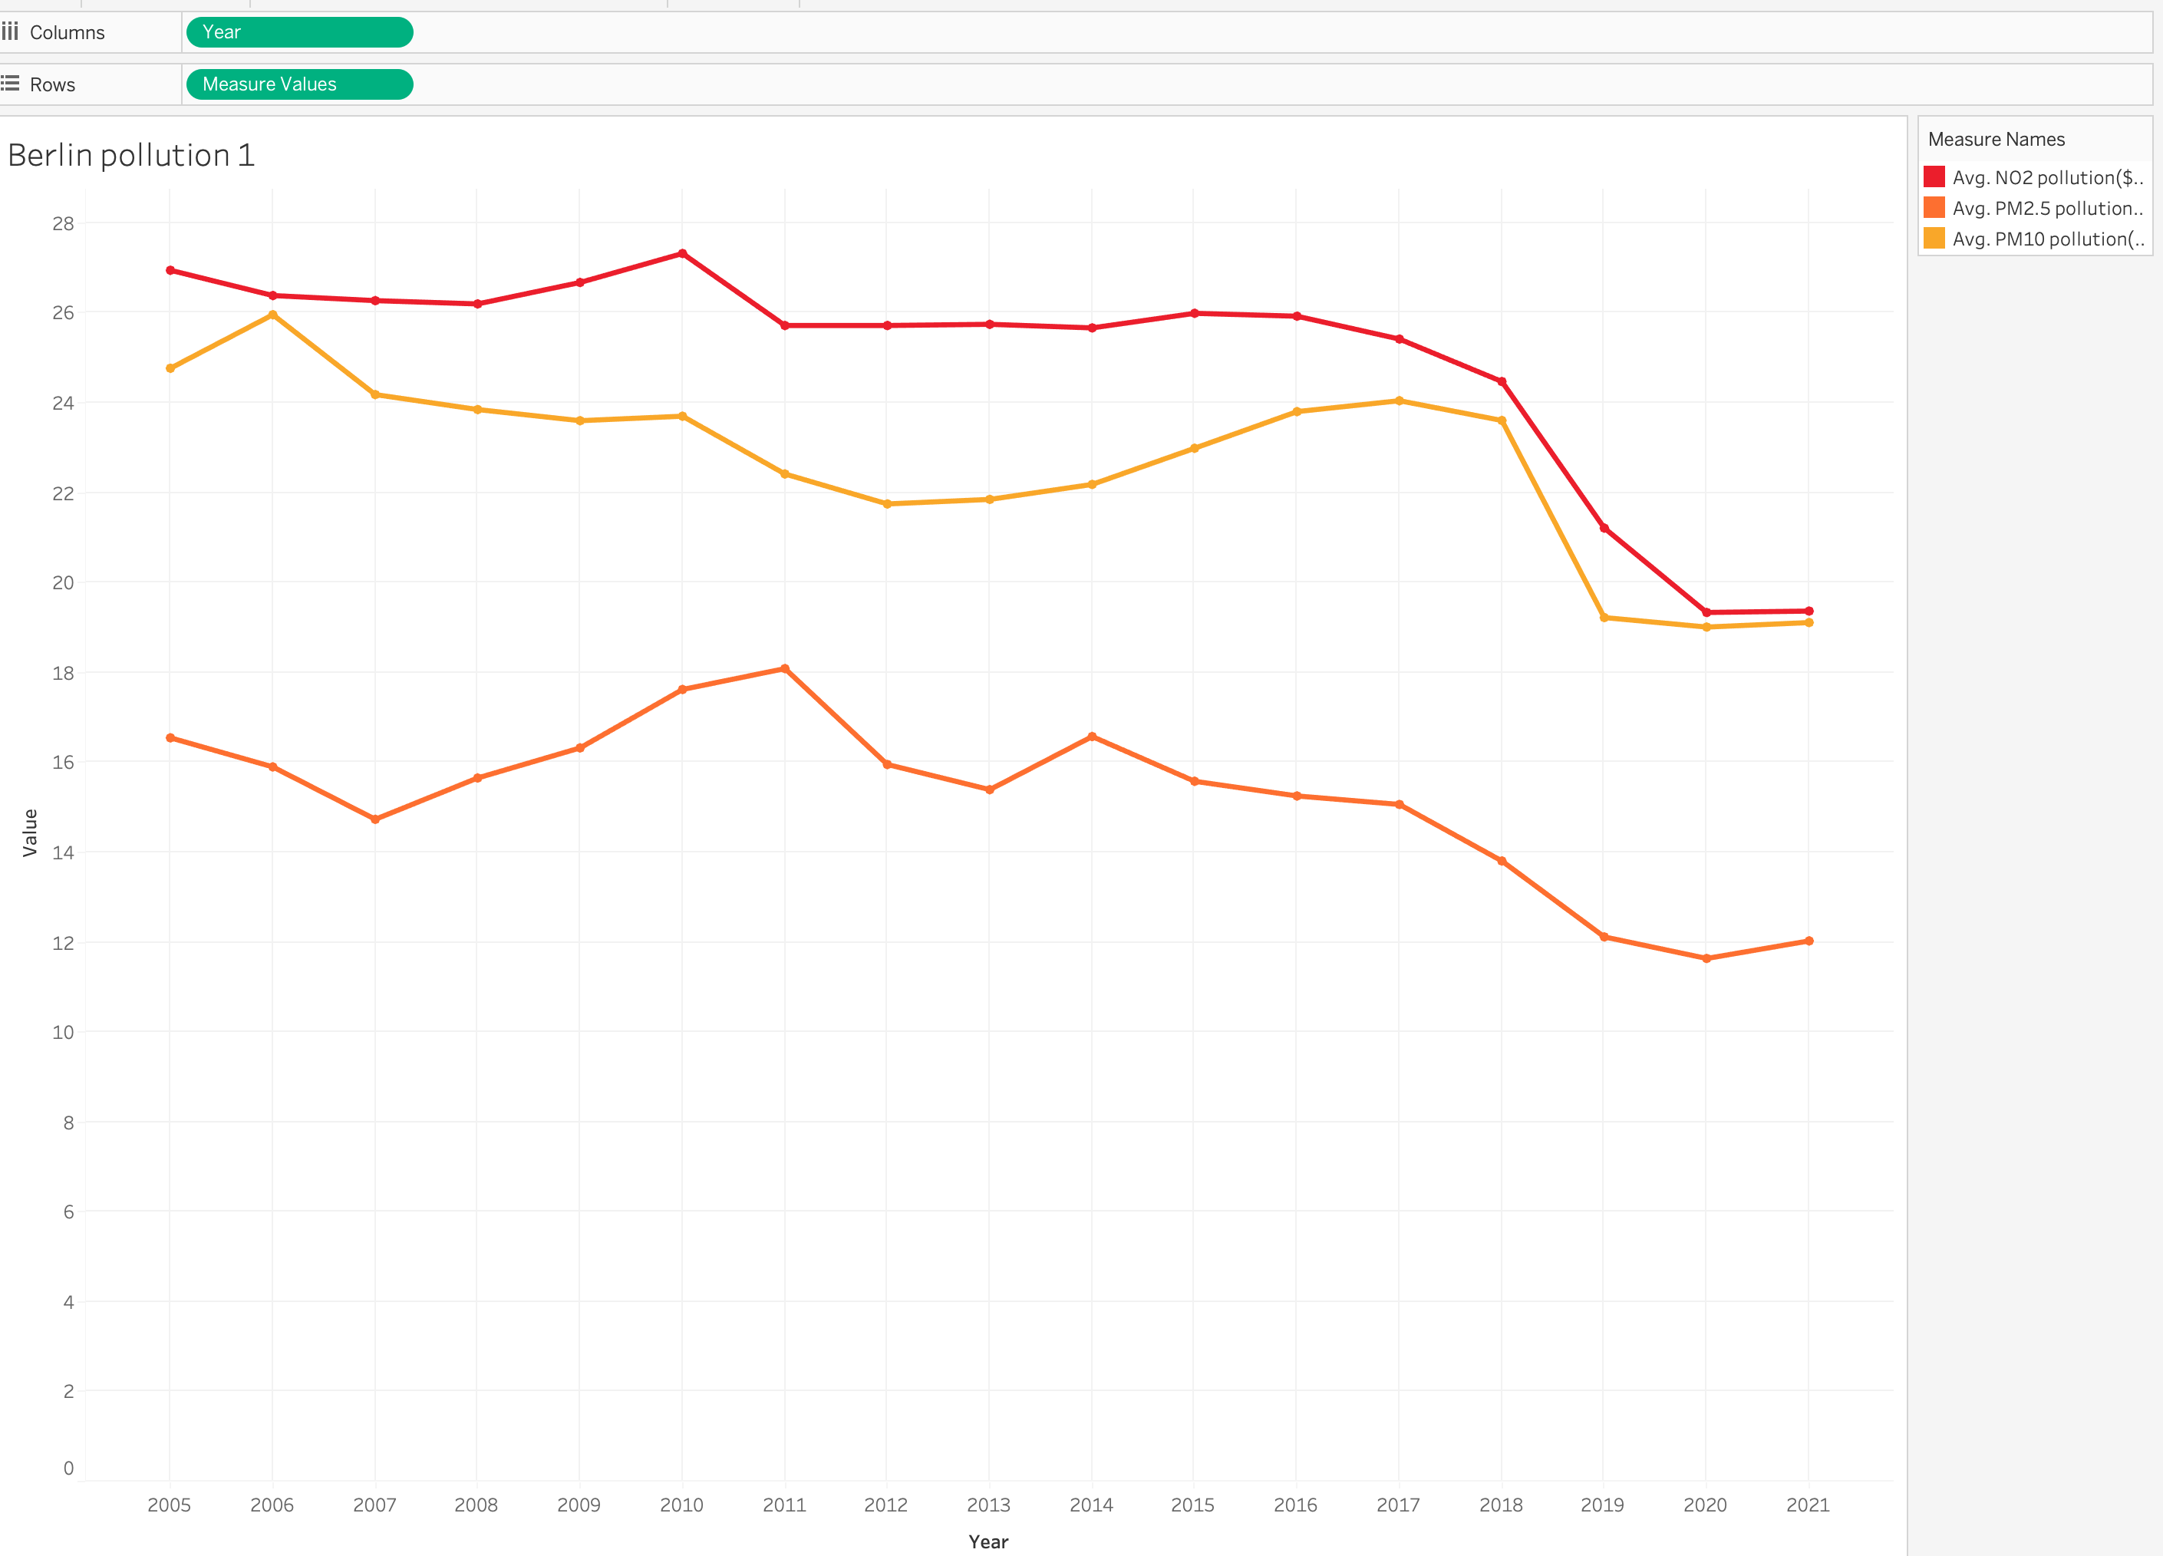
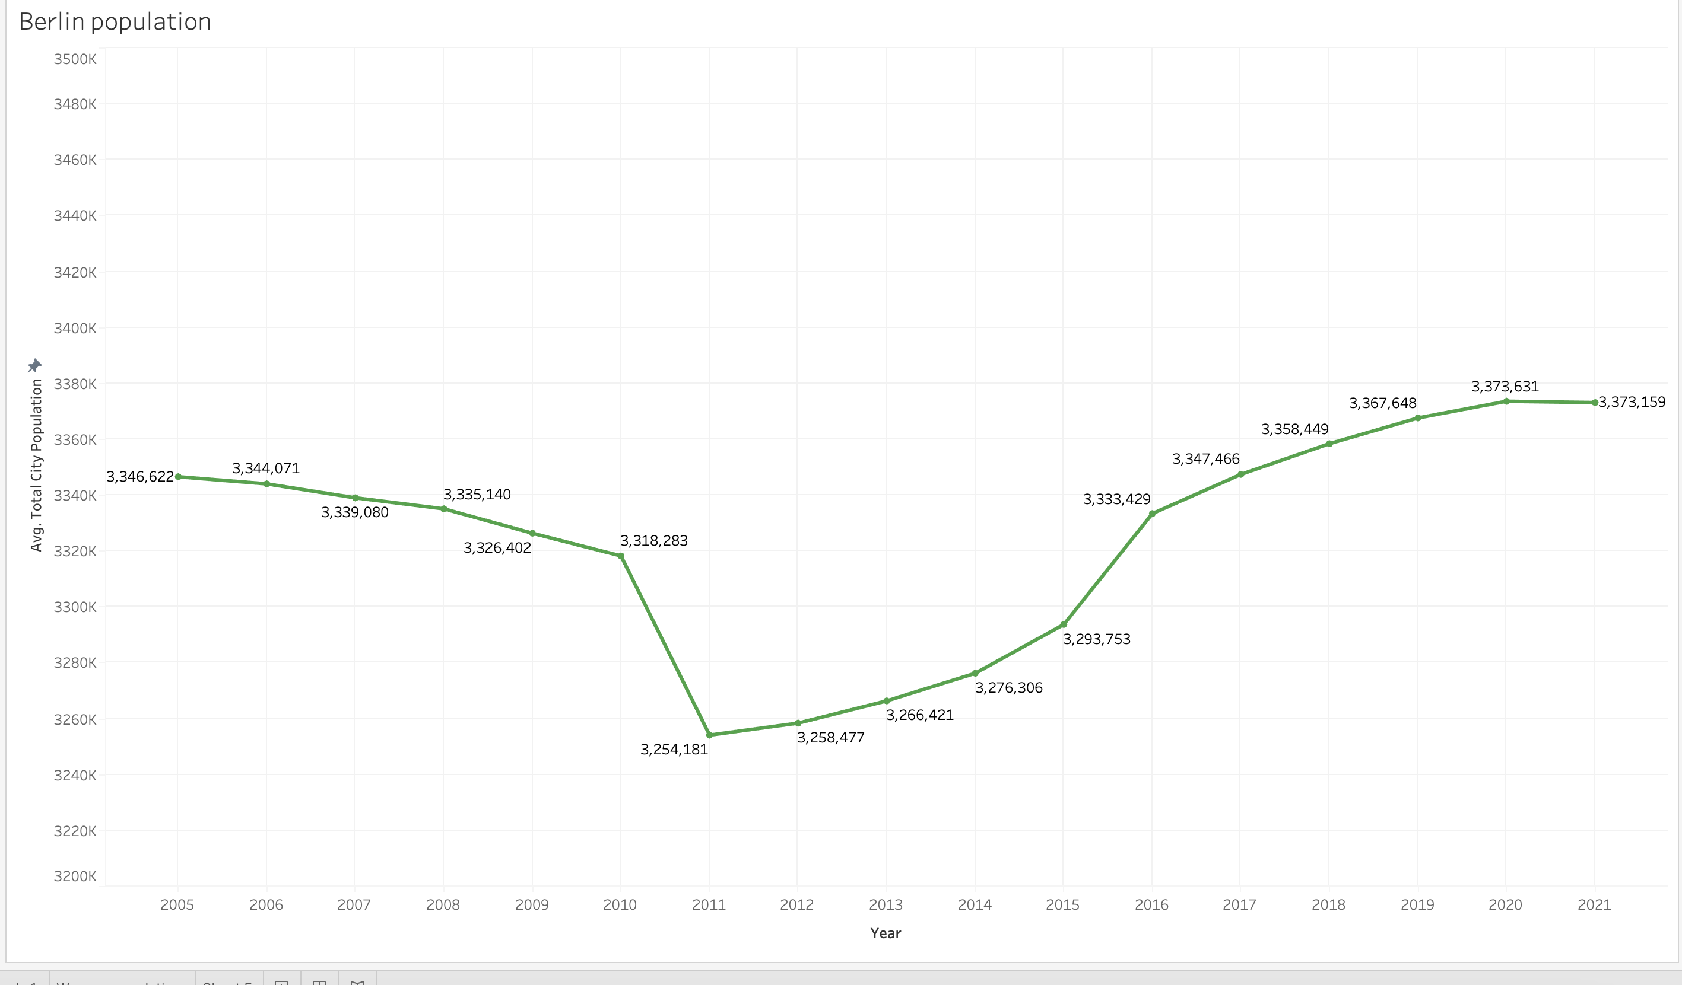
Tableau
Population Berlin
Air pollution Berlin
35.33%
Notes:
Utilization of two datasets for Berlin and Warsaw.
The datasets exclusively comprise numerical values.
Implementation of K-Nearest Neighbors (KNN) technique for handling missing values.
Application of linear regression model to explore relationships between variables.
Conducting one-sided hypothesis testing to assess the significance of identified relationships.
.

Slide 8
Tableau
Population Berlin
Air pollution Berlin
35.33%
Notes:
Utilization of two datasets for Berlin and Warsaw.
The datasets exclusively comprise numerical values.
Implementation of K-Nearest Neighbors (KNN) technique for handling missing values.
Application of linear regression model to explore relationships between variables.
Conducting one-sided hypothesis testing to assess the significance of identified relationships.
.

Slide 9
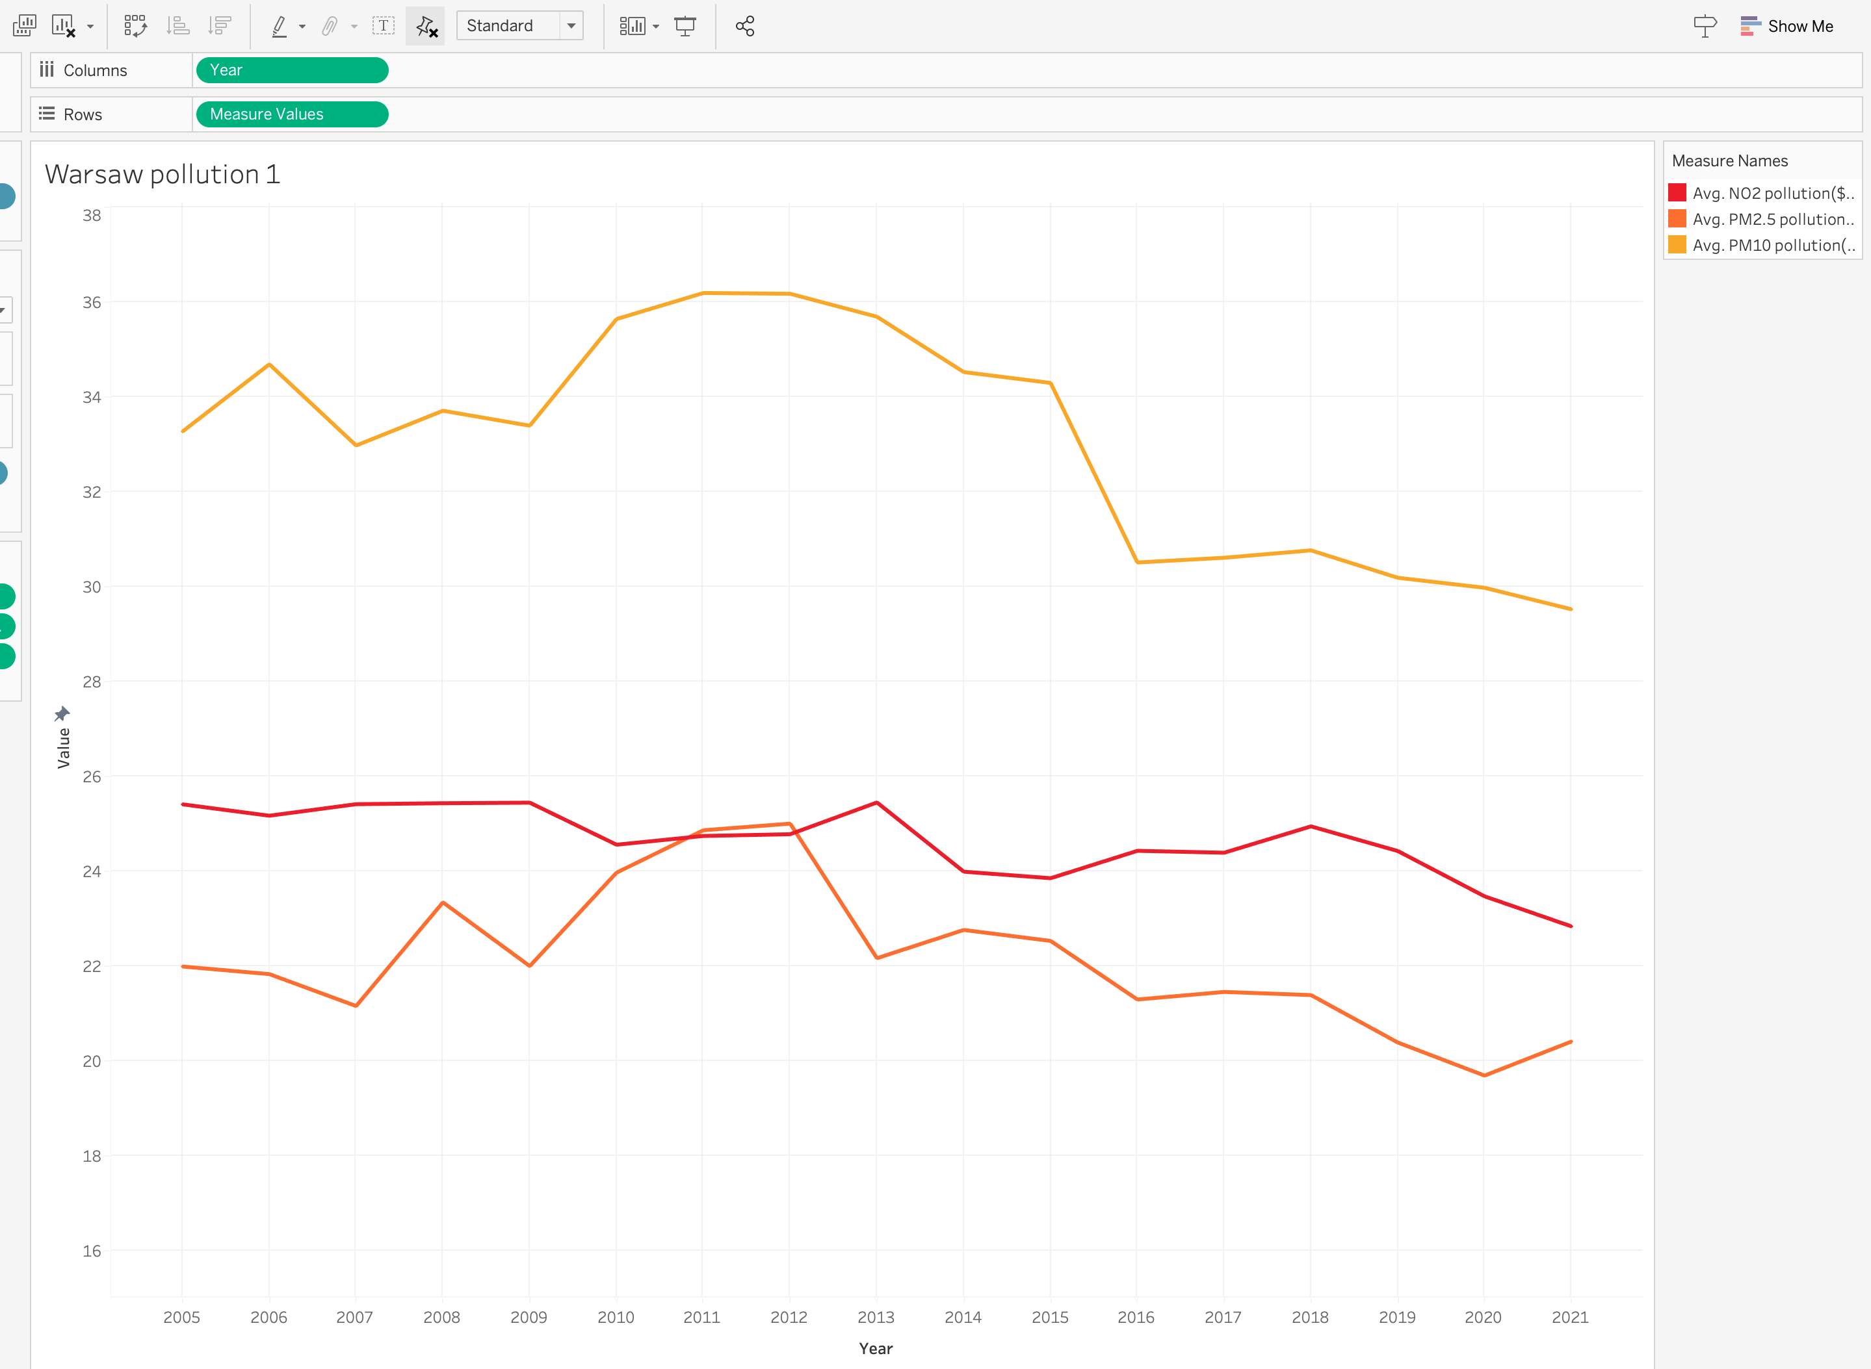
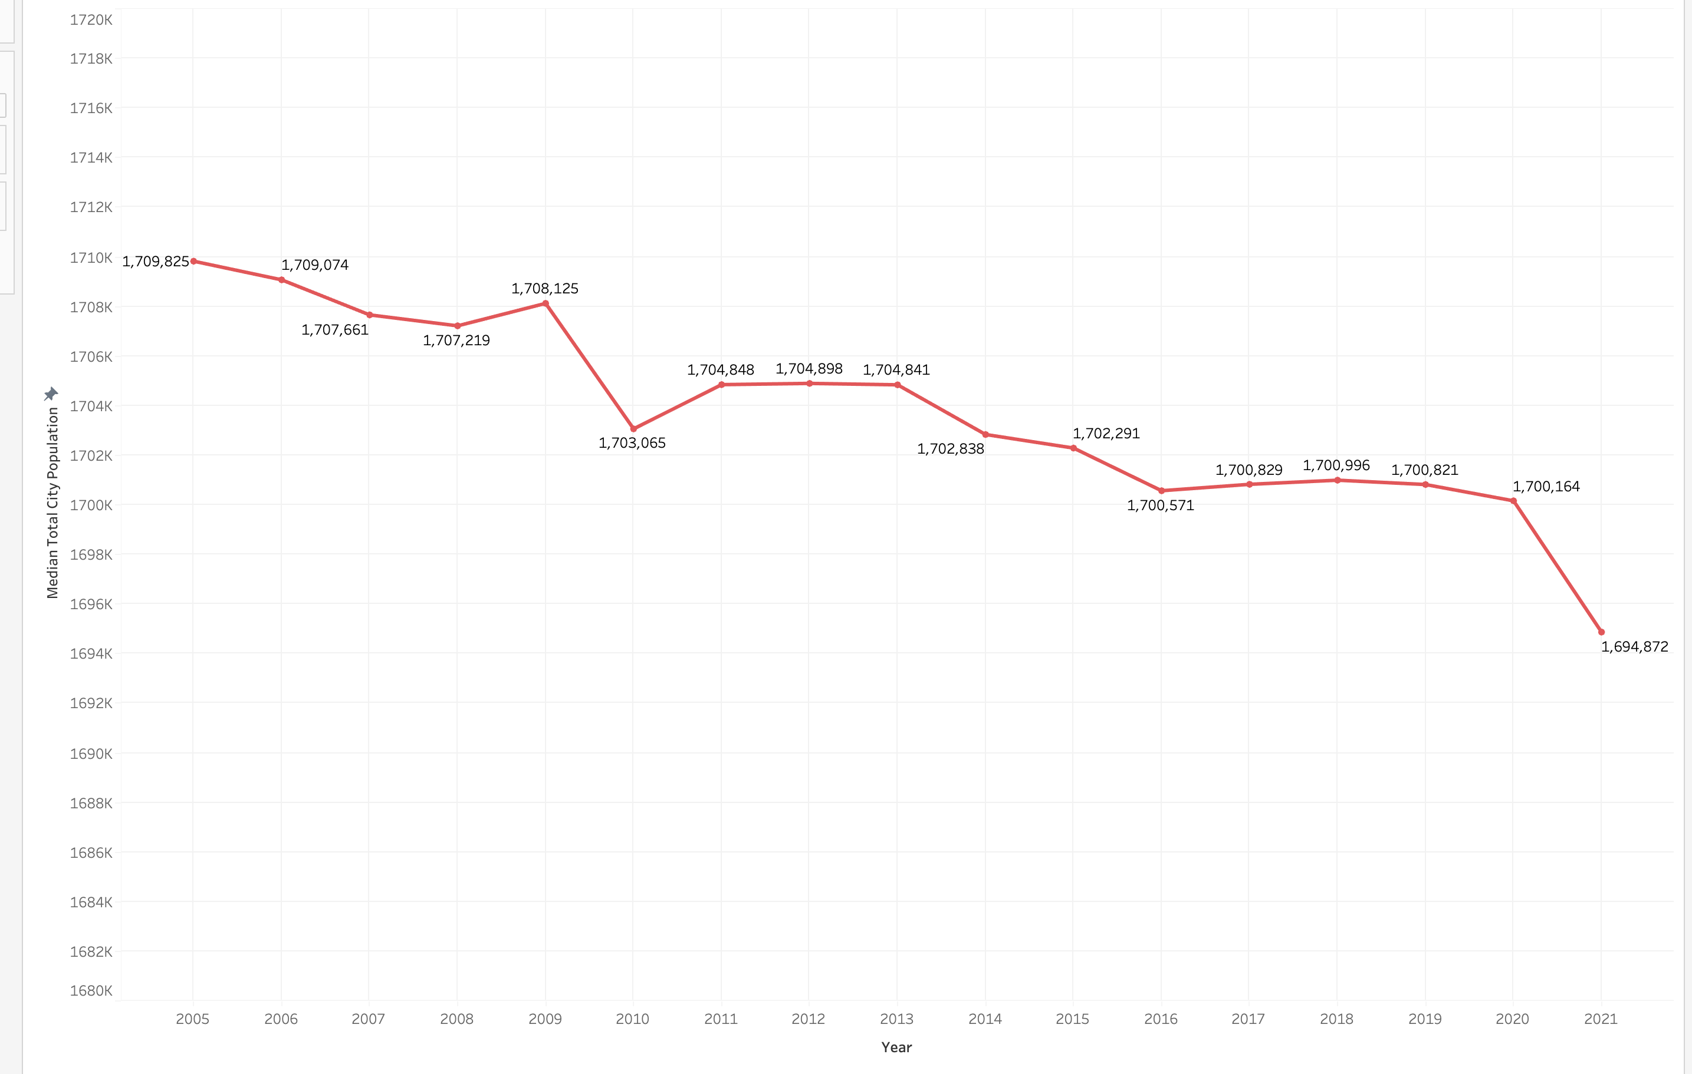
Tableau
Population Warsaw
Air pollution Warsaw
10.13%
Notes:
Utilization of two datasets for Berlin and Warsaw.
The datasets exclusively comprise numerical values.
Implementation of K-Nearest Neighbors (KNN) technique for handling missing values.
Application of linear regression model to explore relationships between variables.
Conducting one-sided hypothesis testing to assess the significance of identified relationships.
.

Slide 10
Conclusions
- Positive Air Quality Impact
- Policy Effectiveness
- Importance of Sustainable Urban Planning
- Recommendations for Future Policies
- Continued Monitoring and Evaluation
Notes:
Positive Air Quality Impact: Analysis indicates that Low Emission Zones (LEZs) have a positive impact on urban air quality by significantly reducing vehicle emissions.
Policy Effectiveness: Results support the effectiveness of LEZs in improving air quality and meeting EU air quality standards.
Importance of Sustainable Urban Planning: The findings underscore the importance of implementing sustainable urban policies like LEZs to address urban air pollution challenges.
Recommendations for Future Policies: Based on the study, recommendations can be made to strengthen and expand LEZs, and develop comprehensive environmental policies promoting cleaner and sustainable mobility.
Continued Monitoring and Evaluation: Ongoing monitoring and evaluation are crucial to ensure the ongoing effectiveness of LEZs and make adjustments as needed.
.

Slide 11
Future directions...
- Create a cleaner function
- Use the predictive model to predict and evaluate the implementation of Low Emission Zones (LEZs) in different cities.
- Study the health impact
Notes:
Positive Air Quality Impact: Analysis indicates that Low Emission Zones (LEZs) have a positive impact on urban air quality by significantly reducing vehicle emissions.
Policy Effectiveness: Results support the effectiveness of LEZs in improving air quality and meeting EU air quality standards.
Importance of Sustainable Urban Planning: The findings underscore the importance of implementing sustainable urban policies like LEZs to address urban air pollution challenges.
Recommendations for Future Policies: Based on the study, recommendations can be made to strengthen and expand LEZs, and develop comprehensive environmental policies promoting cleaner and sustainable mobility.
Continued Monitoring and Evaluation: Ongoing monitoring and evaluation are crucial to ensure the ongoing effectiveness of LEZs and make adjustments as needed.
.

Slide 12
THANKS FOR YOUR ATTENTION!
Notes:
Positive Air Quality Impact: Analysis indicates that Low Emission Zones (LEZs) have a positive impact on urban air quality by significantly reducing vehicle emissions.
Policy Effectiveness: Results support the effectiveness of LEZs in improving air quality and meeting EU air quality standards.
Importance of Sustainable Urban Planning: The findings underscore the importance of implementing sustainable urban policies like LEZs to address urban air pollution challenges.
Recommendations for Future Policies: Based on the study, recommendations can be made to strengthen and expand LEZs, and develop comprehensive environmental policies promoting cleaner and sustainable mobility.
Continued Monitoring and Evaluation: Ongoing monitoring and evaluation are crucial to ensure the ongoing effectiveness of LEZs and make adjustments as needed.
.

