Slide 1
1
File created on: 2019-05-09 20:46:52

Slide 3
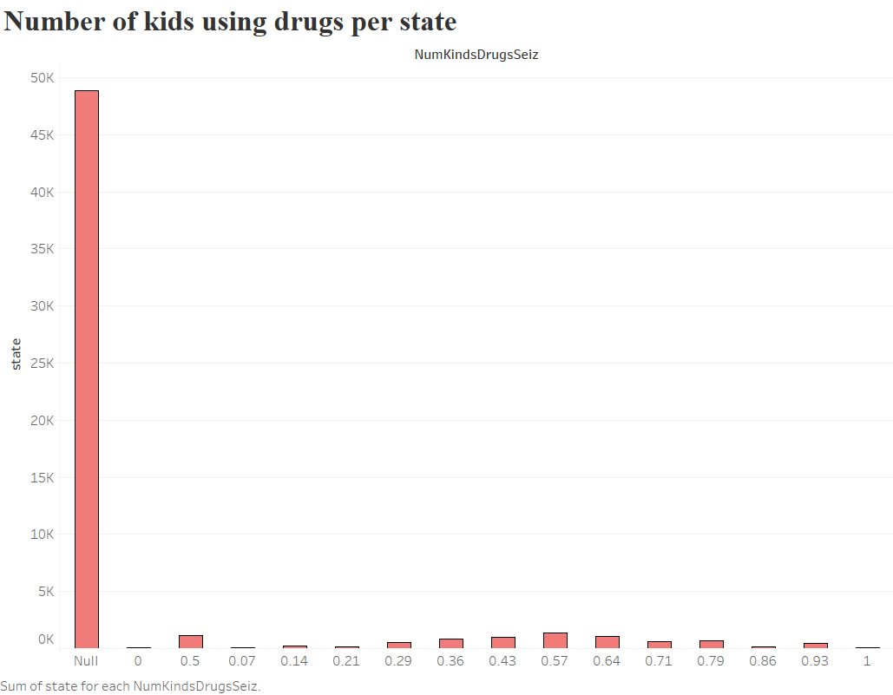

Slide 4


Slide 5
