Slide 1


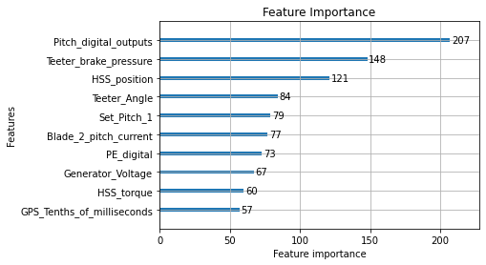
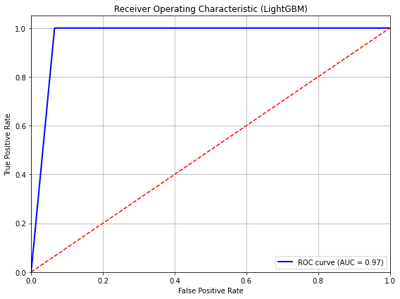
lo
Enhancing Offshore Wind Turbine Maintenance Planning with Machine Learning Models
Katharina Dowlin and Dr. Mariya Naumova
INTRO
Offshore wind energy provides significant environmental and economic benefits, but high Operations and Maintenance (O&M) costs remain a major barrier to large-scale deployment. Improving the ability to predict turbine operational behavior can enhance maintenance planning and reduce unexpected downtime. In this study, we focus on using machine learning models to forecast critical turbine states based on Supervisory Control and Data Acquisition (SCADA) data and environmental conditions, supporting more efficient O&M strategies.
METHODS
We trained and evaluated three machine learning models—Extreme Gradient Boosting (XGBoost), Categorical Boosting (CatBoost), and Light Gradient Boosting Machine (LightGBM)—to predict key turbine operational parameters. The models were trained on real-world SCADA datasets collected from developing offshore wind farm sites in the U.S. North Atlantic region. Model performance was assessed using Mean Squared Error (MSE) and predictive accuracy on test datasets. Feature importance was analyzed to understand the most influential predictors of turbine behavior.
RESULTS
LightGBM achieved the best performance among the models, with the lowest MSE of 0.0413 and the highest test accuracy of 95.87%. CatBoost outperformed XGBoost but showed slightly lower accuracy than LightGBM. Important predictive features included Set_Pitch_1, Pitch_digital_outputs, Teeter_brake_pressure, HSS_position, and Generator_Voltage. The machine learning models demonstrated strong potential for supporting improved maintenance decision-making through better operational forecasting.
DISCUSSION
This work highlights the ability of machine learning models, particularly LightGBM, to predict critical offshore wind turbine operational parameters with high accuracy and robustness to SCADA data noise. Future work will extend this framework by integrating the machine learning predictions into a stochastic optimization model for dynamic maintenance scheduling. Ultimately, this approach aims to support more reliable, cost-effective offshore wind energy deployment by enhancing predictive maintenance strategies.
The ROC curve shows that the LightGBM model can almost perfectly distinguish between turbine operational states. With an AUC of 0.97, the model has excellent predictive power, achieving a high true positive rate while keeping false positives very low. If our model were performing poorly, the ROC curve would lie close to the diagonal red line, and the AUC would be around 0.5 which means no better than random guessing. In contrast, our LightGBM model achieves an AUC of 0.97, showing strong predictive power.
Contact Information: your email
AUTHOR AFFILIATIONS: Katharina Dowlin, School of Arts and Sciences, Rutgers University
ACKNOWLEDGEMENTS: This research was supported by the NJEDA.
Notes:
Notes:
In Powerpoint, click View > Guides
Keep text within gutter guides.
Author list: Don’t split names onto two lines (e.g., “Jimmy [break] Smith”). If that happens, use a new line, unless you need the space. Bold the first names of anybody who’s presenting in person.
Intro/methods/result: Do not drop below font size 28, but if you have extra space, jack up the font size until the space is full.
Do not use color in the sidebars except in graphs/figures. It’ll pull attention from the center and slow interpretation for passersby.

