Slide 1


Space-to-time conversion: oscillations in an artificial neural network serve to generate a temporal code representing multi-object visual input
Katharina Duecker, Marco Idiart, Ole Jensen

Slide 2
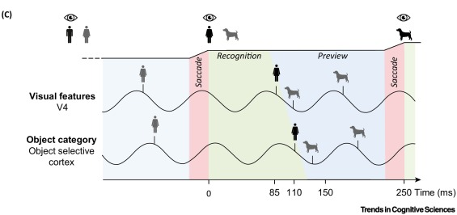
Temporal dynamics of ventral stream reflect pipelining mechanism
Visual input reaches the cortex within ~60 ms (e.g. Kirchberger et al., 2021)
Dendritic bursting of pyramidal cells in V1 L4 underlies alpha rhythm (8-12 Hz; Traub et al. 2020)
The limited capacities of the visual system require an organizing mechanism that solves the competition between simultaneous inputs (Jensen et al. 2014, 2021)
Visual search experiments suggest that selective attention underlies serial and parallel properties (see Wolfe, 1994, 1997,2021)
Suggestion: alpha oscillations serve as a gating mechanism and allow serial properties within region & parallel properties between regions (Jensen & Mazaheri, 2010; Jensen et al. 2014, 2021)
adapted from Jensen et al. 2021
Notes:
Saccade frequency: every 250 ms; minus 100 ms for saccade initiation; minus 60 ms until input reaches V1
Leaves ~90 ms to process current input & preview the next saccade goal

Slide 3
Idea: Artificial Neural Network with oscillatory dynamics that is capable of multiplexing
Goal: Integrate semi-realistic oscillatory dynamics into an ANN to solve the bottleneck problem when multiple stimuli are presented simultaneously
Building blocks:
ANN that can classify different inputs
Competing inputs
Temporal dynamics in hidden nodes, reflecting feedforward dynamics in input layer (Traub et al. 2020)
Pulsed rhythmic inhibition in the alpha range that serves as a gating mechanism to generate a temporal code

Slide 4
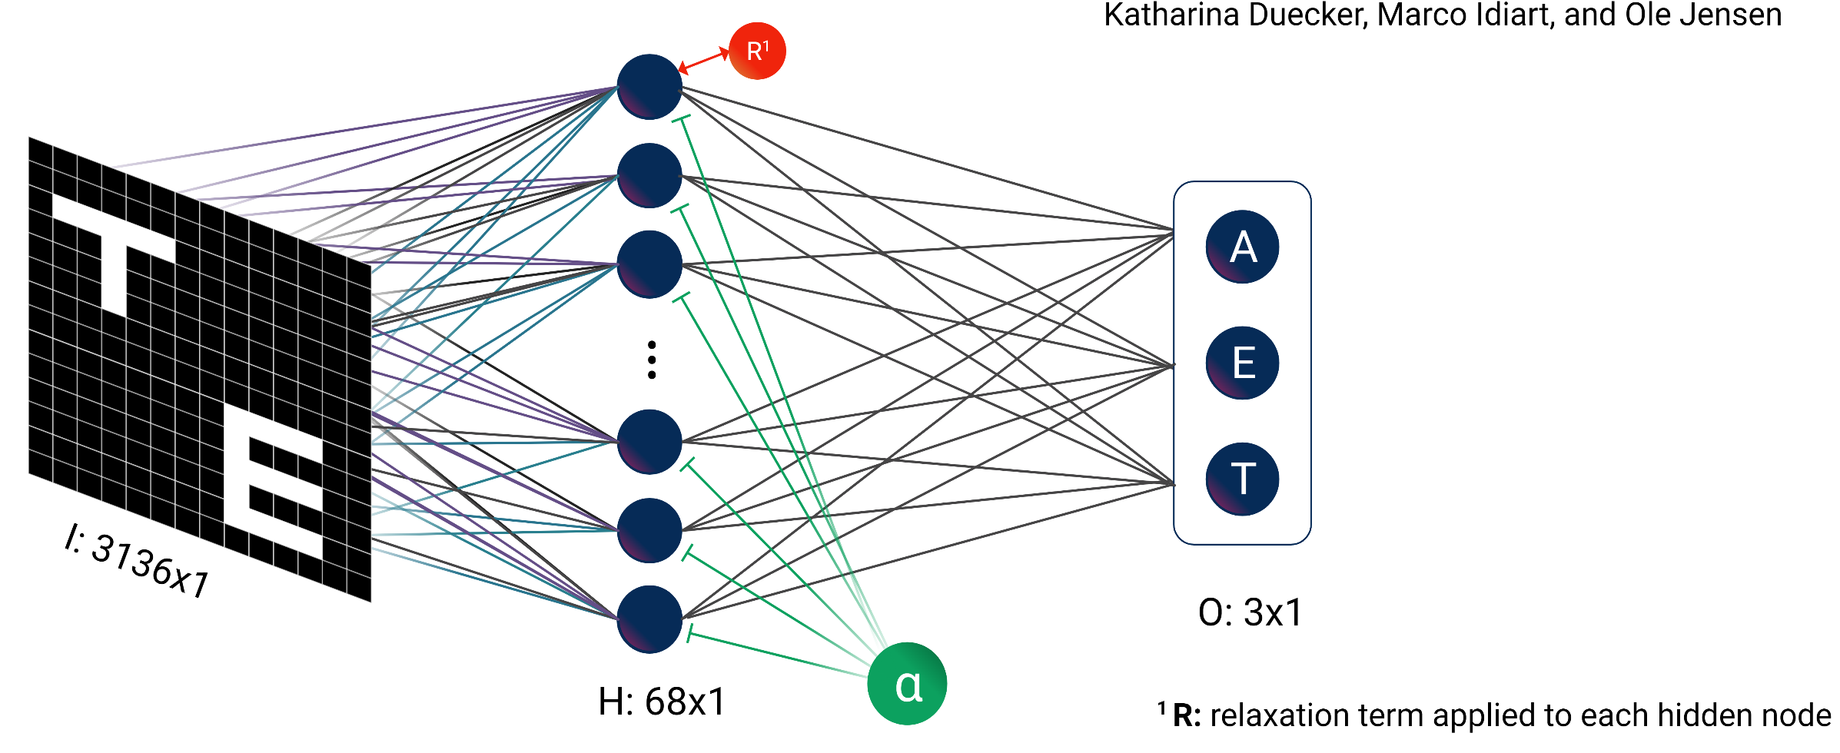
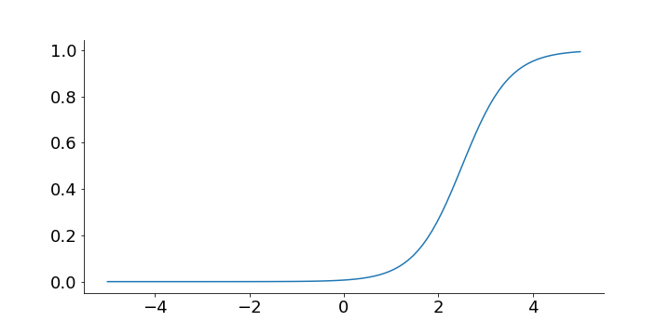
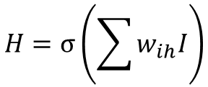

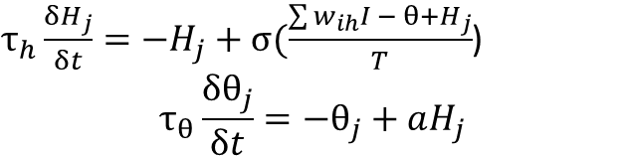
Network architecture
3 Dynamics: each node j activation follows rhythm in the 8-12 Hz range
$τ_{h}\frac{{δH}_{j}}{δt}=−H_{j}+σ(\frac{\sum{w_{ih}I − θ+}H_{j}}{T}$)
$$τ_{θ}\frac{δθ_{j}}{δt}=−θ_{j}+aH_{j}$$
2 Competition: weight matrix entries copied along first dimension
θ
$$O=softmax\left(\sum{w_{ho}H}\right)$$
1 Training: Network trained on one quadrant using gradient descent
4 Inhibition: alpha inhibition applied to entrain nodes to a 10 Hz rhythm
$$H=σ\left(\sum{w_{ih}I}\right)$$
$τ_{h}\frac{{δH}_{j}}{δt}=−H_{j}+σ(\frac{\sum{w_{ih}I − θ−α(t)+}H_{j}}{T}$)

Slide 5
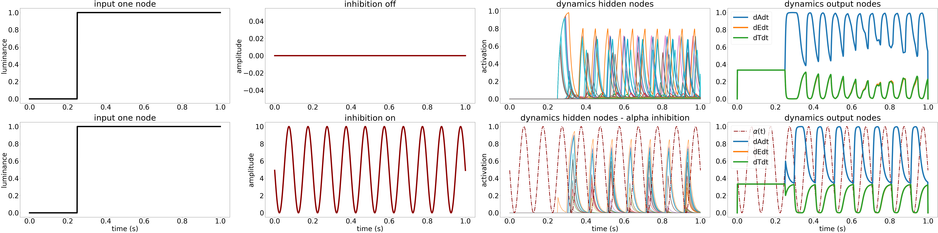
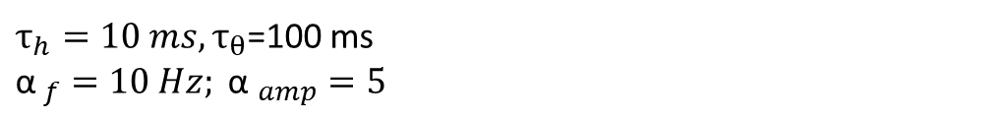
One input: entraining hidden nodes to follow alpha rhythm
Spontaneous alpha oscillations applied to hidden layer
The phase of the alpha oscillations is stable (= not reset when input is presented; Mazaheri & Jensen, 2006)
$τ_{h}=10 ms,τ_{θ}$=100 ms
$${\text{α} }_{f}=10 Hz; {\text{α} }_{amp}=5$$

Slide 6
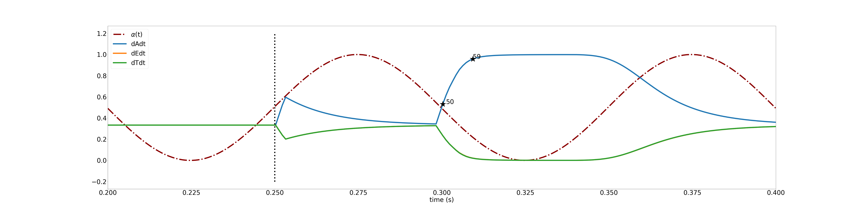
One input: alpha oscillations implement biologically plausible timing
High certainty in output node after ~60 ms

Slide 7
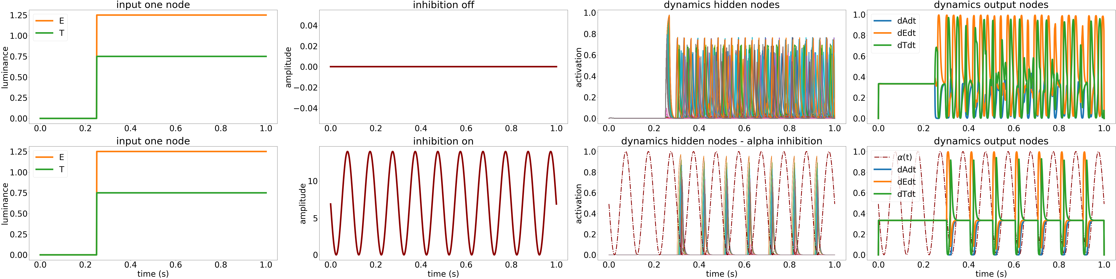
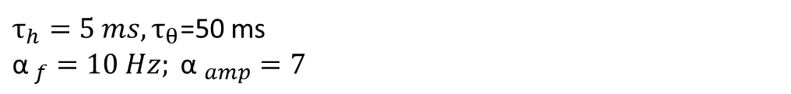
Two inputs: alpha generates a temporal code & solves the biased competition
Hidden dynamics speeded up → competition between inputs
Alpha amplitude increased compared to one-input-case → temporal code
$τ_{h}=5 ms,τ_{θ}$=50 ms
$${\text{α} }_{f}=10 Hz; {\text{α} }_{amp}=7$$

Slide 8
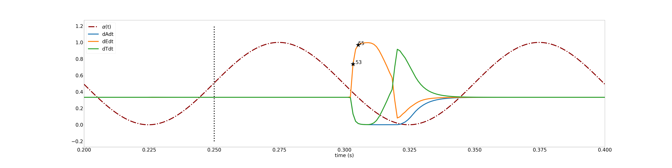
Two inputs: Temporal code
First input reaches output layer after ~60 ms
Second input then wins the competition
Gate is closed by alpha inhibition

Slide 9
Conclusions
Entraining hidden node activations to alpha oscillation leads to:
Semi-plausible temporal constraints
A temporal code solving the biased competition of simultaneously presented inputs
Why bother?
Training computer vision models to sequentially attend to inputs is not trivial (Lei et al., 2021)
We here present a fairly computationally inexpensive mechanism that solves the bottleneck problem, and possesses parallel and serial properties
Biological vision has been the main inspiration for computer vision models (e.g. CNNs), however, the temporal constraints of the visual system have not been sufficiently embraced in these networks
Outlook
Deep NNs that can solve more complicated problems, in which temporal constraints support perceptual binding
Integrate dynamics into biologically plausible models, e.g. “V1 layers” (Marques et al., 2021)
Notes:
Saccade frequency: every 250 ms; minus 100 ms for saccade initiation; minus 60 ms until input reaches V1
Leaves ~90 ms to process current input & preview the next saccade goal

