Slide 1
NN + oscillations
Th, 15/09/22

Slide 2
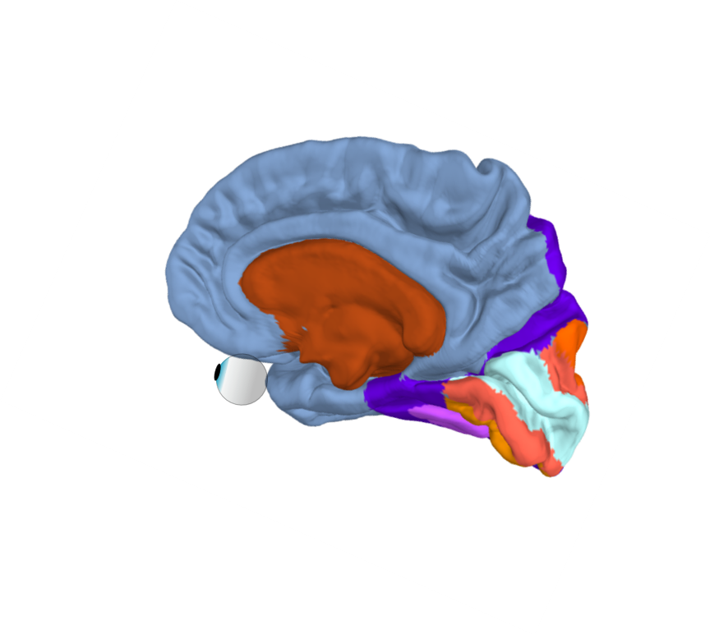
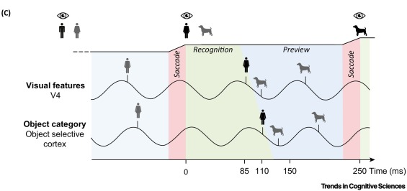
Hypothesis: alpha-gamma temporal code solves bottleneck problem in ventral stream
Alpha (8-12 Hz)
Gamma (>30 Hz)

Slide 3
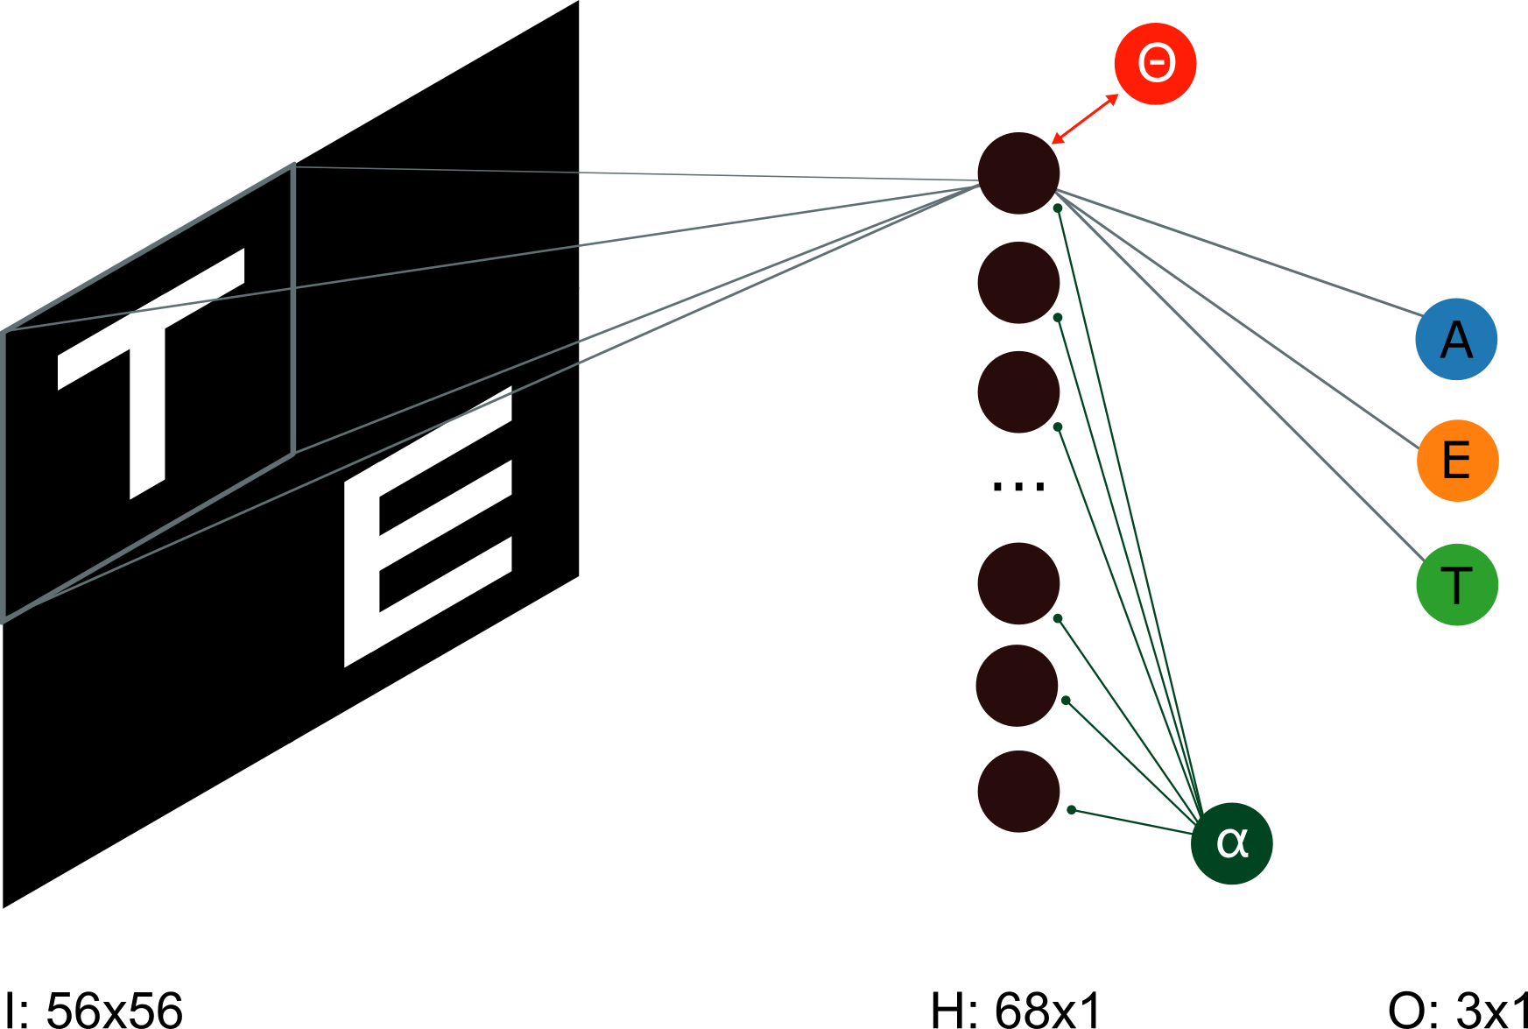
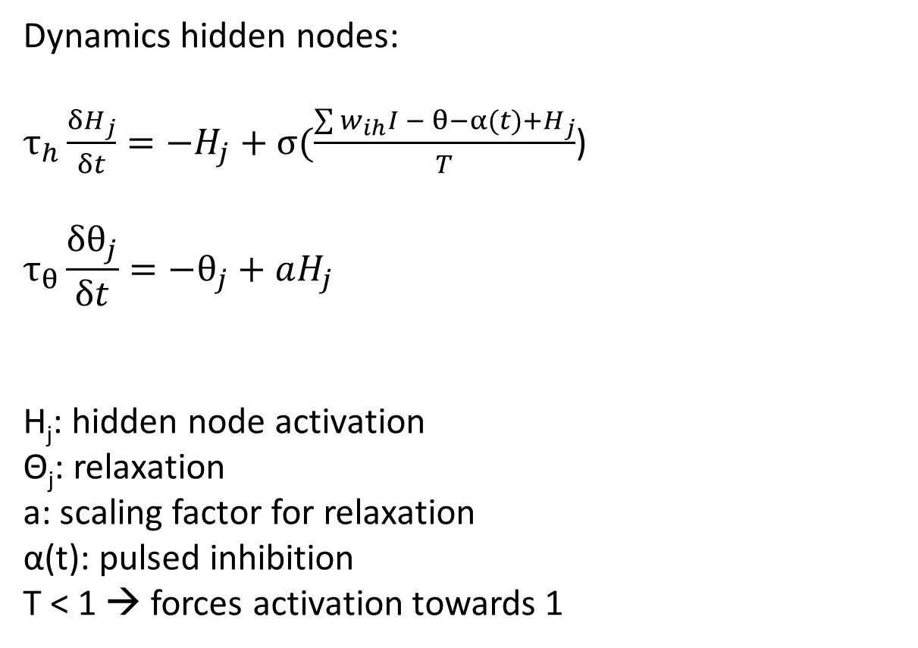
Model & dynamics
Dynamics hidden nodes:
$τ_{h}\frac{{δH}_{j}}{δt}=−H_{j}+σ(\frac{\sum{w_{ih}I − θ−α(t)+}H_{j}}{T}$)
$$τ_{θ}\frac{δθ_{j}}{δt}=−θ_{j}+aH_{j}$$
H_{j}: hidden node activation
Θ_{j}: relaxation
a: scaling factor for relaxation
α(t): pulsed inhibition
T < 1 → forces activation towards 1
W_{HI}: 64x28x28
H[i] = sum[conv(W_{HI}[i],I)-b]
b = -2.5

Slide 4
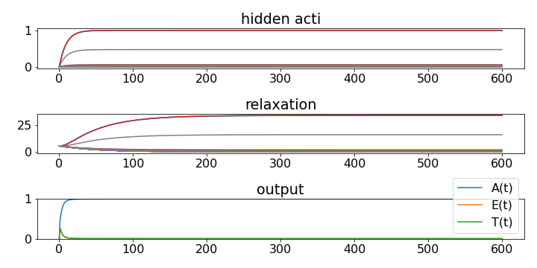
Euler discretization without relaxation: one input

Slide 5
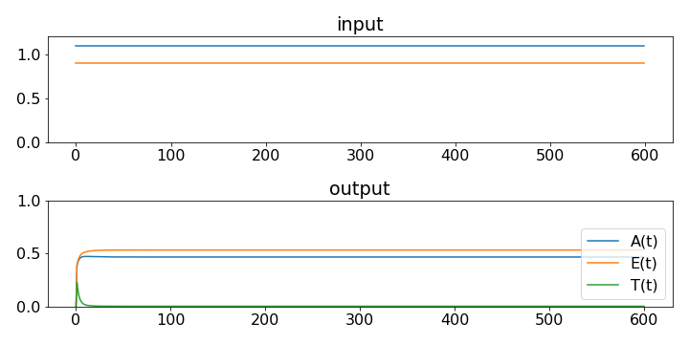
Euler discretization without relaxation: competing inputs

Slide 6
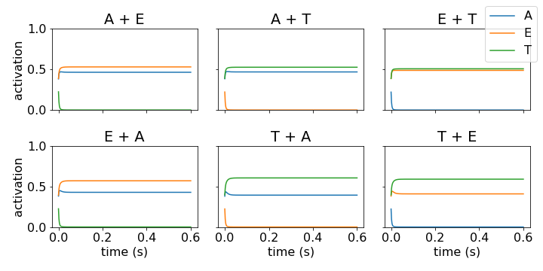
Euler discretization without relaxation: competing inputs

Slide 7
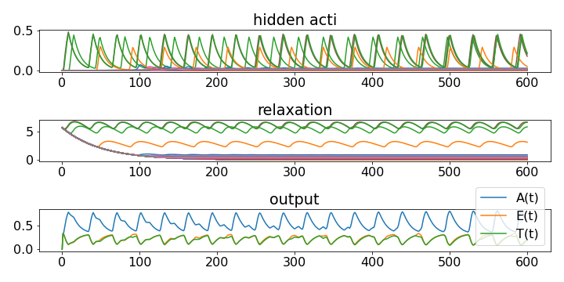
Hidden dynamic: oscillations in the output node

Slide 8
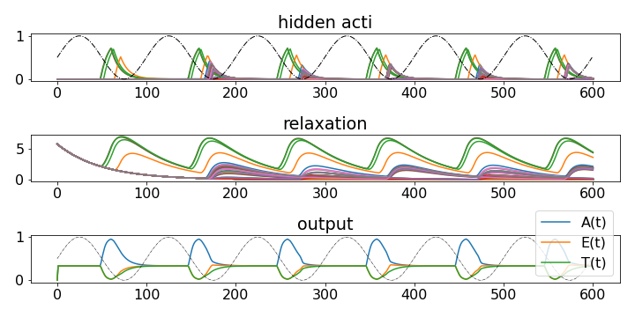
Alpha entrainment of hidden nodes

Slide 9
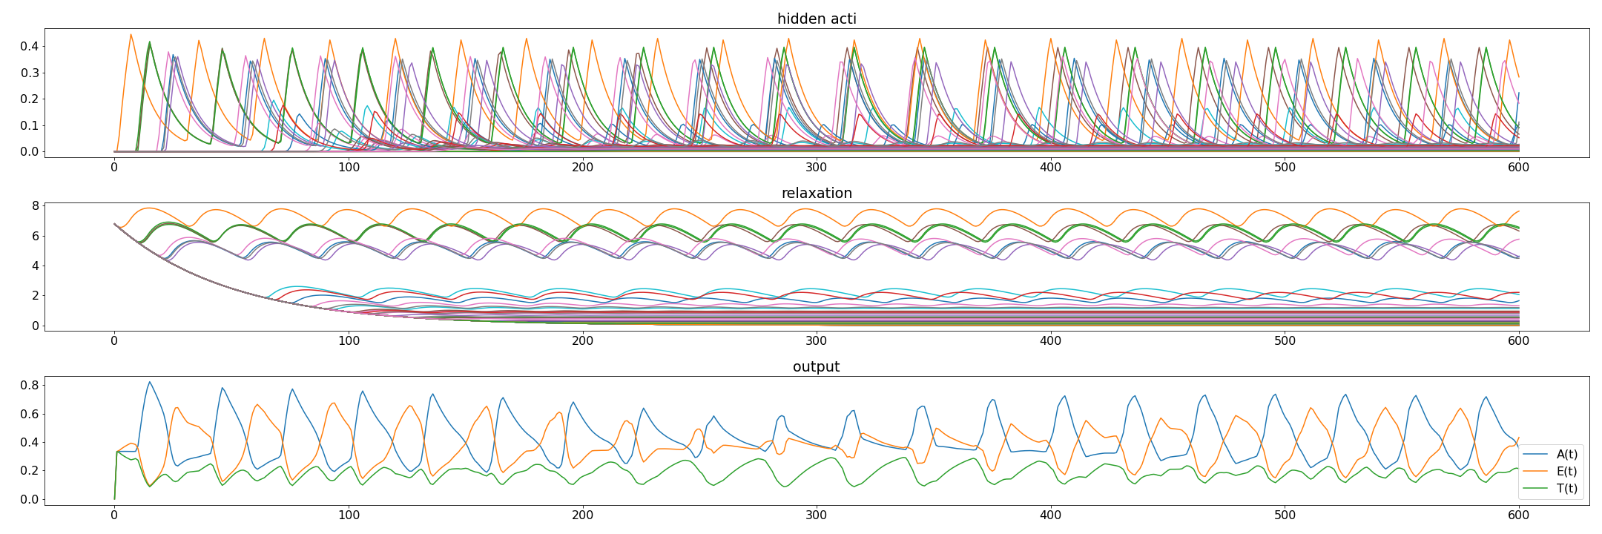
Competing inputs: dynamics

Slide 10
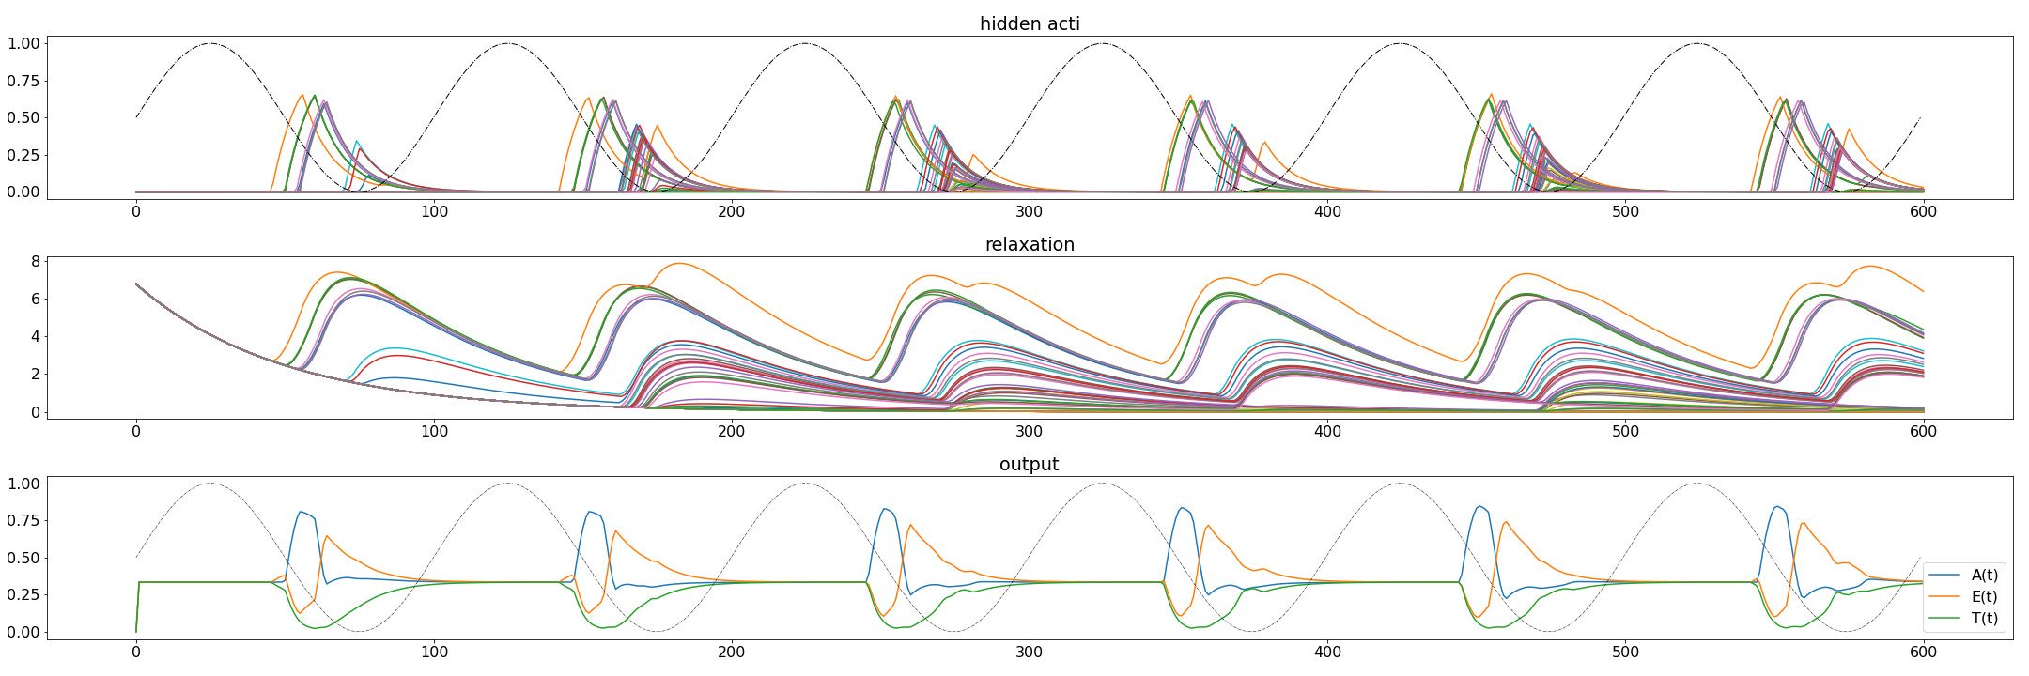
Competing inputs: dynamics + alpha = temporal code

Slide 11
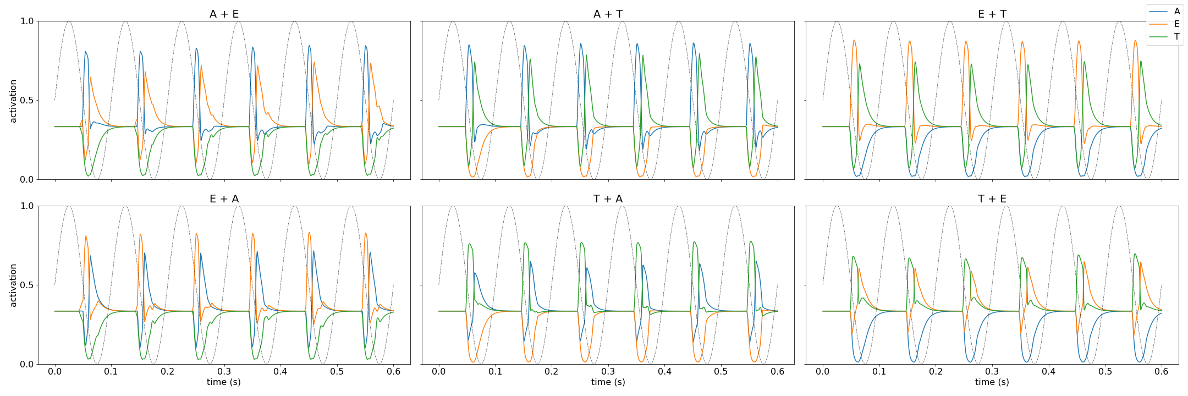
Competing inputs: dynamics + alpha = temporal code

Slide 12

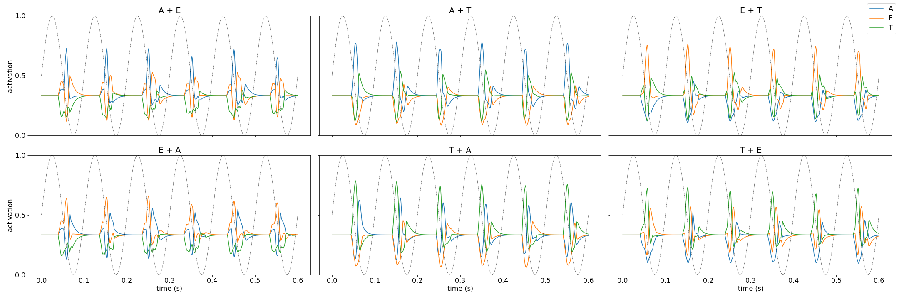
Training on noisy images
Notes:
But needs stronger gain modulation (1.25 & 0.75)

Slide 13
Conclusions
Entraining hidden node activations to alpha oscillation leads to:
Semi-plausible temporal constraints
A temporal code solving the biased competition of simultaneously presented inputs
Why bother?
Training computer vision models to sequentially attend to inputs is not trivial (Lei et al., 2021)
We here present a fairly computationally inexpensive mechanism that solves the bottleneck problem, and possesses parallel and serial properties
Biological vision has been the main inspiration for computer vision models (e.g. CNNs), however, the temporal constraints of the visual system have not been sufficiently embraced in these networks
Outlook
Deep NNs that can solve more complicated problems, in which temporal constraints support perceptual binding
Integrate dynamics into biologically plausible models, e.g. “V1 layers” (Marques et al., 2021)
Notes:
Saccade frequency: every 250 ms; minus 100 ms for saccade initiation; minus 60 ms until input reaches V1
Leaves ~90 ms to process current input & preview the next saccade goal

