Slide 1
NN + oscillations
Th, 31/10/22

Slide 2
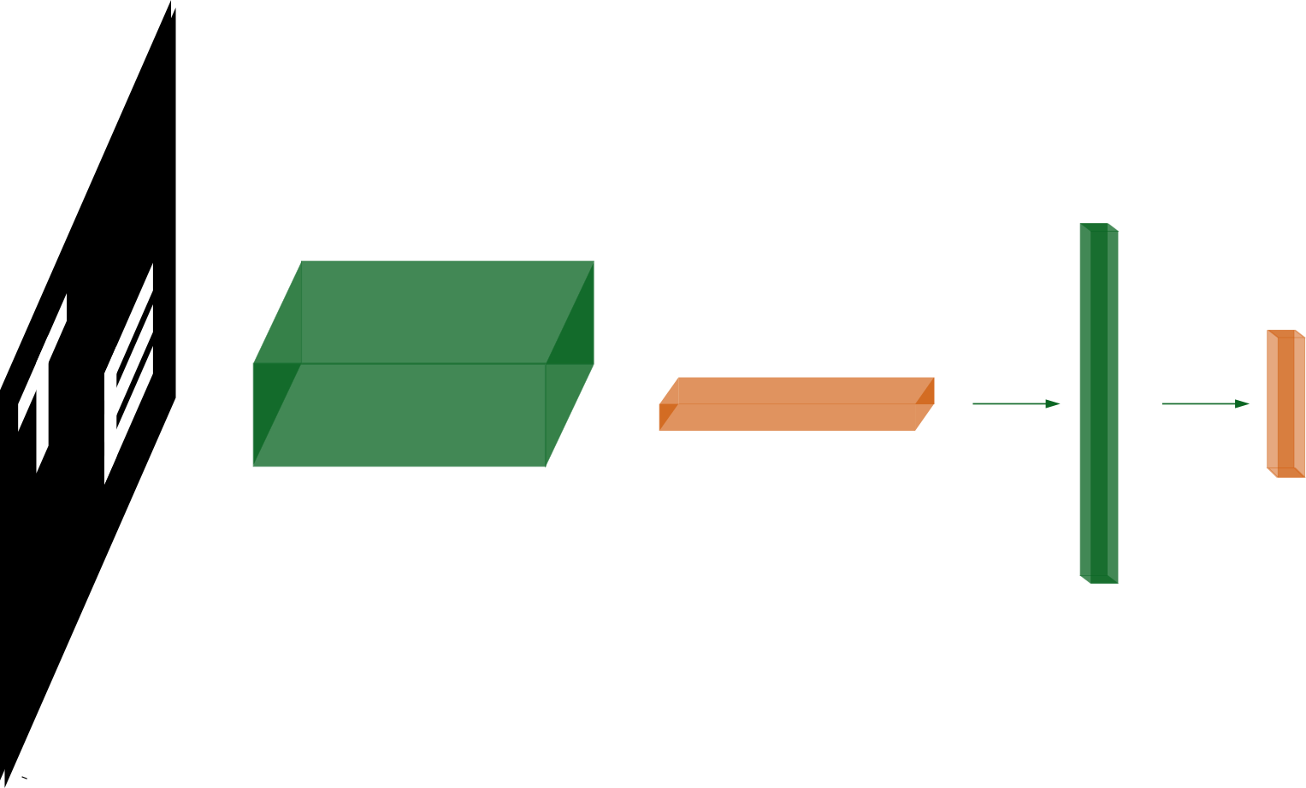
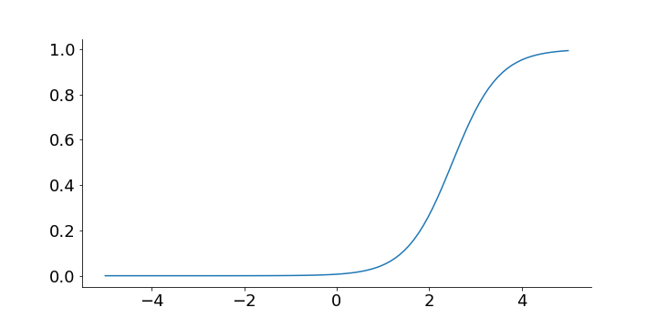
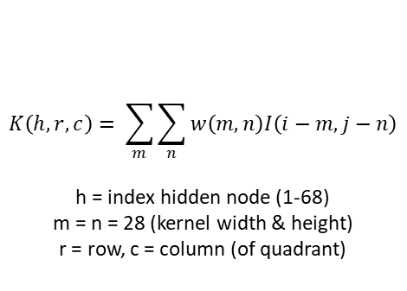
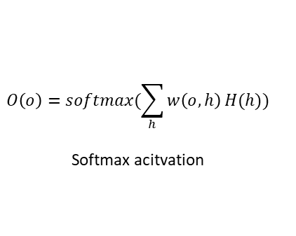

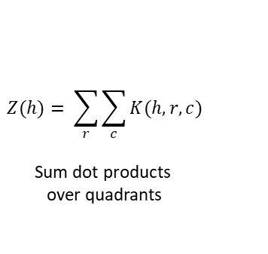
Network architecture
I: 56x56
W: 28x28x68 Kernel convolved with quadrants
P: 2x2x68 Pooling kernel: sum over quadrants
H: 68x1 FC layer
O: 3x1 output
$$K\left(h,r,c\right)= \sum_{m}{\sum_{n}{w\left(m,n\right)I\left(i−m,j−n\right)}}$$
h = index hidden node (1-68)
m = n = 28 (kernel width & height)
r = row, c = column (of quadrant)
$$Z(h)= \sum_{r}{\sum_{c}{K(h,r,c)}}$$
Sum dot products over quadrants
$$H\left(h\right)= σ(Z(h))$$
(shifted) sigmoid activation
$$O\left(o\right)=softmax(\sum_{h}{w\left(o,h\right)}H(h))$$
Softmax acitvation

Slide 3

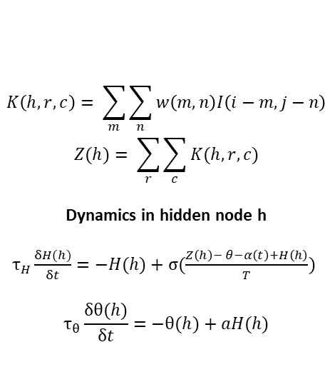
Hidden layer dynamics
$$K\left(h,r,c\right)= \sum_{m}{\sum_{n}{w\left(m,n\right)I\left(i−m,j−n\right)}}$$
$$Z(h)= \sum_{r}{\sum_{c}{K(h,r,c)}}$$
Dynamics in hidden node h
$τ_{H}\frac{δH(h)}{δt}=−H(h)+σ(\frac{Z\left(h\right)− θ−α\left(t\right)+H\left(h\right)}{T})$
$$τ_{θ}\frac{δθ(h)}{δt}=−θ(h)+aH(h)$$
τ_{H} : slope dynamics H
τ_{H} : slope dynamics Θ
H(h): activation in hidden node h
Θ(h): relaxation corresponding to hidden node h
a: scaling factor for relaxation (scaling = a*max(Z))
α(t): pulsed inhibition
T < 1

Slide 4
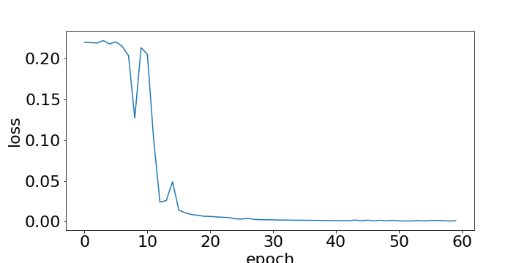
Training model with shifted sigmoid

Slide 5
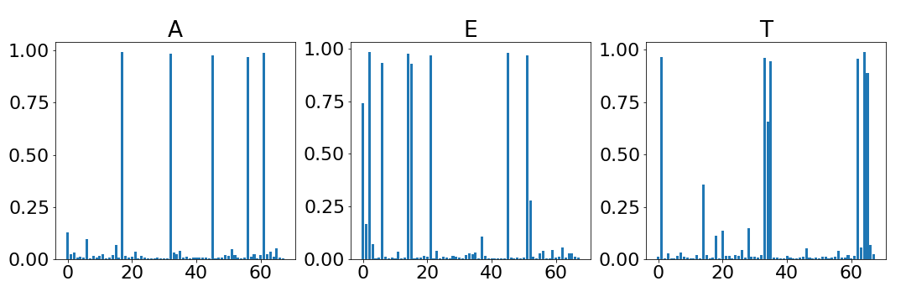
Training model with shifted sigmoid

Slide 6
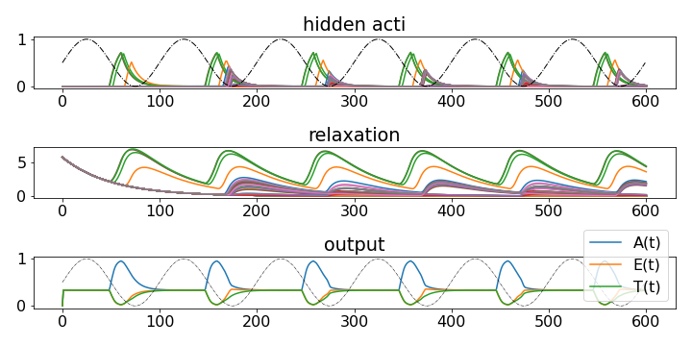
Single input: hidden dynamics & alpha inhibition

Slide 7
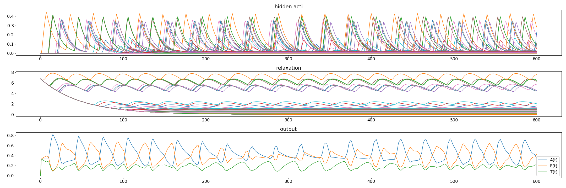
Competing inputs: dynamics without alpha

Slide 8
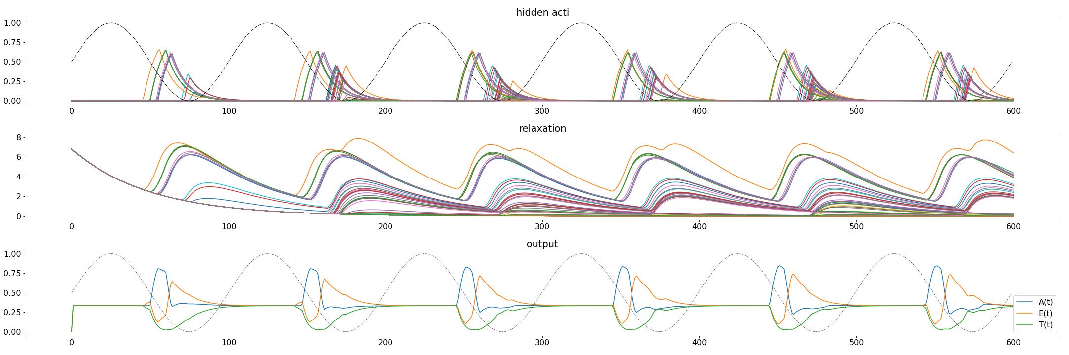
Competing inputs: dynamics + alpha = temporal code

Slide 9
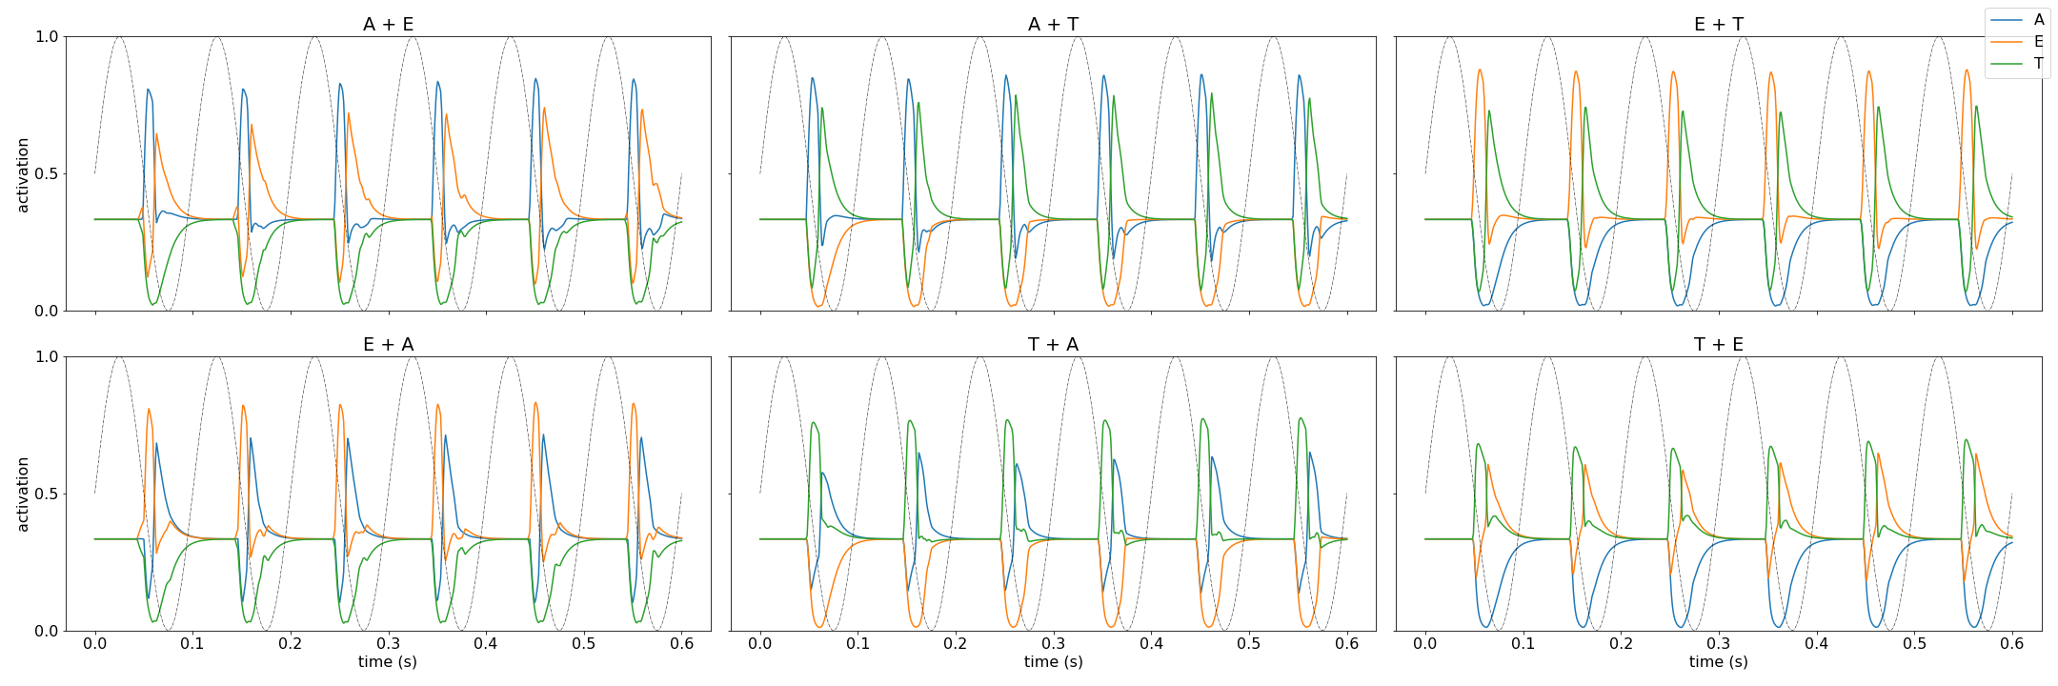
Competing inputs: dynamics + alpha = temporal code

Slide 10
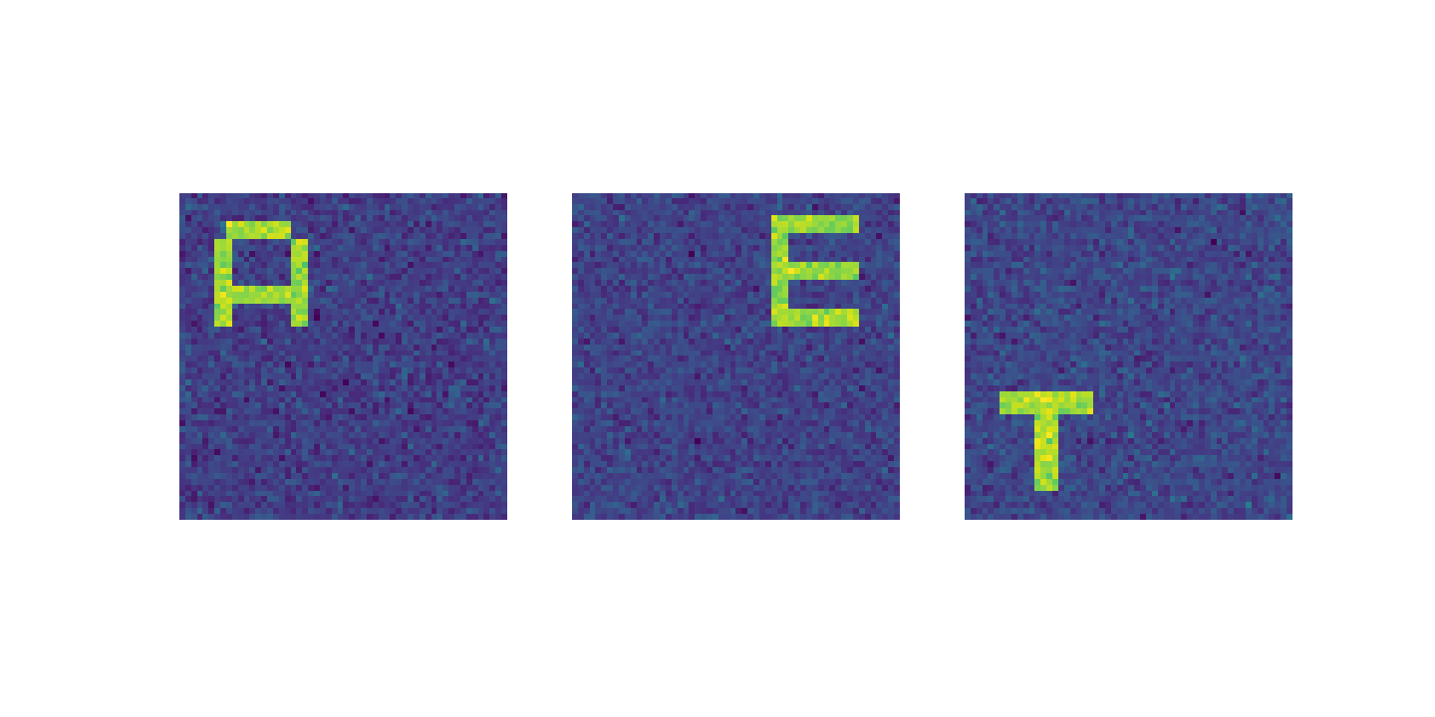
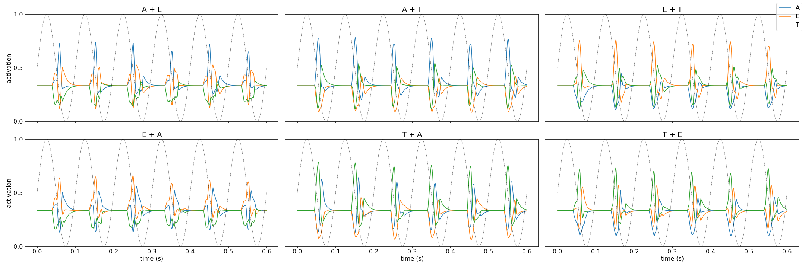
Training on noisy images
Notes:
But needs stronger gain modulation (1.25 & 0.75)

Slide 11
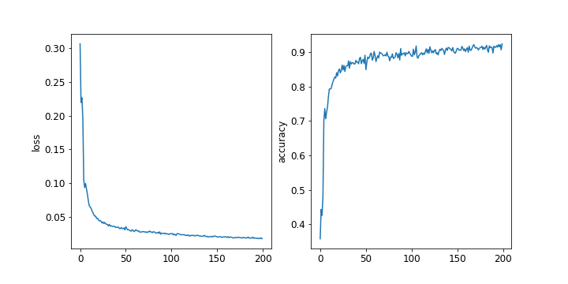
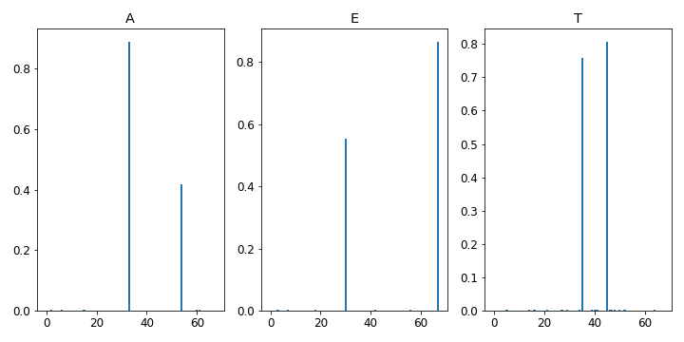

Learned bias with sparsity constraints
Penalty term (added to loss): $$KL(ρ ||{\hat{ρ}}_{j})\sum_{j=1}^{num_{hid}}{ρlog\frac{ρ}{{\hat{ρ}}_{j}}+\left(1−ρ\right)log\frac{1−ρ}{1−{\hat{ρ}}_{j}}}$$
$loss+ = β$ $KL(ρ ||{\hat{ρ}}_{j})$
Penalty term added to bias gradient $β \left(−\frac{ρ}{{\hat{ρ}}_{j}}+ \frac{1−ρ}{1−{\hat{ρ}}_{j}}\right)$ “Tangledness” minimum found with optuna

Slide 12
Learned bias with sparsity constraints
Penalty term (added to loss): $$KL(ρ ||{\hat{ρ}}_{j})\sum_{j=1}^{num_{hid}}{ρlog\frac{ρ}{{\hat{ρ}}_{j}}+\left(1−ρ\right)log\frac{1−ρ}{1−{\hat{ρ}}_{j}}}$$
$loss+ = β$ $KL(ρ ||{\hat{ρ}}_{j})$
Penalty term added to bias gradient $β \left(−\frac{ρ}{{\hat{ρ}}_{j}}+ \frac{1−ρ}{1−{\hat{ρ}}_{j}}\right)$ “Tangledness” minimum found with optuna

Slide 13
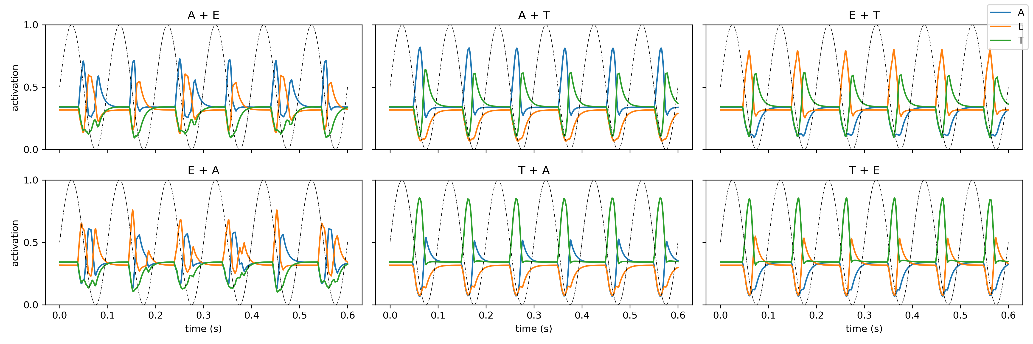
Learned bias with sparsity constraints
Tau_h = 0.01
Tau_R = 0.03

Slide 14
AET net structure on MNIST

Slide 15
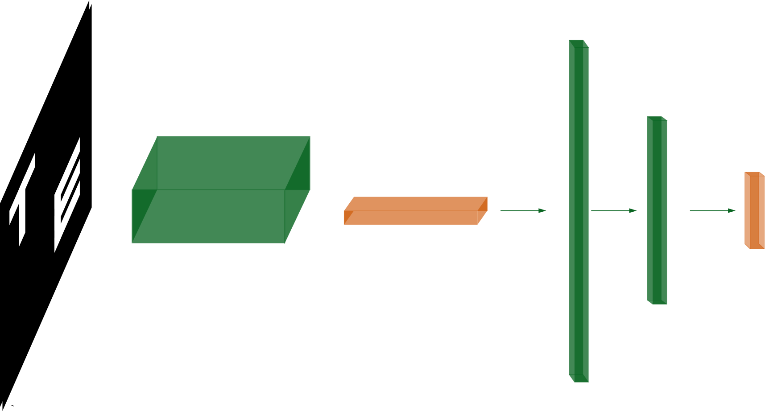
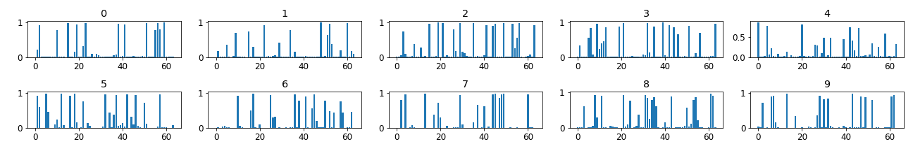
Difference set & learned bias

Slide 16
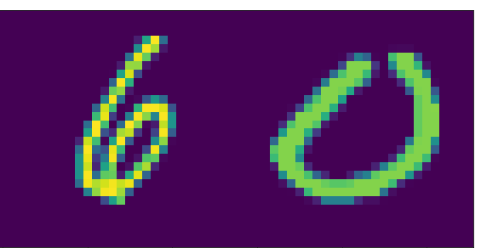
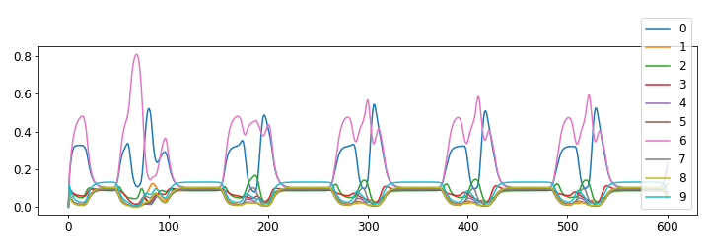
Temporal code on MNIST

Slide 17
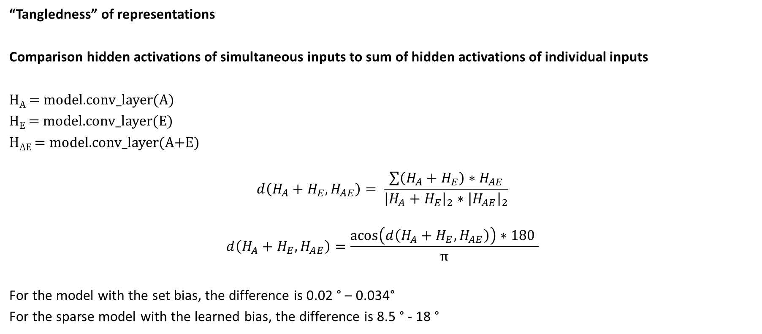
Difference set & learned bias
“Tangledness” of representations
Comparison hidden activations of simultaneous inputs to sum of hidden activations of individual inputs
H_{A} = model.conv_layer(A)
H_{E} = model.conv_layer(E)
H_{AE} = model.conv_layer(A+E)
$$d\left(H_{A}+H_{E},H_{AE}\right)= \frac{\sum{\left(H_{A}+H_{E}\right)∗H_{AE}}}{{\left|H_{A}+H_{E}\right|}_{2}∗{\left|H_{AE}\right|}_{2}}$$
$$d\left(H_{A}+H_{E},H_{AE}\right)=\frac{\operatorname{acos}\left(d\left(H_{A}+H_{E},H_{AE}\right)\right)∗180 }{π}$$
For the model with the set bias, the difference is 0.02 ° – 0.034°
For the sparse model with the learned bias, the difference is 8.5 ° - 18 °

Slide 18
CSHL project: dynamics in CORnet-Z

Slide 19
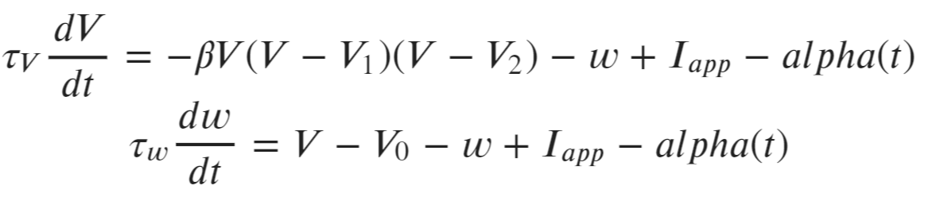
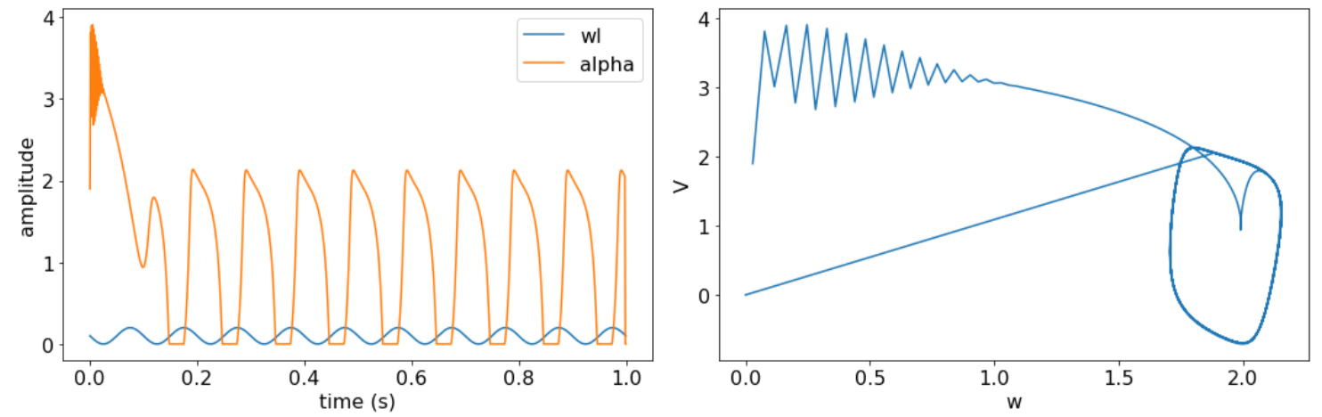


FitzHugh-Nagumo function
$$\sum{wI}$$
$$V_{1 }=0$$
\

Slide 20
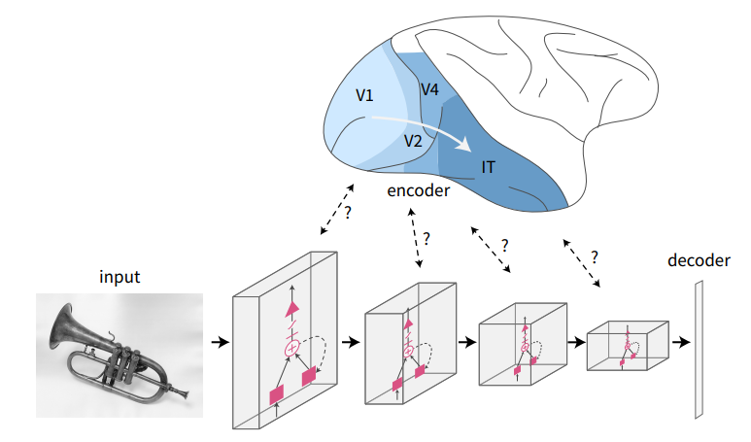
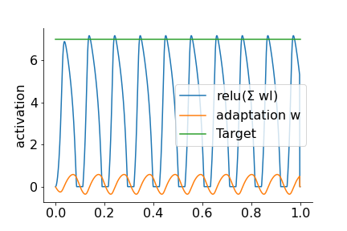
Goal: temporal code in biologically plausible network
Steps
Add linear decoder to CORnet-Z (Kubilius 2019) & train on single letters
Implement dynamical system function that generates oscillations capped at activation of the hidden node
Find layer in which hidden representations are ~additive (V1)
Implement dynamics in layer V1
“Tangledness”
~30 degr
~40 degr

Slide 21
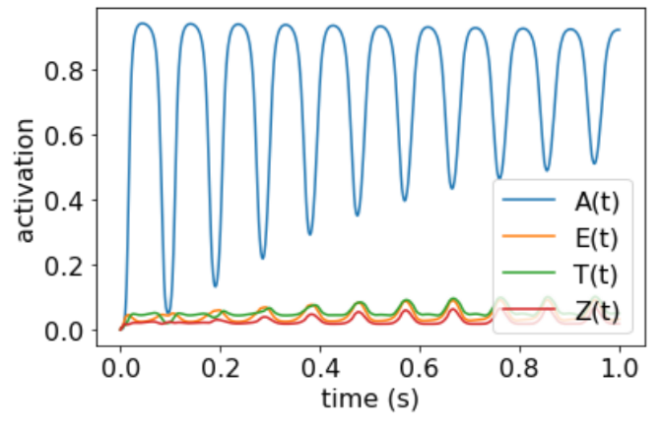
Dynamics in V1
Alpha amplitude = 0

Slide 22
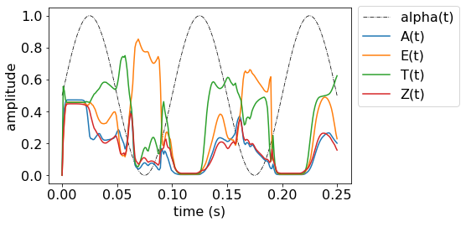
Dynamics in V1

