Slide 1
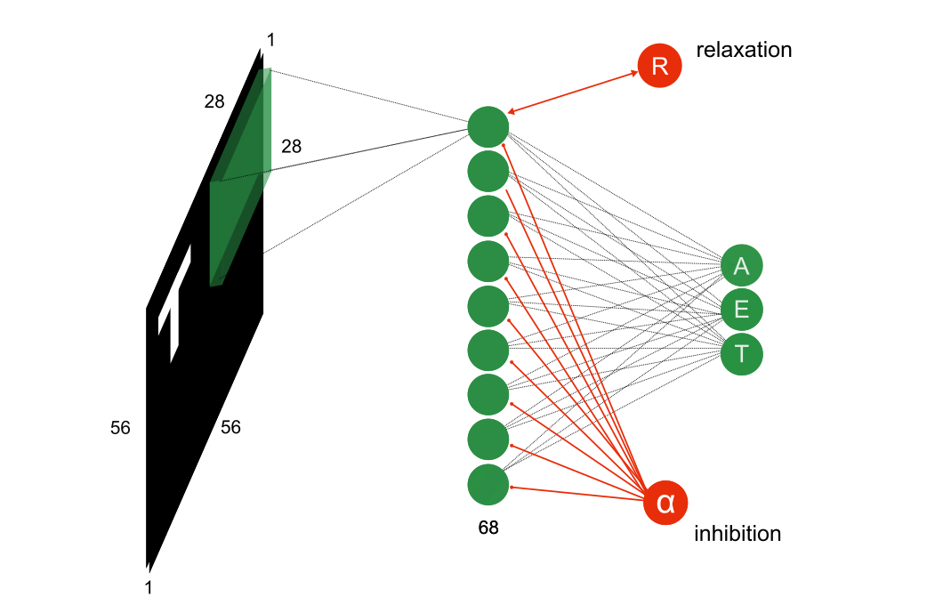
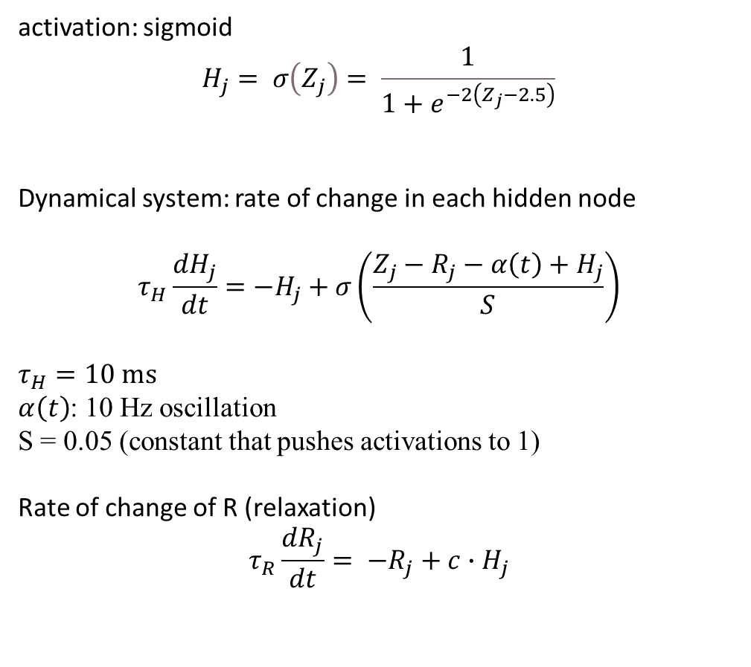
oscillations in a 1-layer network
activation: sigmoid
$$H_{j}= σ\left(Z_{j}\right)= \frac{1}{1+e^{−2\left(Z_{j}−2.5\right)}}$$
Dynamical system: rate of change in each hidden node
$$τ_{H}\frac{dH_{j}}{dt}=−H_{j}+σ\left(\frac{Z_{j}−R_{j}−α\left(t\right)+H_{j}}{S}\right)$$
$$τ_{H}=10 ms$$
$α\left(t\right)$: 10 Hz oscillation
S = 0.05 (constant that pushes activations to 1)
Rate of change of R (relaxation)
$$τ_{R}\frac{dR_{j}}{dt}= {−R}_{j}+c∙H_{j}$$

Slide 2
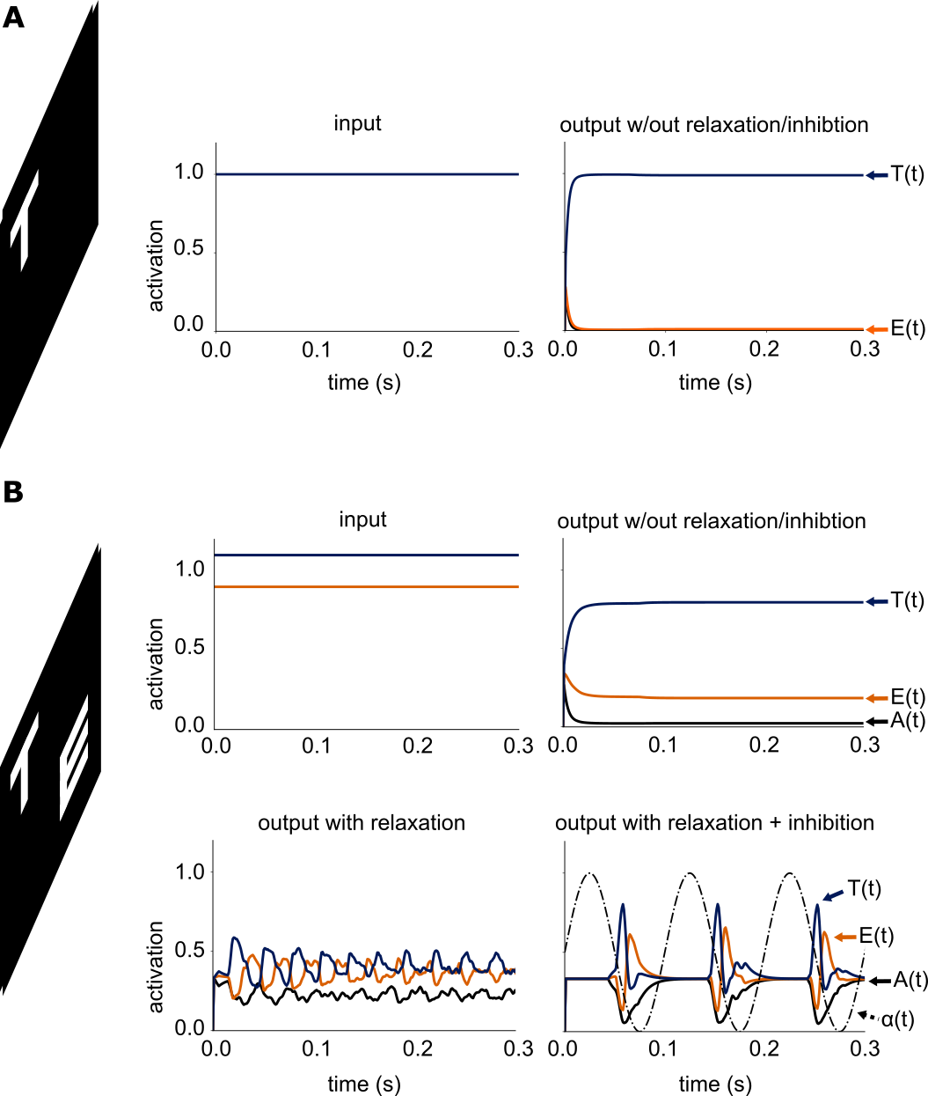
oscillations in a 1-layer network: multiplexing
Single input
competing inputs

