Slide 1

An Overview of the
Concrete Architecture of
presented via a video summary

Slide 2

Team Members & Contributions
Kabeer Adil
Nicholas Tillo
Group leader
Abstract, Introduction
Presenter
Slides, Interactions, 2nd-Level Subsystem Architecture
Kate Edgar
Raksha Rehal
Reflexion Analysis,
Use Cases
Presenter
Voiceover, Conceptual Architecture Overview, Component Breakdown
Xiyun Cao
Yu Xuan Liu
Data Dictionary,
Naming Conventions
Conclusions,
Lessons Learned

Slide 3
01
OVERVIEW

Slide 4

WHY CONCRETE ARCHITECTURE?
Compare differences between conceptual vs. concrete architecture.
Utilize code visualization and analysis tools such as Understand.
Gain insights into KODI's strengths and flaws.

Slide 5
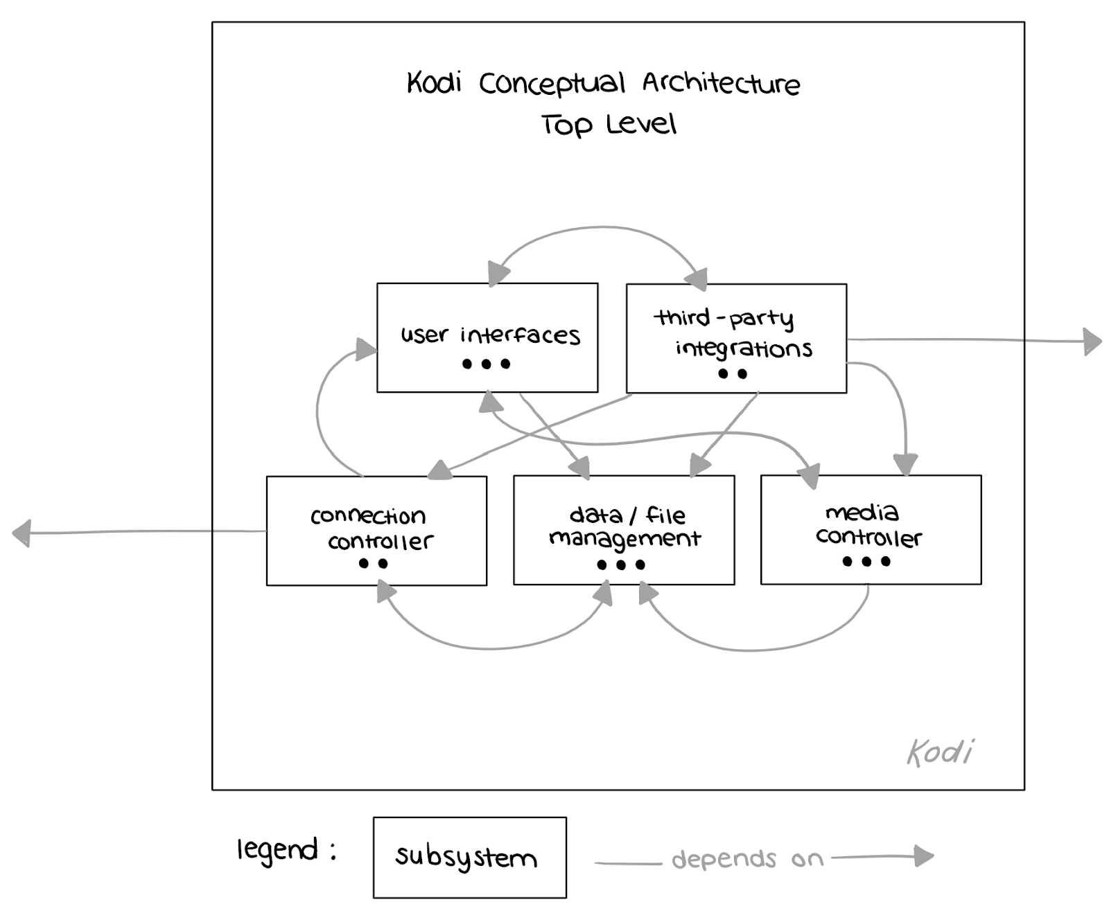
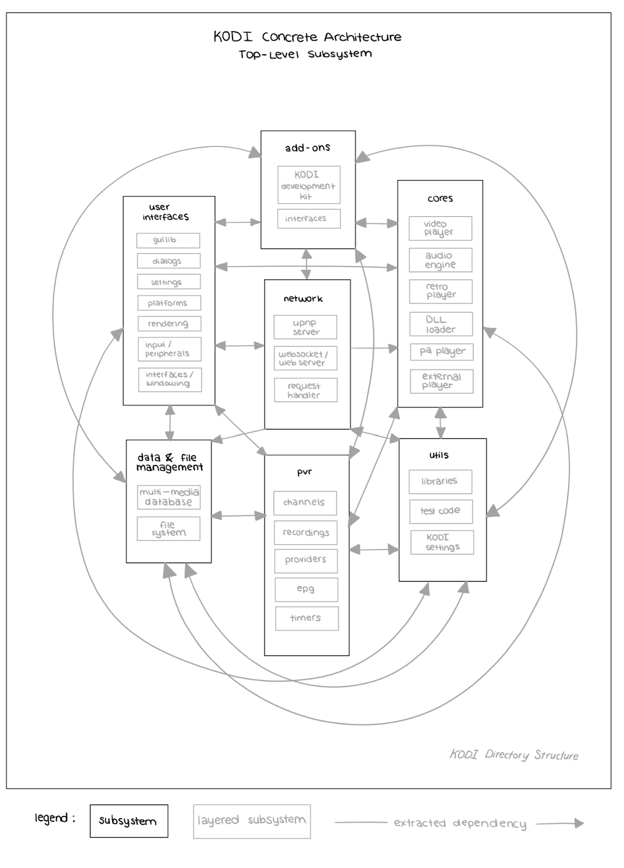
REV
I
EW
Conceptual (left) vs. concrete (right) KODI architectures.
Conceptual subsystems integrated into concrete.

Slide 6
02
CONCRETE ARCHITECTURE BREAKDOWN

Slide 7
MODULAR
LAYERED STYLES
ARCHITECTURAL STYLES
KODI's concrete architecture corresponds well with the with previous conceptual styles, layered and modular,
Additional styles include interpreter pipe and filter, and repository.
UPnP introduces peer-to-peer architecture to KODI's.

Slide 8
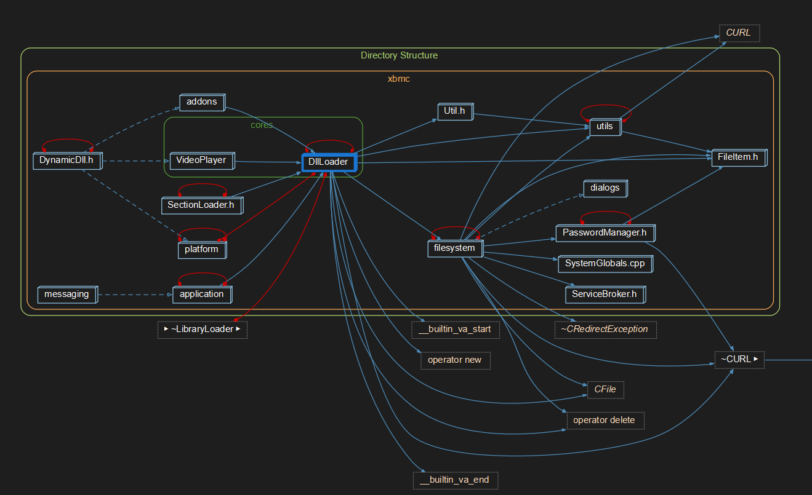
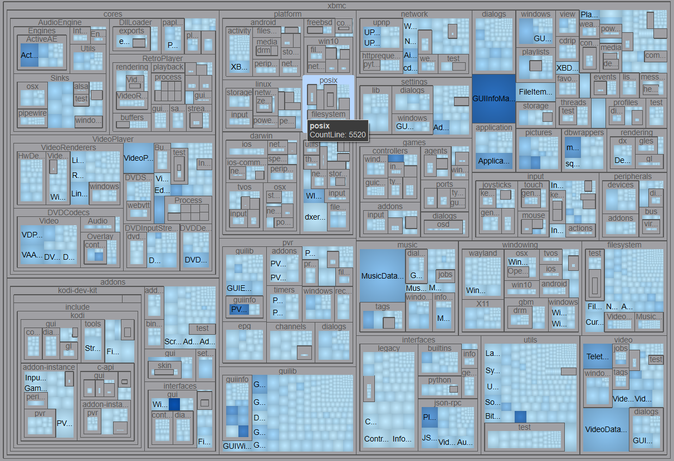
DERIVATION PROCESS
Calls & Called By Graphs &. Treemap

Slide 9
SUBSYSTEMS - RETURNING
USER INTERFACE
Interfaces, Input & Peripherals, Settings GuiLib, Platforms, Dialogue, Rendering.
ADD-ON MANAGER
KODI Development Kits, Interfaces.
DATA & FILE MANAGEMENT
MultiMedia Database, File System
CORE (MEDIA CONTROLLER)
Video Player, Audio Engine, Retry Player, DLL Loader, PA Player, External Player.
NETWORK(THIRD PARTY CONNECTION)
UPnP, Websocket/Web Server, HTTP Server Handler

Slide 10
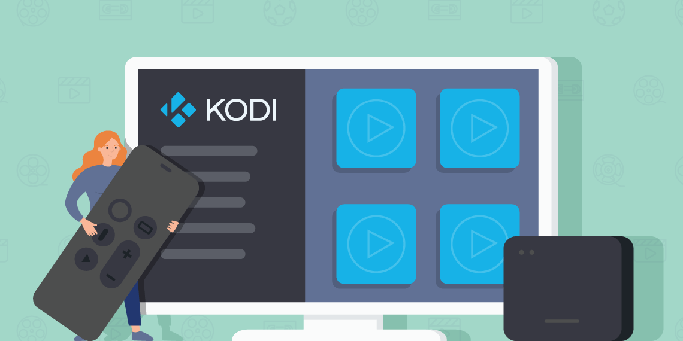
SUBSYSTEMS - ADDED
PERSONAL VIDEO RECORDER
Channels, Recordings, Providers, EPG, TImers
UTILITIES
Test Code, Settings.

Slide 11
TOP-LEVEL INTERACTION BREAKDOWN
HIGHLY INTERCONNECTED
LEAST VS MOST CONNECTED
REQUIRES DEEPER ANALYSIS
Complex dependencies means that subsystems interact closely
Utils & UI of key significance, PV more isolated
Must investigate subsystem for full understanding

Slide 12
03
SECOND-LEVEL SUBSYSTEM

Slide 13
CORES: VIDEO PLAYER
VIDEO PLAYER
most intricate subcomponents
BUFFERS
VIDEO RENDERER
VIDEO CODEC
DVD ENGINE
TESTING
SHADERS
OS PORTING
DVD SUBTITLES
DVD DEMULTIPLEXER
OVERLAY
COLOUR MANAGER
DVD CODEC
DVD INPUT STREAM

Slide 14
CORES: AUDIO & RETRO PLAYERS
AUDIO ENGINE
AUDIO UTILITIES
AUDIO CODEC
AUDIO SINK
AUDIO ENGINE
RETRO PLAYER
RETRO RENDERING
RETRO PROCESSOR
RETRO BUFFER

Slide 15
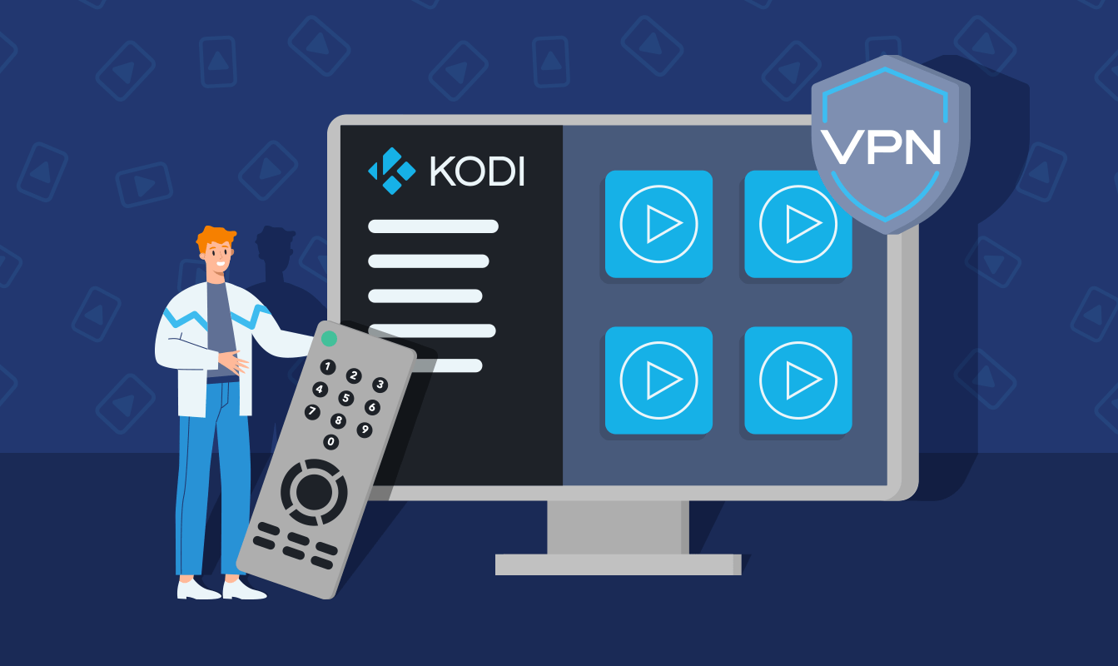
CORES: DLL, PA & EXTERNAL PLAYERS
DLL LINKER
PAPLAYER
EXPORTER
EXTERNAL PLAYER

Slide 16
04
SEQUENCE DIAGRAM AND USE CASE

Slide 17
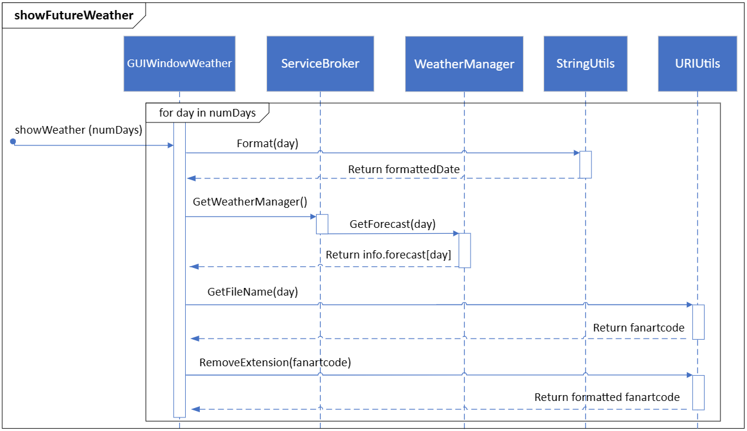
KODI WEATHER WIDGET
User initiates a showWeather event.
Event gets passed through UI components.
Utilities provide aid in formatting output.
Weather data is returned and formatted.

Slide 18
05
EFFECTS OF CONCURRENCY

Slide 19

PRIORITIZING CONCURRENCY
EXAMPLE IN OVERALL ARCHITECTURE
EXAMPLE IN CORES COMPONENT
Threading Component
Buffer Components
Dedicated to process management, threading, and scheduling
Video software loads concurrency to the buffer, minimizing loading times

Slide 20
06
ISSUES ON THE ARCHITECTURE

Slide 21
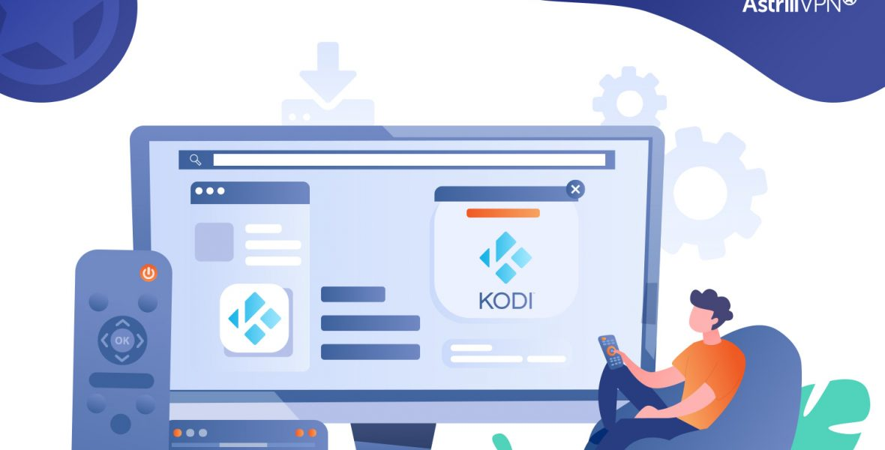
MAIN ISSUES
CODE REPETITION
Redundant code impacts efficiency
INCREASED DEPENDENCIES
Unnecessary dependencies introduce complexity; refactoring subsystems suggested.
DECREASED ABSTRACTION
Layered architecture without abstraction hinders scalability and modifiability

Slide 22
07
REFLEXION ANALYSIS

Slide 23

KEY DIFFERENCES AT TOP-LEVEL
Missing Subsystems
Likely due to evolution over codes lifetime
Less Abstraction
E.g. Video Codec communicates with sections outside its layer
Missing Dependencies
Due to poor code quality restrictions because of open source nature
Harms scalability

Slide 24
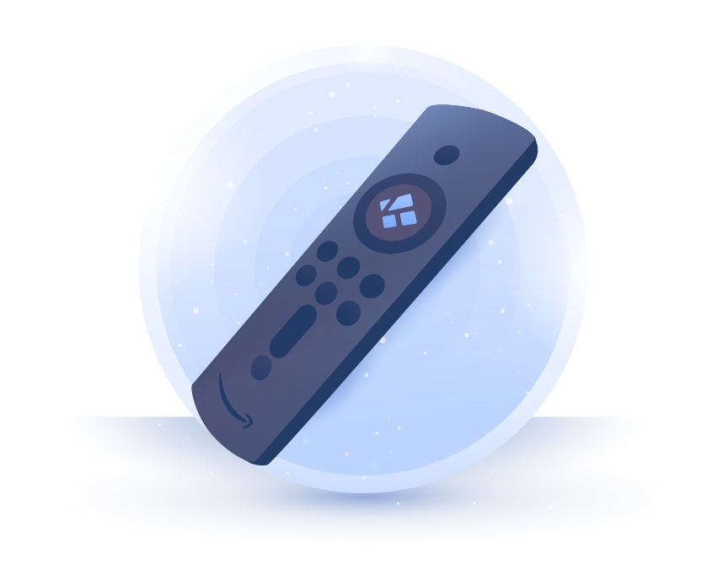
KEY DIFFERENCES AT 2ND-LEVEL
Similarities
Video Player & Renderer similar to conceptual
Differences
Fragmentation of Video Codec into many subcomponents,
Expansion of functionalities

Slide 25
CONCLUSION
Inspecting KODI’s source code reveals plenty about its architecture, providing valuable insights its concrete architecture. Analyzing the differences between KODI’s conceptual and concrete architectures allows us various perspectives to critique its software.

Slide 26
MODULARITY
LAYERING
LESSONS LEARNED
Enhanced functionality
Portability & Scalability
Easily maintained
Easy to contribute to
High levels of security
Ease of access
Aids testing & debugging
Interoperability

Slide 27

POTENTIAL LIMITATIONS
Complications managing module dependencies
Fallbacks in performance upon added modules
Decentralized layout may lead to coordination issues
Developers struggling to grasp the complex modular-layer architectue
Compatability issues between modules and add-ons / add-ons and different OSs
Lack of strong documentation due to the open-source nature

Slide 28
CONTENTS OF THIS TEMPLATE
You can delete this slide when you’re done editing the presentation
FONTS | To view this template correctly in PowerPoint, download and install the fonts we used
USED AND ALTERNATIVE RESOURCES | An assortment of graphic resources that are suitable for use in this presentation
THANKS SLIDE | You must keep it so that proper credits for our design are given
COLORS | All the colors used in this presentation
ICONS AND INFOGRAPHIC RESOURCES | These can be used in the template, and their size and color can be edited
EDITABLE PRESENTATION THEME | You can edit the master slides easily. For more info, click here
For more info: SLIDESGO | BLOG | FAQs
You can visit our sister projects: FREEPIK | FLATICON | STORYSET | WEPIK | VIDEVO

Slide 29
TABLE OF CONTENTS
01
04
02
05
03
06
INTRODUCTION
PRODUCT DEMO
PROBLEM & SOLUTION
TEAM & TIMELINE
MARKET OPPORTUNITY
FINANCIAL & METRICS

Slide 30

WHAT IS A
PITCH DECK?
A pitch deck is a short presentation that entrepreneurs use to describe their business and present it to potential investors. It usually consists of about 10 slides with:
An overview of the company's mission and the product or service offered
Market opportunity
Team, financials, etc.
The goal is to garner enough interest from investors so that they are motivated to invest in the business

Slide 31
01
INTRODUCTION

Slide 32
INTRODUCTION
OUR COMPANY
OUR IDEA
The introduction of your company in the pitch deck should include a brief overview of who you are and what you do. It should also include a brief description of why your product or service is unique and the value it provides to customers
The “our idea” part of a pitch deck should include an explanation of your product/service, how it works, and what the customer value is. You should also explain the market opportunity for your product/service

Slide 33
MAIN IDEAS OF A PITCH DECK
PRESENTATION
INVESTORS
VALUE
A great presentation for a pitch deck should be concise, clear and easy to understand. Visual elements such as charts, graphs, images, and videos can help to make the presentation engaging
When it comes to picking investors for a pitch deck, it's important to research potential investors and understand their preferences, goals
and interests
The value of a product is determined by how much customers are willing to pay for it. It's a combination of factors, including the quality of the product, its features, and how well it meets customer needs

Slide 34
KEY IDEAS IN MARKET OPPORTUNITY
RESEARCH NEW MARKETS
INNOVATIVE SOLUTIONS
Analyze existing customer needs and identify gaps in the market to find new opportunities
Utilize technology and customer feedback to come up with novel solutions that meet your customer’s demands or needs
STAY AHEAD OF TRENDS
SEASONAL SPIKES
Monitor changes in the marketplace, such as shifts in consumer behavior or emerging technologies, to stay competitive and capitalize on new opportunities and trends
Identify times of year when demand for certain products may spike, such as holidays or special occasions, and use these times to target customers or maximize sales

Slide 35
SIX RECOMMENDATIONS
KEEP IT SIMPLE
USE VISUALS
KEEP IT SHORT
Structure your pitch deck clearly and make sure all the important points are easy to understand
Incorporate visuals or graphics to illustrate your message and keep the audience engaged
A good pitch deck should be concise and clear; avoid trying to cram in too much information
MAKE IT MEMORABLE
TEST & ITERATE
MAIN POINTS
Include impactful stories, statistics, or facts that will help your audience remember your
message afterwards
Practice presenting your deck beforehand with friends or colleagues for feedback, then use this input to refine it further
A pitch deck is an overview of your business; focus on key points that get the most important ideas across

Slide 36
4,498,300,000
Number of users analyzed in our market research

Slide 37
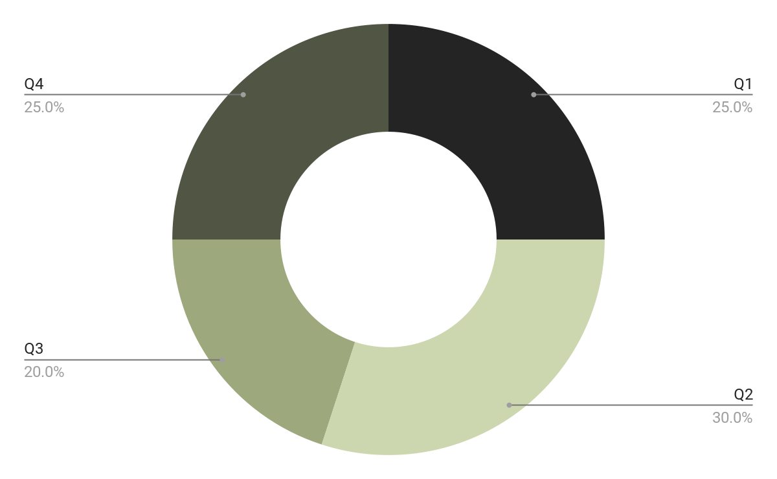
REVENUE BY QUARTER
Q1
Q2
Q3
Q4
January - March
April - June
July - September
October - December
Follow the link in the graph to modify its data and then paste the new one here. For more info, click here

Slide 38
COMPETITION COMPARISON
 | FEATURES | VALUE | PRICING | TRIAL | COMPETENCE | SHARE
Company A | Fuel economy | Special offers | $23,000 | No | Low | 8%
Company B | Design | Reliability | $27,000 | No | Low | 5%
Company C | Performance | Repairs | $30,000 | Yes | High | 20%
Company D | Safety features | Marketing | $24,000 | No | High | 22%
Company E | Technology | Customers | $32,000 | Yes | Low | 10%
Company F | Comfort | Best prices | $15,000 | Yes | High | 30%
Company G | Customization | Brand name | $45,000 | No | Low | 5%

Slide 39

PRODUCT INFOGRAPHIC
VISUALS
FEATURES
Showcase the design of your product
What makes your product unique?
PRICE
USERS
Share the cost and price with investors
Speak about the
target audience
AVAILABILITY
UPDATES
When is the product expected to be ready?
Do you plan on updating it?

Slide 40
TIMELINE OF YOUR PRESENTATION
Provide a brief overview of the pitch deck's content
Engage the audience with a compelling introduction
Identify the customer's pain points
and challenges
Describe how your product or service can solve the problem
Highlight the unique value proposition and benefits of your specific solution
Analyze the target market size, growth potential, and competition briefly
Explain your financial needs and briefly outline your
funding allocation
End with a clear and concise call to action

Slide 41
ORGANIZATIONAL CHART
Jane Doe
CEO
John Smith
Department Head
Maya Willson
Department Head
Emma Miller
Manager
Richard Taylor
Manager
Sarah Williams
Manager
Steven Ander
Manager
Brian Clark
Employee
Michelle García
Employee
James Scott
Employee
William Young
Employee
Alan Turner
Employee

Slide 42
MARKET SIZE OVERVIEW
OUTER CIRCLE
$100M
Include the total size of the market, which represents the entire potential customer base for the product or service
$20M
MIDDLE CIRCLE
Identify the target market for the product or service, which may be a subset of the total market. This could be based on factors such as demographics, geography, or specific needs
INNER CIRCLE
$5M
Indicate the current market size, which represents the portion of the target market that the company has successfully captured

Slide 43
ROADMAP INFOGRAPHIC
INITIATIVE | OBJECTIVE | J | F | M | A | M | J | J | A | S | O | N | D
Understanding | Analyze and understand the needs of your target audience
Conduct research | Research existing products in the industry and analyze how successful they are
Brainstorm ideas | Generate ideas based on user feedback and research findings
Develop a prototype | Create a basic version of the product to show investors
Test for usability | Put the prototype through rigorous testing processes to ensure that it meets user requirements
Analyze feedback | Analyze feedback

Slide 44
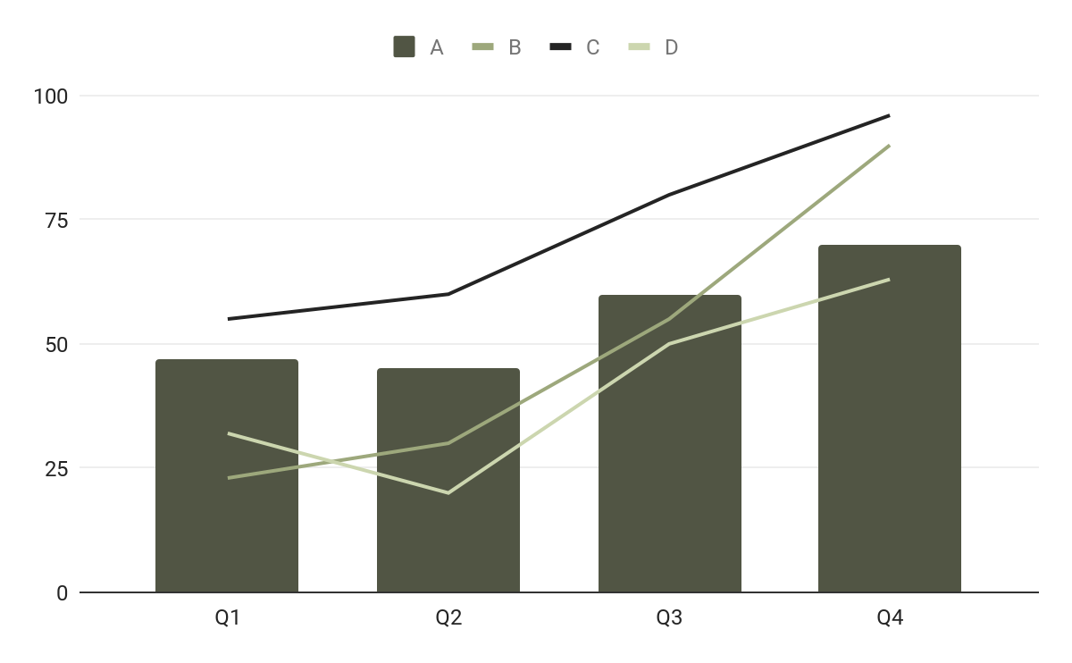
KPI DASHBOARD
PRODUCT | UNITS | REVENUE | RETURNS
Item 1 | 500 | 2,000,000 | 40
Item 2 | 1,000 | 50,750 | 10
Item 3 | 250 | 1,500,000 | 300
Item 4 | 500 | 2,000,000 | 40
Item 5 | 1,000 | 50,750 | 10
Item 6 | 250 | 1,500,000 | 300
Item 7 | 500 | 2,000,000 | 40
Item 8 | 1,000 | 50,750 | 10
$4,000
$100,000
$5,000
Revenue
General costs
Profit
Follow the link in the graph to modify its data and then paste the new one here. For more info, click here

Slide 45
THANKS!
Do you have any questions?
youremail@freepik.com
+34 654 321 432
yourwebsite.com
Please keep this slide for attribution

Slide 46
ICON PACK

Slide 47
RESOURCES
Did you like the resources on this template? Get them for free at our other websites:
Vectors
Business template design
Photos
Office workers using finance graphs I
Office workers using finance graphs II
Icons
Icon Pack: Consumer Behavior | Filled

