Slide 1

Team CMD
UBC Learning Analytics Hackathon 2019
November 3, 2019

Slide 2

Raise your hand if you are a second-year, upper year, or grad student of UBC

Slide 3


Do you remember all course numbers for all courses that you ever taken?

Slide 4

Targeted Audience
All students, especially upper-year, graduate students, and students who were on exchange

Slide 5
Problem
The course calendar has pre-requisites, but only course codes. What if you don't know these codes?
Course codes are internal to university. Any other university developed its own course codes
Unreasonable usage of student memory

Slide 6
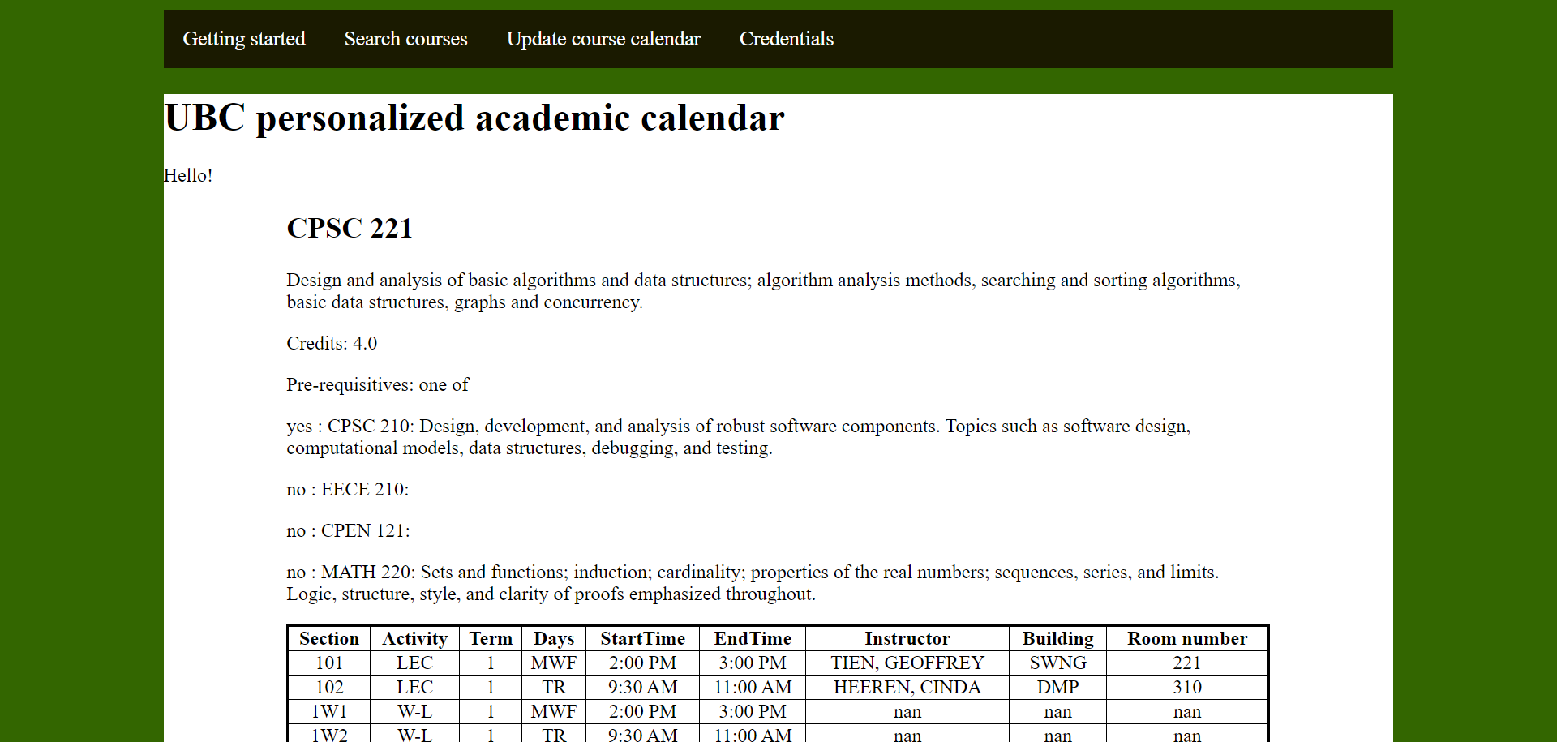
Developed Idea/Solution
Develop a student friendly interface for searching courses based on: their course history and pre-requisites (course title, course description if the course is taken)

Slide 7
Solution
Add pre-req description to the course calendar
Personalize it!
First challenges:
CanvasAPI doesn’t know all courses you took, only those that have Canvas webpage
If the student took the course not in UBC, the system does not have it (the case for exchange students and grad students)

Slide 8
Additional challenges
The data in the course calendar is not clean:
some courses number is 1 instead of 001 (and yes, I’ve checked it, it is not Python glitch)
extra spaces
inconsistent separators inside a single cell
Dynamical approach:
different students took different courses, but the user wants to see accurate prereqs for him/her
each term, courses offered are updated
privacy and security issues

Slide 9
Ensured privacy and security
- users are anonymous, delicate information like CWL account details, token is not required
- the URL to google spreadsheet is protected via wtforms
- all private data in cookies is AES crypted

Slide 10
Further Directions
Add better search tool (if incorporated with Canvas, just use their own)
Add threading
Allow to save courses for students
Show progress towards degree
Add calendar (finding time)
Add Docker container
Set up db and replace pandas with SQL

Slide 11
Contacts
Kateryna Melnykova: naruami@gmail.com
Mary Datan: marydatan@gmail.com
Doreen Mushi : doreenkaduma@gmail.com
GitHub page: https://github.com/kate-melnykova/CanvasAPI-Learning-Analytics

