Slide 1

Market Block Booking
Group 3

Slide 2
Introduction
SDLC development
What is our system ?

Slide 3
Block Booking System
Merchant can book a market block at home.

Slide 4
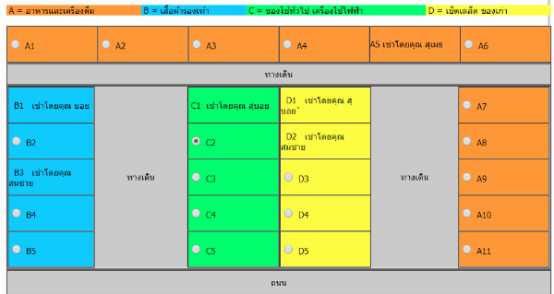
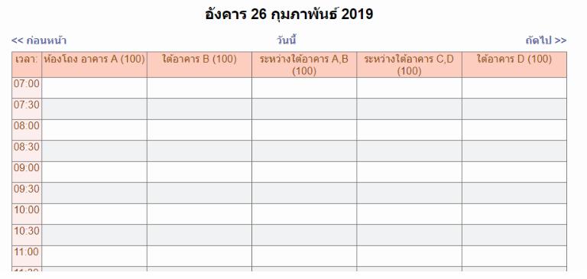
Existing System

Slide 5
Problem
Merchant lack of information about market block reservation.
Long time procedure and a waste of time.
Don’t know what the shop is inside.
Customer won’t know the information about the shop.

Slide 6




How it work ?
Login as Merchant
See any Available
Do the Booking
Booking Complete

Slide 7
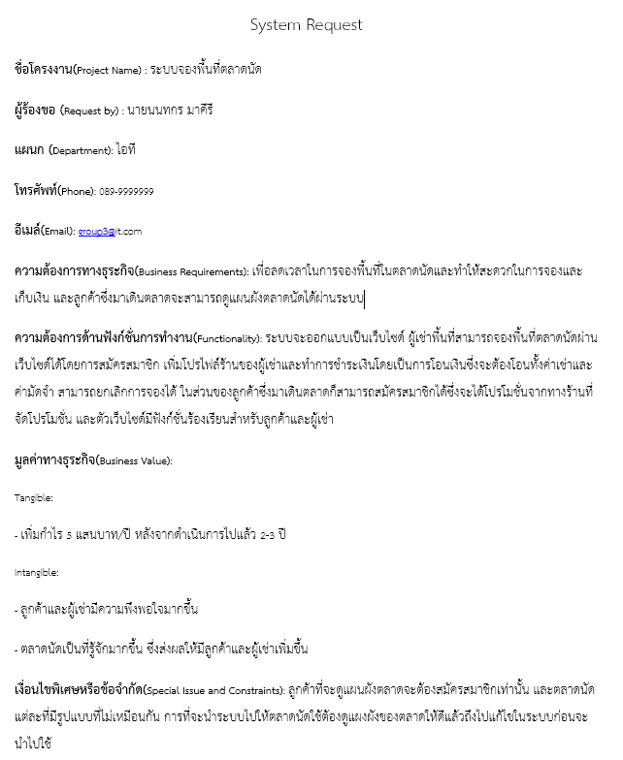
System Request

Slide 8

SDLC Development

Slide 9
SDLC
Planning
Analysis
Design
Implement

Slide 10

Planning
Project Initiation
To reduce the time of market owner work and reduce using of paper in booking.
Project Management
Managing & Control the Project by using Workplan and Gantt Chart

Slide 11
Planning
Workplan
Flow | Work | Time
1 | Analysis | 14
2 | Design | 11
3 | Study | 16
4 | Project Perform | 40
5 | System Testing | 12
6 | Reporting and Presentation | 5
WP : https://drive.google.com/drive/u/0/folders/1SIebmhRh_8xVmj9pkDOTLnwbYbdX861R
GC : https://drive.google.com/drive/u/0/folders/1b_n9g7m7LsvoXlx-H3XKSZKWLrDvUOfs

Slide 12

Analysis
Requirement Analysis
Observation
JAD
Functional Modelling
Use-case Diagrams
Use-case Descriptions
Activity Diagrams
Process & Data Modelling
Context Diagram
Data Flow Diagram Level 0 & 1

Slide 13
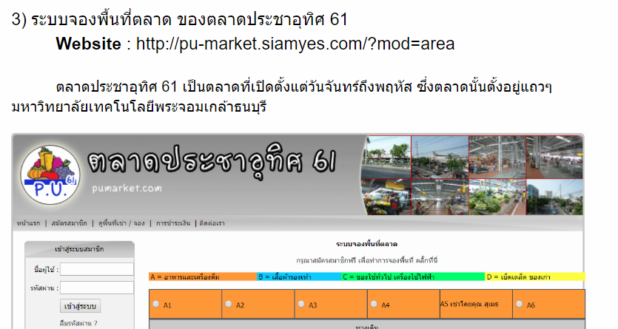
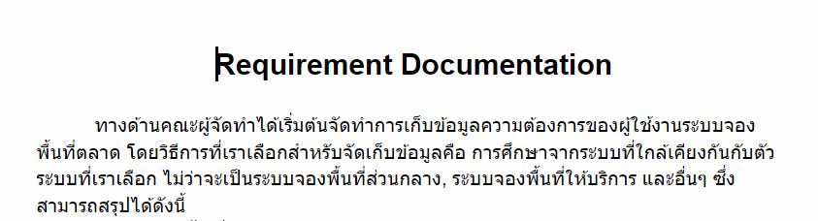
Analysis
Requirement Analysis

Slide 14
Analysis
Requirement Analysis
Problem
Merchant had to come to market by themselves.
Longtime Procedure.
Merchant don’t know the rest of the available areas.
System Cons
Long time user confirmation.
Can’t see what the shop is placed there.
Customer of the shop won’t know where the shop is placed.
Solutions
Making the Booking system that can see where the shop is placed in real-time.
Lnik : https://drive.google.com/drive/folders/1m3X43X9Wra5siIt-XynjPyybysofLccn

Slide 15
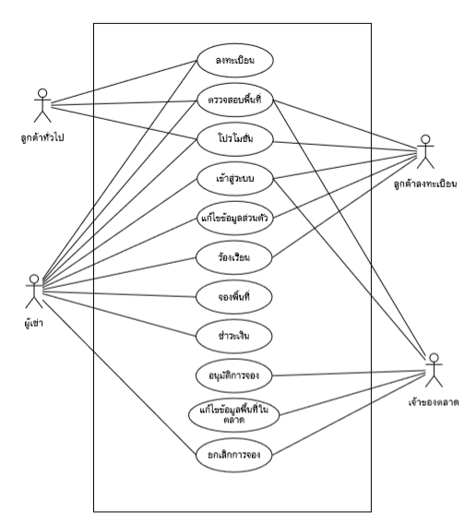
Analysis (Functional Modelling)
Use-Case Diagram

Slide 16
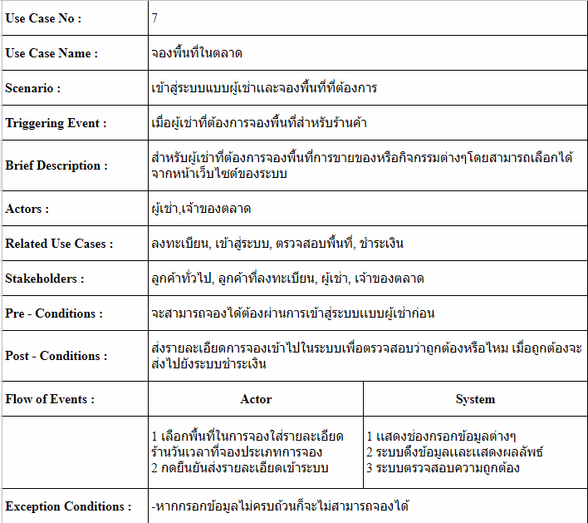
Analysis (Functional Modelling)
Use-Case Descriptions

Slide 17
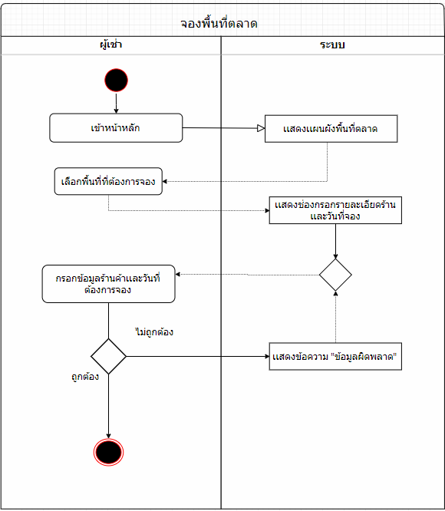
Analysis (Functional Modelling)
Activity Diagrams

Slide 18
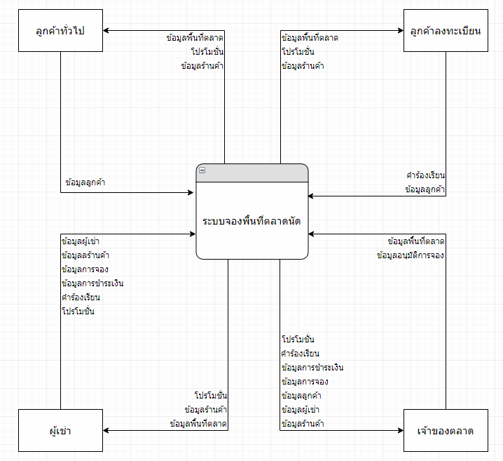
Analysis (Process & Data Modelling)
Context Diagrams

Slide 19
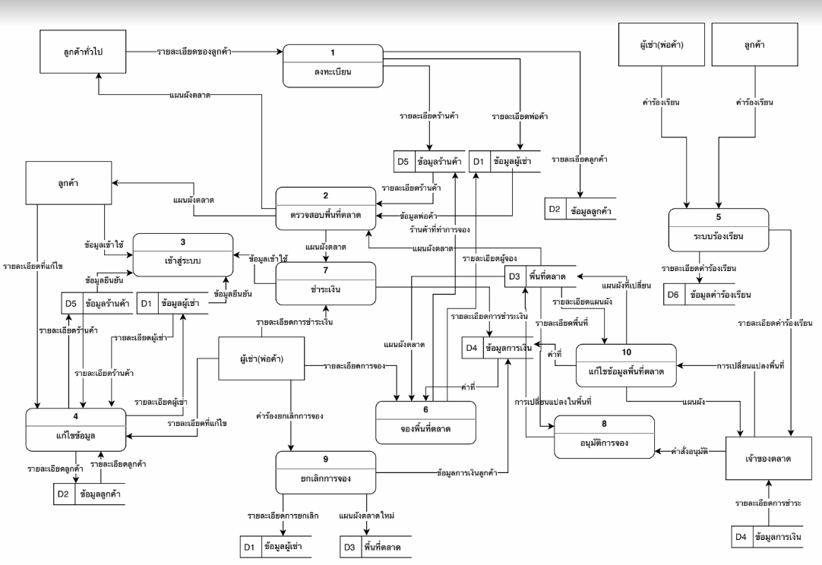
Analysis (Process & Data Modelling)
Data Flow Diagram Level 0

Slide 20
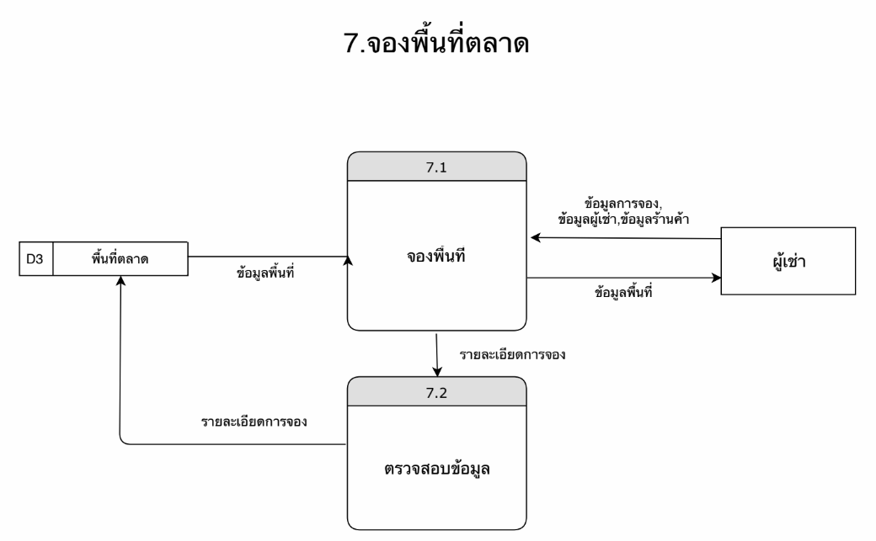
Analysis (Process & Data Modelling)
Data Flow Diagrams Level 1

Slide 21
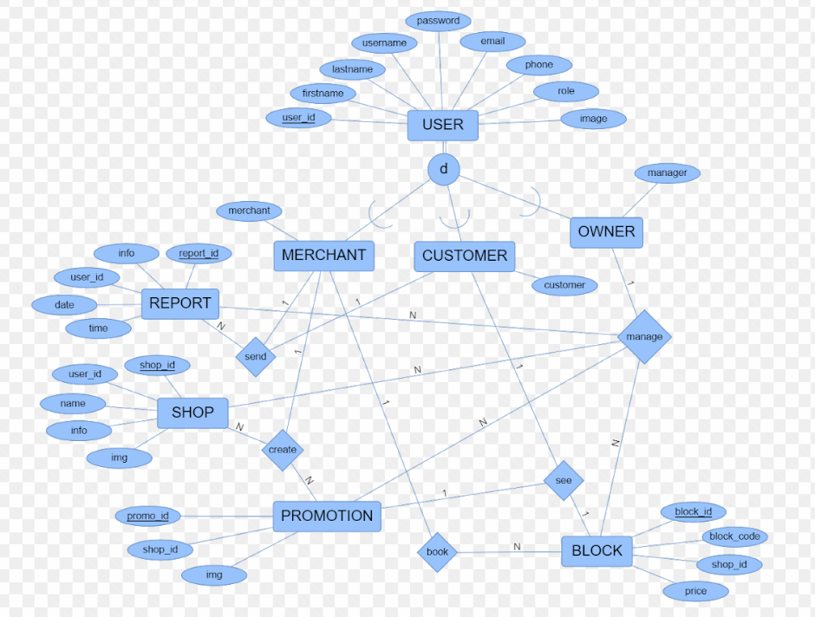
Analysis (Process & Data Modelling)
ER Diagram

Slide 22



Design
Design Strategy
Architecture Design
Hardware & Software Specifications

Slide 23

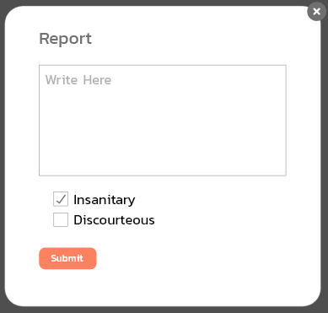
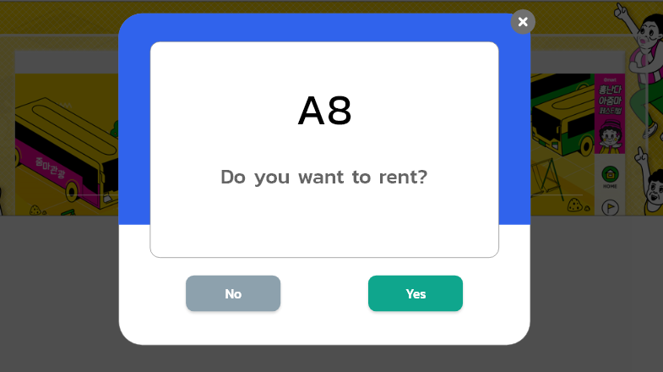
UI Design
Design
UI Design Using Adobe XD

Slide 24

Design Strategy
Design
Use the Requirement that were gathering from analysis phase.
References from area booking websites and others.
Using Custom development to build the new system.

Slide 25
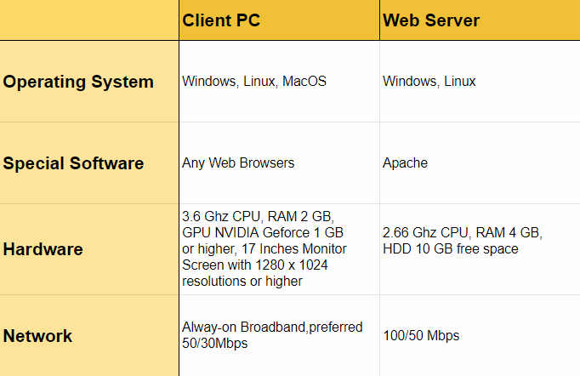
Architecture Design
Design
Hardware & Software Specification

Slide 26


Implementation
Developing and Testing the System’s Software
Unit Tests
Integration Tests
System Tests
Acceptance Test
Managing the Development Process

