Slide 1
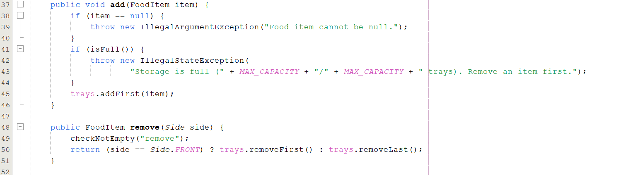
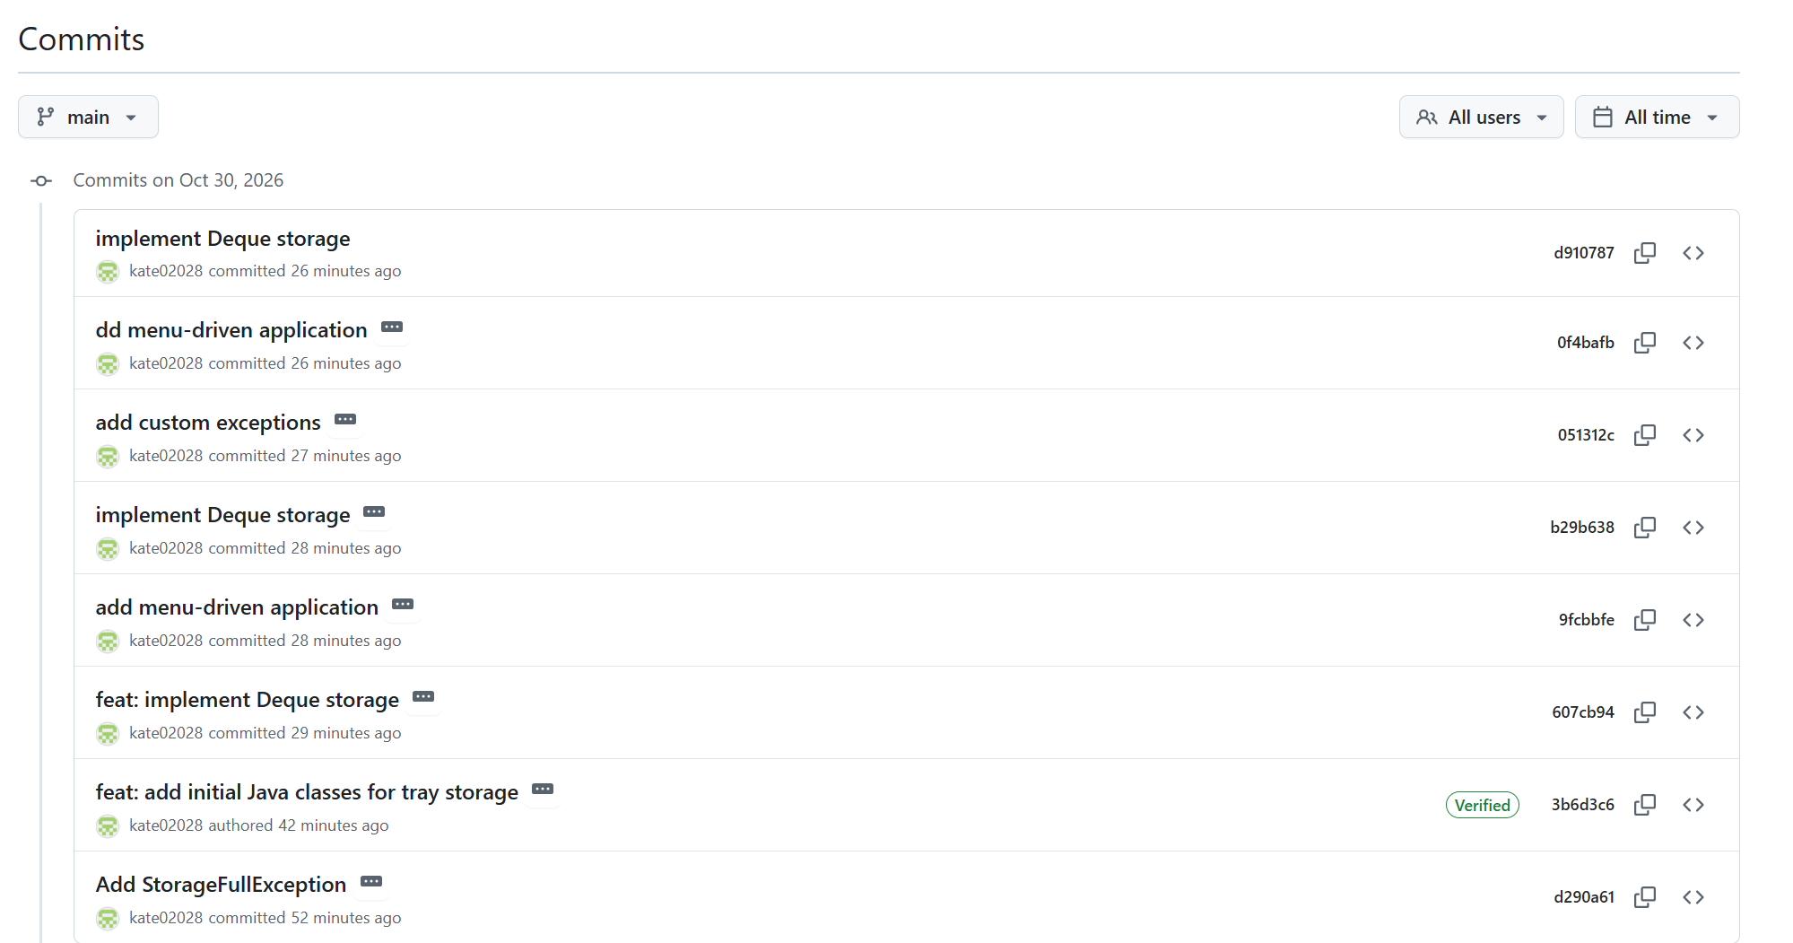
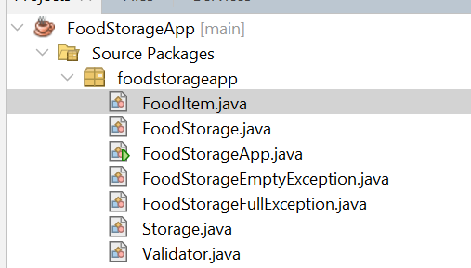
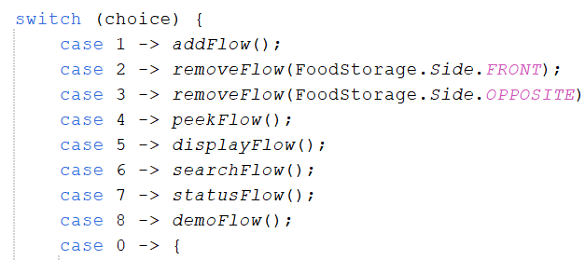
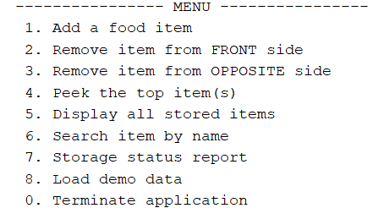
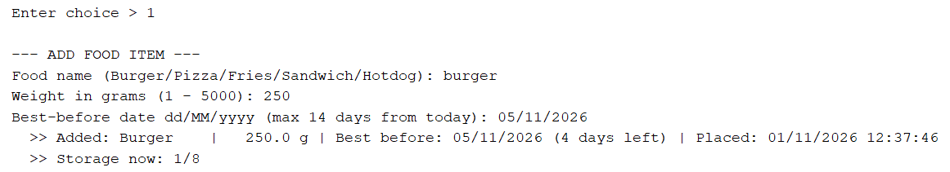
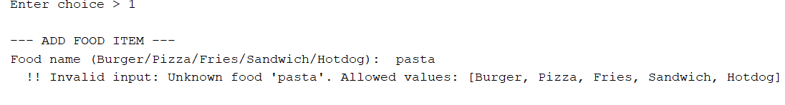
CA1 Fast-Food Tray Storage System: A Java Application Using a Deque
Group name: 124 Student: Tsolmon Jargalsaikhan 2024520, Tuguldur Azzaya 2024418, Khongorzul Oktyabri 2024259 | Module: Algorithms and Architecture | Lecturer: Taufique Ahmed | CCT College Dublin
GitHub: https://github.com/kate02028/FoodStorageApp Video: [Google Drive video link]
Project Overview
OOP Principles
Operations & Time Complexity
Five party foods (Burger, Pizza, Fries, Sandwich, Hotdog) are kept in a two-sided unit of 8 trays. The chef adds at the front and removes from the front or the opposite side. Each tray stores name, weight, best-before date (≤ 14 days) and time placed. Our Java console application models this unit, validates every input and reports clear errors when the storage is full or empty.
Operation | Deque method | Big-O
Add (front) | addFirst | O(1)*
Remove front (Stack) | removeFirst | O(1)
Remove opposite (Queue) | removeLast | O(1)
Peek top | peekFirst / peekLast | O(1)
isEmpty / isFull | size() | O(1)
Search by name | linear scan | O(n)
Display all | linear scan | O(n)
Encapsulation
Private final fields with getters (FoodItem).
Abstraction
Storage hides the deque behind add, remove, peek.
The Storage Unit
Inheritance
Custom exceptions extend RuntimeException.
Figure 6: add() blocks the 9th tray (FoodStorageFullException); remove() takes from either end.
FRONT
Fries
Pizza
Burger
Hotdog
–
–
–
–
OPPOSITE
Polymorphism
FoodItem overrides toString().
Java Application in Action
GitHub Commits
App files
Menu Controls
Newest tray at the front, oldest at the opposite side.
UML Class Diagram
Data Structure: Deque
FoodStorageApp
A deque (double-ended queue) adds and removes at both ends in O(1), so one structure models both removal methods; a plain Stack or Queue supports only one. Built on ArrayDeque, with the 8-tray limit checked in add().
Why it fits this scenario:
• The front side is one end of the deque, the opposite side is the other end.
• The chef chooses the removal side at run time: no second structure is needed.
• Queue mode serves the oldest tray first, reducing expired food.
• ArrayDeque has no capacity limit, so a size check blocks the 9th tray.
+ main(args)
Figure 1: Six classes. FoodStorage holds the deque; Validator checks input.
Figure 2: Each menu option calls one method.
Fast Food Tray Storage System
Validation Rules
uses
Name: one of the five foods only
Weight: numeric, 1–5000 g
Date: real dd/MM/yyyy, not past, ≤ 14 days
Errors when full (8/8) or empty
Storage
Validator
- trays: Deque<FoodItem>
+ add(item)
+ remove(side)
+ peek(side)
+ searchByName(key)
+ display()
+ validateName(s)
+ validateWeight(s)
+ validateBestBefore(s)
Valid item and invalid item
Figure 3: The console menu.
Advantages & Limitations
throws
StorageFullException
Advantages
Limitations
holds 0..8
extends RuntimeException
O(1) at both ends: Highly efficient.
One structure, two modes: Stack (LIFO) & Queue (FIFO).
Encapsulation: Hides complex Deque logic.
Memory Efficient: ArrayDeque is faster than LinkedList.
Not Thread-Safe: Not synchronized for multiple chefs at the exact same millisecond.
No Auto-Expiry: Chef must manually remove expired food.
No Sorting: Stored by time added, not by expiry date.
Fixed capacity: Limited to 8 trays (no auto-resizing).
Stack mode (LIFO): addFirst + removeFirst
FoodItem
ADD
- name, weightGrams
- bestBeforeDate
- timePlaced
+ getStatus()
StorageEmptyException
Figure 4: A valid item is accepted, and the name is corrected to “Burger”
REMOVE ↑ front (newest first)
extends RuntimeException
Queue mode (FIFO): addFirst + removeLast
ADD
REMOVE
Figure 5: An unknown food is rejected with a clear message.
opposite side (oldest first)
Gen AI statement: I used ChatGPT to help identify and correct minor errors in my Java code, count the words in my assignment, and provide feedback on my work. The code and assignment were reviewed by me.
References: Oracle (2024) Java 17 Documentation: Class ArrayDeque. https://docs.oracle.com/en/java/javase/17/docs/api/java.base/java/util/ArrayDeque.html

