Slide 1
Chainmaille Calculation App
By Kaitlyn Vinson

Slide 2
Description of Project
Application on Android Phone
Calculation Tab
Inventory Tab
Instruction Tab

Slide 3
Why I chose this project
Chainmaille Business
Extensive Inventory
No way to calculate rings for each project
Many weave types to remember

Slide 4
Parts of the Application
Calculation tab - easily see the rings necessary for a project
Helps to calculate rings to subtract from inventory
Inventory tab – keep track of inventory for ordering supplies
Can be updated to add new shipments
Instruction tab - brush up on weave instructions
Allow user to remember how to make weaves

Slide 5
Testing
Testing individual modules
Calculations – going through each ring size, ensuring the calculations are correct
Adding and subtracting from inventory – ensuring that the correct total is being subtracted from the inventory
Ensure instruction pages are correct – each link goes to the correct instruction page

Slide 6

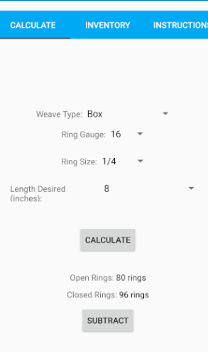
Calculation Tab
Calculates the open and closed rings needed
Users can choose options for:
Weave type
Ring Gauge
Ring Size
Length of Chain
If ring size chosen is not appropriate for the weave, there is a warning in red

Slide 7
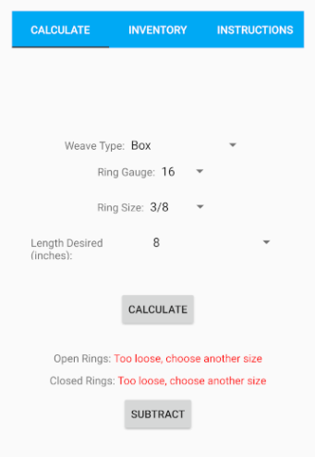
Calculation Tab
Calculate button calculates the open and closed rings
Subtract button subtracts from the inventory
If the rings cannot be calculated, error messages are displayed

Slide 8
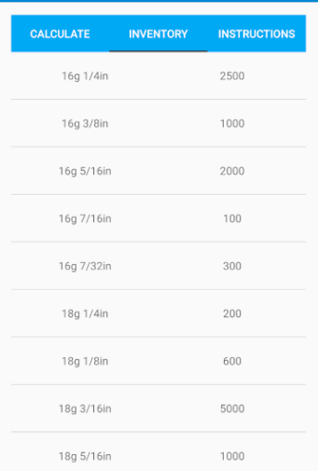
Inventory Tab
Keeps track of ring inventory
Can be updated by selecting the ring
Is also updated by the calculate tab’s subtract button
Allows for scrolling to view whole list

Slide 9
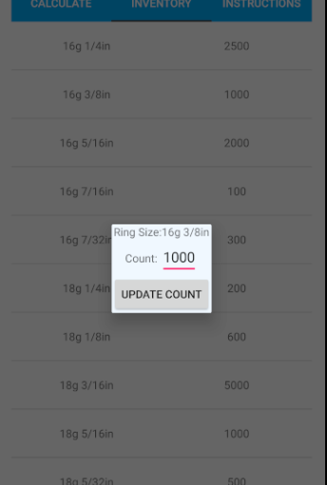
Inventory tab
Update inventory – allows users to add more inventory when purchased

Slide 10
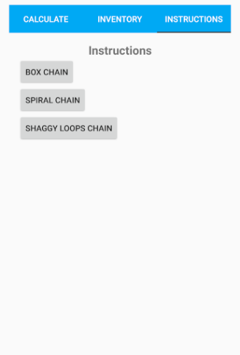
Instructions tab
List of Weave instructions
Step by step instructions with pictures

Slide 11
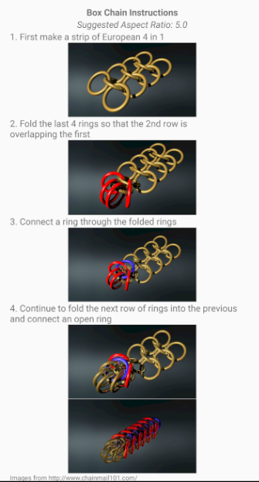
Instructions Tab
Can use back button to return to previous page
Link to source appears at the bottom of the page
Scrolling can be used to view all of the steps

Slide 12
Struggles Encountered
Getting the Inventory to save (Database vs Shared Preferences)
Making sure that lines of code were in the proper places
Accessing data in between the fragment pages

Slide 13
Future Additions
More weaves
Cost calculator for the project – using current costs for rings
Inventory of completed projects

Slide 14





Questions?

