Slide 1
Chainmaille Calculation App
By Kaitlyn Vinson

Slide 2
Description of Project
Application on Android Phone
Calculation Tab
Inventory Tab
Instruction Tab

Slide 3
Why this app is necessary
Calculation tab - easily see the rings necessary for a project
Inventory tab – keep track of inventory for ordering supplies
Instruction tab - brush up on weave instructions

Slide 4
Testing
Testing individual modules
Calculations
Adding and subtracting from inventory
Ensure instruction pages are correct

Slide 5
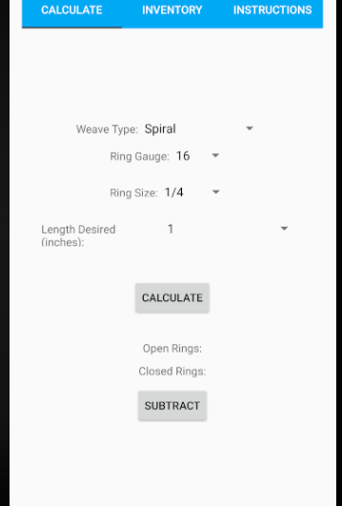
Calculation Tab
Calculates the open and closed rings needed
Users can choose options for:
Weave type
Ring Gauge
Ring Size
Length of Chain
If ring size chosen is not appropriate for the weave, there is a warning in red

Slide 6
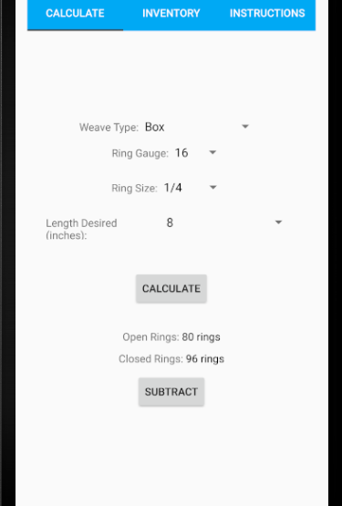
Calculation Tab
Calculate button calculates the open and closed rings
Subtract button subtracts from the inventory

Slide 7
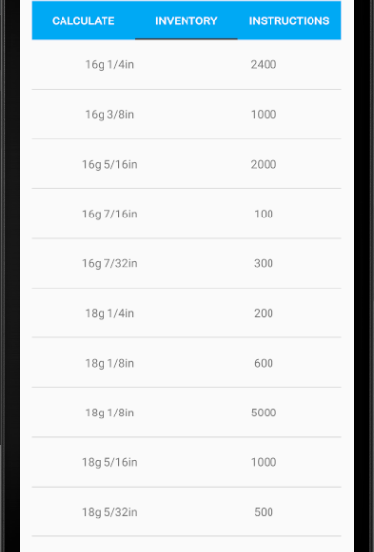
Inventory Tab
Keeps track of ring inventory
Can be edited or added to

Slide 8
Inventory tab
Add inventory
Update inventory

Slide 9
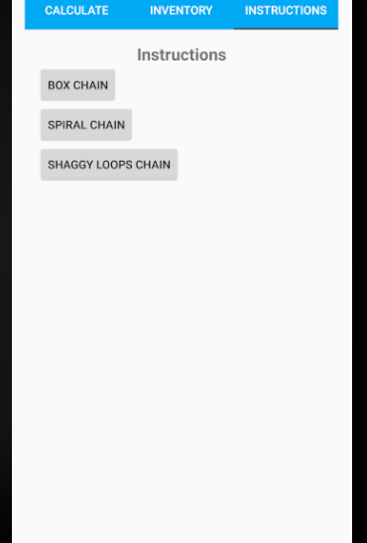
Instructions tab
List of Weave instructions
Step by step instructions with pictures

Slide 10
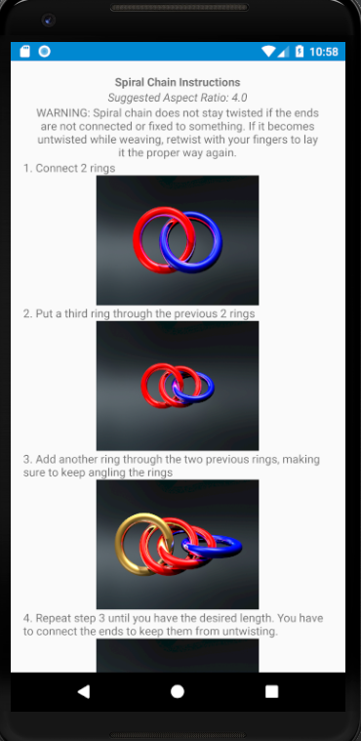
Instructions Tab
Can use back button to return to previous page

Slide 11
Future Additions
More weaves
Cost calculator for the project
Inventory of completed projects

