Slide 1

PROGRAM: 1009 – COMPUTER PROGRAMMER (CP)
INFO2310 – APPLICATION PROJECT

Slide 2

BETTER BOOKS STORE
- BY LIBRARY LEADERS

Slide 3
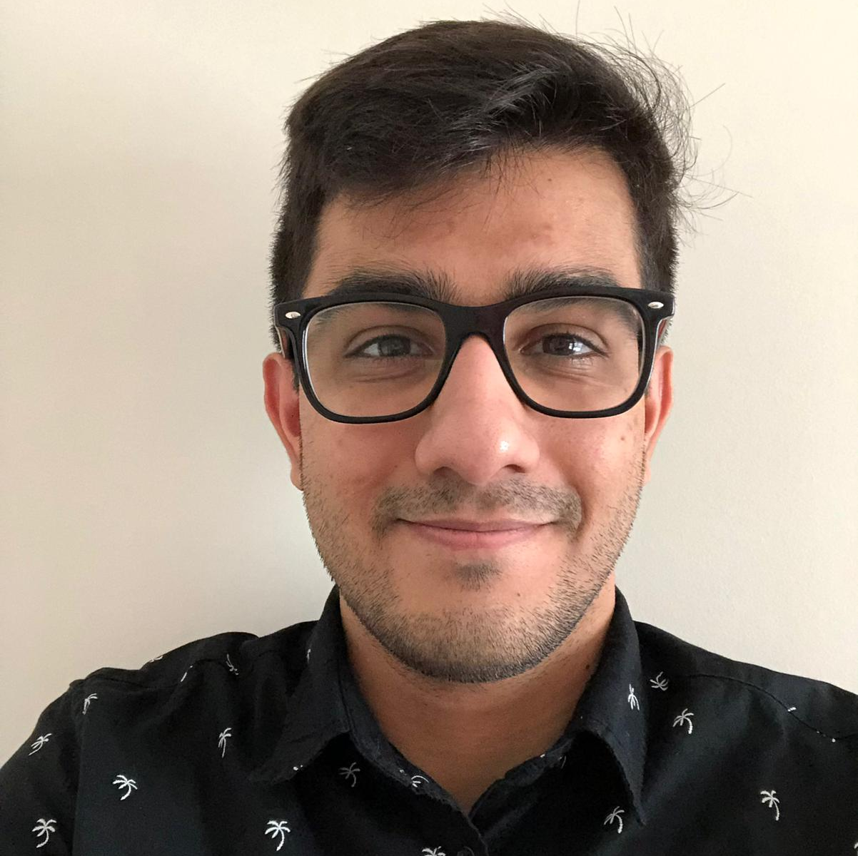
AJAY DHILLON (TEAM MEMBER 1)

Slide 4
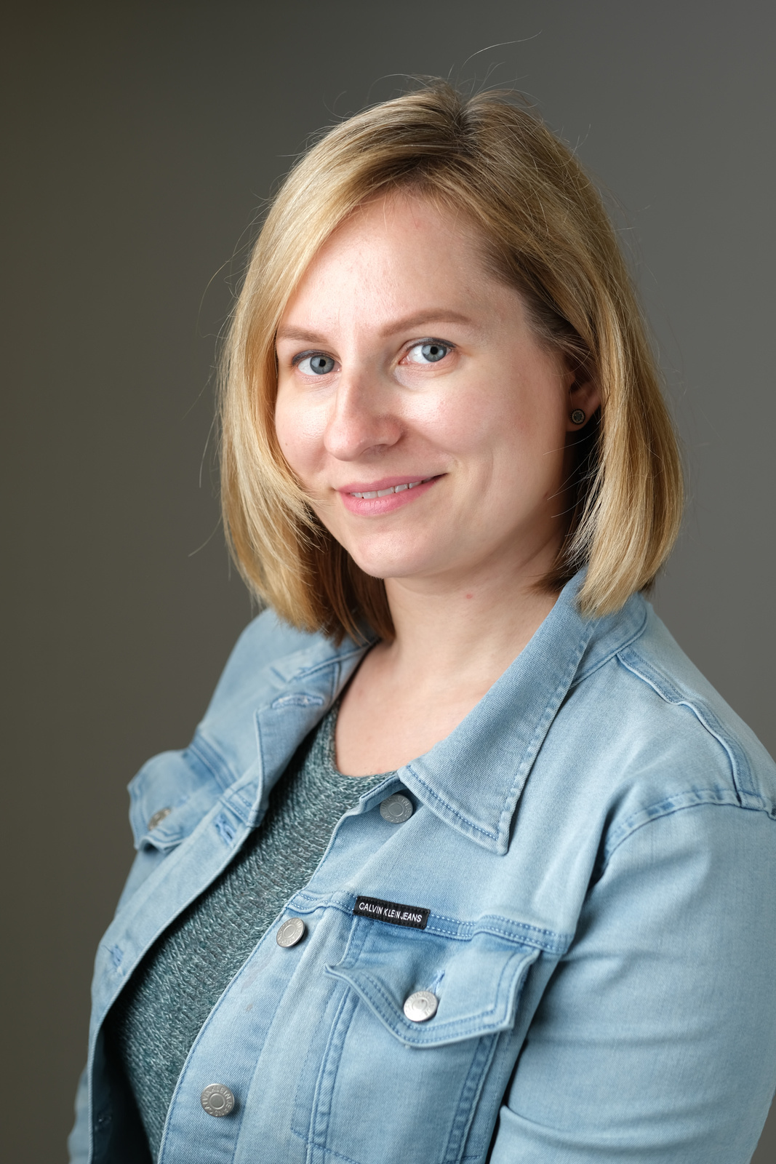
KATE GALICH (TEAM MEMBER 2)

Slide 5
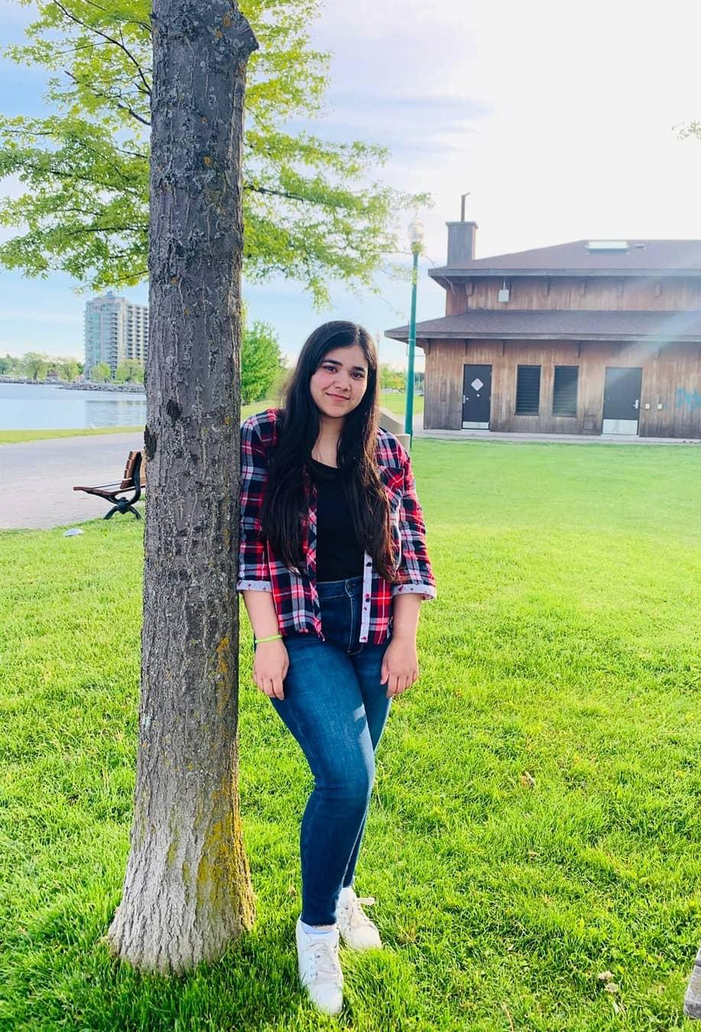
JANVI GARG (TEAM MEMBER 3)

Slide 6
MENTOR: SACHIN PARIKH

Slide 7

BETTER BOOKS STORE (An Entrepreneurial Project)
The purpose of the project is to make the book sharing easier in small community.
People can offer or request any book from the library and can check the availability of the books.
The system will tell the person if the book is already issued and when it is going to be available according to the information given by the individual to whom the book is issued.

Slide 8




Technologies used: C# ASP.net along with the MS SQL database server

Slide 9
THANK YOU

