Slide 1
Strategies of choice between substantivation and regular verb usage in the context of ability in Japanese
Ekaterina Birjukova, Alexandra Efimova

Slide 2
Hypothesis
1
Two different ways of expressing ability
to do something in Japanese:
verb substantivation,
verbal form.
No difference in meaning
Most obvious of the possible dependencies:
сonjugation (1st or 2nd)
length of the verb that holds the main semantics (the number of syllables that it comprises)
speaker’s sex
…

Slide 3
Research design
2
Data: from parallel Japanese-English corpora and database of contemporary song lyrics.
Null hypothesis:
Choice strategy for expressing ability in Japanese verbs is completely random and does not depend on any of the mentioned factors.
Alternative hypothesis:
There is a more or less clear pattern that allows actually calling this choice a strategy.
We use logistic regression to check whether the mentioned effects are statistically significant and whether they have any intrinsic correlation between each other.

Slide 4
Data collection method
3
All data has been collected with web scraping script written in Python.
500 examples from the parallel corpora
30 000 texts from the database.

Slide 5
Context position
4
Examples of right context position:
(1) 僕 は 歌う←
boku wa utau
I THEME to.sing
I sing
(2) 僕 は 歌 を 歌う←
boku wa uta wo utau
I THEME song ACC to.sing
I sing a song
In these examples the verb “to sing” is located to the right from both the subject and the object and denotes an active action, as opposed to its left position.

Slide 6
Context position
4
Examples of left position:
(3) 僕 が →歌う 歌
boku ga utau uta
I NOM to.sing song
a song that I sing
(4) (歌 を) →歌う 僕
uta wo utau boku
song ACC to.sing I
I who sing (a song)
In examples (3) and (4) the verb expresses a property, while the actual verbal action of the sentence will be expressed through some other verb.
In ambiguous cases we marked the context type as “unclear”.

Slide 7
Methods of analysis
5
Fisher’s test to check our preliminary assumptions regarding the importance of the factors for the choice of the strategy.
Linear regression to see which factors are more important and ultimately to build a model that describes our strategies in the best way possible.

Slide 8
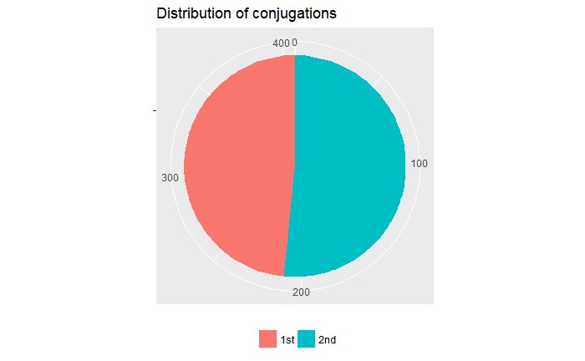
Results: Conjugation
6
Fisher’s test: +- (pv = 0.05095)
Linear regression:
*
R² = 0.007147 0.7%

Slide 9
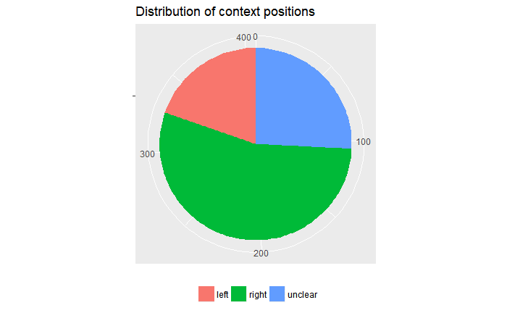
Results: Context position
6
With ambiguous contexts:
Fisher’s test: + (pv = 0.0004691)
Linear regression:
*** right
** unclear
R² = 0.007147 3%

Slide 10
Results: Context position
6
Without ambiguous contexts:
Fisher’s test: + (pv = 0.0002458)
Linear regression:
***
R² = 0.007147 4%
👍

Slide 11
Mixed model
6
Mixed model with conjugation as a random effect and context position as a fixed effect → better results?
form ~ context_pos + (1|conj)
Linear regression:
***
ICC = 0.0040 0.04%
→ Not worth it.

Slide 12
Simple multi-variable model
6
form ~ context_pos + conj
Linear regression:
*** context_pos
. conj
R² = 0.04602 5%
👍

Slide 13
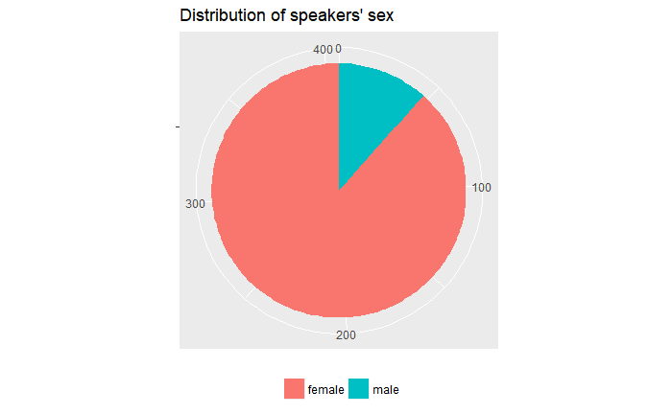
Results: Sex
6
Fisher’s test: + (pv = 0.003389)
Linear regression:
**
R² = 0.02135 2%
👍

Slide 14
Updating the multi-variable model
6
form ~ context_pos + conj + sex
Linear regression:
*** context_pos
conj
* sex
R² = 0.06038 6%
👍

Slide 15
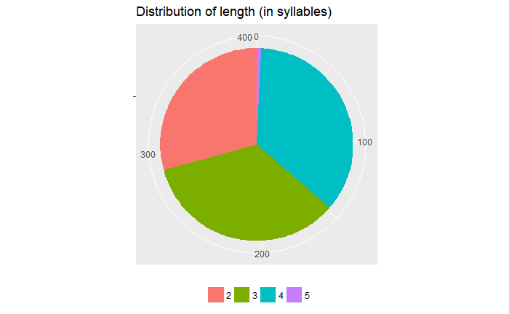
Results: Length
6
Fisher’s test: - (pv = 0.8113)
Linear regression:
-

Slide 16
Updating the multi-variable model
6
form ~ context_pos + conj + sex + length
Linear regression:
*** context_pos
** conj
* sex
** length
R² = 0.0802 8% (!)
👍

Slide 17
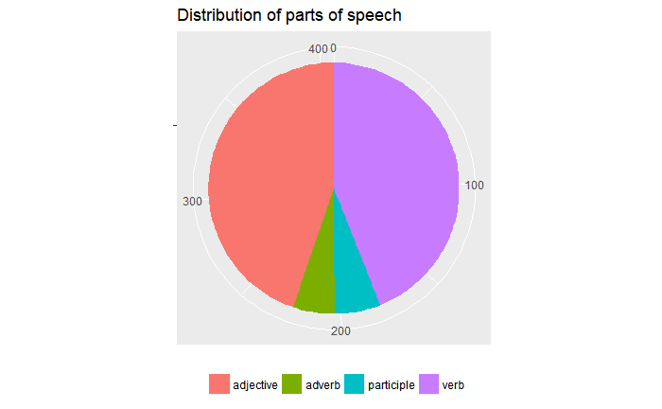
Results: Part of speech
6
Fisher’s test: ++ (pv = 3.08e-08)
Linear regression:
* adv
part
*** v
R² = 0.07762 7% (!)
👍

Slide 18
Updating the multi-variable model
6
form ~ context_pos + conj + sex + length +
+ part_of_speech
Linear regression:
*** context_pos part
** conj * v
* sex
** length
** adv
R² = 0.1367 14%
👍

Slide 19
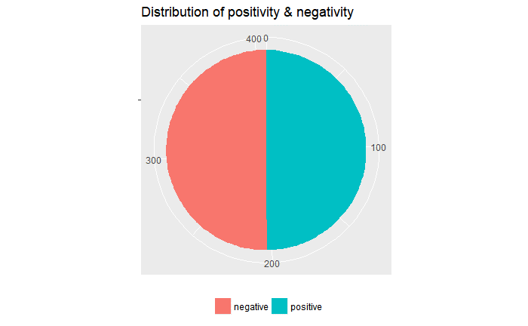
Results: Positivity and negativity
6
Fisher’s test: + (pv = 0.000213)
Linear regression:
***
R² = 0.03177 3%
👍

Slide 20
Updating the multi-variable model
6
form ~ context_pos + conj + sex + length +
+ part_of_speech + pos_neg
Linear regression:
*** context_pos part
** conj v
* sex pos_neg
** length
** adv
R² = 0.1369 14% (+0.02%)
Not worth it.

Slide 21
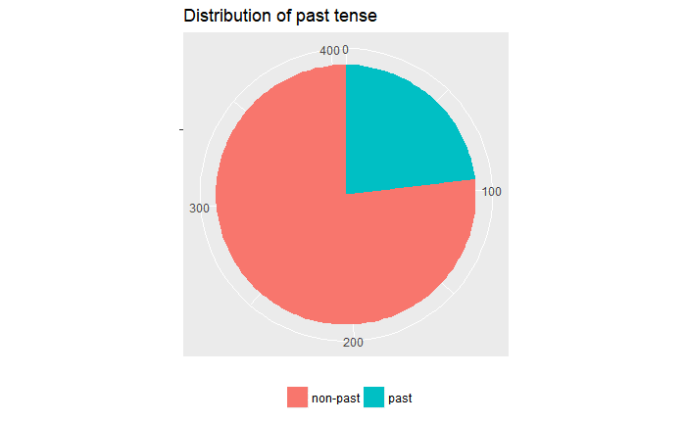
Results: Past tense
6
Fisher’s test: +- (pv = 0.004539)
Linear regression:
.
R² = 0.006273 0.6%

Slide 22
Updating the multi-variable model
6
form ~ context_pos + conj + sex + length +
+ part_of_speech + past_tense
Linear regression:
*** context_pos part
** conj v
* sex past_tense
** length
** adv
R² = 0.1381 14% (+0.12%)
Not worth it.

Slide 23
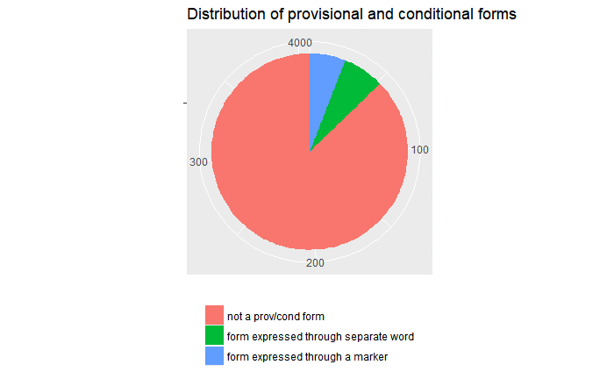
Results: Provisional and conditional form
6
Fisher’s test: ++ (pv = 1.533e-12)
Linear regression:
*** separate word
. Verbal form
R² = 0.112 11% (!)
👍

Slide 24
Updating the multi-variable model
6
form ~ context_pos + conj + sex + length +
+ part_of_speech + prov_cond
Linear regression:
** context_pos part
** conj . v
* sex *** prov_cond sep
** length prov_cond vf
* adv
R² = 0.2052 21%
👍

Slide 25
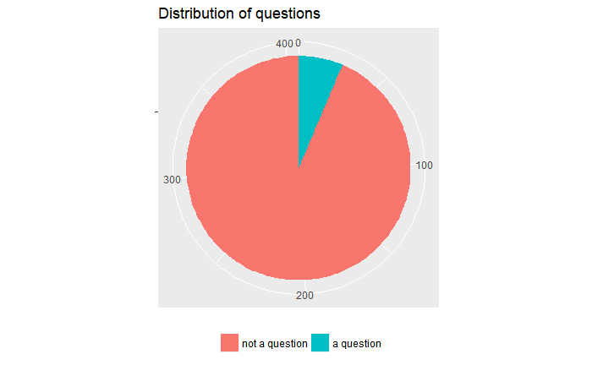
Results: Question
6
Fisher’s test: -- (pv = 1)
Linear regression:
-

Slide 26
Updating the multi-variable model
6
form ~ context_pos + conj + sex + length +
+ part_of_speech + prov_cond + quest
Linear regression:
** context_pos part
** conj . v
* sex *** prov_cond sep
** length prov_cond vf
* adv quest
R² = 0.203 20%
Reduces R².

Slide 27
Final model and conclusion
6
Final
form ~ context_pos + conj + sex + length + part_of_speech + prov_cond
with R² = 0.1856 and 4 highly significant factors out of 9, ambiguous contexts not included.
→ Conclusion:
these factors cannot be used to predict the strategy

Slide 28
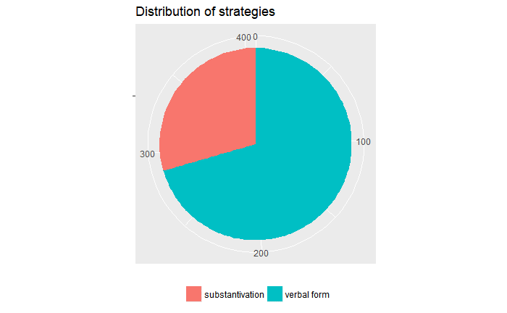
Final model and conclusion
6
form ~ context_pos + conj + sex +
+ length + part_of_speech +
+ prov_cond
Explains 21% of the strategy variable’s variance.
F p-value: 6.898e-13
→ Cannot be used to predict the strategy. ☹
wrong factors?
can’t be predicted in principle?

