Slide 1
Introduction to R for Non-programmers
Lisa Federer, MLIS, MA, AHIP
Research Data Informationist

Slide 2
Course Overview
Introduction to R and RStudio
Why R?
What is RStudio?
Terminology and syntax
Hands-on practice
Deciphering error messages and troubleshooting
Basics of data processing
Statistical analysis
Simple data visualization

Slide 3
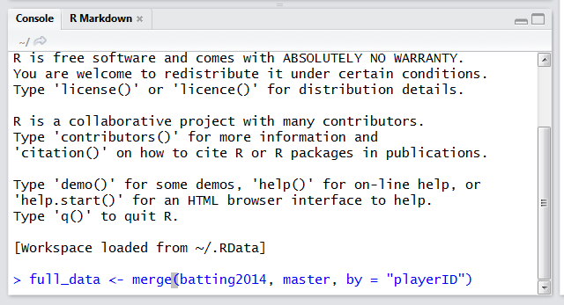
Why R?
One command to carry out complex tasks

Slide 4
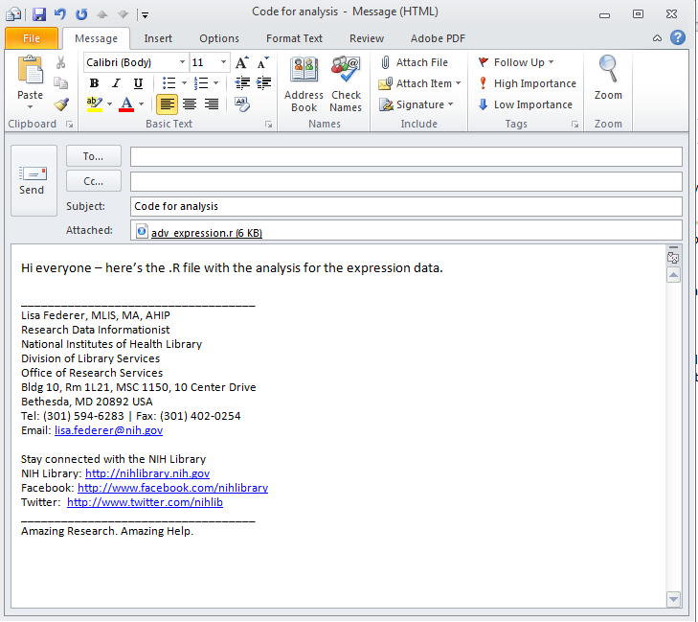
Why R?
Easy to share code, which enhances reproducibility

Slide 5
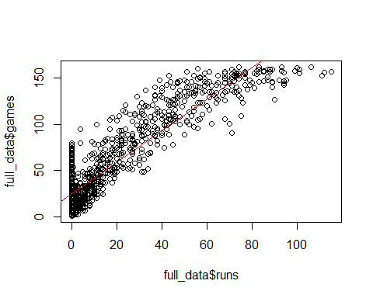
Why R?
Everything in one places: data processing, analysis, and visualization

Slide 6
What is RStudio?
IDE (integrated development environment) for R

Slide 7
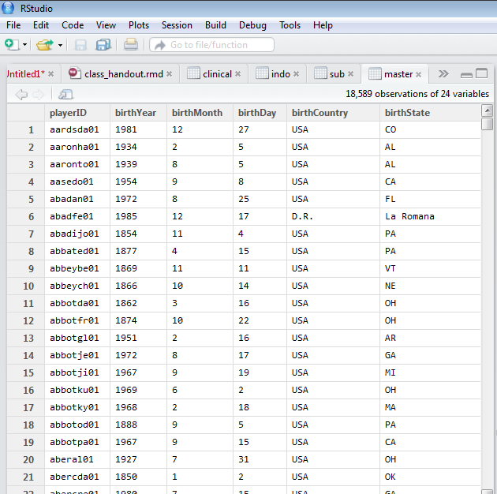
Talking the Talk: R terminology
Data frame: a list of variables of the same number of rows with unique row names

Slide 8
Talking the Talk: R terminology
Function: how to tell R what to do

Slide 9
Talking the Talk: R terminology
Argument: instructions that specify how a function should be run.

