Slide 1
Twitter API
COVID Research
By: Katelyn Chen and Christina Li

Slide 2
Introduction

Slide 3
Our Case
During this pandemic, there have been an increase usage of social media platforms such as Twitter, Facebook, Instagram, etc
We wanted to focus on Twitter specifically COVID-19 tweets
After taking Online Social Networking, there were a lot of similarities in our goals
Twitter API project

Slide 4
Goals
- Using data scraped from their API, we wanted to determine the biggest factor for our prediction
- Find the best model for our case
- Predicting the number of likes on the next tweet relating to COVID-19

Slide 5
Data Collection

Slide 6
Using Twitter API
Applied for an API Student Account
- Reasoning for access to Twitter API
- Generated Tokens and Keys
- Copy and paste 4 different tokens / secret keys in our code for security
Using Python, generated a scraper file to scrape the necessary data and used Pandas Dataframe to convert data collected to CSV

Slide 7
Preprocessing Data
Cleaned our dataset
Looked for null values
Converted isRetweet to 1 or 0 instead of True and False
Normalized the columns used for the modeling (evenly weighted)
Split data into training and testing
70% training
30% testing

Slide 8
Dataset Analysis

Slide 9
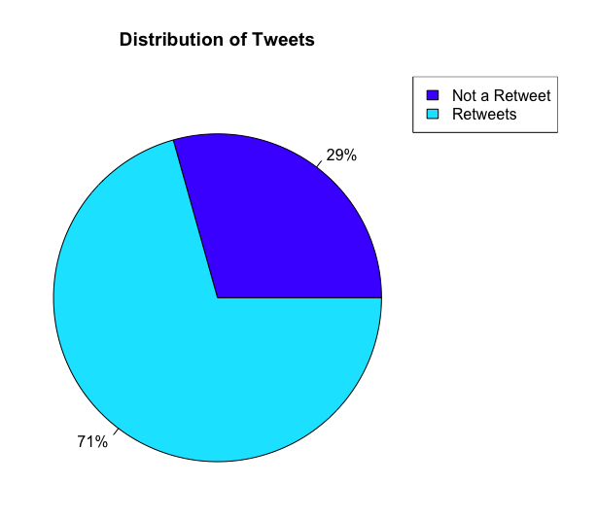
Distribution of Tweets

Slide 10
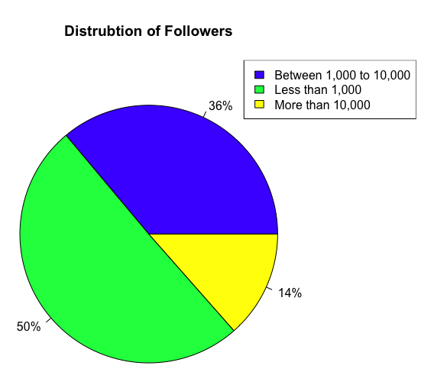
Distribution of Followers

Slide 11
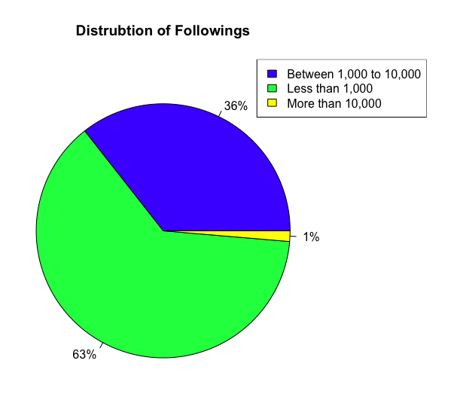
Distribution of Following

Slide 12
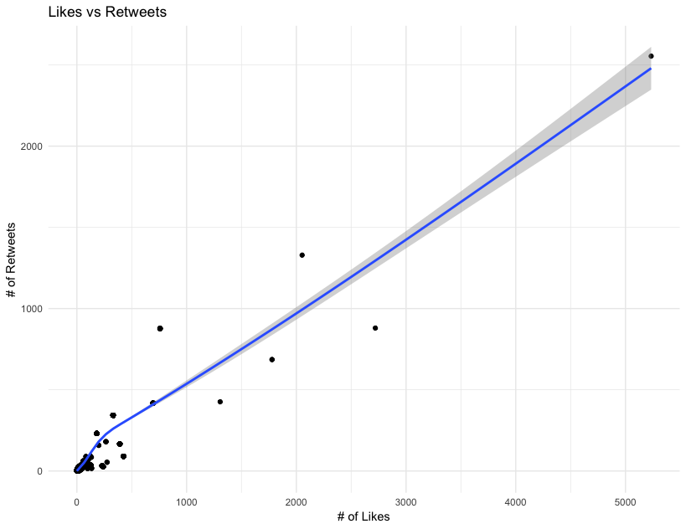
# of Likes vs # of Retweets

Slide 13
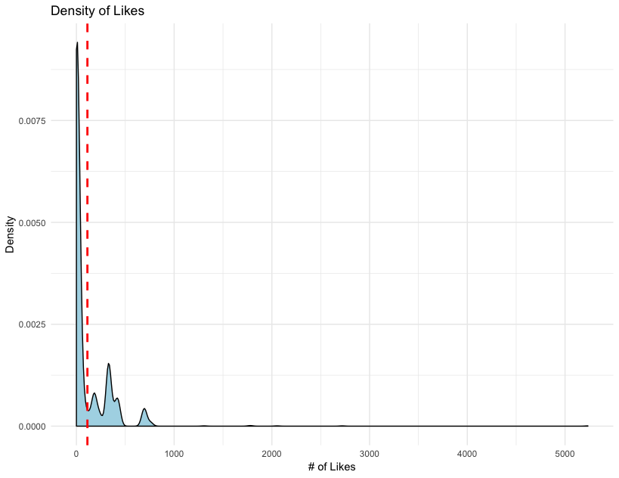
Density of Likes

Slide 14
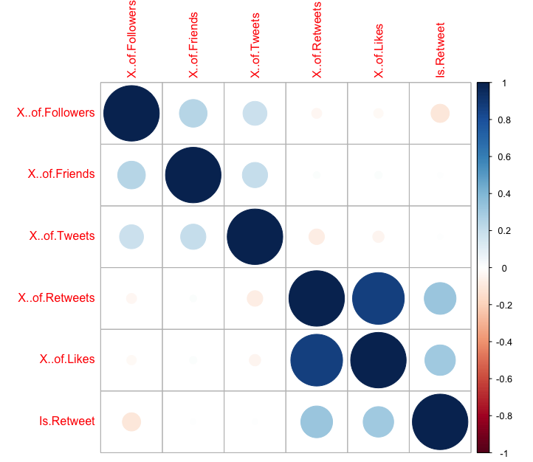
Correlation of Data

Slide 15
Modeling

Slide 16
6 Models Used
(Regressions)
Linear Regression
KNN
CART
Random Forest
Naive Bayes
SVM
Used R^2 Score to determine how close the data is fitted to the regression line
Used Standard Error to determine the distance that observed values fall from the regression line

Slide 17
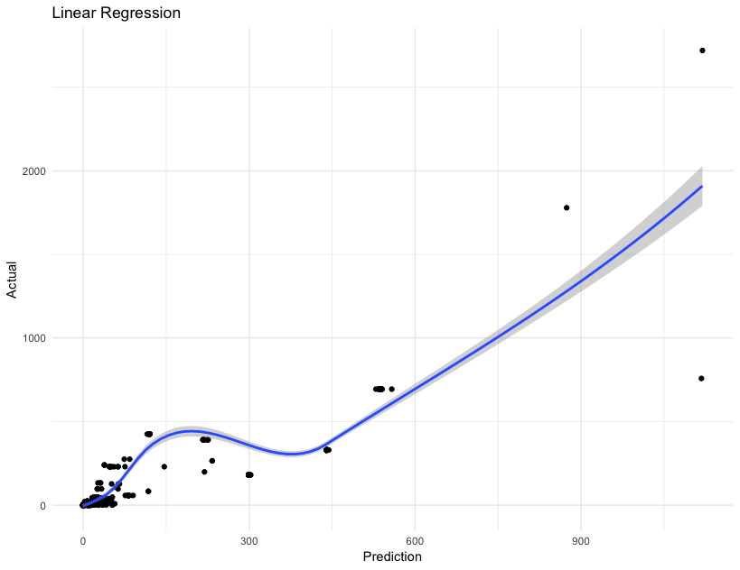
Linear Regression
# Linear Regression
linearRegression <- lm(y_train~., data = x_train)
linearRegressionPredict <- predict(linearRegression, x_test, type="response")
ggplot(NULL,aes(x=linearRegressionPredict, y=y_test)) + geom_point() +
geom_smooth() +
theme_minimal() +
labs(title="Linear Regression", x="Prediction", y='Actual')
linearRegressionSummary <- summary(linearRegression)
linearRegressionR2 <- linearRegressionSummary$r.squared
linearRegressionStandardError <- linearRegressionSummary$sigma

Slide 18
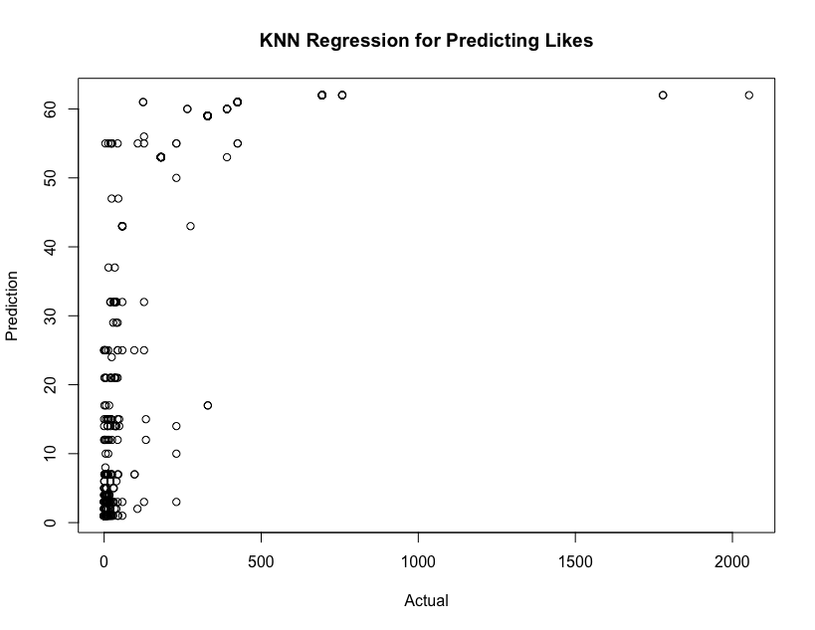
KNN
# KNN
likesPredictionKNN <- knn(train=x_train, test=x_test, cl=y_train, k=15)
plot(y_test, likesPredictionKNN, xlab='Actual', ylab='Prediction', main='KNN Regression for Predicting Likes')
knnSummary <- summary(lm(y_test~likesPredictionKNN))
knnR2 <- knnSummary$r.squared
knnStandardError <- knnSummary$sigma

Slide 19
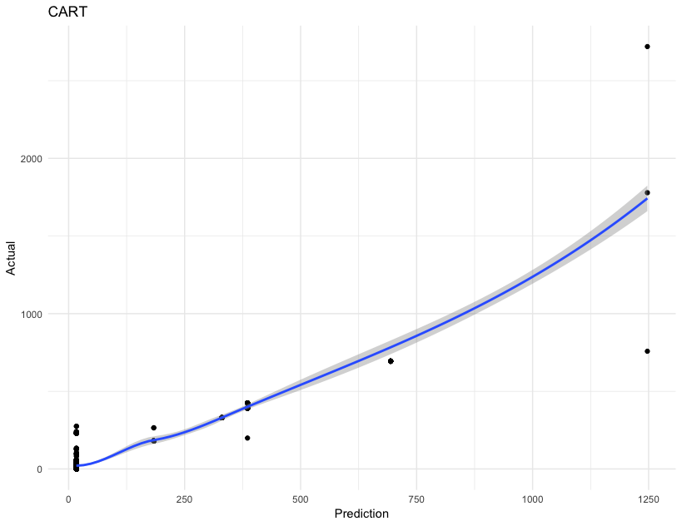
CART
# CART
cartModel <- rpart(y_train~., data=x_train, method="anova")
rpart.plot(cartModel)
cartPredict <- predict(cartModel, x_test)
cartSummary <- summary(lm(y_test~cartPredict))
cartR2 <- cartSummary$r.squared
cartStandardError <- cartSummary$sigma

Slide 20
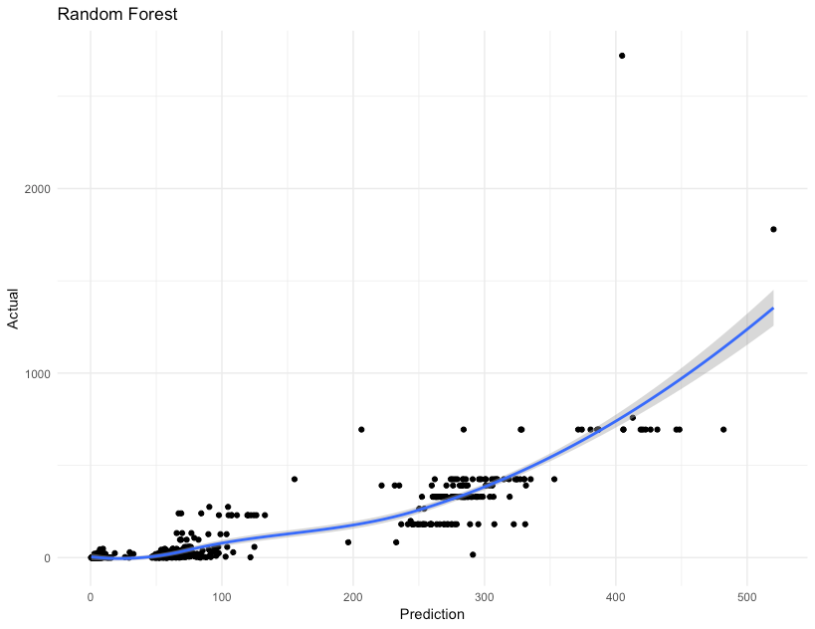
Random Forest
# Random Forest
randomForestFit <- randomForest(y_train~., data=data.frame(x_train))
importance(randomForestFit)
varImpPlot(randomForestFit)
randomForestPrediction <- predict(randomForestFit, x_test)
ggplot(NULL,aes(x=randomForestPrediction, y=y_test)) + geom_point() +
geom_smooth() +
theme_minimal() +
labs(title="Random Forest", x="Prediction", y='Actual')
randomForestSummary <- summary(lm(y_test~randomForestPrediction))
randomForestR2 <- randomForestSummary$r.squared
randomForestStandardError <- randomForestSummary$sigma

Slide 21
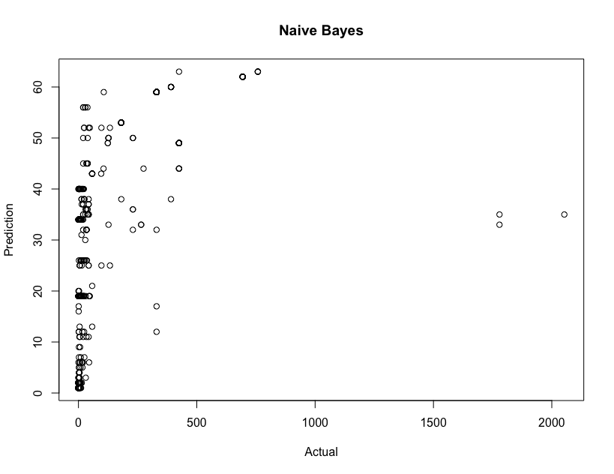
Naive Bayes
# Naive Bayes
naiveBayesModel <- naiveBayes(y_train~., x_train)
naiveBayesPrediction <- predict(naiveBayesModel, x_test)
plot(y_test, naiveBayesPrediction, xlab='Actual', ylab='Prediction', main='Naive Bayes')
naiveBayesSummary <- summary(lm(y_test~naiveBayesPrediction))
naiveBayesR2 <- naiveBayesSummary$r.squared
naiveBayesStandardError <- naiveBayesSummary$sigma

Slide 22
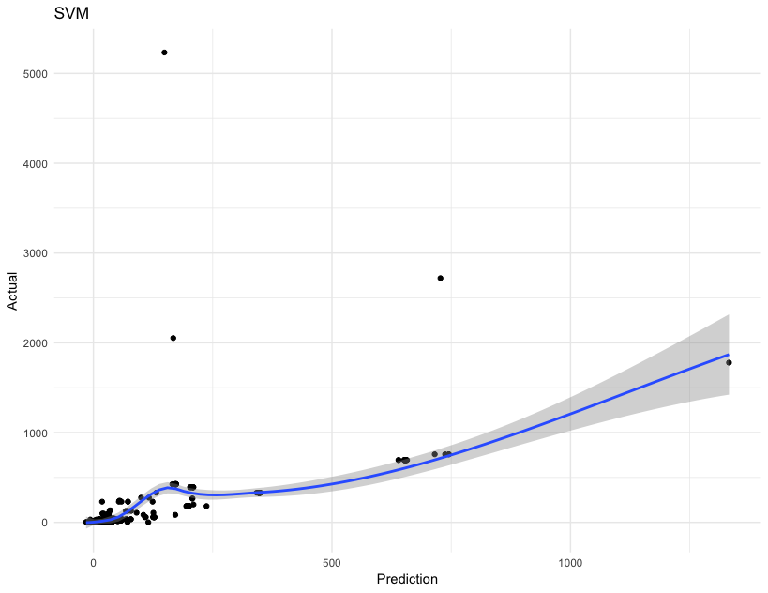
SVM
# SVM
svmModel <- svm(y_train~., data=x_train)
svmPrediction <- predict(svmModel,x_test)
ggplot(NULL,aes(x=svmPrediction, y=y_test)) + geom_point() +
geom_smooth() +
theme_minimal() +
labs(title="SVM", x="Prediction", y='Actual')
svmSummary <- summary(lm(y_test~svmPrediction))
svmR2 <- svmSummary$r.squared
svmStandardError <- svmSummary$sigma

Slide 23
Comparison of the Models
Model | R^2 Score | Standard Error
Linear Regression | 0.7829257 | 108.81694
KNN | 0.8409609 | 89.38537
CART | 0.8714464 | 78.11426
Random Forest | 0.6850138 | 122.27393
Naive Bayes | 0.7582547 | 110.89211
SVM | 0.7269860 | 113.83624

Slide 24
Conclusion

Slide 25
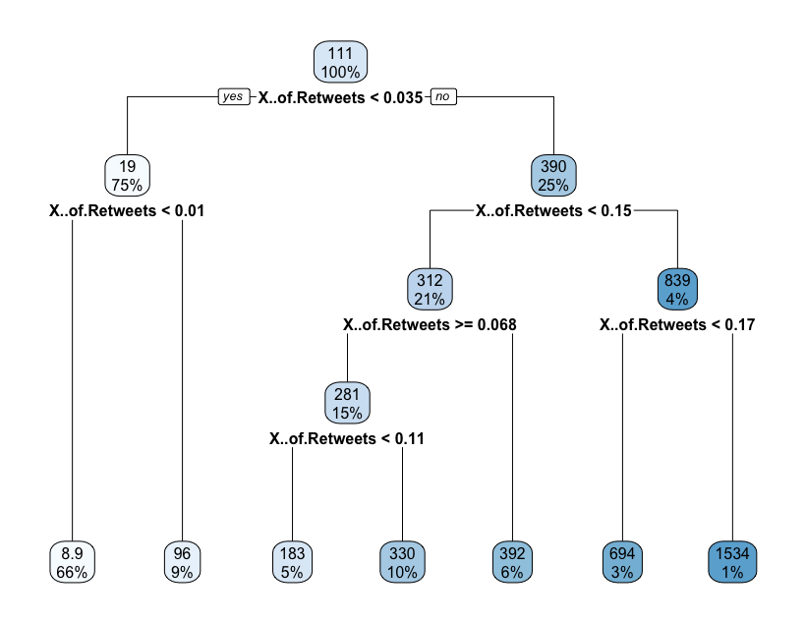
Model
CART was the best model
Prediction: retweets was going to be the biggest factor in our model
Conclusion: confirmed that the number of retweets was the best factor to determine the number of likes on a COVID post

Slide 26
Next Steps
- Using Twitter’s Enterprise API
- impression count ( # views)
- pull more data at a time (limit 3000)
- filter tweets / retweets when scraping
rather than sorting through in RStudio
- gather information from start of covid
- Gather more than 2000 rows of data, having a bigger dataset, we could have better model to predict more accurate results

Slide 27
Thank You! Any Questions?

