Slide 1

Integrating GPS and Smart Phone Technologies for Behavioral Data Collection
*Kathleen (Kate) Deutsch
Grant McKenzie
David Stevenson
Drew Dara-Abrams
Konstadinos Goulias
GeoTrans Lab, Department of Geography
University of California, Santa Barbara

Slide 2
Introduction
As travel behavior researchers we try to understand, model and predict the behavior of individuals, people and populations
Travel demand models require data
Individual attributes
Household attributes
Travel behavior and time use
Land use
Transit network data

Slide 3
Introduction cont.
Travel behavior and time use data collection
A snapshot of the day in the life of a respondent…
7:30- 8:30- Wake Up, Morning Activities
8:30-9:00- Commute to Work
9:00- 12:00- Work
12:00-13:00- Lunch
13:00-18:00- Work
18:00-18:15- Drive to grocery store
18:15-19:00- Shop
19:00-20:00- Eat Dinner
20:00-20:15- Drive home
20:15-23:00- Home activities (emails, phone calls, cleaning)
23:00-7:30- Sleep

Slide 4
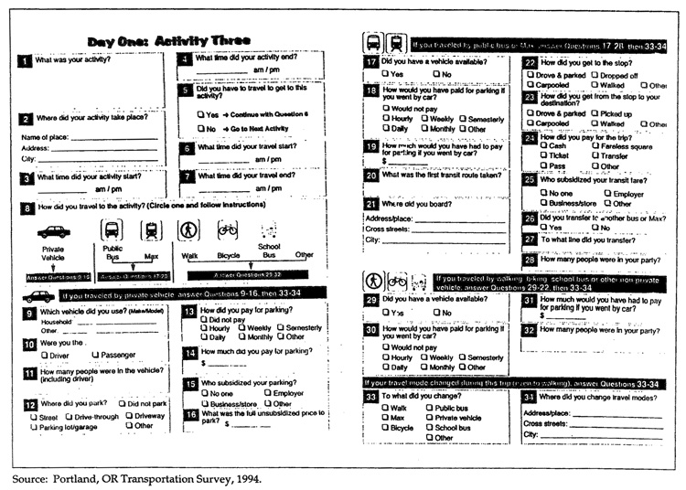
Survey Methods for Activity Diaries
Paper/ Pen based
Often accompanied by CATI or face to face interview

Slide 5
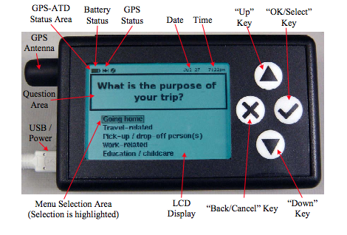
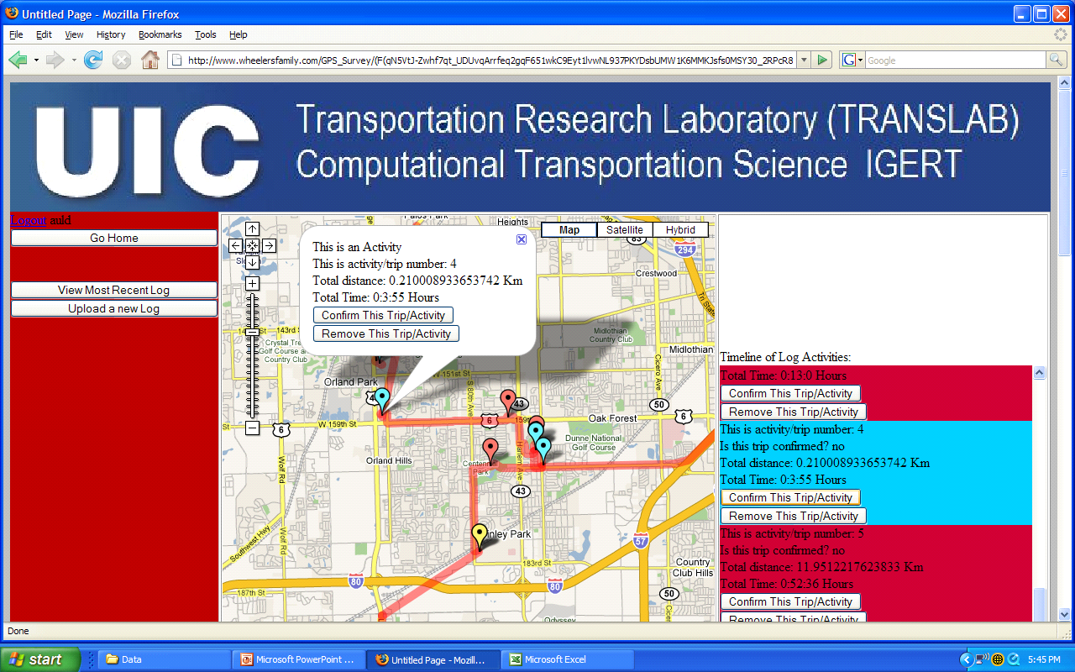
Survey Methods for Activity Diaries
Web based and GPS based
“Automation is the key to reduced respondent burden and increased accuracy and data integrity.” (Yen et al, 2006)
Auld and Mohammadian UIC
Yen, et. al UC Davis

Slide 6
SBTravel- A GPS aided travel survey
Three main points for today
Using technology to reduce respondent burden
Using technology to innovate the “where”, “when” and “how” of data collection
Using technology to enable more in-depth questioning of respondents

Slide 7
Using technology
… to reduce respondent burden

Slide 8
Data Collection and Respondent Burden
“Respondent burden is both tangible and intangible. In tangible terms, it can be measured as the amount of time, cost, etc., that is involved in a respondent complying with the requests of a survey…. There is general agreement that efforts should be made to reduce the data collection burden for respondents to travel surveys.” –-NCHRP manual on Survey Methods

Slide 9
GPS data collection in travel behavior
The use of GPS is not new
27,200 Google Scholar results with “GPS survey travel behavior”
34,300 Google scholar results with the search “GPS survey Geography”
It has been recognized to have the potential to reduce respondent burden
“Compared to conventional travel survey methods, such as CATI surveys that rely on respondents’ self-reports, the use of GPS technology has many advantages. Chief among them is the reduction in respondent burden (Murakami et. al. 2004; Wolf et. al. 1999; Zhou and Golledge, 2007) Chen et al 2010.

Slide 10
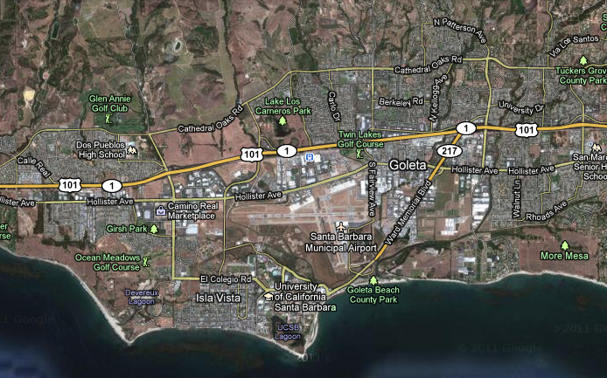
How does SBTravel do this?
7:50am
8 min.
4h 2min.
7:58am
11:00am
11:04am
7h 34min.
6:38 pm

Slide 11
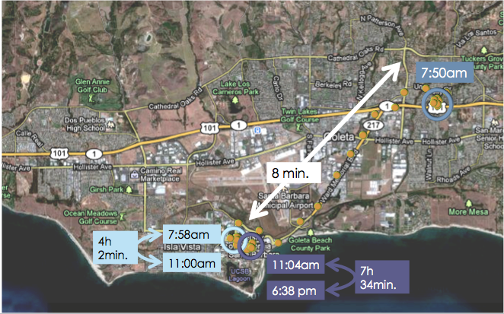
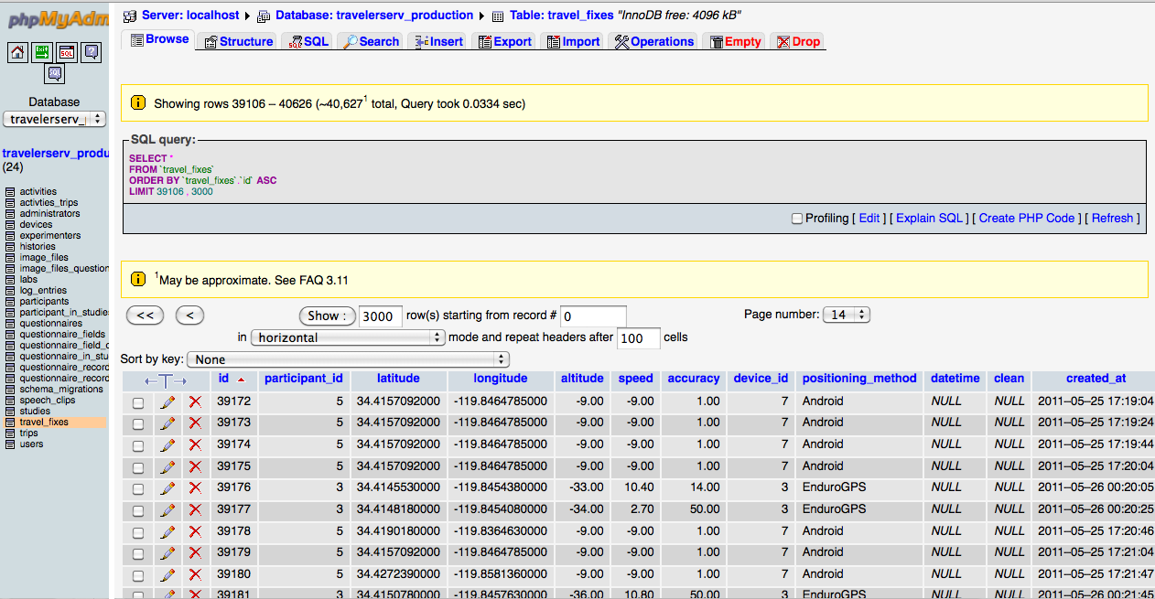
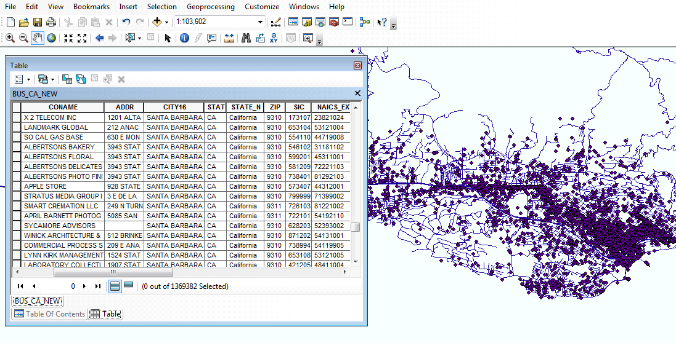
One step further

Slide 12
Using technology…
…to innovate the “where”, “when” and “how” of data collection

Slide 13
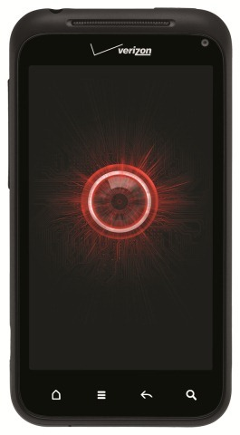
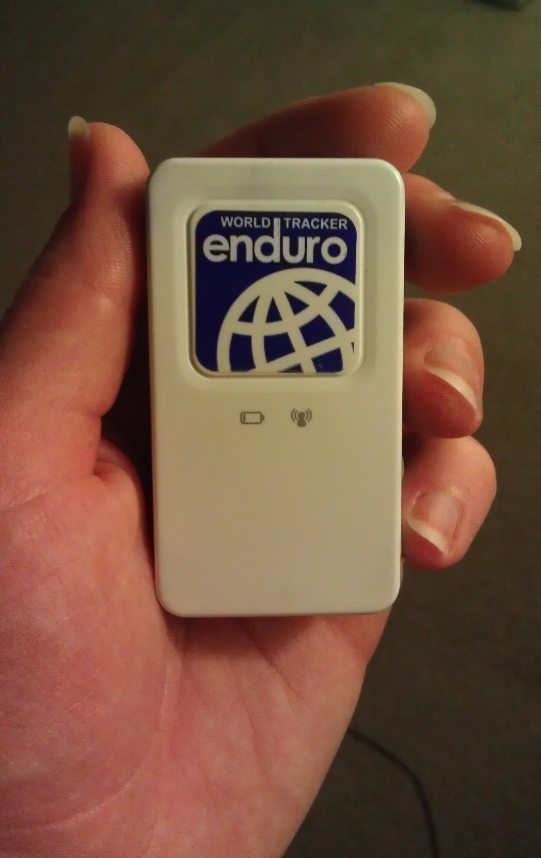
Real time devices

Slide 14
7:50am
8 min.
4h 2min.
7:58am
11:00am
11:04am
7h 34min.
6:38 pm

Slide 15
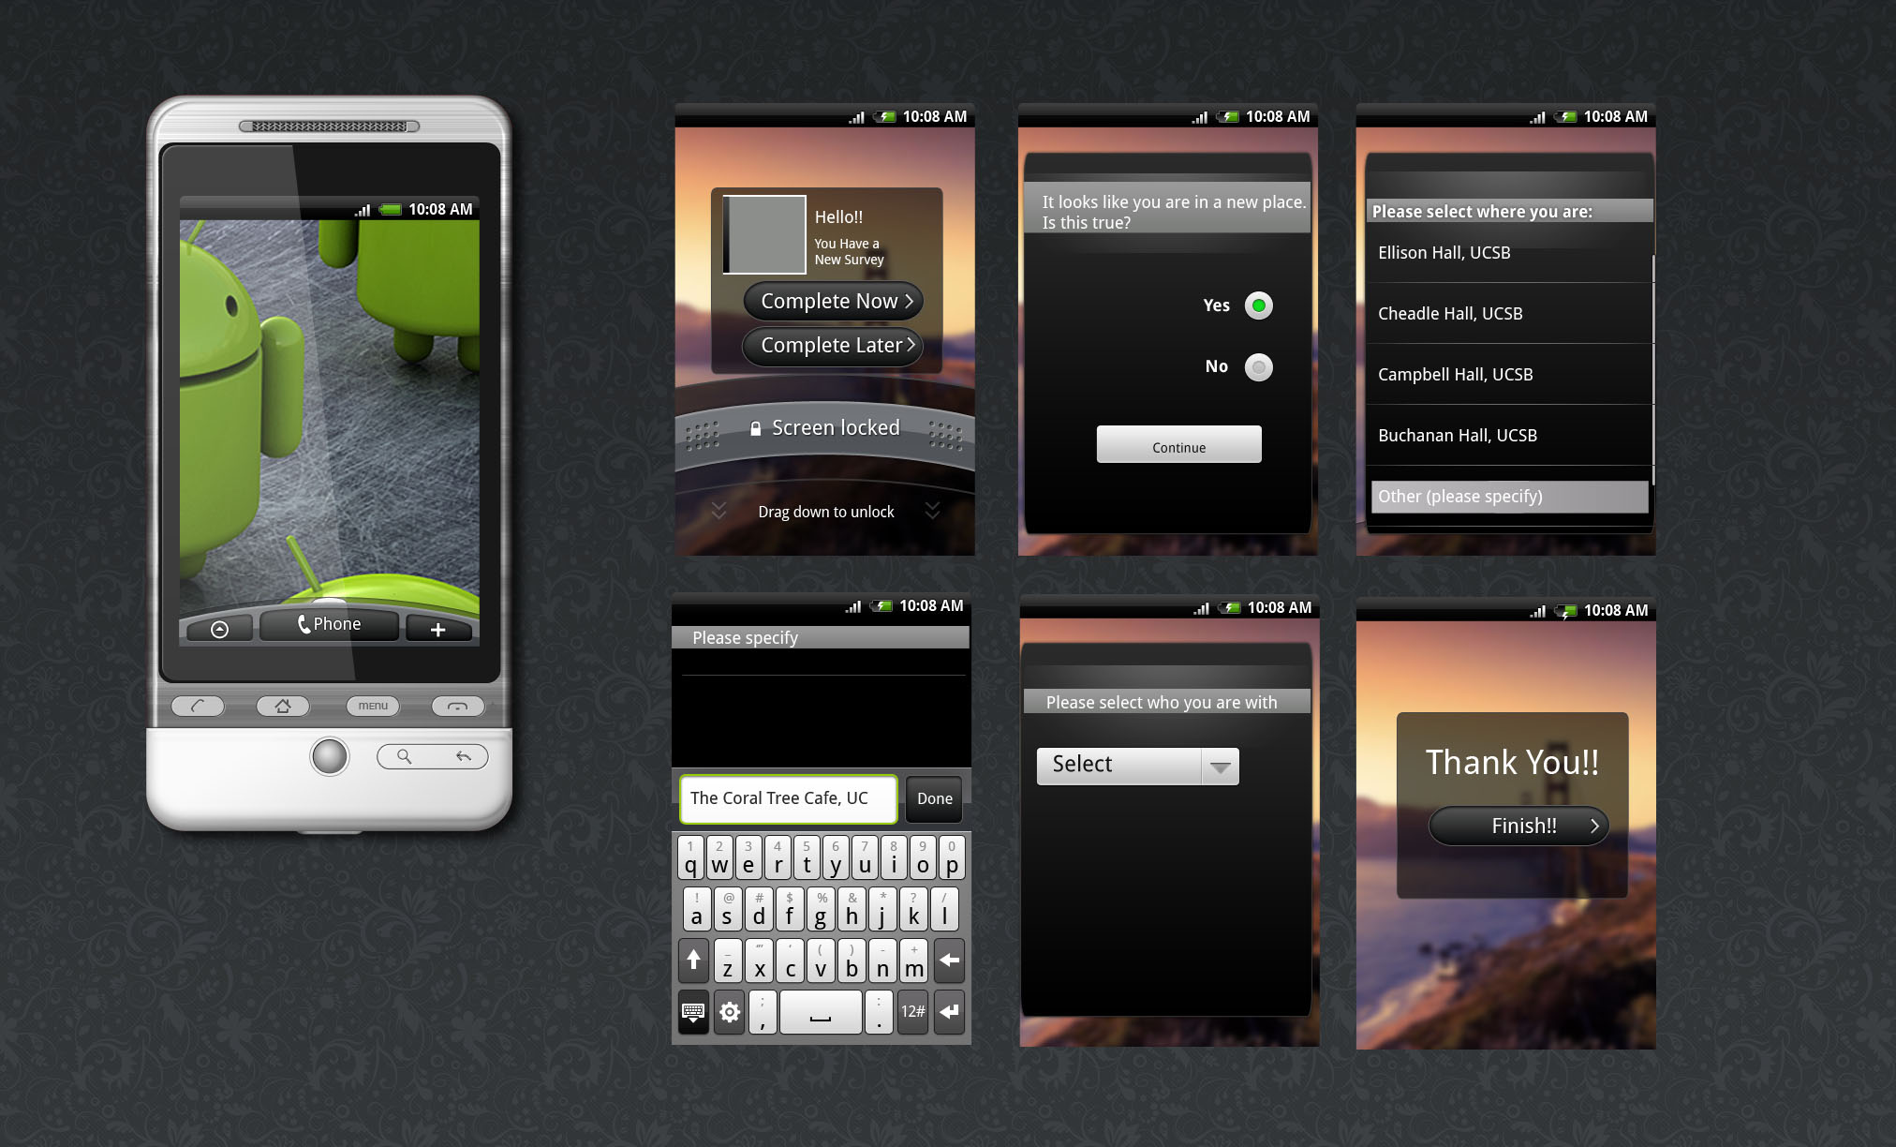
In Situ Communication

Slide 16
Using technology…
…to enable more in-depth questioning of respondents

Slide 17
Decision making processes
We want more than just what activity is being done, where, when and with whom…
How did the people end up at that location
Sense of place
an experiential process that is influenced by the attributes of the setting, and the content that a person brings to it (Steele, 1981)
Social networks
How does a person’s involvement in social groups and their role in decision making impact the choice of a destination?

Slide 18
Current and next steps
Development
Analyze battery life vs time interval of GPS fixes
Store GPS fixes on mobile phone
Further test systems and hardware to assess advantages/ disadvantages
Geocoder comparison
Survey
Pilot and full data collection

Slide 19
Ευχαριστώ
Geotrans Laboratory, UC Santa Barbara
University of California, Transportation Center
University of California, Office of the President
Federal Highway Administration, Eisenhower Fellowship Program
Santa Barbara County Association of Governments

