Slide 1
The Technology Value Stream
Katherine Brown (Graham)
CSD 380
Module 1 – Assignment 1

Slide 2
Contents
Topic 1:
Definitions
Topic 2:
Methods
Topic 3: Lead Time vs. Processing Time
Graphic
Comparison
Topic 4:
The Common Scenario: Lead Time Requiring Months
Topic 5: The Ideal Scenario
Description
Graphic
Topic 6: The Three Ways
Description
The First Way
The Second Way
The Third Way
Citation

Slide 3
Definitions
Lean Manufacturing
Value Stream
In Manufacturing: the sequence of activities an organization undertakes to deliver upon a customer request or the sequence of activities required to design produce and deliver a good or service to a customer
In Technology: the process required to convert a business hypothesis into a technology enabled service or feature the delivers value to the customer
A philosophy that seeks to refine the manufacturing process by minimizing waste while increasing the value offered to customers ⁽²⁾

Slide 4
How this is achieved
Agile or Iterative process
  Translate requirements into User Stories
  Implement these requirement in code or service being built
  Code is check into version control repository
  Test
  Repeat
Phases
  Phase 1: Design and Development
  Phase 2: Testing, Deployment, Operations

Slide 5
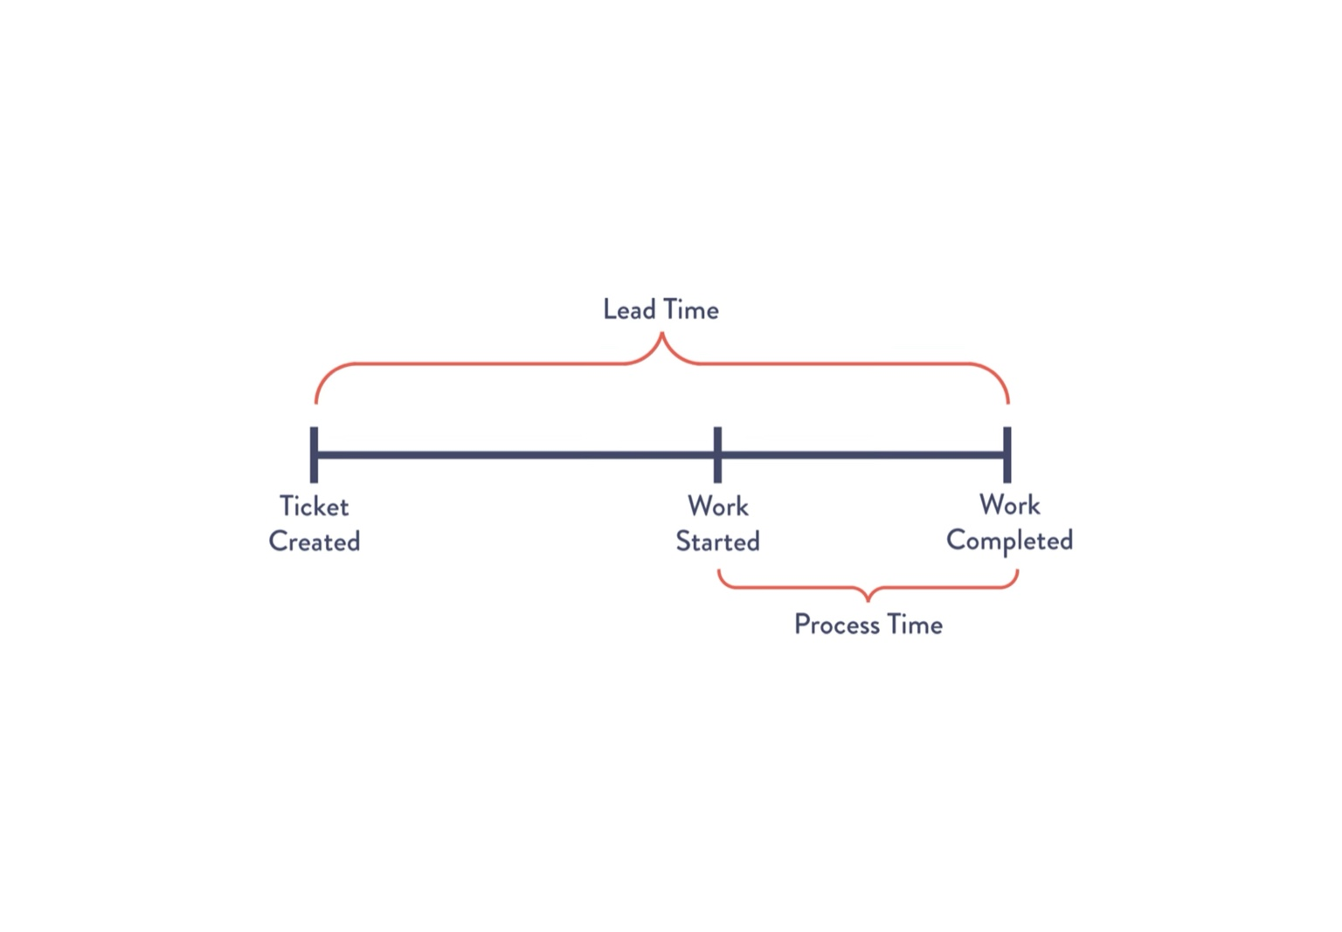
Lead time vs Processing time

Slide 6
Lead time vs Processing time
Lead Time
Processing time
Clock starts when the request is made and stops when the request is complete.
What the customer experiences.
Measure of efficiency as a whole.
Clock starts when the work is started and stops when the request is complete.

Slide 7
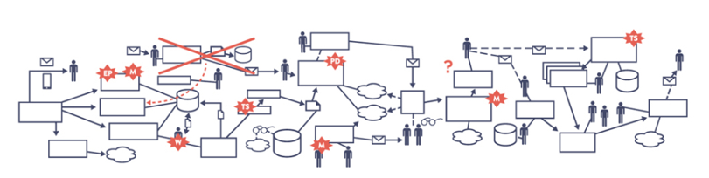
The common Scenario: Deployment Lead Times Requiring Months
Common in large, complex organizations.
  Scarce integration test environments
  Long test and production lead times
  High reliance on manual testing
  Multiple approval processes
Heroics are required at every stage
This leads to poor customer outcomes

Slide 8

The Ideal Scenario:
Deployment Lead Times of Minutes
In this scenario, developers receive fast, constant feedback.
Continual small code changes
Automated testing and deployment
High level of confidence that our changes will operate as designed

Slide 9
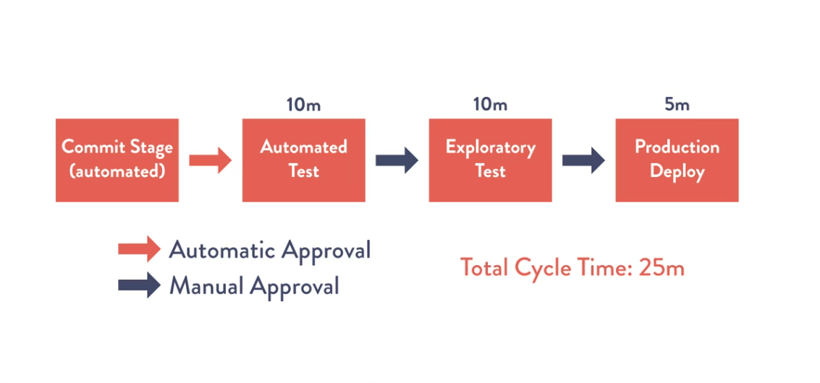
The Ideal Scenario

Slide 10

The Three Ways
First Way:
“Create fast, smooth flow of work from Development to Operations to the customer by optimizing the entire system.”
One-Way Left to right flow of work from Development to Operations
Second Way:
“Enable continuous, amplified feedback loops from Operations back to Development to ensure quality, safety, and rapid correction of issues.”
Flow of feedback from Operations to Development and back to Operations
Third Way:
“A culture of continual learning, experimentation, and risk-tolerant improvement.”
Continuous feedback back and forth between Operations and Development

Slide 11
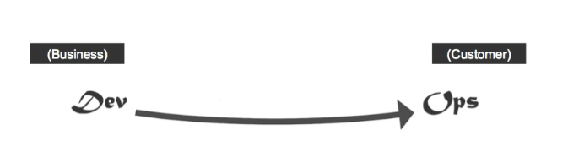
The three ways:
The First Way ⁽³⁾
Pros
  Fast
  No bottlenecks – flow is one-way
  Predictable
Cons
  Limited visibility to downstream issues
  Risk of poor quality – work moves forward with no feedback
  Operations doesn’t get feedback mid stream
  Work stream silos do not enable collaboration or experimentation

Slide 12
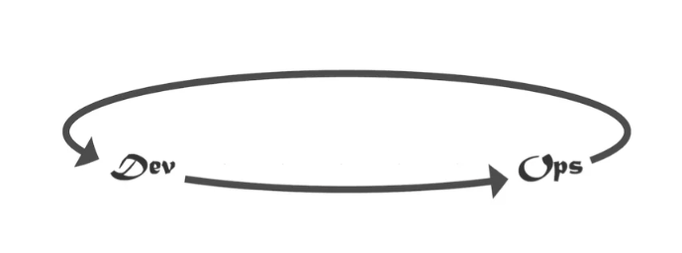
The three ways:
The Second Way ⁽³⁾
Pros
  Higher quality outcomes
  More collaboration between Dev and Ops
  Early detection of problems
Cons
  Potential for too much work in progress if not managed appropriately
  Potential for being overwhelmed with feedback
  Potential of scope creep
  Slower than the first way

Slide 13
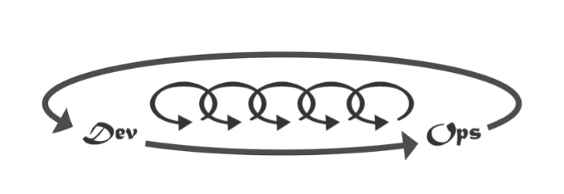
The three ways:
The Third Way ⁽³⁾
Pros
  Encourages innovation
  Better morale and engagement from Dev
  Long term growth not short term efficiency
  Failure becomes learning opportunities
  Customer insights drive continuous product improvement
Cons
  Requires high trust leadership
  Adoption is slow
  Is not risk averse
  Ongoing training and personal development

Slide 14
Citation
All citations, unless otherwise indicated, refer to the course textbook:
1. Kim, G., Humble, J., Debois, P., & Willis, J. (2021). The DevOps handbook: How to create world-class agility, reliability, and security in technology organizations (2nd ed.). IT Revolution.
2. NetSuite. (2024, November 4). What is lean manufacturing? Benefits, principles & implementation. NetSuite. https://www.netsuite.com/portal/resource/articles/erp/lean-manufacturing.shtml
3. Kim, G. (2015). The three ways: The principles underpinning DevOps. IT Revolution. https://itrevolution.com/articles/the-three-ways-principles-underpinning-devops/

