Slide 1

Challenges and Barriers to a Just Culture
Where DevOps Culture Breaks Down

Slide 2
Contents
What is a Just Culture?
Fear of Blame and Retribution
Misunderstanding
Change is Slow
Enabling a Just Culture
Citation
Summary

Slide 3
What is A Just culture
Balancing Learning and Accountability
Focuses on Fixing System
Avoids Blaming Individuals
Encourages reporting of mistakes
Supports Blameless Retrospectives and Continuous Improvement

Slide 4
Fear of Blame and Retribution
People avoid reporting mistake and errors because of fear of punishment or ridicule
Blame culture discourages collaboration and early intervention
Engineers may attempt to cover mistakes rather than fix them
Slower incident detection and resolution
Lessens psychological safety in the workplace

Slide 5
Misunderstanding
People often misinterpret a just culture as one lacking accountability.
Leaders claim to support Just Culture but default to blame when issues arise
Lack of training across all levels of leadership lead to mixed messaging as it relates to issue responses.
Blameless retrospectives and learning practices are not followed through on

Slide 6
Change is Slow
Culture changes take time and reinforcement
Habits and norms are hard to unlearn and change without constant reinforcement
DevOps tools and processes are changing faster than culture is changing
Leadership support is a must
Cultural change requires psychological safety

Slide 7
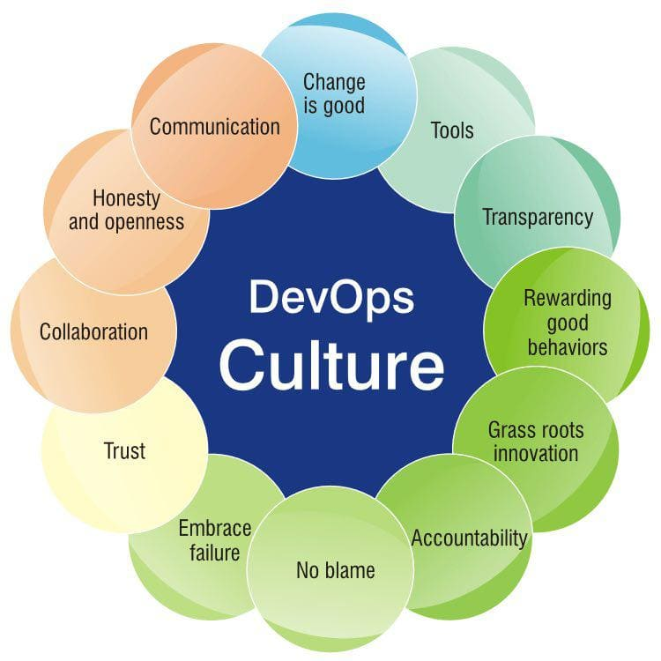
Summary

Slide 8
Enabling a Just Culture
Blameless retrospectives
Build psychological safety
Use Automation and Testing to reduce human error
Involve leaders in day to day processes
Reinforce learning and continuous improvement

Slide 9
Citation
1. Geraghty, T. (2025). Geraghty, T. (2025, July 18). Barriers to psychological safety. PsychSafety.com. https://psychsafety.com/barriers-to-psychological-safety/
2. Gianluca, L. (2025). Gianluca, L. (2025). From blame culture to DevOps: Overcoming the “Not My Problem” syndrome in software teams. Medium.
3. Adaptavist Group. (2025). Adaptavist Group. (2025, March 12). Adaptavist research reveals fear of blame in tech industry. The Adaptavist Group. https://www.theadaptavistgroup.com/company/press/adaptavist-research-reveals-tech-blame-culture

